Slide 1
Lecture 8 Support Vector Machines
EE-uy 4563/EL-GY 9123: Introduction to machine learning
Prof. Sundeep rangan

Slide 2
Learning Objectives
Describe image classification as an classification problem
Interpret weights in linear classification of images
Define the margin in linear classification
Describe the SVM classification problem.
Write equations for solutions of constrained optimization using the Lagrangian.
Describe a kernel SVM problem
Select SVM parameters from cross-validation

Slide 3
Outline
Motivating example: Recognizing handwritten digits
Why logistic regression doesn’t work well.
Maximum margin classifiers
Support vector machines
Constrained optimization
Kernel trick

Slide 4
MNIST Digit Classification
Problem: Recognize hand-written digits
Originally problem:
Census forms
Automated processing
Classic machine learning problem
Benchmark
From Patrick J. Grother, NIST Special Database, 1995

Slide 5
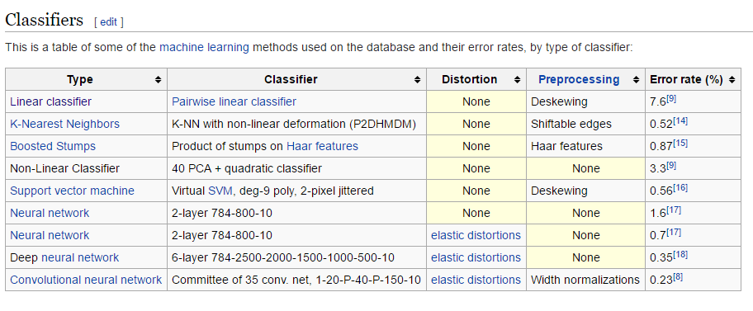
A Widely-Used Benchmark
We will look at SVM today
Not the best algorithm
But quite good
…and illustrates the main points

Slide 6
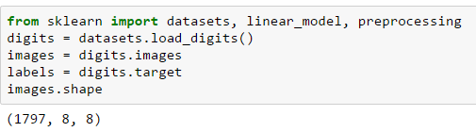
Loading The Data: 8 x 8 Images
Directly in sklearn datasets

Slide 7
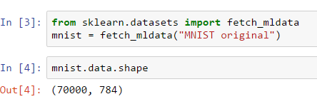
Loading the Data: 28 x 28 Images
Will look at higher resolution version
Also, in sklearn
But needs to download from external site
70,000 samples.
Each image sample is a row

Slide 8




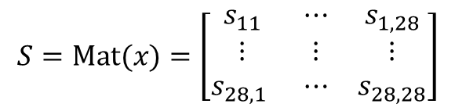

Matrix and Vector Representation
Images can be represented as 2D matrices or 1D vectors
Grayscale: Each pixel value is between 0 (black) and 255 (white)
28
784 = ${28}^{2}$
28
xsq
$$S=\text{M}\text{at}(x)=\left[\begin{matrix}s_{11} & ⋯ & s_{1,28} \\ ⋮ & ⋮ & ⋮ \\ s_{28,1} & ⋯ & s_{28,28}\end{matrix}\right]$$
$$x=\text{v}\text{ec}(S)=\left[\begin{matrix}x_{1} & ⋯ & x_{784}\end{matrix}\right]$$

Slide 9
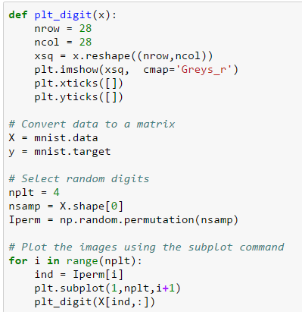
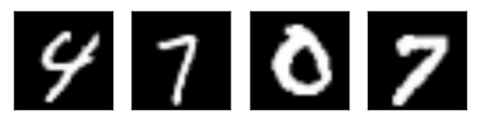
Displaying Images in Python
Key command
4 random images in the dataset
A human can classify these easily

Slide 10
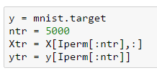
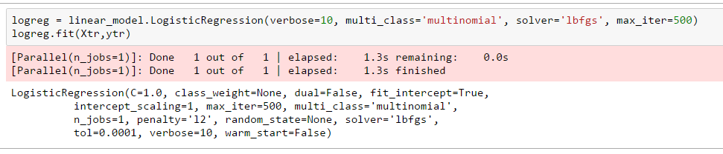
Try a Logistic Classifier
Train on 5000 samples
To reduce training time.
In practice want to train with ~40k
Select correct solver (lbfgs)
Others can be very slow. Even this will take minutes

Slide 11
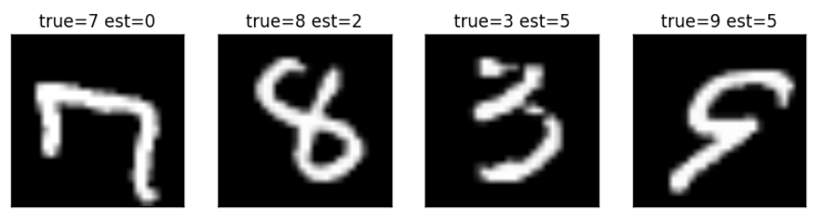
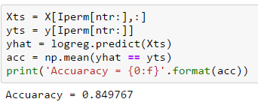
Performance
Accuracy = 85%. Very bad
Some of the errors seem like they should have been easy to spot
What went wrong?

Slide 12

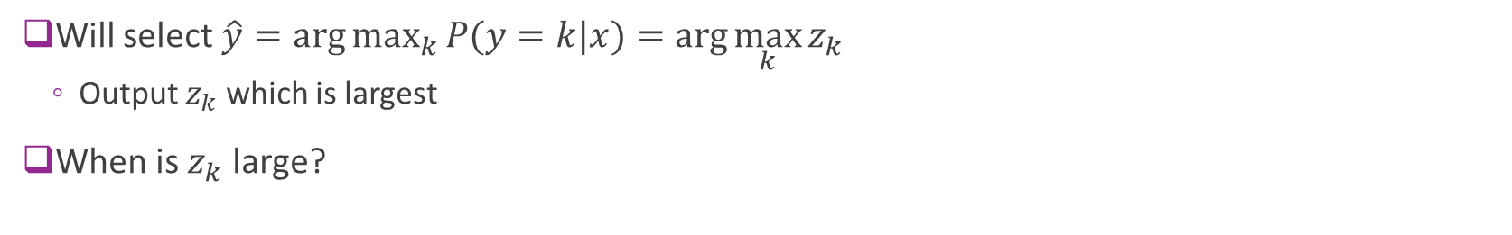
Recap: Logistic Classifier
784
W
$$P(y=k|x)$$
10
Probabilities
Convert 28 x 28 to 784-dim vector
Softmax
Will select $\hat{y}=\arg{\max_{k}{P(y=k|x)}}=\arg{\max_{k}{z_{k}}}$
Output $z_{k}$ which is largest
When is $z_{k}$ large?

Slide 13
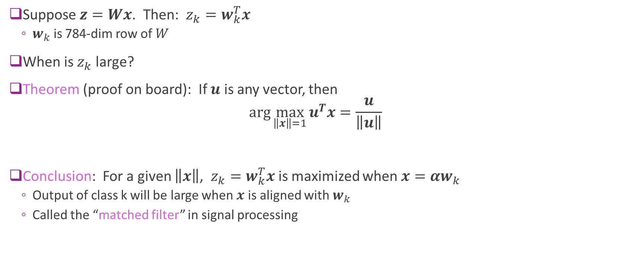
Interpreting the Logistic Classifier Weights
Suppose $z=Wx$. Then: $z_{k}=w_{k}^{T}x$
$w_{k}$ is 784-dim row of $W$
When is $z_{k}$ large?
Theorem (proof on board): If $u$ is any vector, then $\arg{\max_{\left\|x\right\|=1}{u^{T}x}=\frac{u}{\left\|u\right\|}}$
Conclusion: For a given $\left\|x\right\|$, $z_{k}=w_{k}^{T}x$ is maximized when $x=αw_{k}$
Output of class k will be large when $x$ is aligned with $w_{k}$
Called the “matched filter” in signal processing

Slide 14
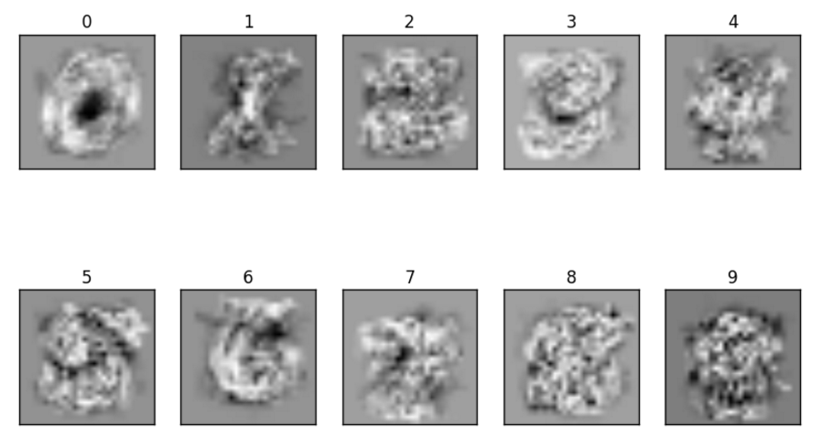

Visualizing the Weights
Each class weight can be viewed as an image.
Class weight output $z_{k}$ will be large when it is aligned with $w_{k}$
Optimized weights for logistic classifier
Why are they blurry?

Slide 15
Problems with Logistic Classifier
Linear weighting cannot capture many deformities in image
Rotations
Translations
Variations in relative size of digit components
Can be improved with preprocessing
E.g. deskewing, contrast normalization, many methods
Is there a better classifier?

Slide 16
Outline
Motivating example: Recognizing handwritten digits
Why logistic regression doesn’t work well.
Maximum margin classifiers
Support vector machines
Constrained optimization
Kernel trick

Slide 17
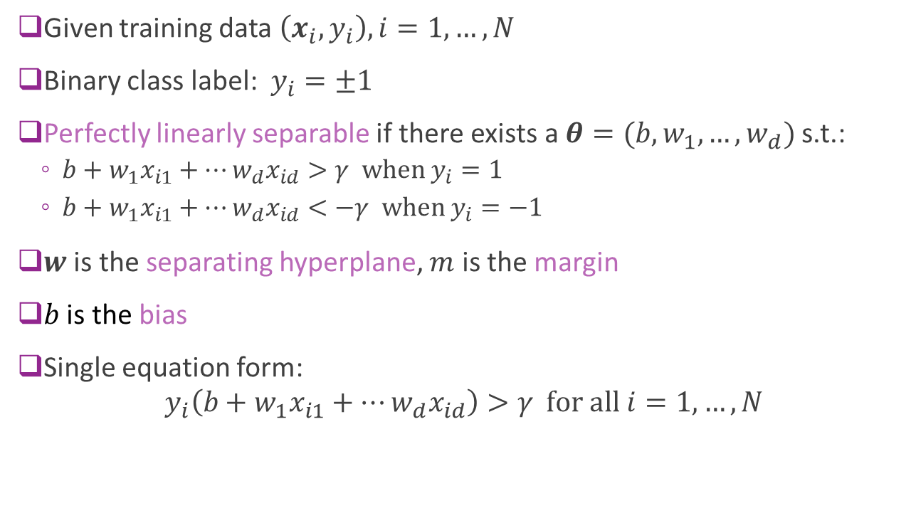



Recap: Linear Separability and Margin
Given training data $\left(x_{i},y_{i}\right), i=1,…,N$
Binary class label: $y_{i}=±1$
Perfectly linearly separable if there exists a $θ=(b,w_{1},…,w_{d})$ s.t.:
$b+w_{1}x_{i1}+⋯w_{d}x_{id}>γ \text{when} y_{i}=1$
$b+w_{1}x_{i1}+⋯w_{d}x_{id}<−γ \text{when} y_{i}=−1$
$w$ is the separating hyperplane, $m$ is the margin
$b$ is the bias
Single equation form:
$$y_{i}\left(b+w_{1}x_{i1}+⋯w_{d}x_{id}\right)>γ \text{for} \text{all} i=1,…,N$$
$$m=\frac{γ}{\left\|w\right\|}$$
$$m$$
$$m$$

Slide 18

Maximum Margin Classifier
Suppose data is perfectly linearly separable.
Define maximum margin classifier
$\max_{w, γ} γ$
Such that $y_{i}\left(b+w^{T}x\right)≥γ \text{for} \text{all} i$
$\sum_{j=1}^{d}{w_{j}^{2}}≤1$
Called a constrained optimization
Objective function and constraints
More on this later.
Maximizes the margin
Ensures all points are correctly classified
Scaling on weights

Slide 19
Visualizing Maximum Margin Classifier
Fig. 9.3 of ISL
Margin determined by closest points to the line
In this figure, there are 3 points at the margin

Slide 20
Problems with MM classifier
Data is often not perfectly separable
Only want to correctly separate most points
MM classifier is not robust
A single sample can radically change line
Fig. 9.4
Fig. 9.5

Slide 21
Outline
Motivating example: Recognizing handwritten digits
Why logistic regression doesn’t work well.
Maximum margin classifiers
Support vector machines
Constrained optimization
Kernel trick

Slide 22
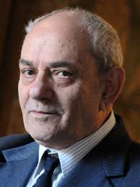
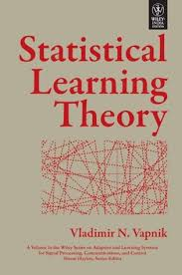
Support Vector Machine
Support Vector Machine (SVM)
Vladimir Vapnik, 1963
But became widely-used with kernel trick, 1993
More on this later
Got best results on character recognition
Key idea: Allow “slack” in the classification

Slide 23
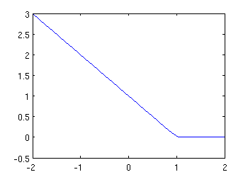
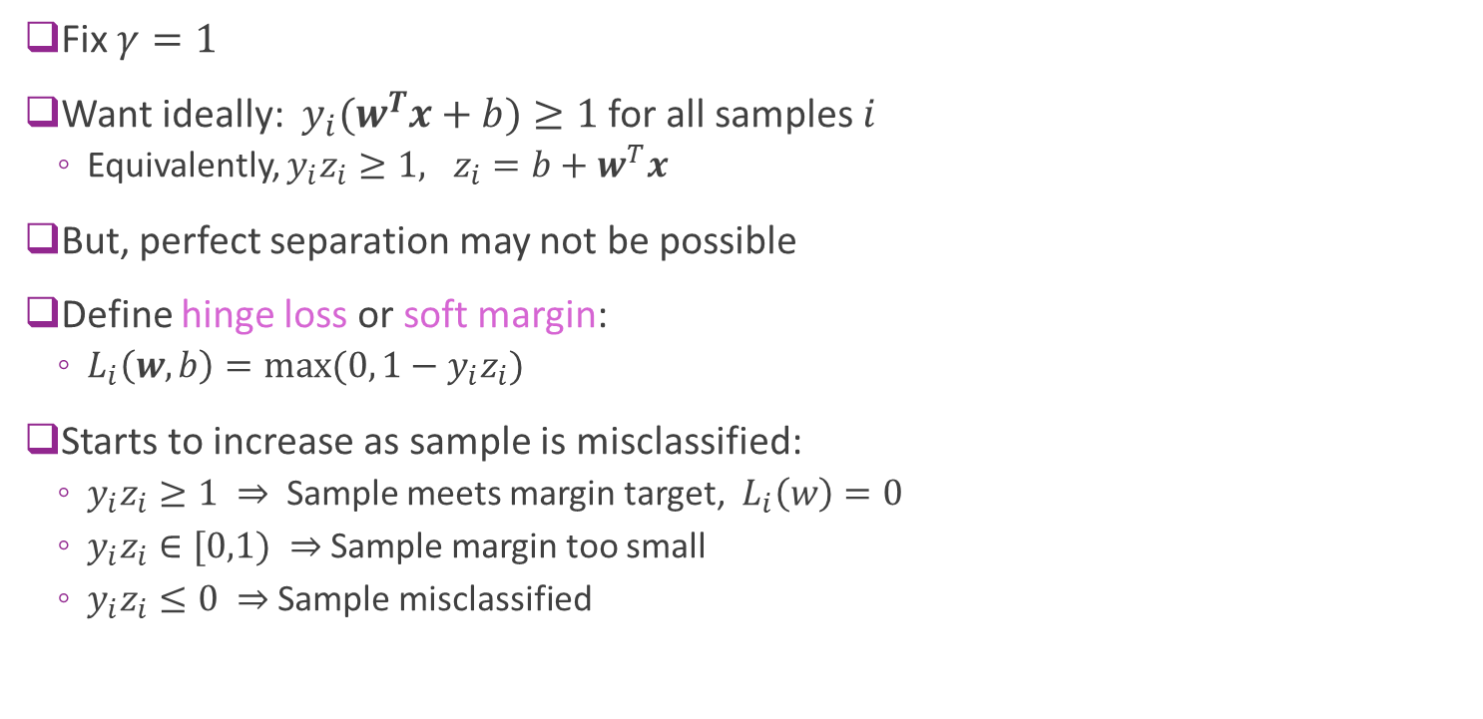


Hinge Loss
Fix $γ=1$
Want ideally: $y_{i}(w^{T}x+b)≥1$ for all samples $i$
Equivalently, $y_{i}z_{i}≥1, z_{i}=b+w^{T}x$
But, perfect separation may not be possible
Define hinge loss or soft margin:
$L_{i}\left(w,b\right)=max⁡(0, 1−y_{i}z_{i})$
Starts to increase as sample is misclassified:
$y_{i}z_{i}≥1 ⇒$ Sample meets margin target, $L_{i}\left(w\right)=0$
$y_{i}z_{i}∈[0,1) ⇒$Sample margin too small
$y_{i}z_{i}≤0 ⇒$Sample misclassified
$$L_{i}(z_{i})$$
$${y_{i}z}_{i}$$
Misclassifies
Meets margin
Close to margin

Slide 24
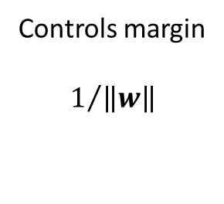
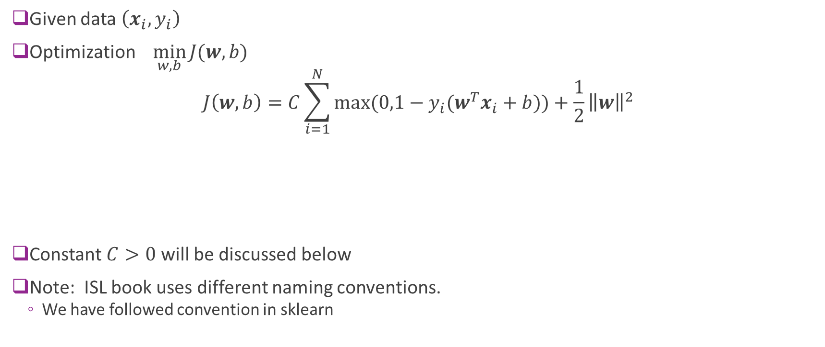
SVM Optimization
Given data $\left(x_{i},y_{i}\right)$
Optimization $\min_{w,b}{J(w,b)}$
$$J\left(w,b\right)=C\sum_{i=1}^{N}{max⁡(0,1−y_{i}(w^{T}x_{i}+b))}+\frac{1}{2}{\left\|w\right\|}^{2}$$
Constant $C>0$ will be discussed below
Note: ISL book uses different naming conventions.
We have followed convention in sklearn
Hinge loss terms
Attempts to reduce
Misclassifications
Controls margin $$1/{\left\|w\right\|}$$

Slide 25
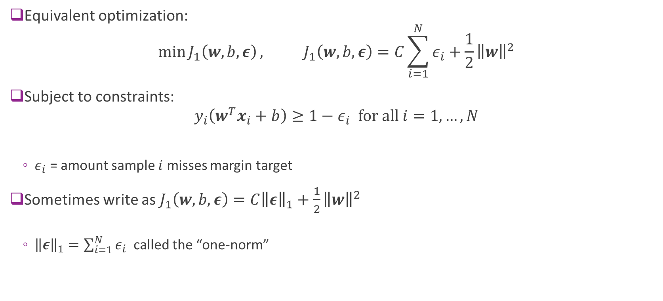
Alternate Form of SVM Optimization
Equivalent optimization:
$$\min{J_{1}\left(w,b,ε\right)}, J_{1}\left(w,b,ε\right)=C\sum_{i=1}^{N}{ε_{i}}+\frac{1}{2}{\left\|w\right\|}^{2}$$
Subject to constraints:
$${y_{i}\left(w^{T}x_{i}+b\right)≥1−ε}_{i} for all i=1,…,N$$
$ε_{i}$ = amount sample $i$ misses margin target
Sometimes write as $J_{1}\left(w,b,ε\right)=C{\left\|ε\right\|}_{1}+\frac{1}{2}{\left\|w\right\|}^{2}$
${\left\|ε\right\|}_{1}=\sum_{i=1}^{N}{ε_{i}}$ called the “one-norm”

Slide 26
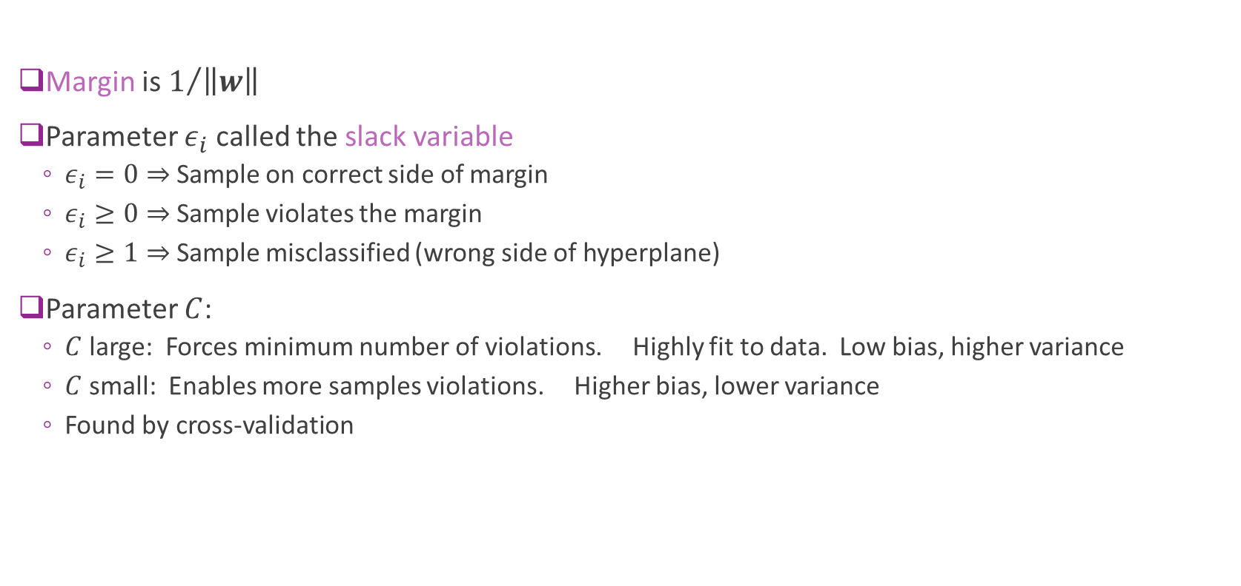
Interpreting Parameters
Margin is $1/{\left\|w\right\|}$
Parameter $ε_{i}$ called the slack variable
$ε_{i}=0⇒$ Sample on correct side of margin
$ε_{i}≥0⇒$ Sample violates the margin
$ε_{i}≥1⇒$ Sample misclassified (wrong side of hyperplane)
Parameter $C$:
$C$ large: Forces minimum number of violations. Highly fit to data. Low bias, higher variance
$C$ small: Enables more samples violations. Higher bias, lower variance
Found by cross-validation

Slide 27
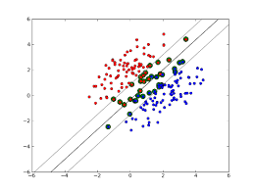

Support Vectors
Support vectors: Samples that either:
Are exactly on margin: $y_{i}(w^{T}x_{i}+b)=1$
Or, on wrong side of margin: $y_{i}\left(w^{T}x_{i}+b\right)≤1$
Changing samples that are not SVs
Does not change solution
Provides robustness

Slide 28

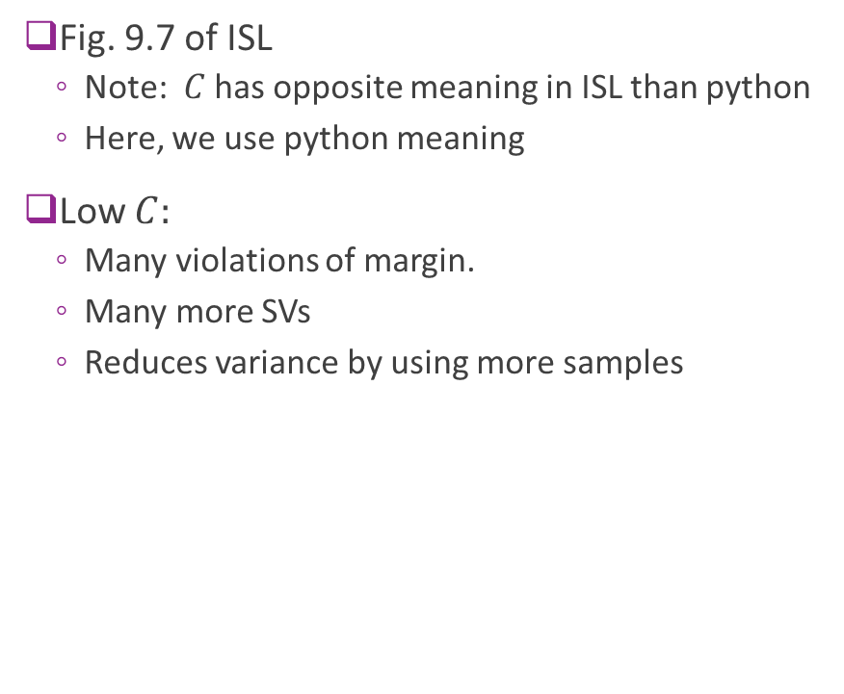




Illustrating Effect of $C$
Low $C=C_{1}$
$$C_{2}$$
Fig. 9.7 of ISL
Note: $C$ has opposite meaning in ISL than python
Here, we use python meaning
Low $C:$
Many violations of margin.
Many more SVs
Reduces variance by using more samples
$$C_{3}$$
High $C_{4}$

Slide 29
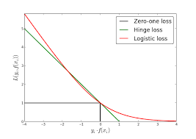

Relation to Logistic Regression
Logistic regression also minimizes a loss function (proof on board): $J\left(w,b\right)=\sum_{i=1}^{N}{L_{i}(w,b)}, L_{i}\left(w,b\right)=\ln{P(y_{i}|x_{i})}=−ln⁡(1+e^{−{y_{i}z}_{i}})$

Slide 30
Outline
Motivating example: Recognizing handwritten digits
Why logistic regression doesn’t work well.
Maximum margin classifiers
Support vector machines
Constrained optimization
Kernel trick

Slide 31
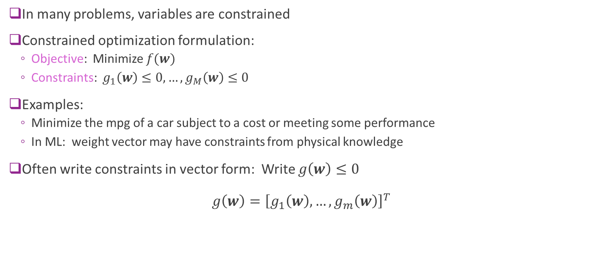
Constrained Optimization
In many problems, variables are constrained
Constrained optimization formulation:
Objective: Minimize $f(w)$
Constraints: $g_{1}\left(w\right)≤0,…,g_{M}\left(w\right)≤0$
Examples:
Minimize the mpg of a car subject to a cost or meeting some performance
In ML: weight vector may have constraints from physical knowledge
Often write constraints in vector form: Write $g\left(w\right)≤0$ $g\left(w\right)={\left[g_{1}\left(w\right),…,g_{m}\left(w\right)\right]}^{T}$

Slide 32
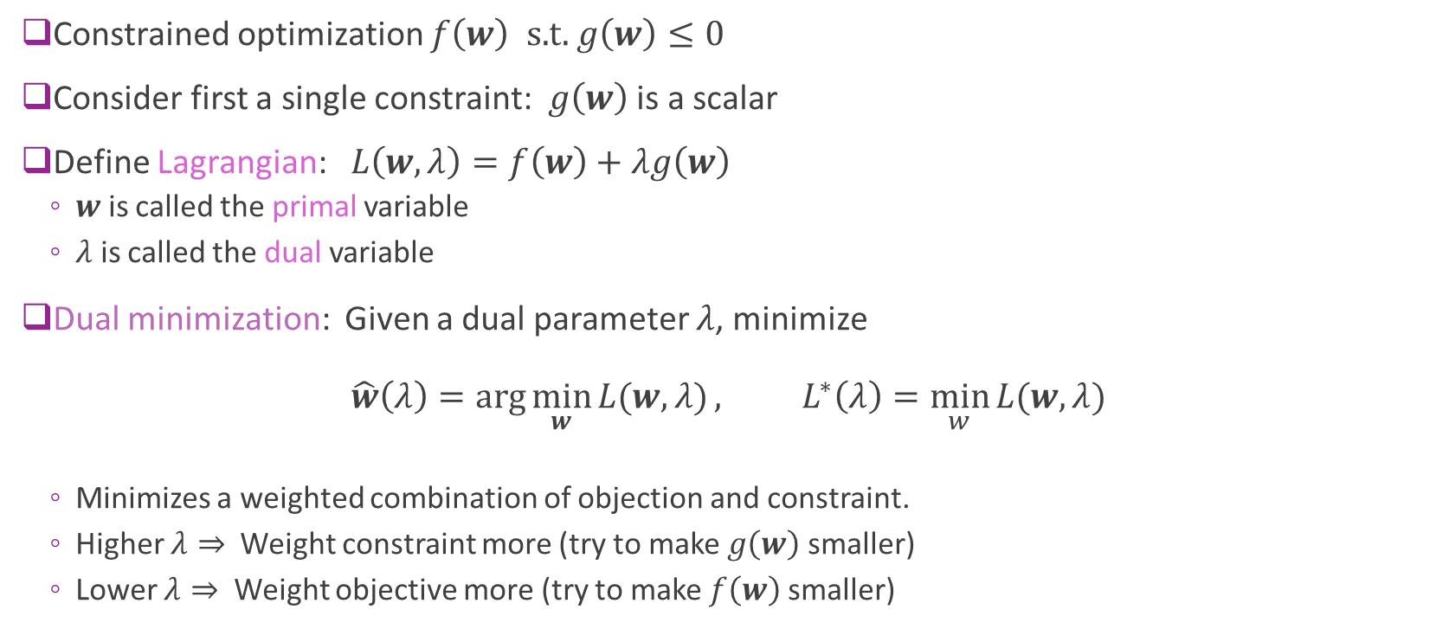
Lagrangian
Constrained optimization $f\left(w\right) \text{s}\text{.}\text{t}\text{.} g\left(w\right)≤0$
Consider first a single constraint: $g\left(w\right)$ is a scalar
Define Lagrangian: $L\left(w,λ\right)=f\left(w\right)+λg\left(w\right)$
$w$ is called the primal variable
$λ$ is called the dual variable
Dual minimization: Given a dual parameter $λ$, minimize $\hat{w}\left(λ\right)=\arg{\min_{w}{L(w,λ)}}, L^{∗}\left(λ\right)=\min_{w}{L(w,λ)}$
Minimizes a weighted combination of objection and constraint.
Higher $λ⇒$ Weight constraint more (try to make $g\left(w\right)$ smaller)
Lower $λ⇒$ Weight objective more (try to make $f\left(w\right)$ smaller)

Slide 33
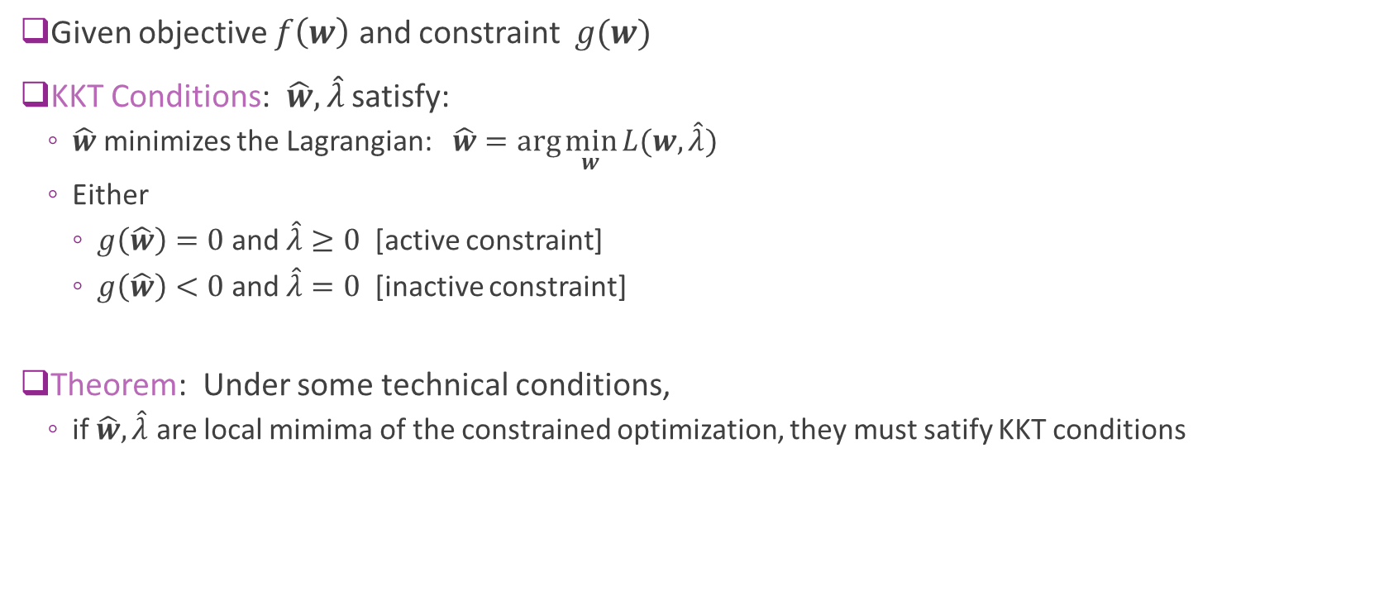
KKT Conditions
Given objective $f\left(w\right)$ and constraint $g(w)$
KKT Conditions: $\hat{w},\hat{λ}$ satisfy:
$\hat{w}$ minimizes the Lagrangian: $\hat{w}=\arg{\min_{w}{L(w,\hat{λ})}}$
Either
$g\left(\hat{w}\right)=0$ and $\hat{λ}≥0$ [active constraint]
$g\left(\hat{w}\right)<0$ and $\hat{λ}=0$ [inactive constraint]
Theorem: Under some technical conditions,
if $\hat{w},\hat{λ}$ are local mimima of the constrained optimization, they must satify KKT conditions

Slide 34
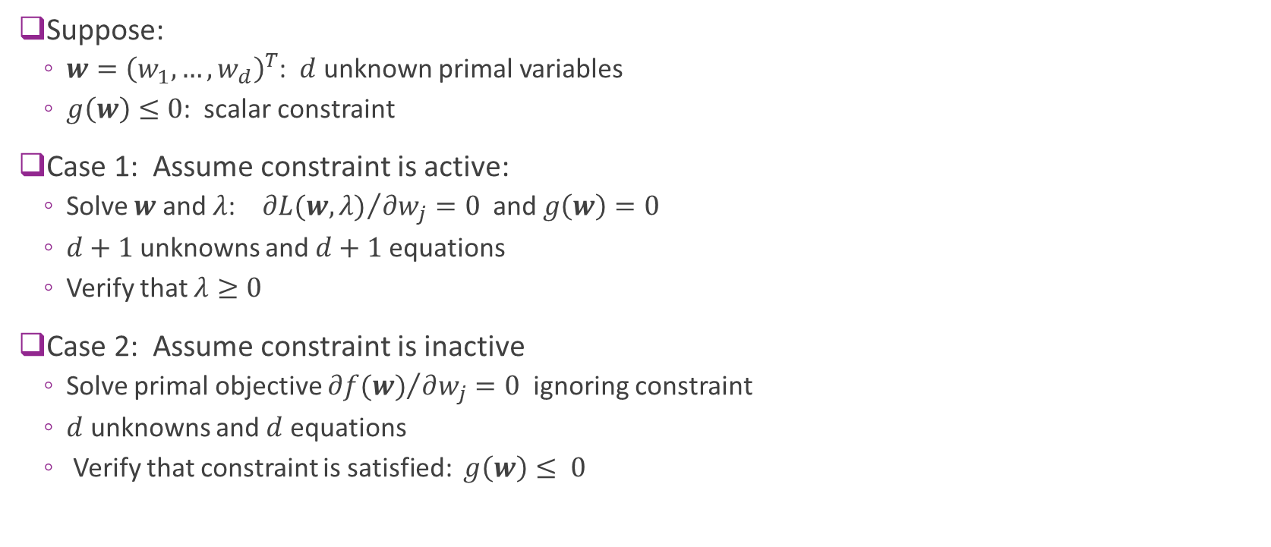
General Procedure for Single Constraint
Suppose:
$w={\left(w_{1},…,w_{d}\right)}^{T}$: $d$ unknown primal variables
$g\left(w\right)≤0$: scalar constraint
Case 1: Assume constraint is active:
Solve $w$ and $λ$: ${∂L(w,λ)}/{∂w_{j}}=0$ and $g\left(w\right)=0$
$d+1$ unknowns and $d+1$ equations
Verify that $λ≥0$
Case 2: Assume constraint is inactive
Solve primal objective ${∂f(w)}/{∂w_{j}}=0$ ignoring constraint
$d$ unknowns and $d$ equations
Verify that constraint is satisfied: $g\left(w\right)≤ 0$

Slide 35

KKT Conditions Illustrated
Example 1: Constraint is “active” $\min_{w}{w^{2}} s.t. w+1≤0$
Example 2: Constraint is “inactive” $\min_{w}{w^{2}} s.t. w−1≤0$
Examples worked on board

Slide 36
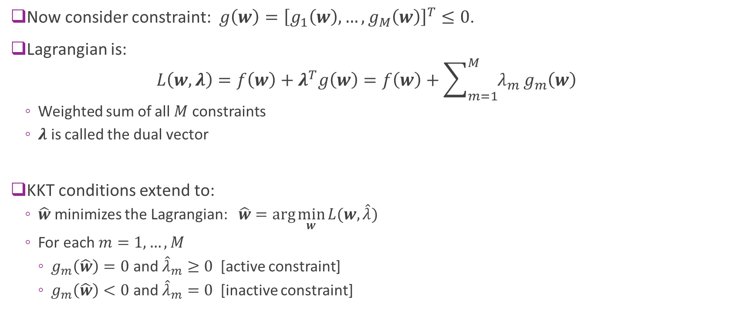
Multiple Constraints
Now consider constraint: $g\left(w\right)={\left[g_{1}\left(w\right),…,g_{M}\left(w\right)\right]}^{T}≤0$.
Lagrangian is: $L\left(w,λ\right)=f\left(w\right)+λ^{T}g\left(w\right)=f\left(w\right)+\sum_{m=1}^{M}{λ_{m}}g_{m}\left(w\right)$
Weighted sum of all $M$ constraints
$λ$ is called the dual vector
KKT conditions extend to:
$\hat{w}$ minimizes the Lagrangian: $\hat{w}=\arg{\min_{w}{L(w,\hat{λ})}}$
For each $m=1,…, M$
$g_{m}\left(\hat{w}\right)=0$ and ${\hat{λ}}_{m}≥0$ [active constraint]
$g_{m}\left(\hat{w}\right)<0$ and ${\hat{λ}}_{m}=0$ [inactive constraint]

Slide 37
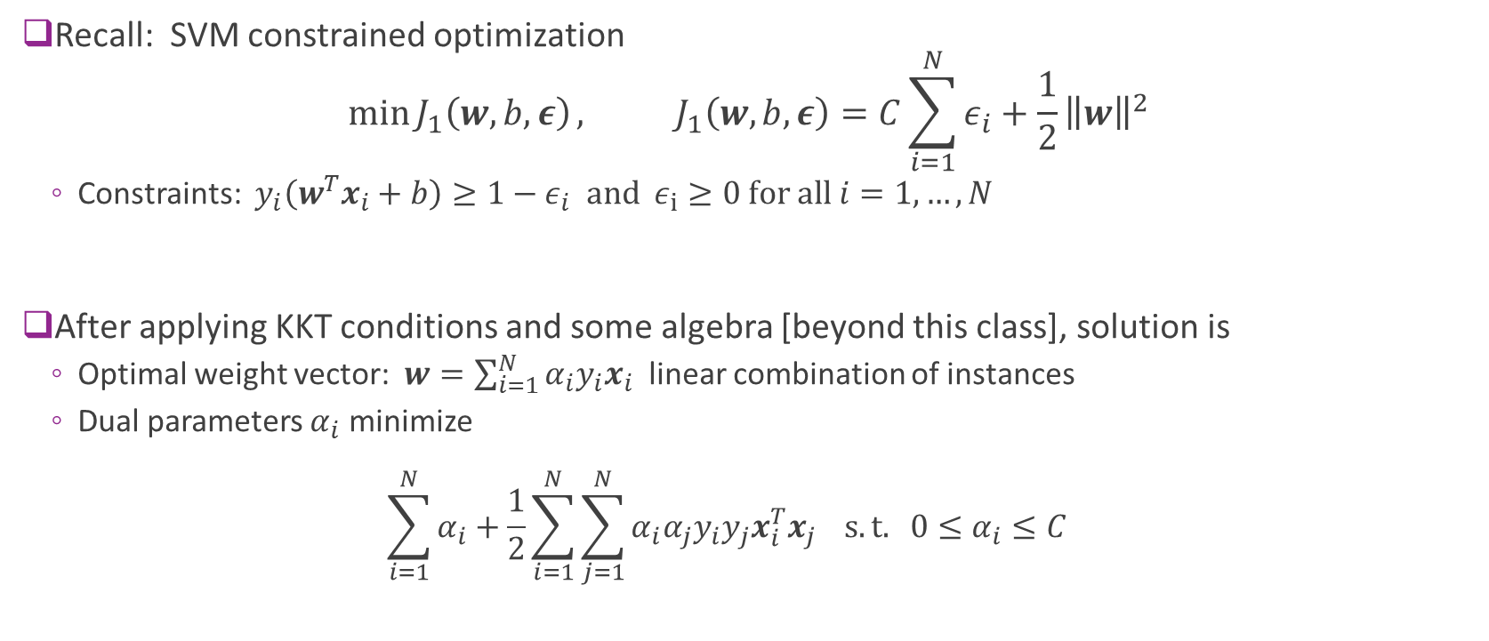
SVM Constrained Optimization
Recall: SVM constrained optimization $\min{J_{1}\left(w,b,ε\right)}, J_{1}\left(w,b,ε\right)=C\sum_{i=1}^{N}{ε_{i}}+\frac{1}{2}{\left\|w\right\|}^{2}$
Constraints: ${y_{i}\left(w^{T}x_{i}+b\right)≥1−ε}_{i} and ε_{i}≥0 for all i=1,…,N$
After applying KKT conditions and some algebra [beyond this class], solution is
Optimal weight vector: $w=\sum_{i=1}^{N}{α_{i}y_{i}x_{i}}$ linear combination of instances
Dual parameters $α_{i}$ minimize $\sum_{i=1}^{N}{α_{i}}+\frac{1}{2}\sum_{i=1}^{N}{\sum_{j=1}^{N}{α_{i}α_{j}y_{i}y_{j}x_{i}^{T}x_{j}}} s.t. 0≤α_{i}≤C$

Slide 38
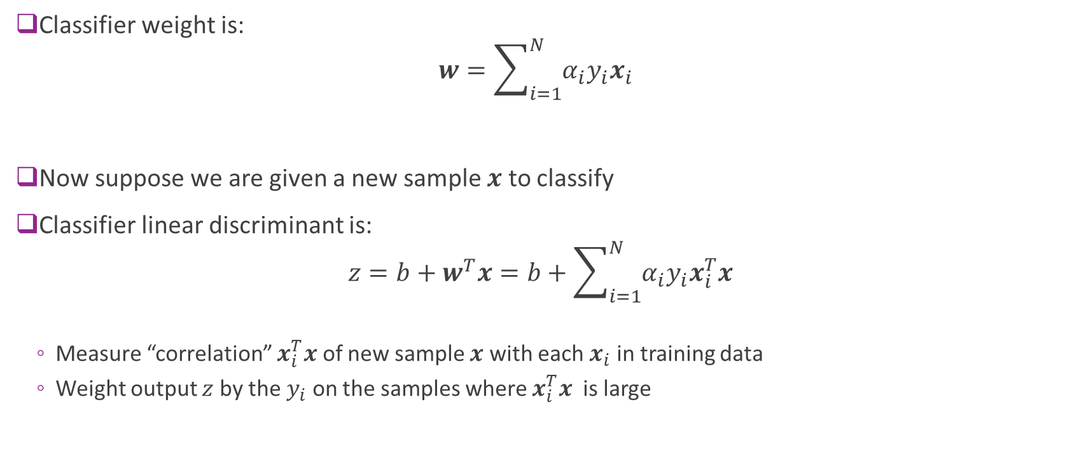
Correlation Interpretation of SVM
Classifier weight is: $w=\sum_{i=1}^{N}{α_{i}y_{i}x_{i}}$
Now suppose we are given a new sample $x$ to classify
Classifier linear discriminant is:
Measure “correlation” $x_{i}^{T}x$ of new sample $x$ with each $x_{i}$ in training data
Weight output $z$ by the $y_{i}$ on the samples where $x_{i}^{T}x$ is large

Slide 39
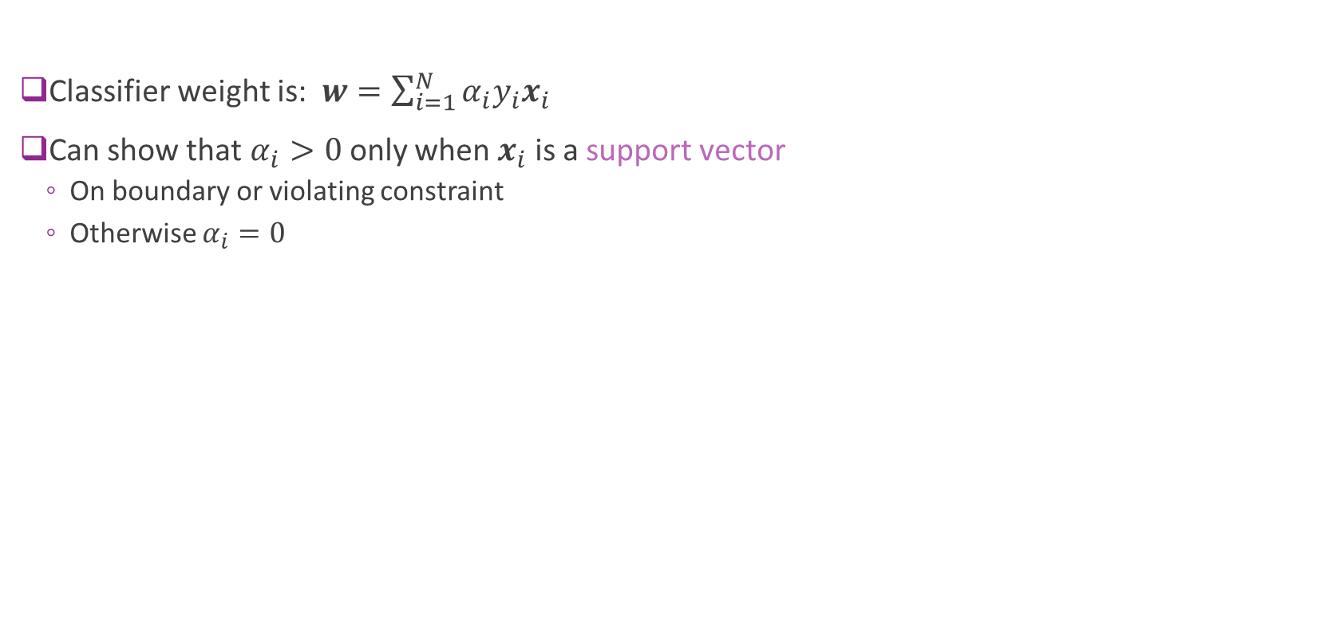
Support Vectors
Classifier weight is: $w=\sum_{i=1}^{N}{α_{i}y_{i}x_{i}}$
Can show that $α_{i}>0$ only when $x_{i}$ is a support vector
On boundary or violating constraint
Otherwise $α_{i}=0$

Slide 40
Outline
Motivating example: Recognizing handwritten digits
Why logistic regression doesn’t work well.
Maximum margin classifiers
Support vector machines
Constrained optimization
Kernel trick

Slide 41
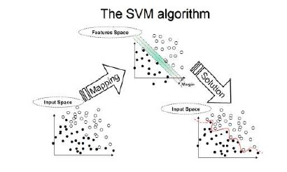

Transform Problem
Transform problem: replace $x$ with $φ\left(x\right)$
Enables more rich classifiers
Examples: polynomial classification $φ\left(x\right)=[1,x,x^{2},…,x^{d−1}]$
Tries to find separation in a feature space
From https://www.dtreg.com/solution/view/20

Slide 42

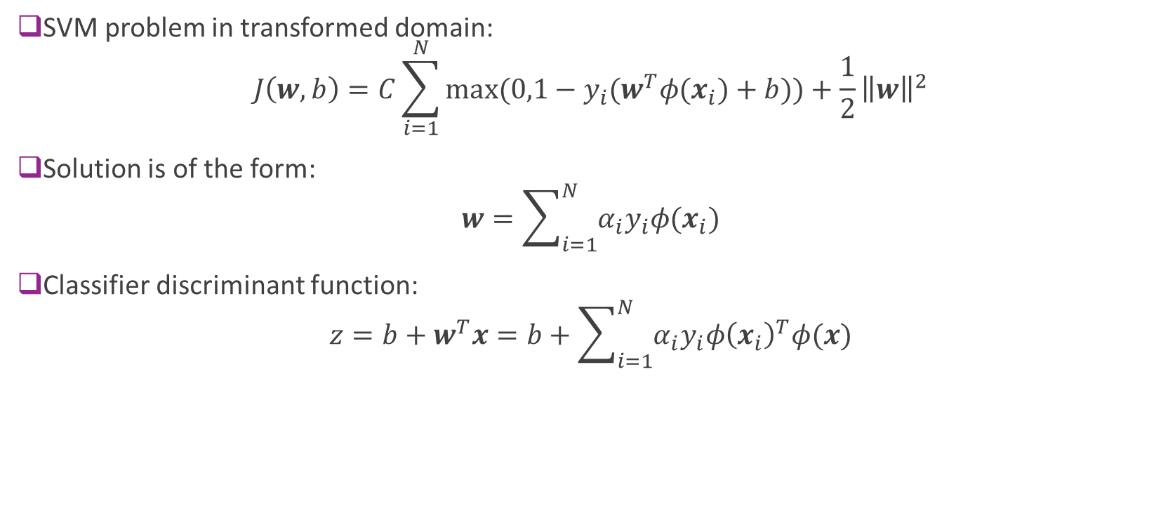
Transform Problem
SVM problem in transformed domain: $J\left(w,b\right)=C\sum_{i=1}^{N}{max⁡(0,1−y_{i}(w^{T}φ(x_{i})+b))}+\frac{1}{2}{\left\|w\right\|}^{2}$
Solution is of the form: $w=\sum_{i=1}^{N}{α_{i}y_{i}φ(x_{i})}$
Classifier discriminant function: $z=b+w^{T}x=b+\sum_{i=1}^{N}{α_{i}y_{i}φ{\left(x_{i}\right)}^{T}φ(x)}$
$K(x_{i},x)$ = “kernel”

Slide 43

Kernel Trick
Classifier is:
$z=b+w^{T}x=b+\sum_{i=1}^{N}{α_{i}y_{i}K\left(x_{i},x\right)}, K\left(x_{i},x\right)=φ{\left(x_{i}\right)}^{T}φ(x)$
$\hat{y}=\text{sign}\left(z\right)=\left\{\begin{matrix}1 & \text{if} z>0 \\ −1 & \text{if} z<0\end{matrix}\right.$
Do not need to explicitly compute $φ(x)$
Can directly compute kernel $K\left(x_{i},x\right)$
Provided kernel corresponds to some $φ(x)$

Slide 44
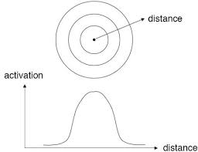

Understanding the Kernel
Kernel function $K\left(x_{i},x\right)$:
measures “distance” between new sample $x$ and training data $x_{i}$
$K\left(x_{i},x\right)$ large $⇒$ $x_{i},x$ close
$K\left(x_{i},x\right)≈0$ $⇒$ $x_{i},x$ far
Linear discriminant $z=b+\sum_{i=1}^{N}{α_{i}y_{i}K\left(x_{i},x\right)}$
Weighs sample $x_{i}$ that are close to $x$

Slide 45
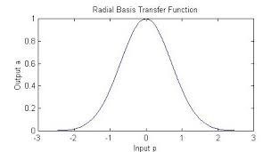
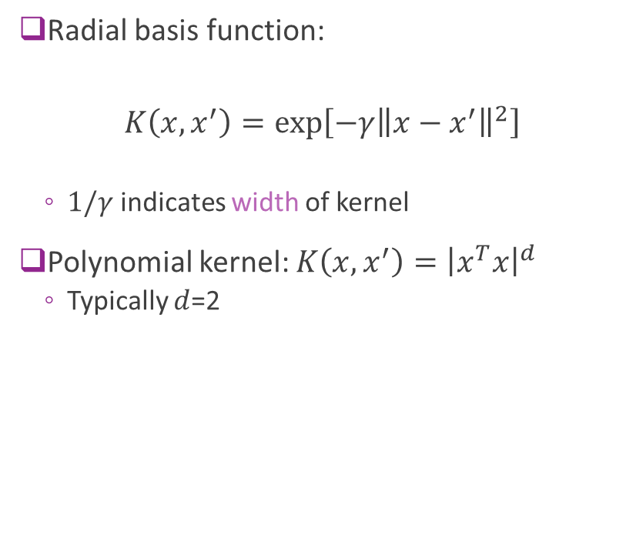
Possible Kernels
Radial basis function:
$$K\left(x,x^{′}\right)=\exp\left[−γ{\left\|x−x^{′}\right\|}^{2}\right]$$
$1/γ$ indicates width of kernel
Polynomial kernel: $K\left(x,x^{′}\right)={\left|x^{T}x\right|}^{d}$
Typically $d$=2

Slide 46
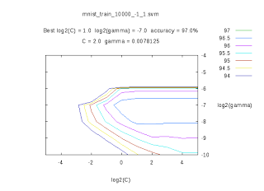
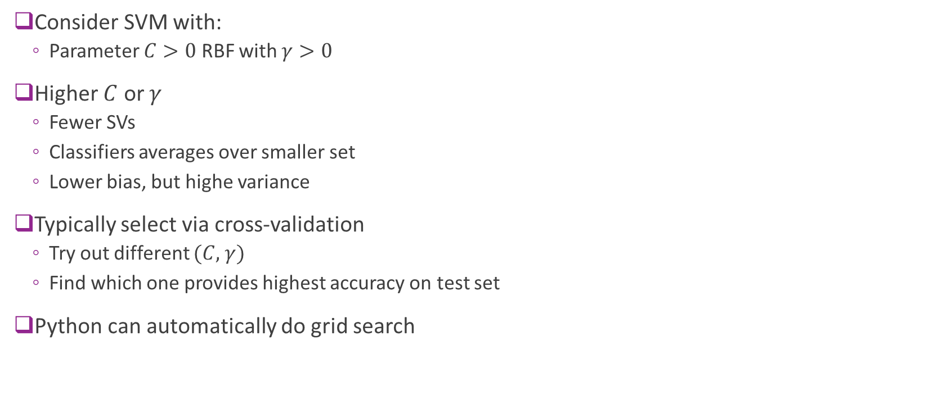
Parameter Selection
Consider SVM with:
Parameter $C>0$ RBF with $γ>0$
Higher $C$ or $γ$
Fewer SVs
Classifiers averages over smaller set
Lower bias, but highe variance
Typically select via cross-validation
Try out different $(C,$ $γ)$
Find which one provides highest accuracy on test set
Python can automatically do grid search
http://peekaboo-vision.blogspot.com/2010/09/mnist-for-ever.html

Slide 47
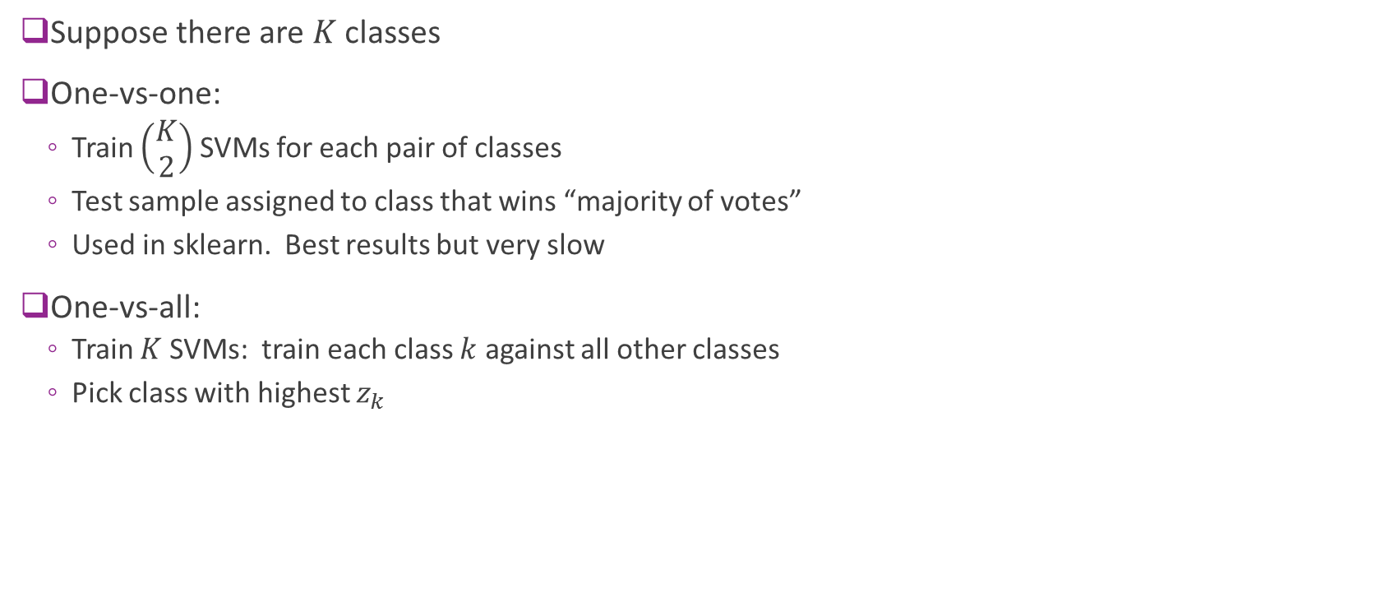
Multi-Class SVMs
Suppose there are $K$ classes
One-vs-one:
Train $\left(\begin{matrix}K \\ 2\end{matrix}\right)$ SVMs for each pair of classes
Test sample assigned to class that wins “majority of votes”
Used in sklearn. Best results but very slow
One-vs-all:
Train $K$ SVMs: train each class $k$ against all other classes
Pick class with highest $z_{k}$

Slide 48

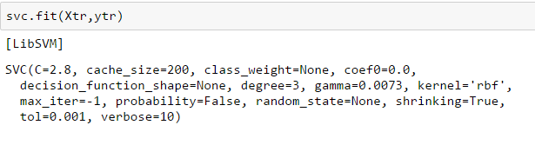



MNIST Results
Run classifier
Very slow
Several minutes for 40,000 samples
Slow in training and test
Major drawback of SVM
Accuracy $≈0.984$
Much better than logistic regression
Can get better with:
pre-processing
More training data
Optimal parameter selection

Slide 49

MNIST Errors
Some of the error are hard even for a human

