Slide 1
Lecture 9 Neural Networks
EE-UY 4563/EL-GY 9123: Introduction to machine learning
Prof. Sundeep rangan

Slide 2
Learning Objectives
Mathematically describe a neural network with a single hidden layer
Describe mappings for the hidden and output units
Manually compute output regions for very simple networks
Select the loss function based on the problem type
Build and train a simple neural network in Keras
Write the formulas for gradients using backpropagation
Describe mini-batches in stochastic gradient descent

Slide 3
Outline
Motivating Idea: Nonlinear classifiers from linear features
Neural Networks
Neural Network Loss Function
Stochastic Gradient Descent
Building and Training a Network in Keras
Synthetic data
MNIST
Tensors
Gradient Tensors
Backpropagation Training

Slide 4
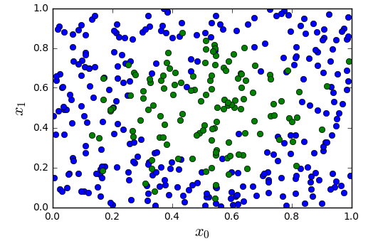
Most Datasets are not Linearly Separable
Consider simple synthetic data
See figure to the left
2D features
Binary class label
Not separated linearly
All code in https://github.com/sdrangan/introml/blob/master/neural/synthetic.ipynb

Slide 5
From Linear to Nonlinear
Idea: Build nonlinear region from linear decisions
Possible form for a classifier:
Step 1: Classify into small number of linear regions
Step 2: Predict class label from step 1 decisions

Slide 6
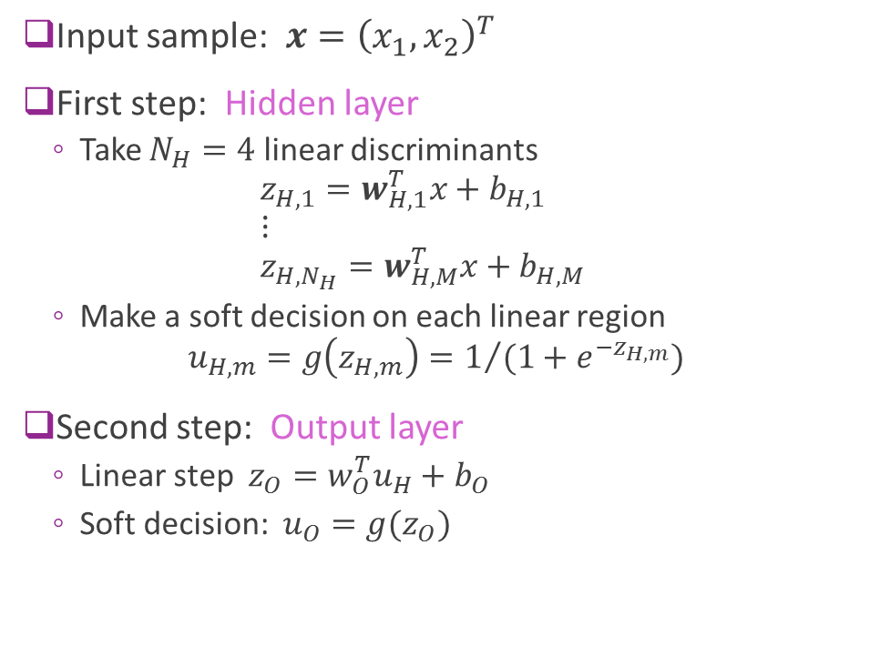
A Possible Two Stage Classifier
Input sample: $x={\left(x_{1},x_{2}\right)}^{T}$
First step: Hidden layer
Take $N_{H}=4$ linear discriminants $z_{H,1}=w_{H,1}^{T}x+b_{H,1}$ $⋮$ $z_{H,N_{H}}=w_{H,M}^{T}x+b_{H,M}$
Make a soft decision on each linear region $u_{H,m}=g\left(z_{H,m}\right)=1/{(1+e^{−z_{H,m}})}$
Second step: Output layer
Linear step $z_{O}=w_{O}^{T}u_{H}+b_{O}$
Soft decision: $u_{O}=g(z_{O})$

Slide 7

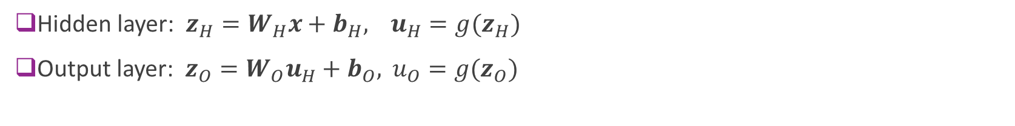

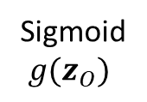
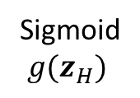

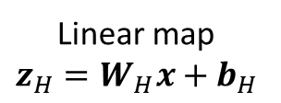


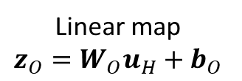
Model Block Diagram
Hidden layer: $z_{H}=W_{H}x+b_{H},$ $u_{H}=g(z_{H})$
Output layer: $z_{O}=W_{O}u_{H}+b_{O},$ $u_{O}=g(z_{O})$
Linear map $$z_{H}=W_{H}x+b_{H}$$
Sigmoid $g(z_{H})$
Linear map $$z_{O}=W_{O}u_{H}+b_{O}$$
Sigmoid $g(z_{O})$
$$z_{O}$$
$$u_{O}$$
$$x$$
Soft binary decision
Input
$$z_{H}$$
$$u_{H}$$
Hidden layer
Output layer

Slide 8
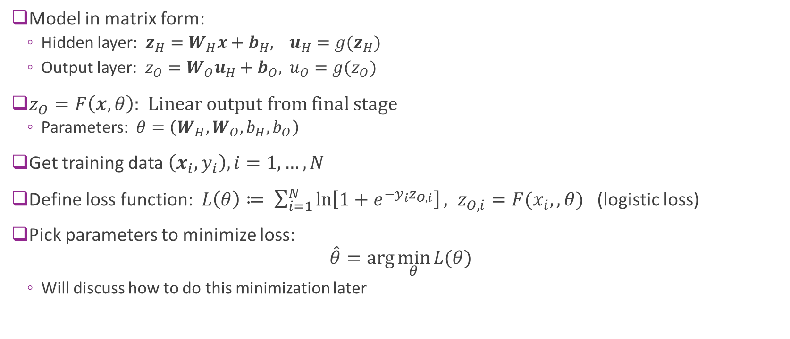
Training the Model
Model in matrix form:
Hidden layer: $z_{H}=W_{H}x+b_{H},$ $u_{H}=g(z_{H})$
Output layer: $z_{O}=W_{O}u_{H}+b_{O},$ $u_{O}=g(z_{O})$
$z_{O}=F\left(x,θ\right)$: Linear output from final stage
Parameters: $θ=\left(W_{H},W_{O},b_{H},b_{O}\right)$
Get training data $\left(x_{i},y_{i}\right), i=1,…,N$
Define loss function: $L\left(θ\right)≔ \sum_{i=1}^{N}{\ln\left[1+e^{−y_{i}z_{O,i}}\right]}, z_{O,i}=F(x_{i},,θ)$ (logistic loss)
Pick parameters to minimize loss: $\hat{θ}=\arg{\min_{θ}{L(θ)}}$
Will discuss how to do this minimization later

Slide 9
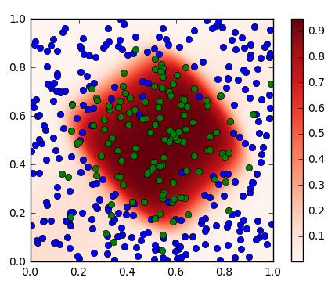



Results
Neural network finds a nonlinear region
Plot shows:
Blue circles: Negative samples
Greed circles: Positive samples
Red color: Classifier soft probability $g(z_{O})$
$$x_{1}$$
$$x_{0}$$

Slide 10
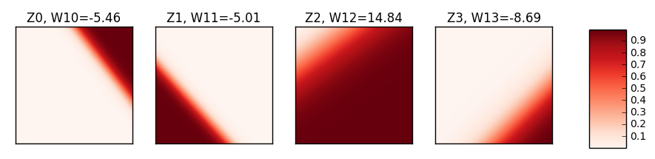


Visualizing the Hidden Layer Weights
$$x_{1}$$
$$x_{0}$$
Hidden weights finds lower layer features

Slide 11
Outline
Motivating Idea: Nonlinear classifiers from linear features
Neural Networks
Neural Network Loss Function
Stochastic Gradient Descent
Building and Training a Network in Keras
Synthetic data
MNIST
Tensors
Gradient Tensors
Backpropagation Training

Slide 12
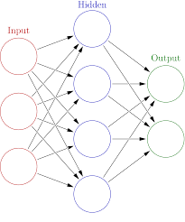

General Structure
Input: $x=\left(x_{1},⋯,x_{d}\right)$
$d$ = number of features
Hidden layer:
Linear transform: $z_{H}=W_{H}x+b_{H}$
Soft decision: $u_{H}=g\left(z_{H}\right)$
Dimension: $M$ hidden units
Output layer:
Linear transform: $z_{O}=W_{O}u_{H}+b_{O}$
Dimension: $K$ = number of classes / outputs
Can be used for classification or regression

Slide 13

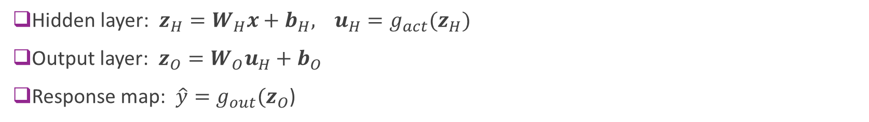

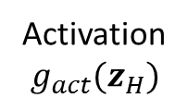

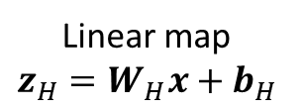


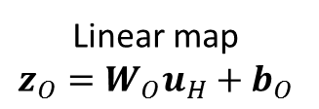
General Neural Net Block Diagram
Hidden layer: $z_{H}=W_{H}x+b_{H},$ $u_{H}=g_{act}(z_{H})$
Output layer: $z_{O}=W_{O}u_{H}+b_{O}$
Response map: $\hat{y}=g_{out}(z_{O}$)
Linear map $$z_{H}=W_{H}x+b_{H}$$
Activation $g_{act}(z_{H})$
Linear map $$z_{O}=W_{O}u_{H}+b_{O}$$
Response map
$\hat{y}=g_{out}(z_{O}$)
$$x$$
$$z_{O}$$
Input
$$z_{H}$$
$$u_{H}$$
Hidden layer
Output layer

Slide 14
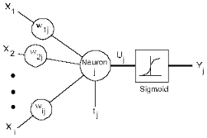




Terminology
Hidden variables: the variables $z_{H},u_{H}$
These are not directly observed
Hidden units: The functions that compute:
$z_{H,i}=\sum_{j}{W_{H,ij}x_{j}+b_{H,i}}, u_{H,i}=g(z_{H,i})$
The function $g(z)$ called the activation function
Output units: The functions that compute
$z_{O,i}=\sum_{j}{W_{O,ij}u_{H,j}+b_{O,i}}$
$$z_{H,i}$$
$$u_{H,i}$$
$$b_{H,i}$$

Slide 15
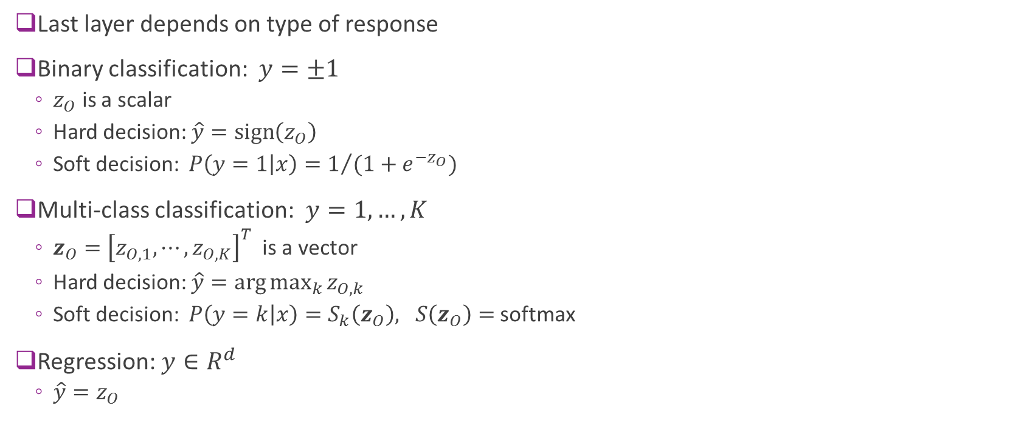
Response Map or Output Activation
Last layer depends on type of response
Binary classification: $y=±1$
$z_{O}$ is a scalar
Hard decision: $\hat{y}=\text{sign}\left(z_{O}\right)$
Soft decision: $P\left(y=1 | x\right)=1/{(1+e^{−z_{O}})}$
Multi-class classification: $y=1,…,K$
$z_{O}={\left[z_{O,1},⋯,z_{O,K}\right]}^{T}$ is a vector
Hard decision: $\hat{y}=\arg{\max_{k}{z_{O,k}}}$
Soft decision: $P\left(y=k | x\right)=S_{k}\left(z_{O}\right), S\left(z_{O}\right)=$ softmax
Regression: $y∈R^{d}$
$\hat{y}=z_{O}$

Slide 16
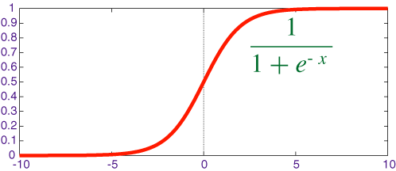
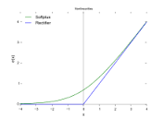

Hidden Activation Function
Two common activation functions
Sigmoid:
$g_{act}\left(z\right)=1/{1+e^{−z} }$
Benefits: Values are bounded
Often used for small networks
Rectified linear unit (ReLU):
$g_{act}\left(z\right)=max⁡(0,z)$
Can add sparsity (more on this later)
Often used for larger networks
Esp. in combination with dropout

Slide 17
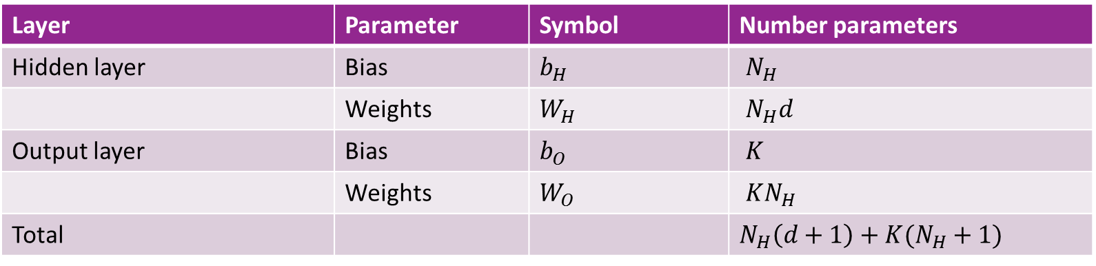
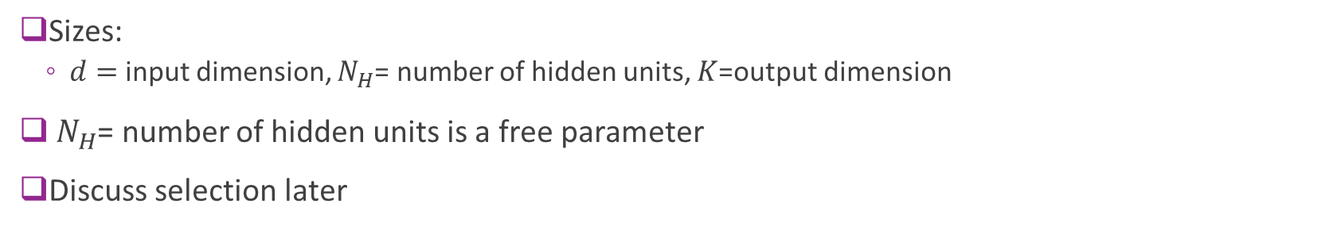
Number of Parameters
Layer | Parameter | Symbol | Number parameters
Hidden layer | Bias | $b_{H}$ | $N_{H}$
 | Weights | $W_{H}$ | $N_{H}d$
Output layer | Bias | $b_{O}$ | $K$
 | Weights | $W_{O}$ | $KN_{H}$
Total |  |  | $N_{H}\left(d+1\right)+K(N_{H}+1)$
Sizes:
$d=$ input dimension, $N_{H}$= number of hidden units, $K$=output dimension
$N_{H}$= number of hidden units is a free parameter
Discuss selection later

Slide 18
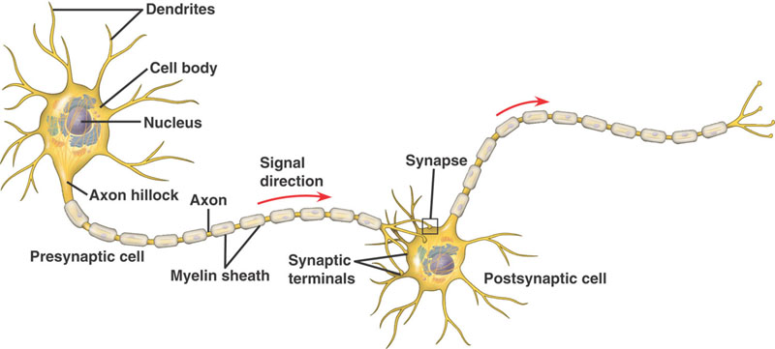
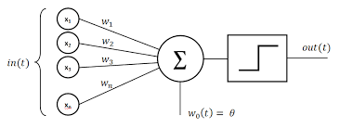
Inspiration from Biology
Simple model of neurons
Dendrites: Input currents from other neurons
Soma: Cell body, accumulation of charge
Axon: Outputs to other neurons
Synapse: Junction between neurons
Operation:
Take weighted sum of input current
Outputs when sum reaches a threshold
Each neuron is like one unit in neural network

Slide 19
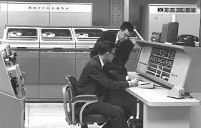
History
Interest in understanding the brain for thousands of years
1940s: Donald Hebb. Hebbian learning for neural plasticity
Hypothesized rule for updating synaptic weights in biological neurons
1950s: Frank Rosenblatt: Coined the term perceptron
Essentially single layer classifier, similar to logistic classification
Early computer implementations
But, Limitations of linear classifiers and computer power
1960s: Backpropagation: Efficient way to train multi-layer networks
More on this later
1980s: Resurgence with greater computational power
2005+: Deep networks
Many more layers. Increased computational power and data
Enabled first breakthroughs in various image and text processing.
Next lecture

Slide 20
Outline
Motivating Idea: Nonlinear classifiers from linear features
Neural Networks
Neural Network Loss Function
Stochastic Gradient Descent
Building and Training a Network in Keras
Synthetic data
MNIST
Tensors
Gradient Tensors
Backpropagation Training

Slide 21

Training a Neural Network
Given data: $\left(x_{i},y_{i}\right), i=1,…,N$
Learn parameters: $θ=(W_{H},b_{H},W_{o},b_{o})$
Weights and biases for hidden and output layers
Will minimize a loss function: $L\left(θ\right)$ $\hat{θ}=\arg{\min_{θ}{L\left(θ\right)}}$
$L\left(θ\right)$ = measures how well parameters $θ$ fit training data $\left(x_{i},y_{i}\right)$

Slide 22
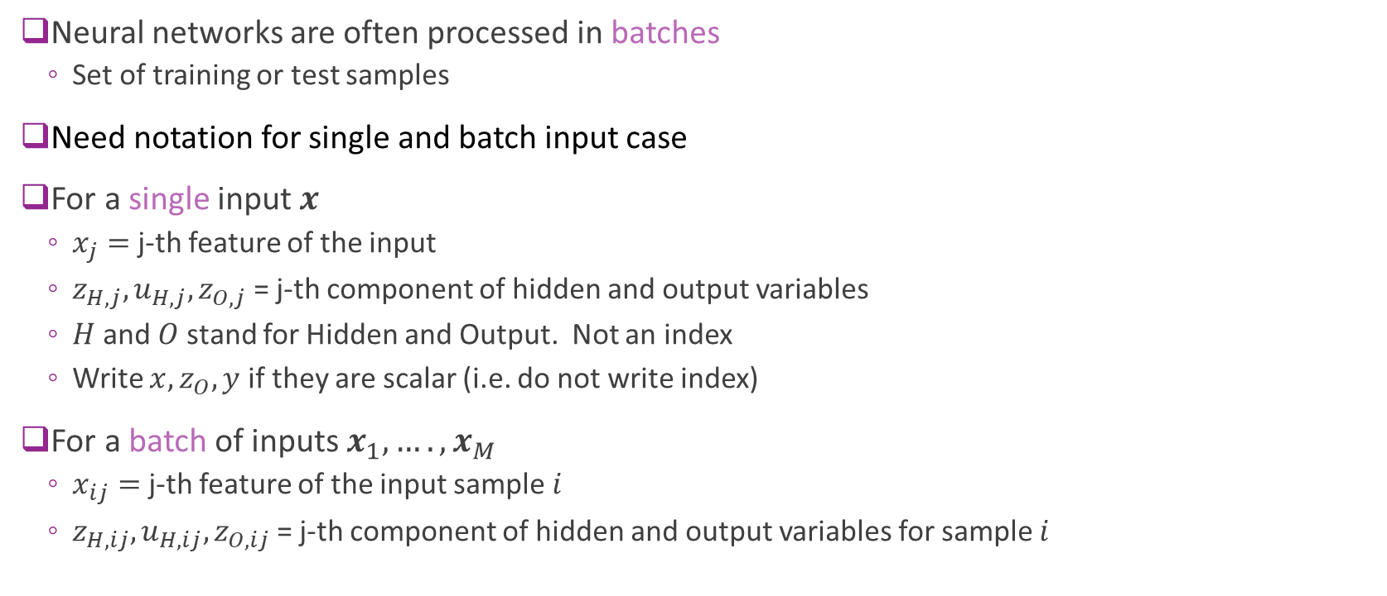
Note on Indexing
Neural networks are often processed in batches
Set of training or test samples
Need notation for single and batch input case
For a single input $x$
$x_{j}=$ j-th feature of the input
$z_{H,j},u_{H,j},z_{O,j}$ = j-th component of hidden and output variables
$H$ and $O$ stand for Hidden and Output. Not an index
Write $x,z_{O},y$ if they are scalar (i.e. do not write index)
For a batch of inputs $x_{1},….,x_{M}$
$x_{ij}=$ j-th feature of the input sample $i$
$z_{H,ij},u_{H,ij},z_{O,ij}$ = j-th component of hidden and output variables for sample $i$

Slide 23
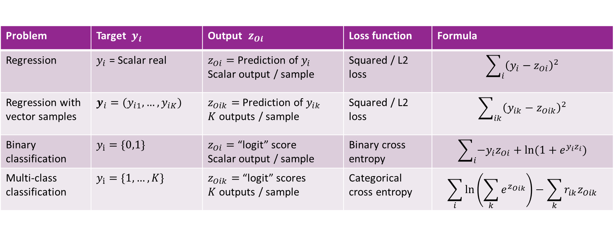
Selecting the Right Loss Function
Depends on the problem type
Always compare final output $z_{Oi}$ with target $y_{i}$
Problem | Target $y_{i}$ | Output $z_{Oi}$ | Loss function | Formula
Regression | $y_{i}$ = Scalar real | $z_{Oi}=$Prediction of $y_{i}$ Scalar output / sample | Squared / L2 loss | $$\sum_{i}{{\left(y_{i}−z_{Oi}\right)}^{2}}$$
Regression with vector samples | $y_{i}=(y_{i1},…,y_{iK})$ | $z_{Oik}=$Prediction of $y_{ik}$ $K$ outputs / sample | Squared / L2 loss | $$\sum_{ik}{{\left(y_{ik}−z_{Oik}\right)}^{2}}$$
Binary classification | $y_{i}=\{0,1\}$ | $z_{Oi}=$“logit” score Scalar output / sample | Binary cross entropy | $$\sum_{i}{−y_{i}z_{Oi}+ln⁡(1+e^{y_{i}z_{i}})}$$
Multi-class classification | $y_{i}=\{1,…,K\}$ | $z_{Oik}=$“logit” scores $K$ outputs / sample | Categorical cross entropy | $$\sum_{i}{ln⁡\left(\sum_{k}{e^{z_{Oik}}}\right)−\sum_{k}{r_{ik}z_{Oik}}}$$

Slide 24
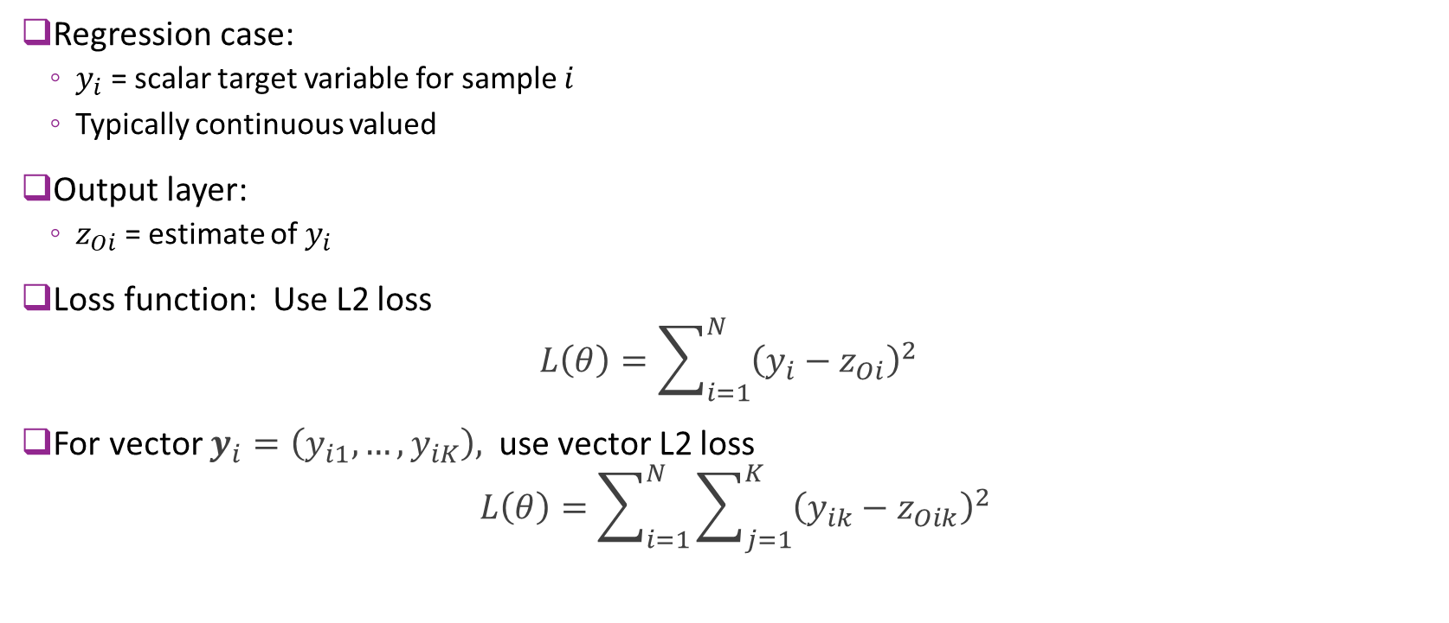
Loss Function: Regression
Regression case:
$y_{i}$ = scalar target variable for sample $i$
Typically continuous valued
Output layer:
$z_{Oi}$ = estimate of $y_{i}$
Loss function: Use L2 loss $L\left(θ\right)=\sum_{i=1}^{N}{{\left(y_{i}−z_{Oi}\right)}^{2}}$
For vector $y_{i}=\left(y_{i1},…,y_{iK}\right),$ use vector L2 loss
$$L\left(θ\right)=\sum_{i=1}^{N}{\sum_{j=1}^{K}{{\left(y_{ik}−z_{Oik}\right)}^{2}}}$$

Slide 25
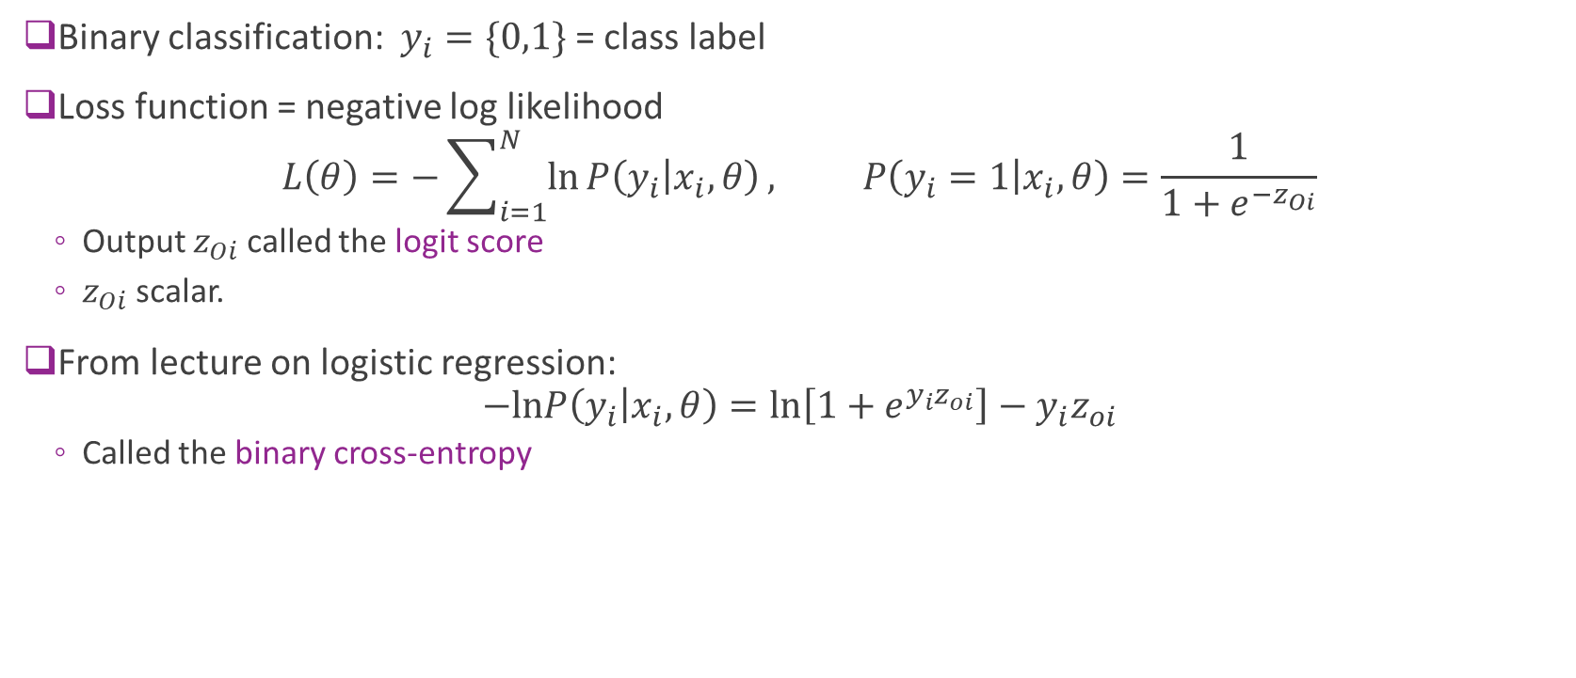
Loss Function: Binary Classification
Binary classification: $y_{i}=\{0,1\}$ = class label
Loss function = negative log likelihood
$$L\left(θ\right)=−\sum_{i=1}^{N}{\ln{P\left(y_{i} | x_{i},θ\right)}}, P\left(y_{i}=1 | x_{i},θ\right)=\frac{1}{1+e^{{−z}_{Oi}}}$$
Output $z_{Oi}$ called the logit score
$z_{Oi}$ scalar.
From lecture on logistic regression: $−lnP\left(y_{i} | x_{i},θ\right)=\ln\left[1+e^{y_{i}z_{oi}}\right]−y_{i}z_{oi}$
Called the binary cross-entropy

Slide 26

Loss Function: Multi-Class Classification 1
$y_{i}=\{1,…,K\}$ = class label
Output: $z_{Oi}=(z_{O,i1},…,z_{O,iK})$
$K$ outputs. One per class
Also called the logit score
Likelihood given by softmax:
$$P\left(y_{i}=k | x_{i},θ\right)=g_{k}\left(z_{Oi}\right), g_{k}\left(z_{Oi}\right)=\frac{e^{z_{O,ik}}}{\sum_{ℓ}{e^{z_{O,ik}}}}$$
Assigns class highest probability with highest logit score

Slide 27

Loss Function: Multi-Class Classification 2
$y_{i}=\{1,…,K\}$ = class label
Define one-hot coded response $r_{ik}=\left\{\begin{matrix}1 & y_{i}=k \\ 0 & y_{i}≠k\end{matrix}\right.$
$r_{i}=(r_{i1},…,r_{iK})$ is $K$-dimensional
Negative log-likelihood given by: $L\left(θ\right)=\sum_{i}{ln⁡\left(\sum_{k}{e^{z_{Oik}}}\right)−\sum_{k}{r_{ik}z_{O,ik}}}$
Called the categorical cross-entropy

Slide 28
Outline
Motivating Idea: Nonlinear classifiers from linear features
Neural Networks
Neural Network Loss Function
Stochastic Gradient Descent
Building and Training a Network in Keras
Synthetic data
MNIST
Tensors
Gradient Tensors
Backpropagation Training

Slide 29
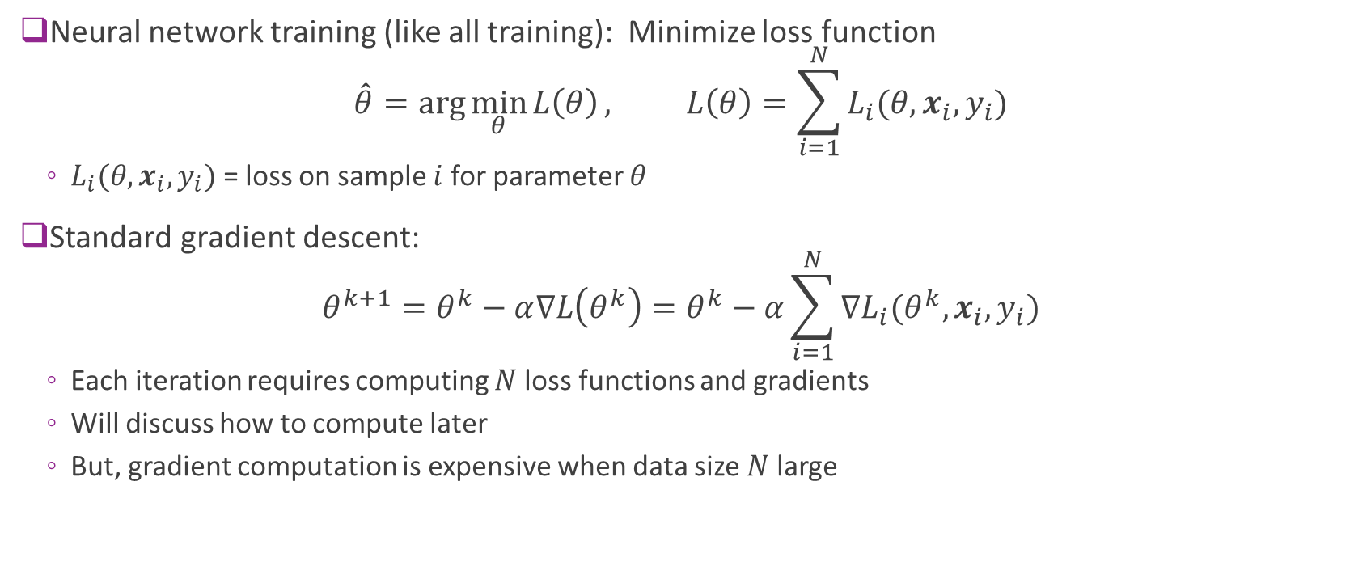
Problems with Standard Gradient Descent
Neural network training (like all training): Minimize loss function $\hat{θ}=\arg{\min_{θ}{L\left(θ\right)}}, L\left(θ\right)=\sum_{i=1}^{N}{L_{i}(θ,x_{i},y_{i})}$
$L_{i}(θ,x_{i},y_{i})$ = loss on sample $i$ for parameter $θ$
Standard gradient descent: $θ^{k+1}=θ^{k}−α∇L\left(θ^{k}\right)=θ^{k}−α\sum_{i=1}^{N}{{∇L}_{i}(θ^{k},x_{i},y_{i})}$
Each iteration requires computing $N$loss functions and gradients
Will discuss how to compute later
But, gradient computation is expensive when data size $N$ large

Slide 30
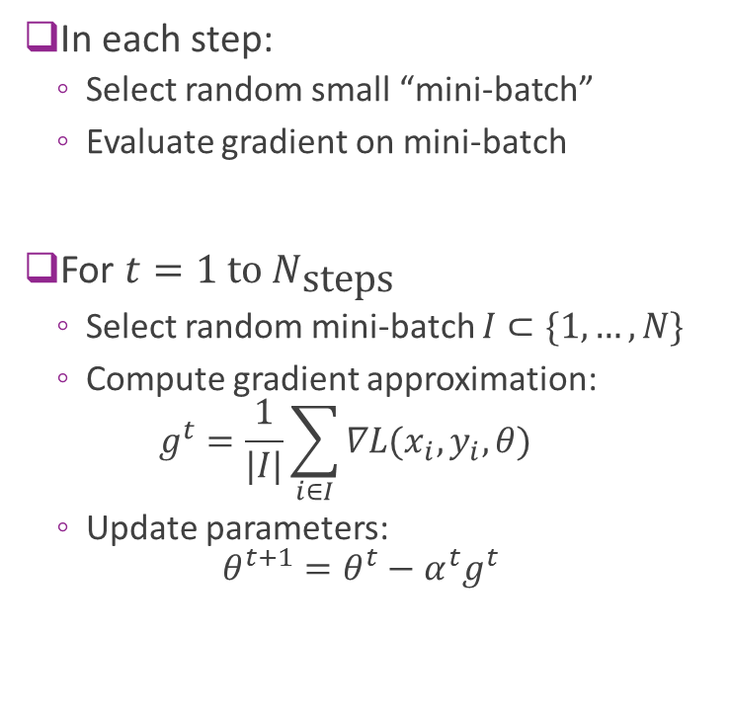
Stochastic Gradient Descent
In each step:
Select random small “mini-batch”
Evaluate gradient on mini-batch
For $t=1 \text{to} N_{\text{steps}}$
Select random mini-batch $I⊂\{1,…,N\}$
Compute gradient approximation: $g^{t}=\frac{1}{|I|}\sum_{i∈I}{∇L(x_{i},y_{i},θ)}$
Update parameters: $θ^{t+1}=θ^{t}−α^{t}g^{t}$
Full batch of training records
e.g. 50,000 in MNIST
Randomly selected mini-batch
e.g. 100 records

Slide 31
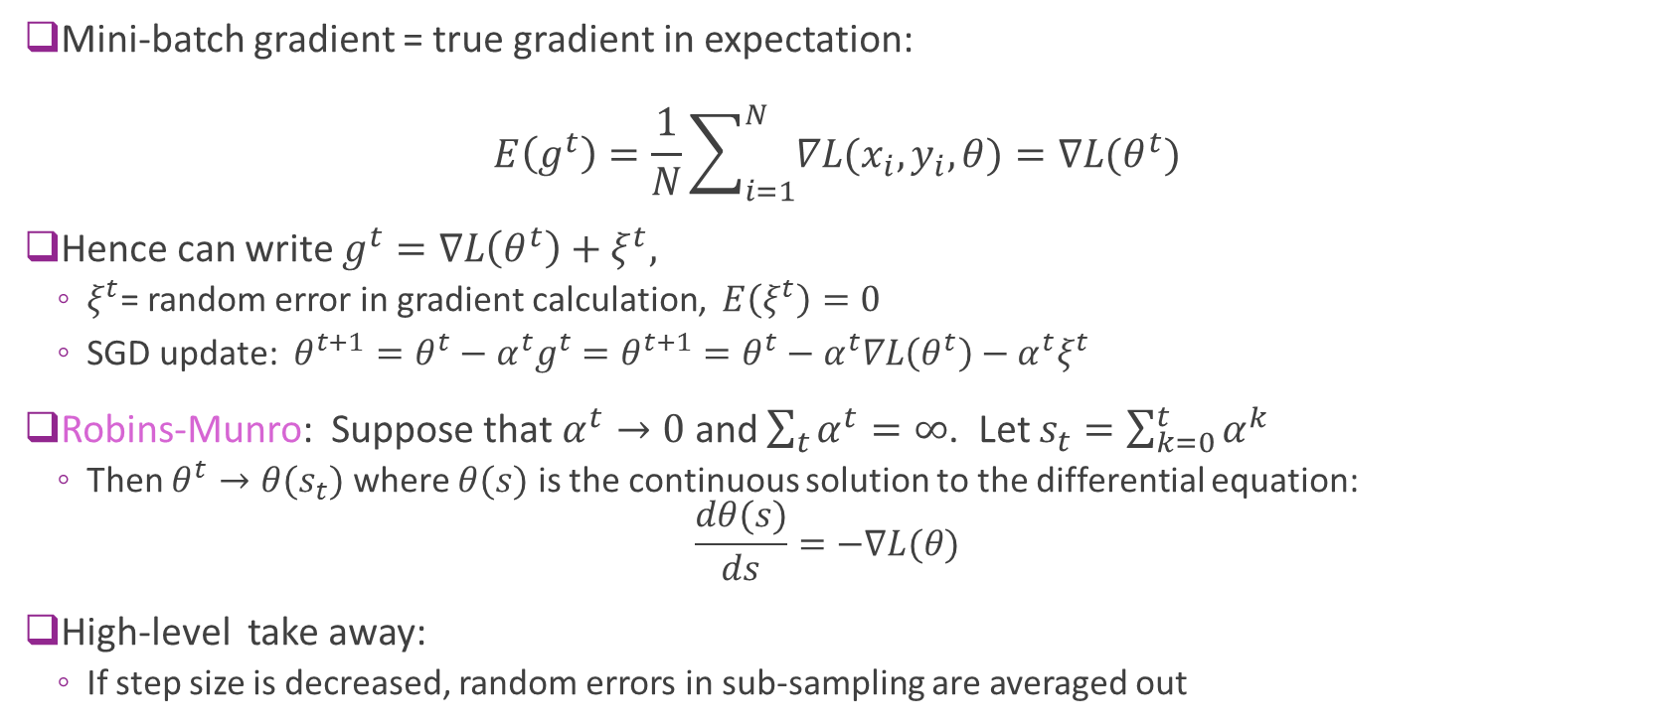
SGD Theory (Advanced)
Mini-batch gradient = true gradient in expectation: $E\left(g^{t}\right)=\frac{1}{N}\sum_{i=1}^{N}{∇L(x_{i},y_{i},θ)}=∇L(θ^{t})$
Hence can write $g^{t}=∇L\left(θ^{t}\right)+ξ^{t},$
$ξ^{t}$= random error in gradient calculation, $E\left(ξ^{t}\right)=0$
SGD update: $θ^{t+1}=θ^{t}−α^{t}g^{t}=θ^{t+1}=θ^{t}−α^{t}∇L\left(θ^{t}\right)−α^{t}ξ^{t}$
Robins-Munro: Suppose that $α^{t}→0$ and $\sum_{t}{α^{t}}=∞$. Let $s_{t}=\sum_{k=0}^{t}{α^{k}}$
Then $θ^{t}→θ(s_{t})$ where $θ(s)$ is the continuous solution to the differential equation: $\frac{dθ(s)}{ds}=−∇L(θ)$
High-level take away:
If step size is decreased, random errors in sub-sampling are averaged out

Slide 32
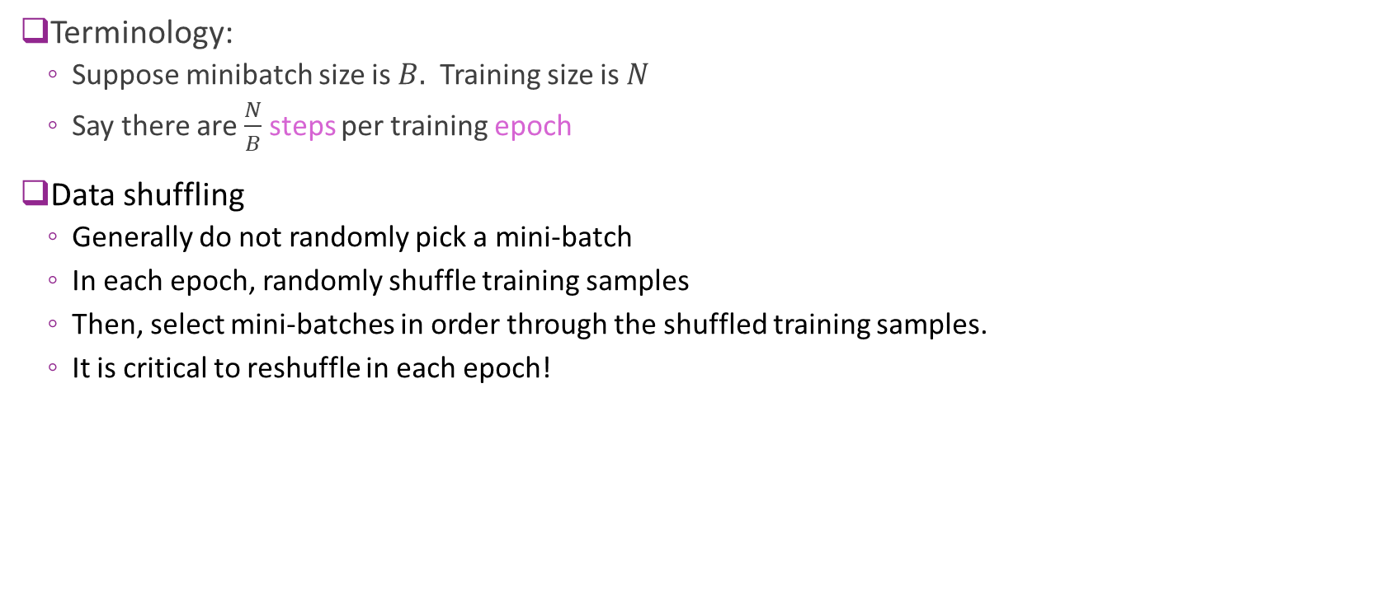
SGD Practical Issues
Terminology:
Suppose minibatch size is $B.$ Training size is $N$
Say there are $\frac{N}{B}$ steps per training epoch
Data shuffling
Generally do not randomly pick a mini-batch
In each epoch, randomly shuffle training samples
Then, select mini-batches in order through the shuffled training samples.
It is critical to reshuffle in each epoch!

Slide 33
Outline
Motivating Idea: Nonlinear classifiers from linear features
Neural Networks
Neural Network Loss Function
Stochastic Gradient Descent
Building and Training a Network in Keras
Synthetic data
MNIST
Tensors
Gradient Tensors
Backpropagation Training

Slide 34
Deep Learning Zoo

Slide 35
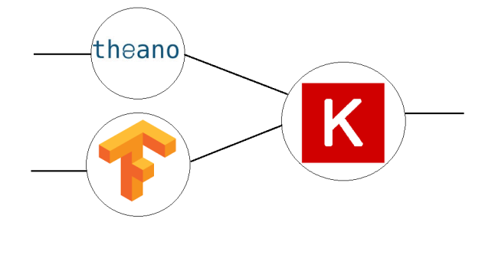
Keras Package
High-level neural network language
Runs on top of a backend
Much simpler than raw backend language
Very fast coding
Uniform language for all backend
Likely will be incorporated into TF
But…
Slightly less flexible
Not as fast sometimes
In this class, we use Keras
Keras
High-level language
Low-level backend
(e.g. Tensorflow, Theano, CNTK, …)

Slide 36
Keras Recipe
Step 1. Describe model architecture
Number of hidden units, output units, activations, …
Step 2. Select and optimizer
Step 3. Select a loss function and compile the model
Step 4. Fit the model
Step 5. Test / use the model

Slide 37
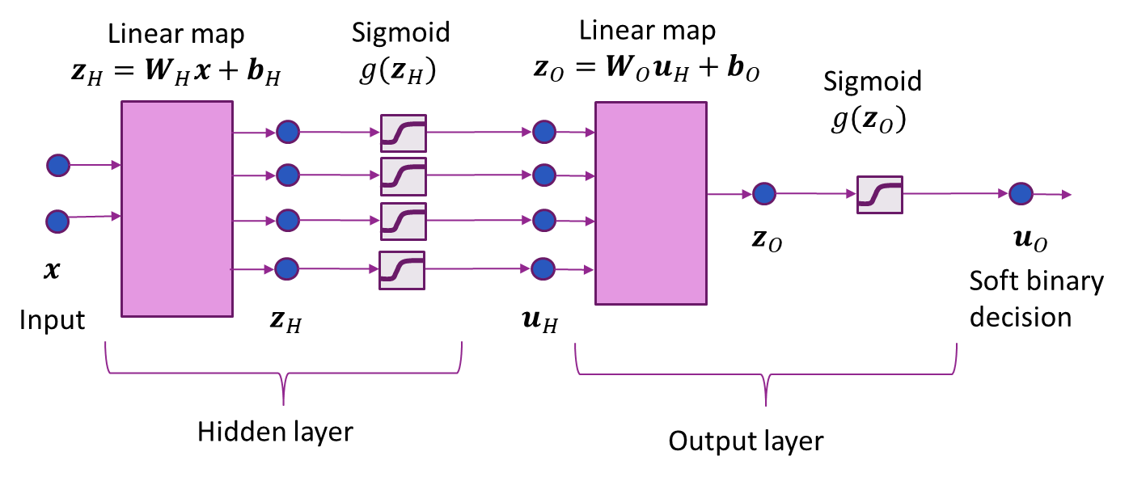
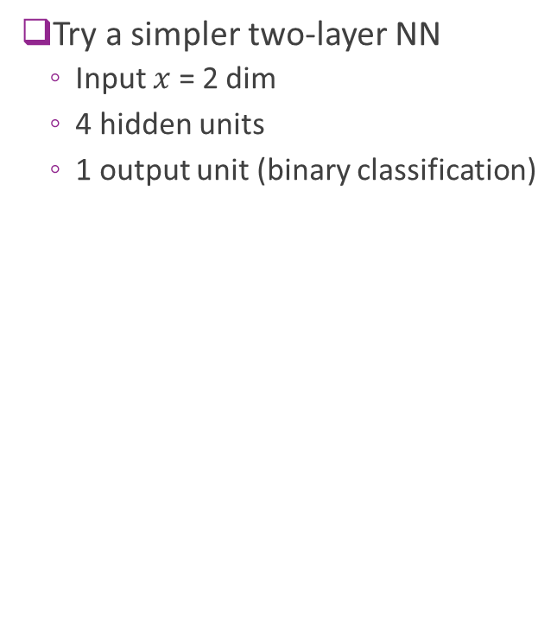
Synthetic Data Example
Try a simpler two-layer NN
Input $x$ = 2 dim
4 hidden units
1 output unit (binary classification)

Slide 38

Step 0: Import the Packages
Install a deep learing backend: Tensorflow, Theano, CNTK, …
Then install Keras

Slide 39


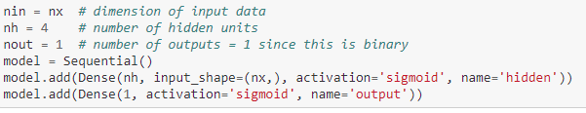
Step 1: Define Model
Load modules for layers
Clear graph
Build model
This example: dense layers
Give each layer a dimension, name & activation

Slide 40
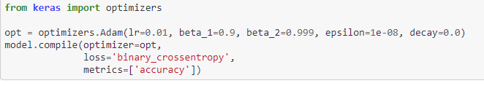
Step 2, 3: Select and Optimizer & Compile
Adam optimizer generally works well for most problems
In this case, had to manually set learning rate
Use binary cross-entropy loss
Metrics indicate what will be printed in each epoch

Slide 41
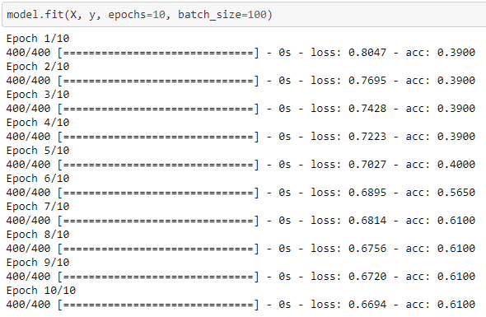
Step 4: Fit the Model
Use keras fit function
Specify number of epoch & batch size
Prints progress after each epoch
Loss = loss on training data
Acc = accuracy on training data

Slide 42
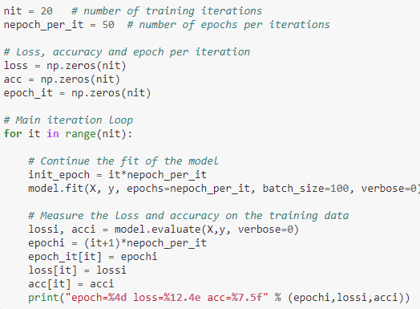
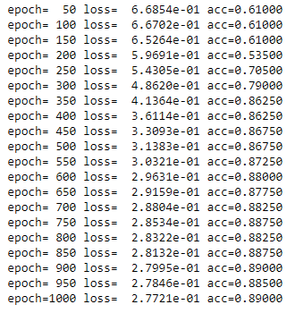
Fitting the Model with Many Epochs
This example requires large number of epochs (~1000)
Do not want to print progress on each epoch
Rewrite code to manually print progress
Can also use a callback function

Slide 43
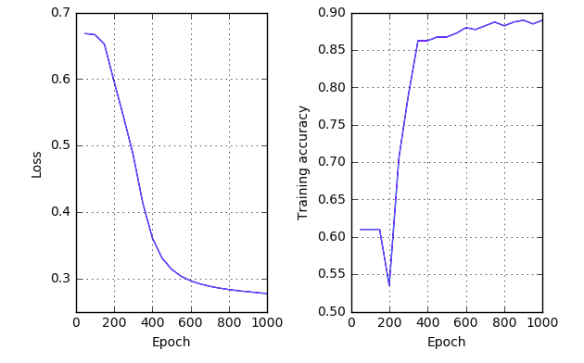
Performance vs Epoch
Can observe loss function slowly converging

Slide 44
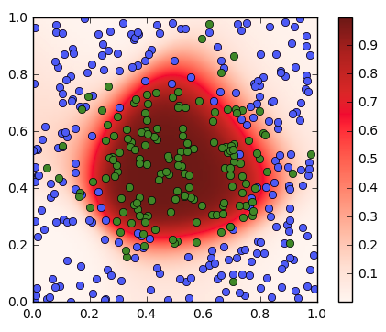
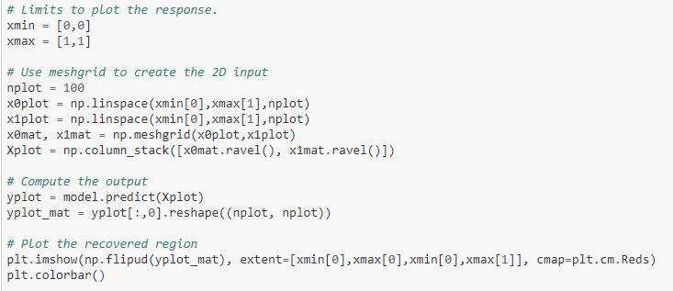

Step 5. Visualizing the Decision Regions
Feed in data $x=(x_{1},x_{2})$ over grid of points in $\left[0,1\right]×\left[0,1\right]$
Use predict to observe output for each input point
Plot outputs $u_{O}=sigmoid(z_{O})$

Slide 45



Visualizing the Hidden Layers
Create a new model with hidden layer output
Feed in data $x=(x_{1},x_{2})$ over $\left[0,1\right]×\left[0,1\right]$
Predict outputs from hidden outputs

Slide 46

In-Class Exercise
Go to demo on github

Slide 47
Outline
Motivating Idea: Nonlinear classifiers from linear features
Neural Networks
Neural Network Loss Function
Stochastic Gradient Descent
Building and Training a Network in Keras
Synthetic data
MNIST
Tensors
Gradient Tensors
Backpropagation Training

Slide 48

Recap: MNIST data
Classic MNIST problem:
Detect hand-written digits
Each image is 28 x 28 = 784 pixels
Dataset size:
50,000 training digits
10,000 test
10,000 validation (not used here)
Can be loaded with sklearn and many other packages

Slide 49


Simple MNIST Neural Network
784 inputs, 100 hidden units, 10 outputs

Slide 50


Fitting the Model
Run for 20 epochs, ADAM optimizer, batch size = 100
Final accuracy = 0.972
Not great, but much faster than SVM. Also CNNs we study later do even better.

Slide 51
Outline
Motivating Idea: Nonlinear classifiers from linear features
Neural Networks
Neural Network Loss Function
Stochastic Gradient Descent
Building and Training a Network in Keras
Synthetic data
MNIST
Tensors
Gradient Tensors
Backpropagation Training

Slide 52

What is a Tensor?
A multi-dimensional array
Examples:
2D: A grayscale image [height x width]
3D: A color image [height x width x rgb]
4D: A collection of images [height x width x rgb x image number]
Like numpy ndarray
Basic unit in tensorflow
Rank or order = Number of dimensions
Note: Rank has different meaning in linear algebra

Slide 53

Indexing Tensors
Suppose $X$ is a tensor of order $N$
Index with a multi-index $X[i_{1},…,i_{N}$]
May also use subscript: $X_{i_{1},…,i_{N} }$
Example: Suppose $X$ = collection of images [height x width x rgb x image number]
$X\left[100,150,1,30\right]=$pixel (100,150) for color channel 1 (green) on image 30
If $i_{1}∈\left\{0,…,d_{1}−1\right\}, i_{2}∈\left\{0,…,d_{2}−1\right\}, …$ then total number of elements = $d_{1}d_{2}…d_{N}$

Slide 54

Creating Tensors in Numpy
Numpy ndarrays = tensors
Most numpy function work on tensors naturally

Slide 55

Indexing Tensors in Numpy
Same indexing applies as in matrices and vectors

Slide 56



Tensors and Neural Networks
Need to be consistent with indexing
For a single input $x:$
Input $x$: vector of dimension $d$
Hidden layer: $z_{H},u_{H}$: vectors of dimension $N_{H}$
Outputs: $z_{O}:$ dimension $z_{H}$
A batch of inputs with $M$ samples:
Input $x$: Matrix of dimension $M×d$
Hidden layer: $z_{H},u_{H}$: vectors of dimension ${M×N}_{H}$
Outputs: $z_{O}:$ dimension $M×K$
Can generalize to other shapes of input
Sample dimension $d$
Number samples $M$

Slide 57
Outline
Motivating Idea: Nonlinear classifiers from linear features
Neural Networks
Neural Network Loss Function
Stochastic Gradient Descent
Building and Training a Network in Keras
Synthetic data
MNIST
Tensors
Gradient Tensors
Backpropagation Training

Slide 58

Recap: Gradient for Scalar Output Function
Consider scalar-valued function $f(w)$
Vector input $w$. Then gradient is: $∇_{w}f\left(w\right)=\left[\begin{matrix}{∂f(w)}/{∂w_{1}} \\ ⋮ \\ {∂f(w)}/{∂w_{N}}\end{matrix}\right]$
Matrix input $W$, size $M×N$. Then gradient is: $∇_{w}f\left(W\right)=\left[\begin{matrix}{∂f(W)}/{∂W_{11}} & ⋯ & {∂f(W)}/{∂W_{1N}} \\ ⋮ & ⋮ & ⋮ \\ {∂f(W)}/{∂W_{M1}} & ⋯ & {∂f(W)}/{∂W_{MN}}\end{matrix}\right]$
Gradient is same size as the argument

Slide 59

Recap 2: Gradient and Linearization
Suppose $f\left(x\right)$ is scalar valued.
Linearization property: If $x≈x_{0}$,
$$f\left(x\right)≈f\left(x_{0}\right)+\left\langle ∇f\left(x_{0}\right),x−x_{0}\right\rangle$$
Inner product:
Vector $x$: $\left\langle ∇f\left(x_{0}\right),x−x_{0}\right\rangle =\sum_{i}{\frac{∂f\left(x_{0}\right)}{∂x_{i}} (x_{i}−x_{0i})}$
Matrix $x$: $\left\langle ∇f\left(x_{0}\right),x−x_{0}\right\rangle =\sum_{ij}{\frac{∂f\left(x_{0}\right)}{∂x_{ij}} (x_{ij}−x_{0,ij})}$
Sum over partial derivatives for all components

Slide 60

Jacobian
How do we generalize to vector-valued functions?
Vector valued $f\left(w\right)={\left[f_{1}\left(w\right),…,f_{M}\left(w\right)\right]}^{T}, w={\left(w_{1},…,w_{N}\right)}^{T}$
$M$ outputs, $N$ inputs
Jacobian is the matrix: $\frac{∂f\left(w\right)}{∂w}=\left[\begin{matrix}{∂f_{1}(w)}/{∂w_{1}} & ⋯ & {∂f_{1}(w)}/{∂w_{N}} \\ ⋮ & ⋮ & ⋮ \\ {∂f_{M}(w)}/{∂w_{1}} & ⋯ & {∂f_{M}(w)}/{∂w_{N}}\end{matrix}\right]$
Linearization: For $w≈w_{0}$ $f\left(w\right)≈f\left(w_{0}\right)+\frac{∂f\left(w_{0}\right)}{∂w}(w−w_{0})$

Slide 61

Jacobian Examples
Example 1: $f\left(w\right)=(w_{1}w_{2},w_{1}^{2}+w_{3}^{3})$
2 outputs, 3 inputs. $\frac{∂f(w)}{∂w}=\left[\begin{matrix}w_{2} & w_{1} & 0 \\ 2w_{1} & 0 & 3w_{3}^{2}\end{matrix}\right]$
Example 2: $f\left(w\right)=Aw$ $\frac{∂f(w)}{∂w}=A$
Example 3: Componentwise function: $f\left(w\right)=\left(f_{1}\left(w_{1}\right),f_{2}\left(w_{2}\right),…,f_{M}\left(w_{M}\right)\right)$ $\frac{∂f(w)}{∂w}=diag\left(f_{1}′\left(w_{1}\right), …,f_{M}′\left(w_{M}\right)\right)=\left[\begin{matrix}f_{1}^{′}(w_{1}) & ⋯ & 0 \\ ⋮ & ⋱ & ⋮ \\ 0 & ⋯ & f_{M}^{′}(w_{M})\end{matrix}\right]$

Slide 62

Gradient for Tensors Inputs & Outputs
General setting: $y=f\left(x\right)$
$x$ is a tensor or order $N$
$y$ is a tensor or order $M$
Gradient tensor: A tensor of order $N+M$:
$${\left[\frac{∂f\left(x\right)}{∂x}\right]}_{i_{1},…i_{M},j_{1},…,j_{N}}=\frac{∂f_{i_{1},…,i_{M}}\left(x\right)}{∂x_{j_{1},…,j_{N}}}$$
Tensor has the derivative of every output with respect to every input.
Ex: $x$ has shape (50,30), $y$ has shape (10,20,40)
$\frac{∂f\left(x\right)}{∂x}$ has shape (10,20,40,50,30)
10(20)(40)(50)(30) = 1.2(10)^7 elements

Slide 63

Gradient Tensor Linear Approximation
Suppose $y=f\left(x\right)$
$x$ is a tensor of shape ($d_{1},…,d_{N})$, $y$ is a tensor of shape ($k_{1},…,k_{M})$
Linear approximation: If $x≈x_{0}$, $f\left(x\right)≈f\left(x_{0}\right)+\left\langle \frac{∂f\left(x_{0}\right)}{∂x},x−x_{0}\right\rangle$
Tensor dot product: $\left\langle u,v\right\rangle \left[i_{1},…,i_{M}\right]= \sum_{j_{1}=1}^{d_{1}}{⋯\sum_{j_{N}=1}^{d_{N}}{ u\left[i_{1},…,i_{M},j_{1},…,j_{N}\right]v\left[j_{1},…,j_{N}\right]}}$
Output index
Input indices
Sum over input index

Slide 64

Example Dimensions
Suppose $y=f\left(x\right)$
$x$ is a tensor of shape ($20,30)$, $y$ is a tensor of shape ($5,10,15)$
Gradient tensor
$\frac{∂f\left(x_{0}\right)}{∂x}$ shape (5,10,15,20,30)
Tensor dot product:
$\left\langle \frac{∂f\left(x_{0}\right)}{∂x},x−x_{0}\right\rangle$ has shape (5,10,15)
Same shape as output

Slide 65

Gradients Tensors vs. Gradients & Jacobians
If $f(x)$ is a M-dim vector and $x$ is an N-vector:
Gradient tensor = Jacobian. $\frac{∂f(x)}{∂x}$ is dimension M x N
If $f(x)$ is scalar-valued and $x$ is a vector of dimension $N$ :
Gradient = $∇f\left(x\right)$. Dimension = N
Gradient tensor = $\frac{∂f(x)}{∂x}$ . Dimension = 1 x N
If $x$ is a matrix of dimension $M×N$ :
Gradient = $∇f\left(x\right)$. Dimension = $M×N$
Gradient tensor = $\frac{∂f(x)}{∂x}$ . Dimension = $1×M×N$
Conclusion: Gradient tensors generalize Jacobians and gradients for scalar output functions
For scalar output functions, must ignore first dimension.

Slide 66
Outline
Motivating Idea: Nonlinear classifiers from linear features
Neural Networks
Neural Network Loss Function
Stochastic Gradient Descent
Building and Training a Network in Keras
Synthetic data
MNIST
Tensors
Gradient Tensors
Backpropagation Training

Slide 67

Stochastic Gradient Descent
Training uses SGD
In each step:
Select a subset of sample for minibatch $I⊂\{1,…,N\}$
Evaluate mini-bath loss $L\left(θ^{t}\right)= \sum_{i∈I}{L_{i}(θ^{t},x_{i},y_{i})}$
Evaluate mini-batch gradient $g^{t}= \sum_{i∈I}{{∇L}_{i}(θ^{t},x_{i},y_{i})}$
Take SGD step: $θ^{t+1}=θ^{t}−αg^{t}$
Question: How do we compute gradient?

Slide 68

Gradients with Multiple Parameters
For neural net problem: $θ=(W_{H},b_{H},W_{o},b_{o})$
Gradient is computed with respect to each parameter:
$$∇L\left(θ\right)=[∇_{W_{H}}L\left(θ\right),∇_{b_{H}}L\left(θ\right),∇_{W_{O}}L\left(θ\right),∇_{b_{O}}L\left(θ\right)]$$
Gradient descent is performed on each parameter: $W_{H}←W_{H}−α∇_{W_{H}}L\left(θ\right),$ $b_{H}←b_{H}−α∇_{b_{H}}L\left(θ\right),$ $….$

Slide 69









Computation Graph & Forward Pass
Neural network loss function can be computed via a computation graph
Sequence of operations starting from measured data and parameters
Loss function computed via a forward pass in the computation graph
$z_{H,i}=W_{H}x_{i}+b_{H}$
$u_{H,i}=g_{act}(z_{H,i})$
$z_{O,i}=W_{O}u_{H,i}+b_{O}$
$L=\sum_{i}{L_{i}(z_{O,i},y_{i}) }$
$$L(θ)$$
Hidden variable
Observed variable
Trainable variable
$$x_{i}$$
$$z_{H,i}$$
$$u_{H,i}$$
$$z_{O,i}$$
$$W_{H},b_{H}$$
$$W_{O},b_{O}$$
$$y_{i}$$

Slide 70



Forward Pass Example in Numpy
Example network:
Single hidden layer with $N_{H}$ hidden units, single output unit
Sigmoid activation, binary cross entropy loss

Slide 71




Chain Rule
How do we compute gradient?
Consider a three node computation graph:
$y=h\left(x\right), z=g\left(y\right)$
So $z=f\left(x\right)=g(h\left(x\right))$
What is $\frac{∂z}{∂x}$?
If variables were scalars, we could compute gradients via chain rule: $\frac{∂z}{∂x}=\frac{∂f(x)}{∂x}=\frac{∂g(y)}{∂y}\frac{∂h(x)}{∂x}$
What happens for tensors?
$$x$$
$$y$$
$$z$$

Slide 72





Tensor Chain Rule
Consider Tensor case:
$x$ has shape $\left(n_{1},…,n_{N}\right)$,
$y$ has shape $\left(m_{1},…,m_{M}\right)$
$z$ has shape $\left(r_{1},…,r_{R}\right)$
Compute gradient tensors:
$\frac{∂g\left(z\right)}{∂z}$ has shape $\left(r_{1},…,r_{R},m_{1},…,m_{M}\right)$
$\frac{∂h\left(x\right)}{∂x}$ has shape $\left(m_{1},…,m_{M},n_{1},…,n_{N}\right)$
Tensor chain rule: $\frac{∂z}{∂x}=\frac{∂f\left(x\right)}{∂x}=\left\langle \frac{∂g\left(z\right)}{∂z},\frac{∂h\left(x\right)}{∂x}\right\rangle$
$$x$$
$$y=h(x)$$
$$z=g(y)$$
Tensor dot product over dimensions $\left(m_{1},…,m_{M}\right)$.

Slide 73


Gradients on a Computation Graph
Backpropagation: Compute gradients backwards
Use tensor dot products and chain rule
First compute all derivatives of all the variables
${∂L}/{∂z_{O}}$
${∂L}/{∂u_{H}}=\left\langle {∂L}/{∂z_{O}},{∂z_{O}}/{∂u_{H}}\right\rangle$
${∂L}/{∂z_{H}}=\left\langle {∂L}/{∂u_{H}},{∂u_{H}}/{∂z_{H}}\right\rangle$
${∂L}/{∂x}=\left\langle {∂L}/{∂z_{H}},{∂z_{H}}/{∂x}\right\rangle$
Then compute gradient of parameters:
${∂L}/{∂W_{O}}=\left\langle {∂L}/{∂W_{O}},{∂z_{O}}/{∂W_{O}}\right\rangle$
${∂L}/{∂b_{O}}=\left\langle {∂L}/{∂z_{O}},{∂z_{O}}/{∂b_{O}}\right\rangle$
${∂L}/{∂W_{H}}=\left\langle {∂L}/{∂W_{H}},{∂z_{H}}/{∂W_{H}}\right\rangle$
${∂L}/{∂b_{H}}=\left\langle {∂L}/{∂z_{H}},{∂z_{H}}/{∂b_{H}}\right\rangle$

Slide 74

Back-Propagation Example (Part 1)
Continue our example:
Single hidden layer with $N_{H}$ hidden units, single output unit
Sigmoid activation, binary cross entropy loss
$M$ samples, $d$ input dimension
Loss node:
$L=\sum_{i}{L_{i}(z_{O,i},y_{i})}$
$\frac{∂L}{∂z_{O}}=\left(\frac{∂L_{1}}{∂z_{O,1}},….,\frac{∂L_{M}}{∂z_{O,M}}\right)$, shape = $M$

Slide 75

Back-Propagation Example (Part 2)
Node $z_{O}$
$z_{O}=u_{H}W_{O}+b_{O}$
Gradient:
$\frac{∂z_{O,ik}}{∂u_{H,ij}}=W_{O,jk}$
Other partial derivatives are zero
Apply chain rule:
$\frac{∂L}{∂u_{H,ij}}=\sum_{k}{\frac{∂L}{∂z_{O,ik}}\frac{∂z_{O,ik}}{∂u_{H,ij}}}=\sum_{k}{\frac{∂L}{∂z_{O,ik}}W_{O,jk}}$
$\frac{∂L}{∂u_{H}}=\frac{∂L}{∂z_{O}}W_{O}^{T}$ (dimension $M×N_{H}$)

Slide 76

Back-Propagation Example (Part 3)
Node $z_{O}$
$z_{O}=u_{H}W_{O}+b_{O}$
Gradient:
$\frac{∂z_{O,ik}}{∂W_{O,jk} }=u_{H,ij}$
Other partial derivatives are zero
Apply chain rule:
$\frac{∂L}{∂W_{O,jk}}=\sum_{i}{\frac{∂L}{∂z_{O,ik}}\frac{∂z_{O,ik}}{∂W_{O,jk}}}=\sum_{i}{\frac{∂L}{∂z_{O,ik}}u_{O,ij}}$
$\frac{∂L}{∂W_{O}}=u_{H}^{T}\frac{∂L}{∂z_{O}}$ (dimension $N_{H}×K$)
Similarly obtain
$\frac{∂L}{∂b_{O}}=1^{T}\frac{∂L}{∂z_{O}}$ (dimension $K$)

Slide 77
Back-Propagation Example (Part 4,…)
Will be done in class
Summary:
Forward pass: Compute hidden nodes and loss
Backward pass: Compute gradients

