Slide 1
Lecture 11 Principal Component Analysis
EE-uy 4563 / EL-Gy 9123: Introduction to machine learning
Prof. Sundeep rangan

Slide 2
Outline
Dimensionality reduction
Principal components and directions of variance
Approximation with PCs
Computing PCs via the SVD
Face example in python

Slide 3
Dimensionality Reduction
Many modern data sets have very high dimension
Want to reduce dimension:
Simplify classification / regression tasks on the data set
Visualize data
Find underlying commonalities in data

Slide 4
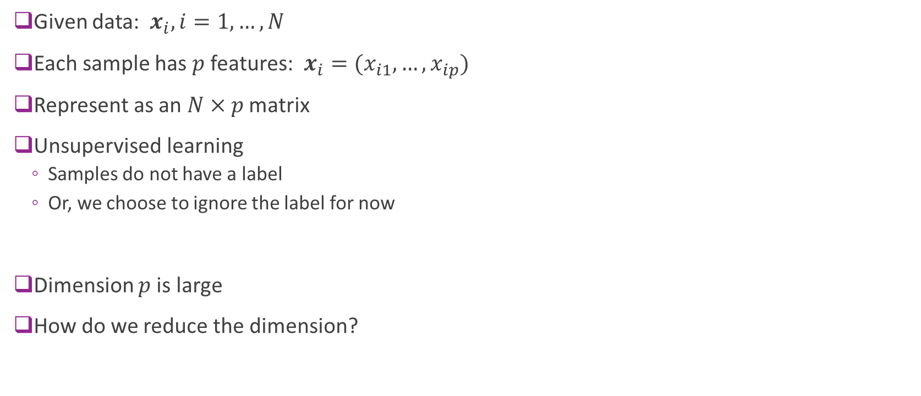
Data Definitions
Given data: $x_{i}, i=1,…,N$
Each sample has $p$ features: $x_{i}=(x_{i1},…,x_{ip})$
Represent as an $N×p$ matrix
Unsupervised learning
Samples do not have a label
Or, we choose to ignore the label for now
Dimension $p$is large
How do we reduce the dimension?

Slide 5
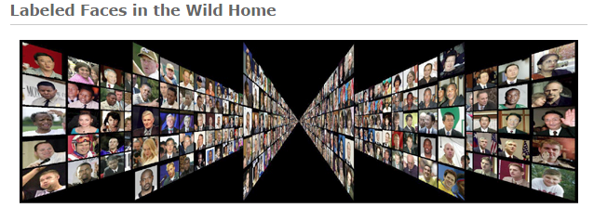
Example: Faces
Face images can be high-dimensional
We will use 50 x 37 = 1850 pixels
But, there may be few degrees of freedom
Can we reduce the dimensionality of this?
Data Labelled Faces in the Wild project
http://vis-www.cs.umass.edu/lfw
Large collection of faces (13000 images)
Taken from web articles about 10 years ago

Slide 6

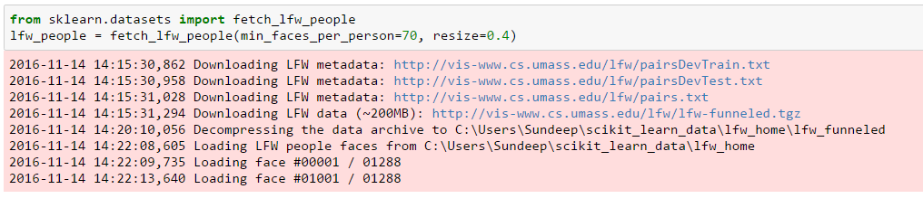
Loading the Data
Built-in routines to load data is sciket-learn
Can take several minutes the first time (Be patient)

Slide 7
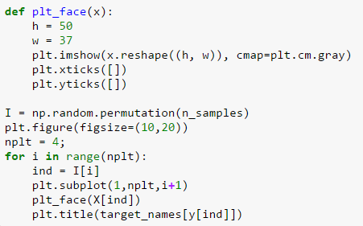
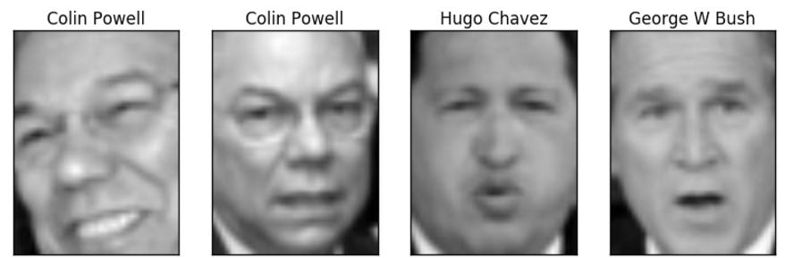
Plotting the Data
Some example faces
You may be too young to remember them all

Slide 8
Outline
Dimensionality reduction
Principal components and directions of variance
Approximation with PCs
Computing PCs via the SVD
Face example in python

Slide 9
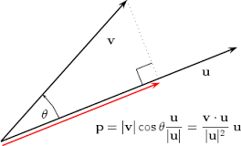




Projections
Given a vectors $z$ and $v$
Projection of $z$ onto $v$ is: $\hat{z}={\text{Proj}}_{v}\left(z\right)=αv, α= \frac{v^{T}z}{v^{T}v}=\frac{\left\|z\right\|}{\left\|v\right\|} cos θ$
Let $V=\left\{αv\right|α∈R\}$ = vectors on the line spanned by $v$
Theorem: ${\text{Proj}}_{v}\left(z\right)$ is closest point in $V$ to $z$: $\hat{z}=\arg{\min_{w∈V}{{\left\|z−w\right\|}^{2}}}$
$$z$$
$$v$$
$$\hat{z}$$

Slide 10
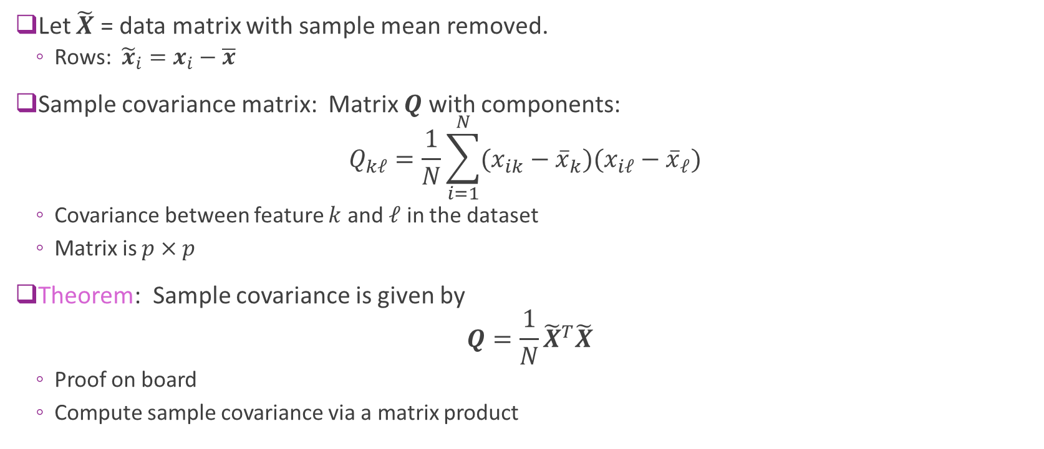
Sample Covariance Matrix
Let $\tilde{X}$ = data matrix with sample mean removed.
Rows: ${\tilde{x}}_{i}=x_{i}−\overline{x}$
Sample covariance matrix: Matrix $Q$ with components: $Q_{kℓ}=\frac{1}{N}\sum_{i=1}^{N}{(x_{ik}−{\overline{x}}_{k})(x_{iℓ}−{\overline{x}}_{ℓ})}$
Covariance between feature $k$ and $ℓ$ in the dataset
Matrix is $p×p$
Theorem: Sample covariance is given by $Q=\frac{1}{N}{\tilde{X}}^{T}\tilde{X}$
Proof on board
Compute sample covariance via a matrix product

Slide 11
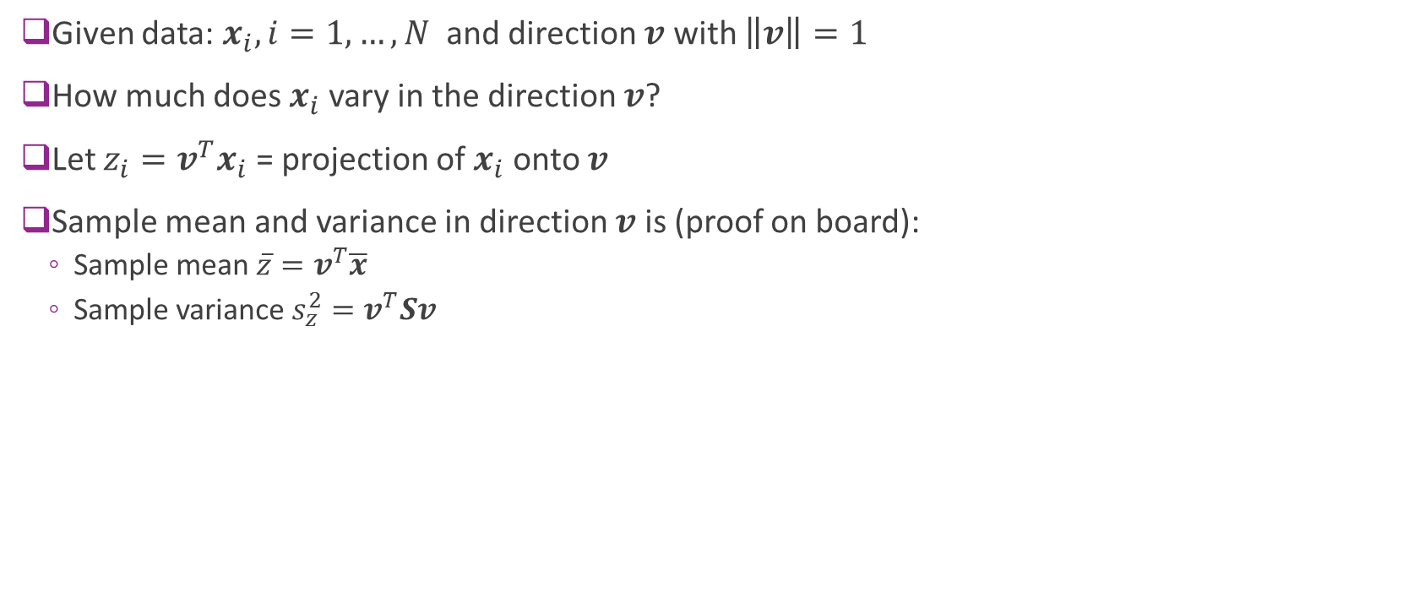
Directional Variance
Given data: $x_{i}, i=1,…,N$ and direction $v$ with $\left\|v\right\|=1$
How much does $x_{i}$ vary in the direction $v$?
Let $z_{i}=v^{T}x_{i}$ = projection of $x_{i}$ onto $v$
Sample mean and variance in direction $v$ is (proof on board):
Sample mean $\overline{z}=v^{T}\overline{x}$
Sample variance $s_{z}^{2}=v^{T}Sv$

Slide 12
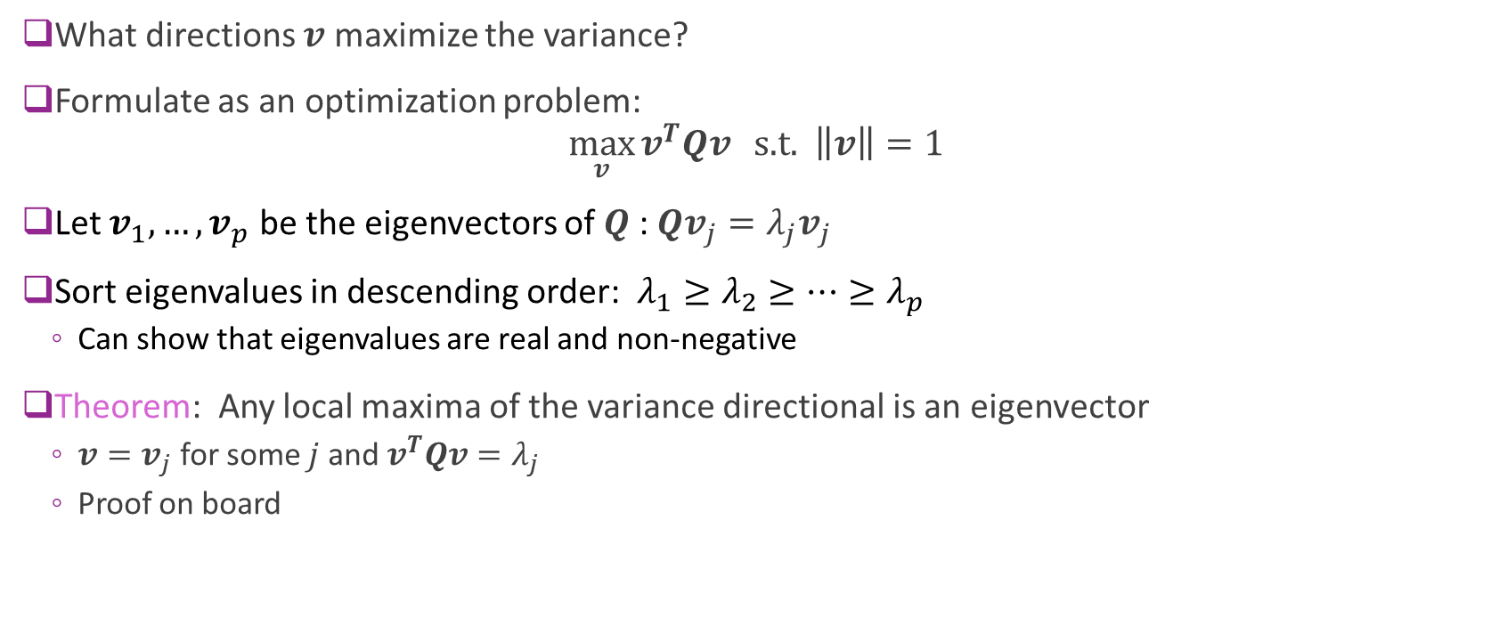
Maximizing Directional Variance
What directions $v$ maximize the variance?
Formulate as an optimization problem: $\max_{v}{v^{T}Qv} \text{s}\text{.}\text{t}\text{. } \left\|v\right\|=1$
Let $v_{1},…,v_{p}$ be the eigenvectors of $Q$ : $Qv_{j}=λ_{j}v_{j}$
Sort eigenvalues in descending order: $λ_{1}≥λ_{2}≥…≥λ_{p}$
Can show that eigenvalues are real and non-negative
Theorem: Any local maxima of the variance directional is an eigenvector
$v=v_{j}$ for some $j$ and $v^{T}Qv=λ_{j}$
Proof on board

Slide 13
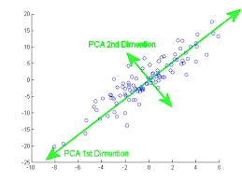
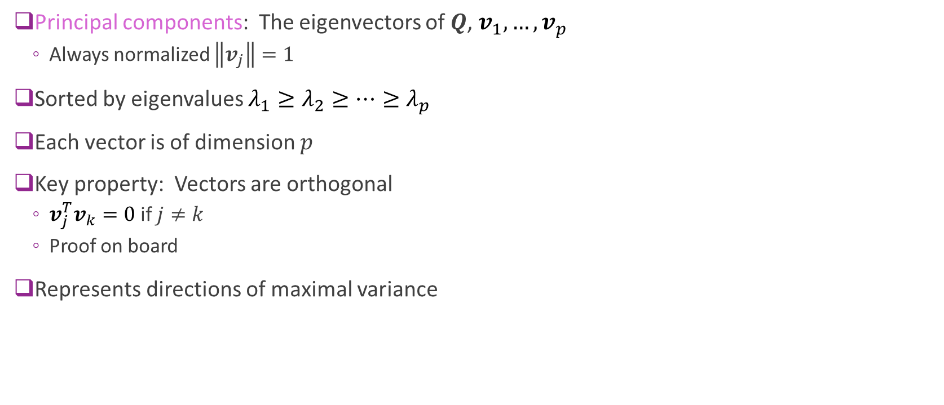
Principal Components
Principal components: The eigenvectors of $Q$, $v_{1},…,v_{p}$
Always normalized $\left\|v_{j}\right\|=1$
Sorted by eigenvalues $λ_{1}≥λ_{2}≥…≥λ_{p}$
Each vector is of dimension $p$
Key property: Vectors are orthogonal
$v_{j}^{T}v_{k}=0$ if $j≠k$
Proof on board
Represents directions of maximal variance

Slide 14
Outline
Dimensionality reduction
Principal components and directions of variance
Approximation with PCs
Computing PCs via the SVD
Face example in python

Slide 15
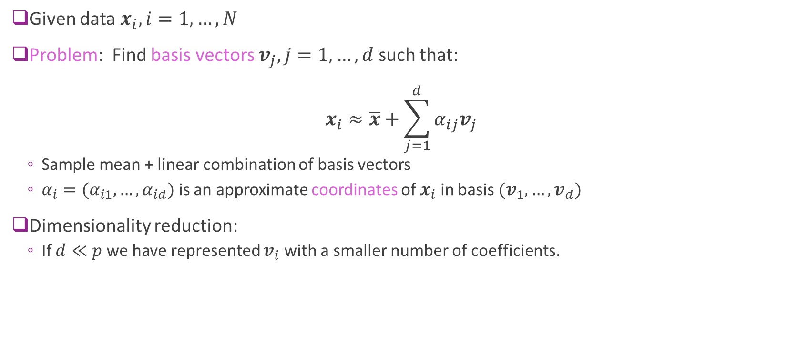
Low-Dimensional Representations
Given data $x_{i}, i=1,…,N$
Problem: Find basis vectors $v_{j}, j=1,…,d$ such that: $x_{i}≈\overline{x}+\sum_{j=1}^{d}{α_{ij}v_{j}}$
Sample mean + linear combination of basis vectors
$α_{i}=(α_{i1},…,α_{id})$ is an approximate coordinates of $x_{i}$ in basis $(v_{1},…,v_{d})$
Dimensionality reduction:
If $d≪p$ we have represented $v_{i}$ with a smaller number of coefficients.

Slide 16
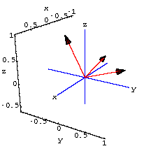
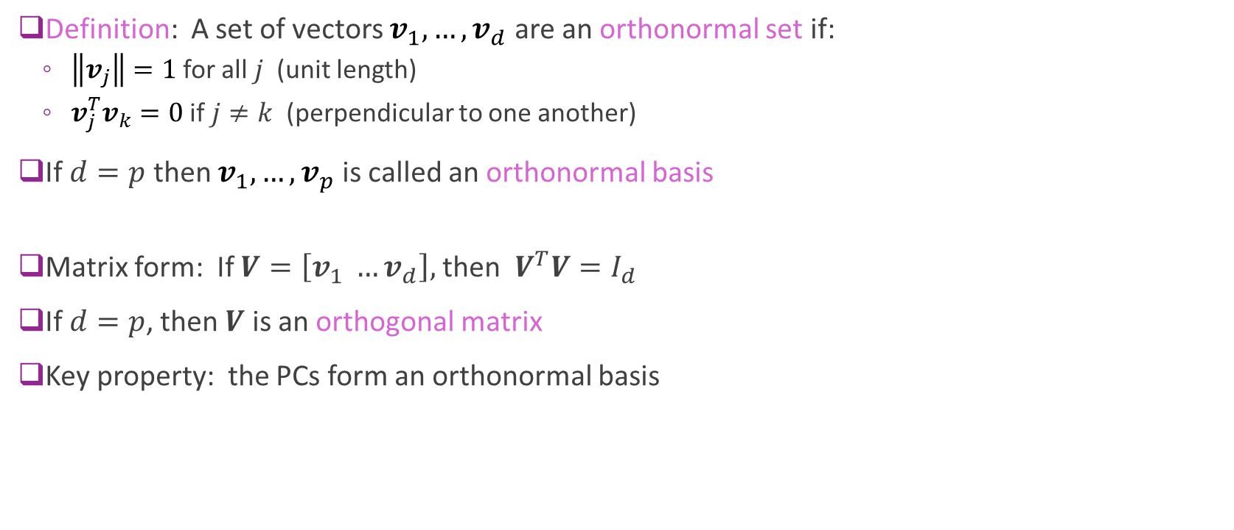
Orthonormal Sets and Bases
Definition: A set of vectors $v_{1},…,v_{d}$ are an orthonormal set if:
$\left\|v_{j}\right\|=1$ for all $j$ (unit length)
$v_{j}^{T}v_{k}=0$ if $j≠k$ (perpendicular to one another)
If $d=p$ then $v_{1},…,v_{p}$ is called an orthonormal basis
Matrix form: If $V=\left[v_{1} …v_{d}\right],$ then $V^{T}V=I_{d}$
If $d=p$, then $V$ is an orthogonal matrix
Key property: the PCs form an orthonormal basis

Slide 17

Coefficients in an Orthonormal Basis
Suppose $v_{1},…,v_{p}$ is an orthonormal basis
Given a vector $z$, can write $z=\sum_{j=1}^{p}{α_{j}v_{j}}, α_{j}=v_{j}^{T}z$
Simple expression for computing coefficients in an orthonormal basis
Matrix form: $α=V^{T}z, z=Vα$

Slide 18

Approximating the Data Matrix
Given data $x_{i}, i=1,…,N$
Let $v_{1},…,v_{p}$ be the PCs
Find coefficient expansion of each data sample: $x_{i}=\overline{x}+\sum_{j=1}^{p}{α_{ij}v_{j}}, α_{ij}=v_{j}^{T}(x_{i}−\overline{x})$
Now consider approximation with $d$ coefficients: ${\hat{x}}_{i}=\overline{x}+\sum_{j=1}^{d}{α_{ij}v_{j}}$

Slide 19

Average Approximation Error
Let ${\hat{x}}_{i}$ = approximation with $d$ PCs
Error in sample $i$: $x_{i}−{\hat{x}}_{i}=\sum_{j=d+1}^{p}{α_{ij}v_{j}}$
Theorem: Average error with a $d$ PC approximation is: $\frac{1}{N}\sum_{i=1}^{N}{{\left\|x_{i}−{\hat{x}}_{i}\right\|}^{2}}=\sum_{j=d+1}^{p}{λ_{j}}$
Sum of the smallest $p−d$ eigenvalues

Slide 20
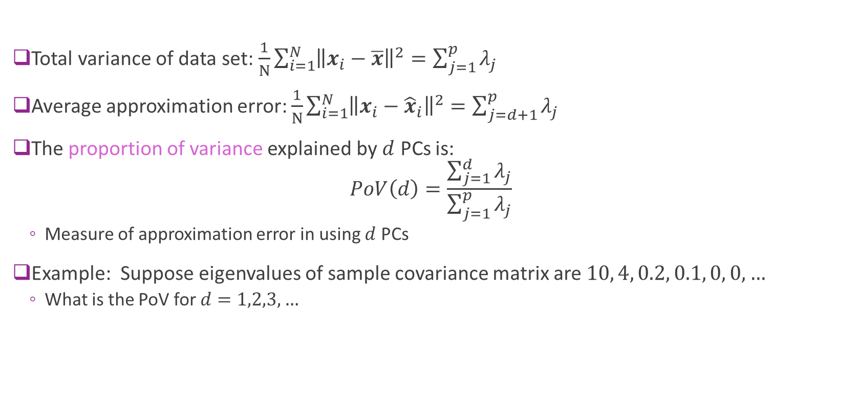
Proportion of Variance (PoV)
Total variance of data set: $\frac{1}{N}\sum_{i=1}^{N}{{\left\|x_{i}−\overline{x}\right\|}^{2}}=\sum_{j=1}^{p}{λ_{j}}$
Average approximation error: $\frac{1}{N}\sum_{i=1}^{N}{{\left\|x_{i}−{\hat{x}}_{i}\right\|}^{2}}=\sum_{j=d+1}^{p}{λ_{j}}$
The proportion of variance explained by $d$ PCs is: $PoV\left(d\right)=\frac{\sum_{j=1}^{d}{λ_{j}}}{\sum_{j=1}^{p}{λ_{j}}}$
Measure of approximation error in using $d$ PCs
Example: Suppose eigenvalues of sample covariance matrix are $10, 4, 0.2, 0.1, 0, 0, …$
What is the PoV for $d=1,2,3, …$

Slide 21
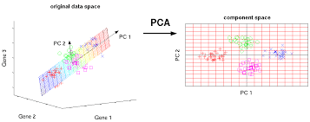
Visualizing the Representation
Finds a low-dimensional representation

Slide 22
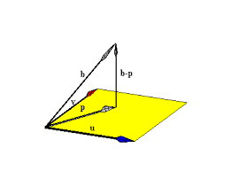
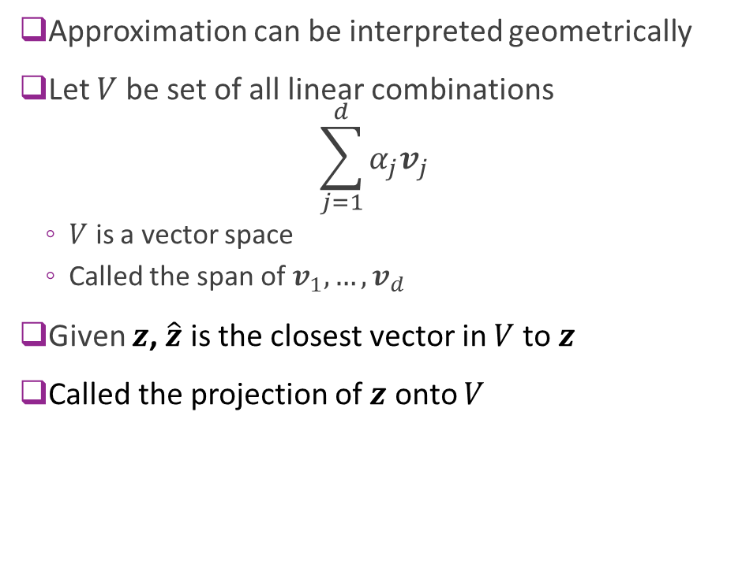




Geometry of Approximations
Approximation can be interpreted geometrically
Let $V$ be set of all linear combinations $\sum_{j=1}^{d}{α_{j}v_{j}}$
$V$ is a vector space
Called the span of $v_{1},…,v_{d}$
Given $z$, $\hat{z}$ is the closest vector in $V$ to $z$
Called the projection of $z$ onto $V$
$$z$$
$$z−\hat{z}$$
$$\hat{z}$$
Space spanned by $v_{1},…,v_{d}$

Slide 23
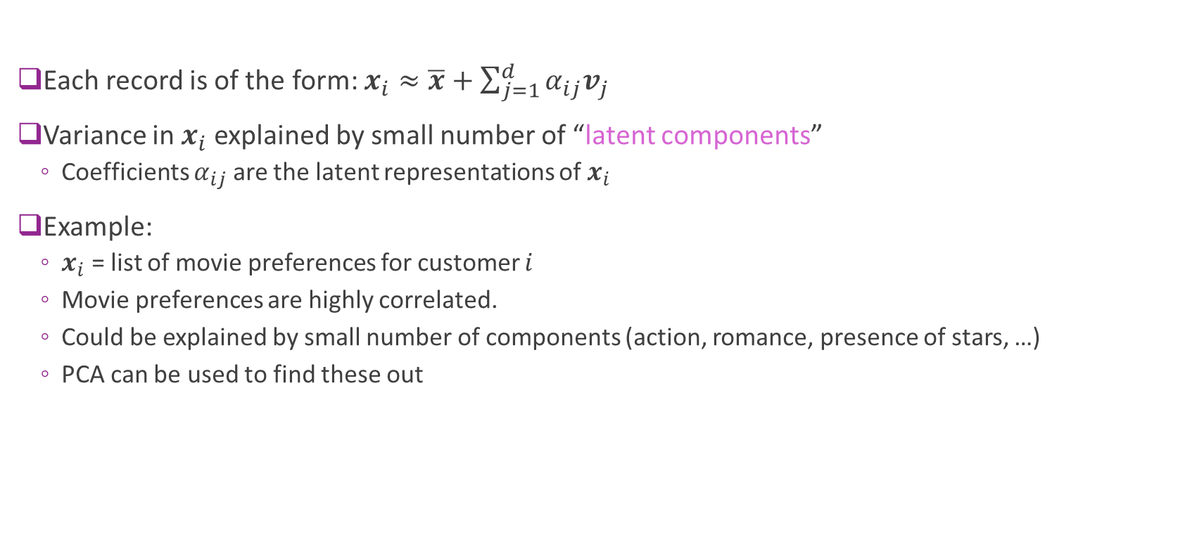
Latent Representations
Each record is of the form: $x_{i}≈\overline{x}+\sum_{j=1}^{d}{α_{ij}v_{j}}$
Variance in $x_{i}$ explained by small number of “latent components”
Coefficients $α_{ij}$ are the latent representations of $x_{i}$
Example:
$x_{i}$ = list of movie preferences for customer $i$
Movie preferences are highly correlated.
Could be explained by small number of components (action, romance, presence of stars, …)
PCA can be used to find these out

Slide 24
Example: USArrests
Arrests per capita in four categories
One record per US state
Visualize PCA in a biplot
See the scores (i.e. coefficients of each state)
Loading (PC vectors)
Fig from ISL 10.1

Slide 25
Outline
Dimensionality reduction
Principal components and directions of variance
Approximation with PCs
Computing PCs via the SVD
Face example in python

Slide 26

Singular Value Decomposition
Given matrix $A∈R^{M×N}$
SVD is $A=USV^{T}$, where
$U∈R^{M×r}, U^{T}U=I_{r}$
$V∈R^{N×r}, V^{T}V=I_{r}$
$S=\text{diag}(s_{1},…,s_{r})$, sorted $s_{1}≥s_{2}≥⋯≥s_{r}≥0$ . Called the singular values
All matrices have an SVD
Number of singular values $r≤\min{(M,N)}$

Slide 27

Computing the PCA via SVD
Let $\tilde{X}$ = data matrix with sample mean removed.
Take SVD: $\tilde{X}={USV}^{T}$
Properties:
Sample covariance matrix is $Q=\frac{1}{N}{\tilde{X}}^{T}\tilde{X}=\frac{1}{N}VS^{2}V^{T}$
Eigenvalues are $λ_{j}={s_{j}^{2}}/N$
PCs are $v_{j},$ columns of $V$
Coefficients are $α=\tilde{X}V=US$

Slide 28
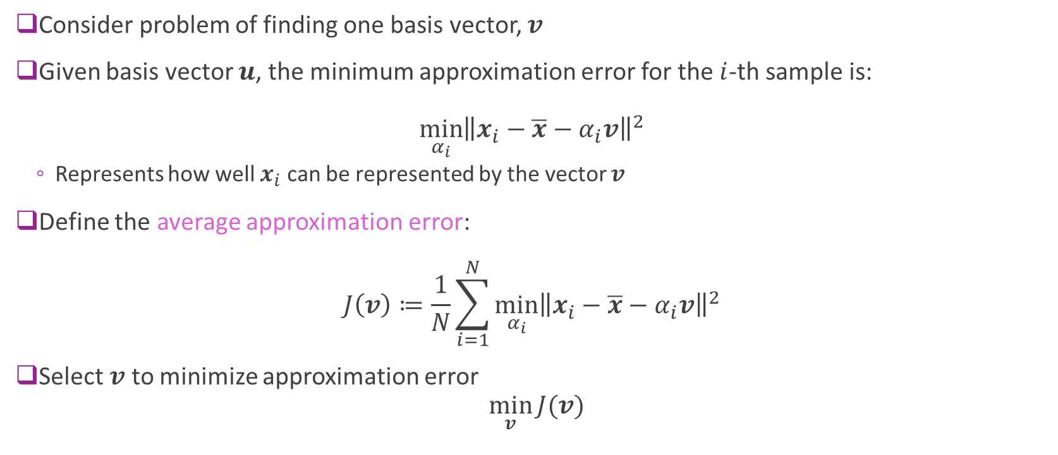
Finding the Basis Vectors
Consider problem of finding one basis vector, $v$
Given basis vector $u$, the minimum approximation error for the $i$-th sample is: $\min_{α_{i}}{{\left\|x_{i}−\overline{x}−α_{i}v\right\|}^{2}}$
Represents how well $x_{i}$ can be represented by the vector $v$
Define the average approximation error: $J\left(v\right)≔\frac{1}{N}\sum_{i=1}^{N}{\min_{α_{i}}{{\left\|x_{i}−\overline{x}−α_{i}v\right\|}^{2}}}$
Select $v$ to minimize approximation error $\min_{v}{J(v)}$

Slide 29
Outline
Dimensionality reduction
Principal components and directions of variance
Approximation with PCs
Computing PCs via the SVD
Face example in python

Slide 30
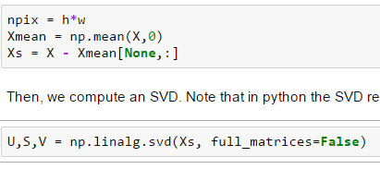
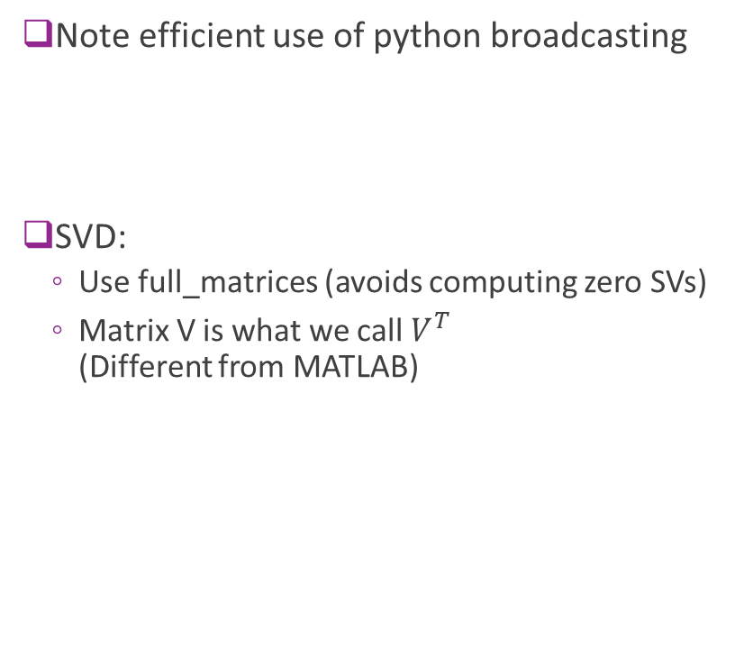
Computing the SVD
Note efficient use of python broadcasting
SVD:
Use full_matrices (avoids computing zero SVs)
Matrix V is what we call $V^{T}$ (Different from MATLAB)

Slide 31
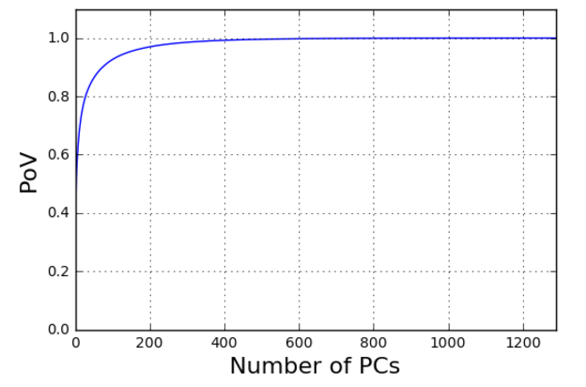
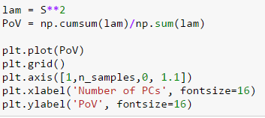
Finding the PoV
Most variance explained in about 400 components
Some reduction

Slide 32
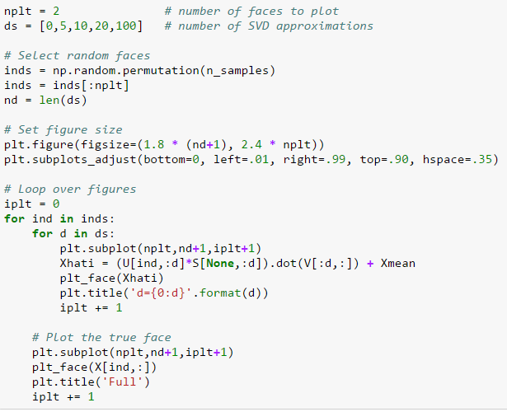
Plotting Approximations
Selection of figure sizes for subplot
Note: Efficient computing of approx

Slide 33
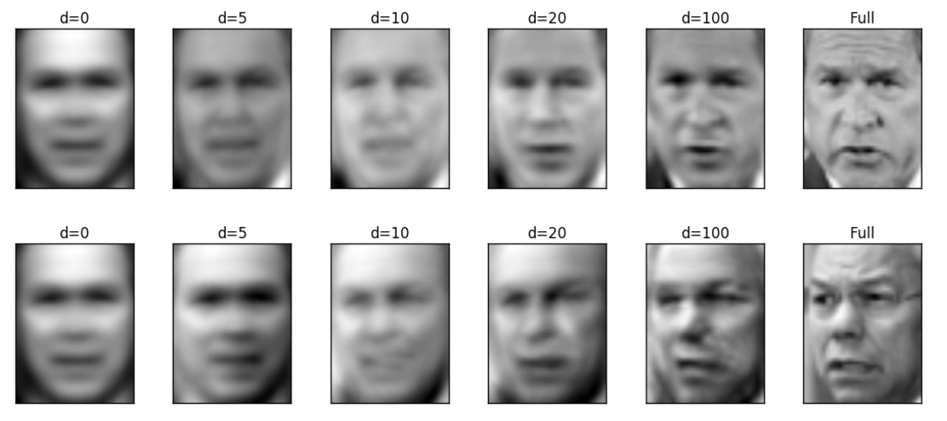
Plotting the Approximations

Slide 34
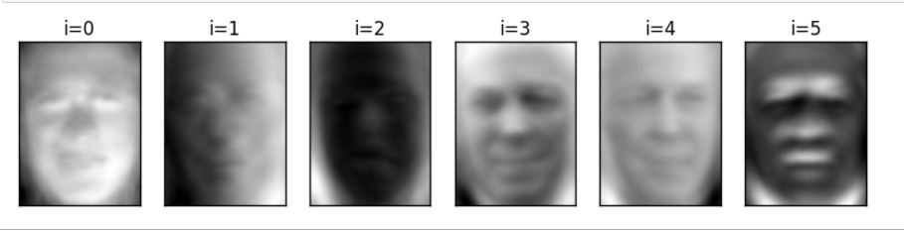
Plotting the PCs
The PCs can be plotted as well

Slide 35
Other Considerations
Normalization: For most data, it is essential to standardize before computing PC
Otherwise, components with large values dominate small ones
Sklearn has built in PCA routine (will explore in lab)
Some texts do not subtract mean
Will be picked up as one of the PCs

Slide 36





State-of-the-Art: Auto-Encoders
PCA is a simple example of an autoencoder
Tries to find low-dim representation
Restricted to linear transforms
Not very good for images and complex data
$$α=V^{T}x$$
$$\hat{x}=Vα$$
$$x$$
High-dim object
$$α$$ Low-dim representation
$$\hat{x}$$
Approximation

Slide 37
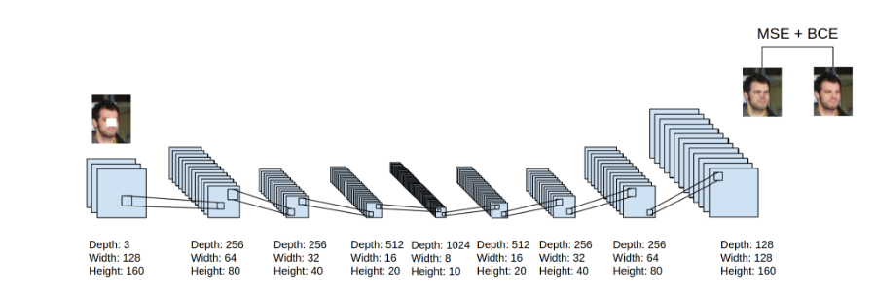
Deep Auto-Encoders
Can use deep networks for learning complex latent representations and their inverses
http://www.cc.gatech.edu/~hays/7476/projects/Avery_Wenchen/
https://swarbrickjones.wordpress.com/2016/01/13/enhancing-images-using-deep-convolutional-generative-adversarial-networks-dcgans/ (Code in Theano not tensorflow)

