Slide 1
Lecture 12 Clustering, K-Means and EM
EE-uy 4563/El-GY 9123: Introduction to machine learning
Prof. Sundeep rangan

Slide 2
Outline
Motivating Example: Document clustering
K-means
K-means for document clustering
Latent semantic analysis
Gaussian Mixture models (GMMs)
Expectation Maximization (EM) fitting of GMMs
Convergence of EM

Slide 3

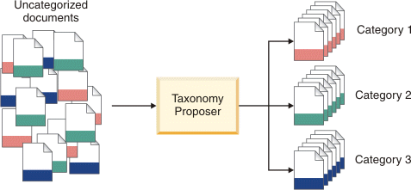
Document Clustering
Data mining
Often have huge numbers of documents
How can we organize this?
Key idea: documents are often in clusters
Can we detect these clusters?
Can be a lucrative service
See IBM service to left

Slide 4
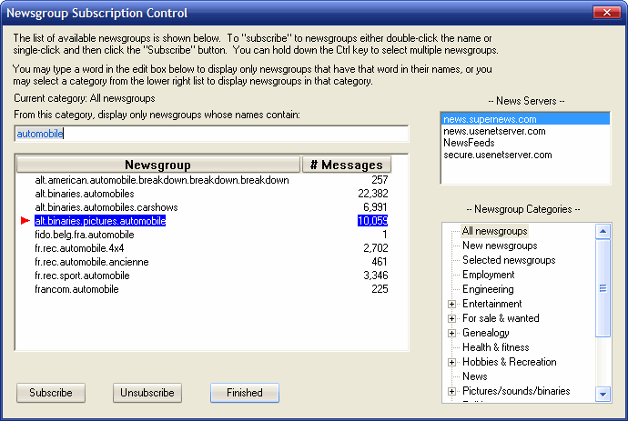
UseNet Newsgroups
Began in late 1970s
Discussion groups for various topics
Started on early university networks
Migrated to Internet
Peaked in 1990s
Useful for studying clustering
Simple documents
“ground truth”: Docs have categories

Slide 5
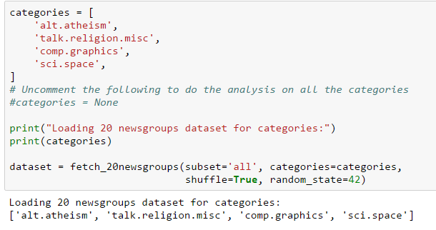
Loading the Data
See demo_doc_cluster.ipynb
Taken from http://scikit-learn.org/stable/auto_examples/text/document_clustering.html
Newsgroups built into sklearn

Slide 6
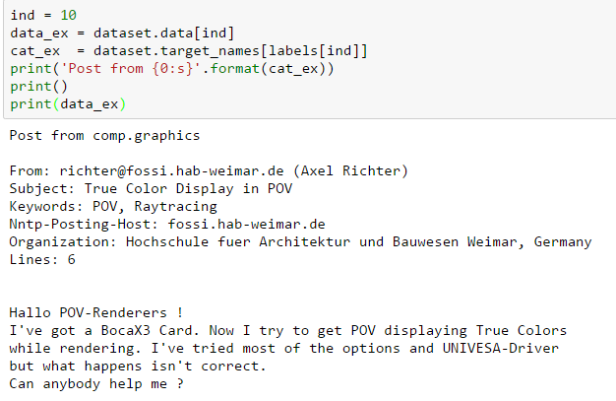
A Typical Newsgroup Post
Data for the posts are in:
Dataset.data
Dataset.labels
Dataset.target_names

Slide 7
Outline
Motivating Example: Document clustering
K-means
K-means for document clustering
Latent semantic analysis
Gaussian Mixture models (GMMs)
Expectation Maximization (EM) fitting of GMMs
Convergence of EM

Slide 8
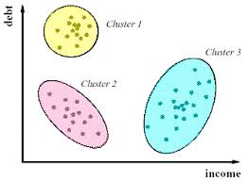
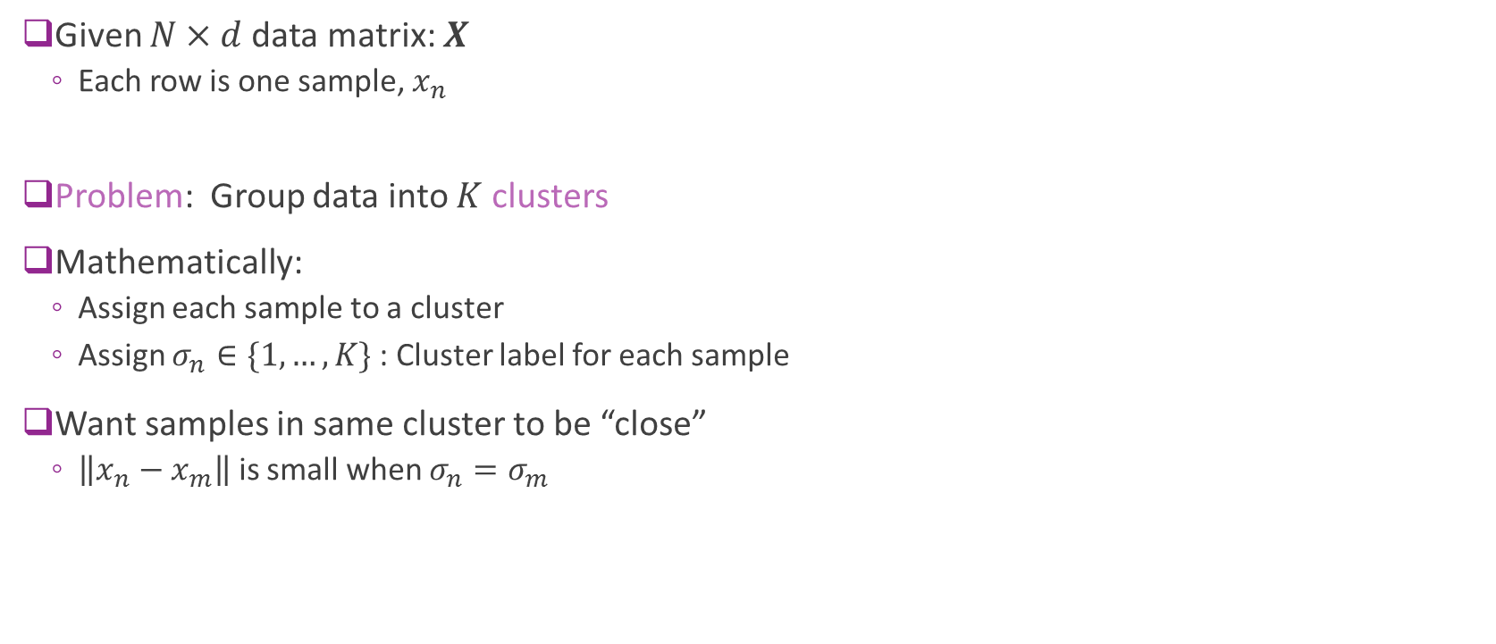
Clustering
Given $N×d$data matrix: $X$
Each row is one sample, $x_{n}$
Problem: Group data into $K$ clusters
Mathematically:
Assign each sample to a cluster
Assign $σ_{n}∈\{1,…, K\}$ : Cluster label for each sample
Want samples in same cluster to be “close”
$\left\|x_{n}−x_{m}\right\|$ is small when $σ_{n}=σ_{m}$

Slide 9
Clustering
Clustering has many applications
Any time you want to segment data
Uncovering latent discrete variables
Examples:
Segmenting sections of an image
Segmenting customers in market data
From: Market segmentation possibilities in the tourism market context of South Africa

Slide 10
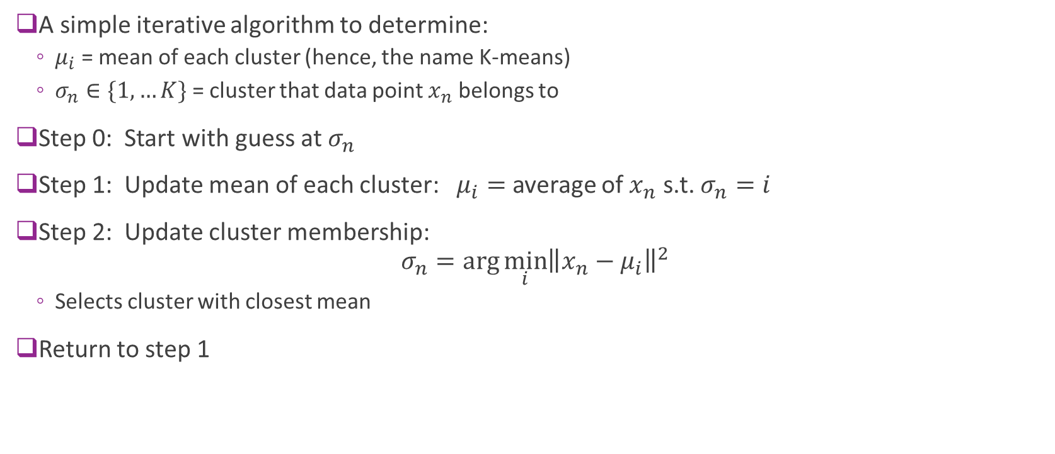
K-means
A simple iterative algorithm to determine:
$μ_{i}$ = mean of each cluster (hence, the name K-means)
$σ_{n}∈\{1,…K\}$ = cluster that data point $x_{n}$ belongs to
Step 0: Start with guess at $σ_{n}$
Step 1: Update mean of each cluster: $μ_{i}=$ average of $x_{n}$ s.t. $σ_{n}=i$
Step 2: Update cluster membership: $σ_{n}=\arg{\min_{i}{{\left\|x_{n}−μ_{i}\right\|}^{2}}}$
Selects cluster with closest mean
Return to step 1

Slide 11
K-Means illustrated
From Bishop, Chapter 9.
K-Means on “old faithful” data set

Slide 12
Image Segmentation
Also from Bishop.
Use K-means on the RGB values (dimension = 3)

Slide 13
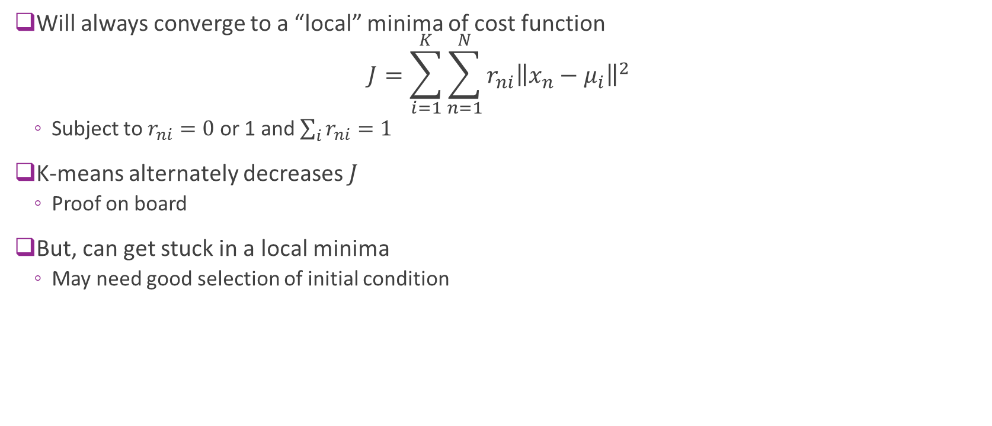
Convergence
Will always converge to a “local” minima of cost function $J=\sum_{i=1}^{K}{\sum_{n=1}^{N}{r_{ni}{\left\|x_{n}−μ_{i}\right\|}^{2}}}$
Subject to $r_{ni}=0$or 1 and $\sum_{i}{r_{ni}=1}$
K-means alternately decreases $J$
Proof on board
But, can get stuck in a local minima
May need good selection of initial condition

Slide 14

Distance measures
Distance measures
How do measure similarity between samples?
Above algorithms used squared distance $\left\|x_{n}−x_{m}\right\|$
Many possibilities
How to represent data as a vector?
Should you normalize entries?
What distance metric should you use?

Slide 15
Initialization
Initialization:
Final limit of K-means depends on initial condition
May obtain poor clustering with bad initial condition
Possible solutions:
K-means++: http://ilpubs.stanford.edu:8090/778/1/2006-13.pdf
Provides good initial condition based on data
Multiple initial starts

Slide 16
Outline
Motivating Example: Document clustering
K-means
K-means for document clustering
Latent semantic analysis
Gaussian Mixture models (GMMs)
Expectation Maximization (EM) fitting of GMMs
Convergence of EM

Slide 17
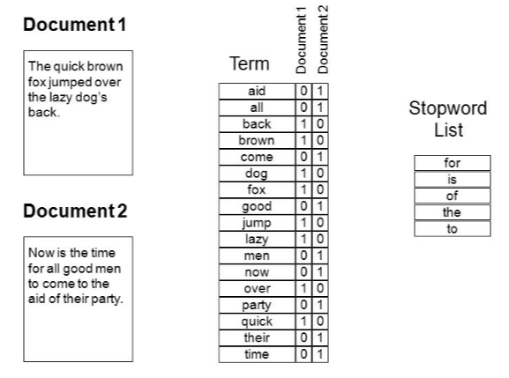
Bag of Words
Document is natively text
Must represent as a numeric vector
Represent by word counts
Enumerate all words
Each document is count of frequencies
Stopwords

Slide 18
Discussion Questions
Is the absolute number of times a word appears the correct metric?
What about the length of the document?
What about the frequency of the word?
What words “matter”?

Slide 19
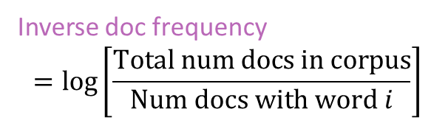

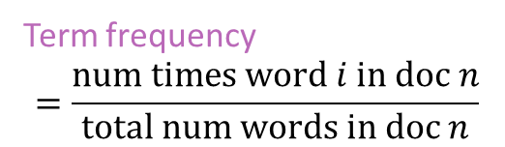
Term Frequency – Inverse Document Frequency
Use TF-IDF weight for vectors: $X[n,i]= TF_{i,n} × IDF_{i}$
Document weight vector
Term frequency
$$=\frac{\text{num} \text{times} \text{word} i \text{in} \text{doc} n}{\text{total} \text{num} \text{words} \text{in} \text{doc} n}$$
Inverse doc frequency
$$=\log\left[\frac{Total num docs in corpus}{Num docs with word i}\right]$$

Slide 20
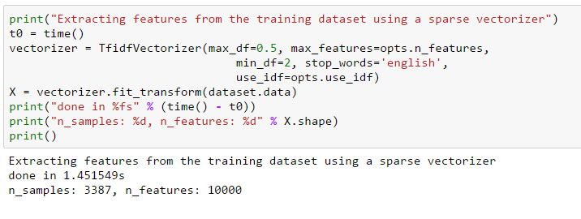
Computing TF-IDF in Python
Can compute the TF-IDF using sklearn functions

Slide 21
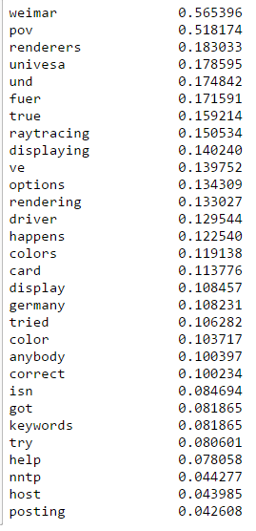
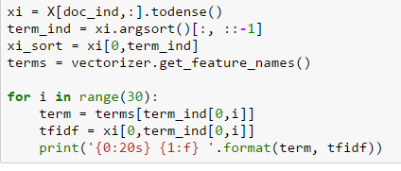
Typical TF-IDF scores
Code to display terms with highest scores

Slide 22
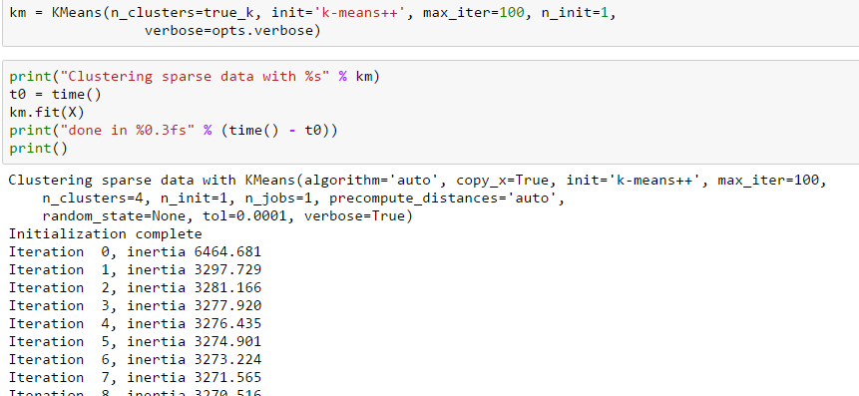
Running K-Means
Use Python built-in function

Slide 23
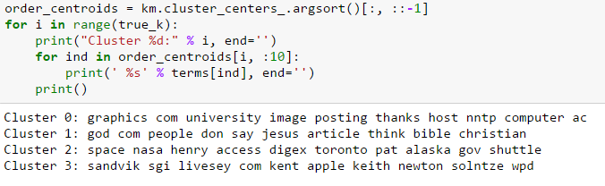
Plotting the Results
Most important words in each cluster
Highest weights in cluster centers

Slide 24
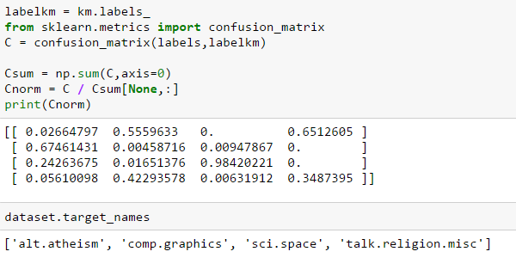
Confusion Matrix
Estimated clusters vs. true categories
Can you see where it got confused?

Slide 25
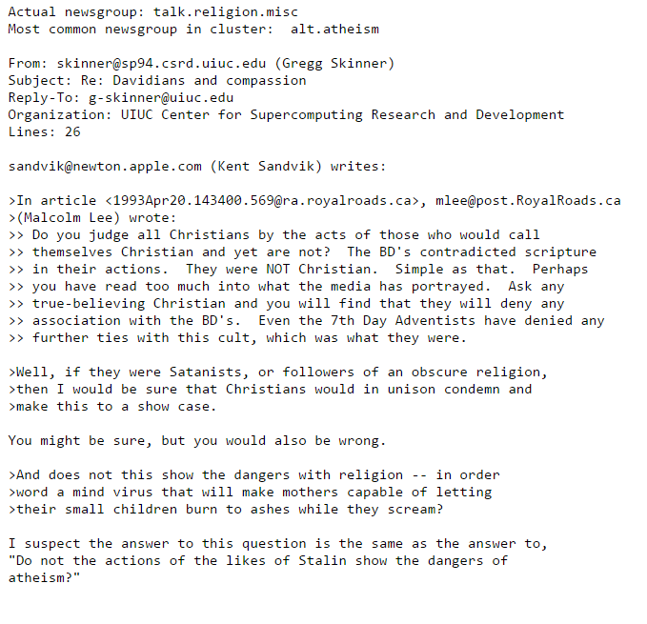
An Example “Wrong” cluster
Post is from talk.religion.misc
Placed in cluster with mostly alt.atheism

Slide 26
Outline
Motivating Example: Document clustering
K-means
K-means for document clustering
Latent semantic analysis
Gaussian Mixture models (GMMs)
Expectation Maximization (EM) fitting of GMMs
Convergence of EM

Slide 27




Need for Dimensionality Reduction
Term-document matrix $X$ is large
$N=$ document $×M$ words in vocabulary
$M$ is large
Can be ${10}^{6}$ in commercial systems
Document represented by long sparse vector
Inefficient
Need dimensionality reduction
Words $M$
Documents $N$
$$X$$

Slide 28





Latent Semantic Analysis
LSA = PCA on term-document matrix
$X≈USV^{T}=AV^{T}, A=US$
$U,S,V^{T}$ computed by low-rank SVD
Words $M$
“Features” $K$
Words $M$
Words $M$
$$V^{T}$$
Documents $N$
=
$$A$$
$$X$$

Slide 29
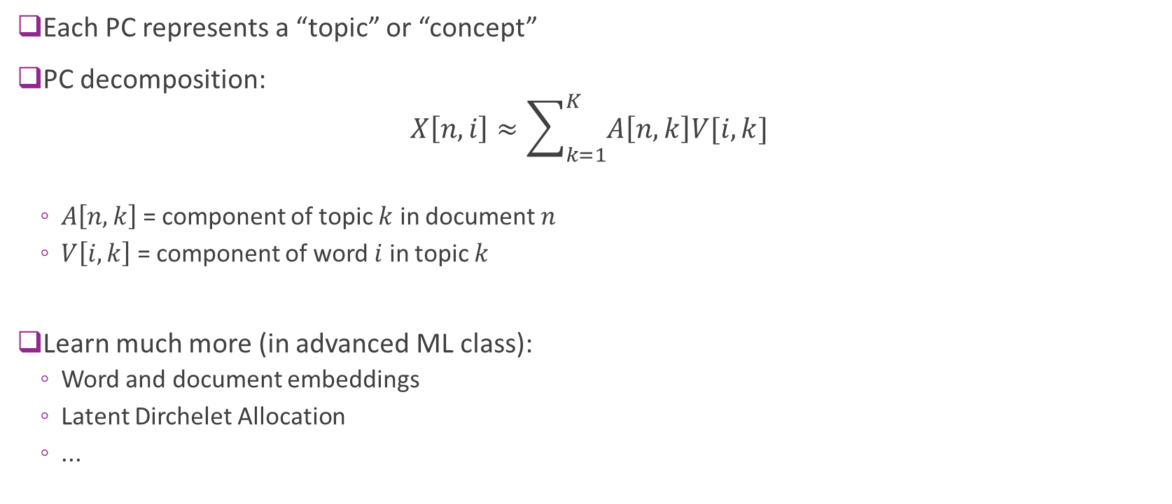
LSA Interpretation
Each PC represents a “topic” or “concept”
PC decomposition: $X\left[n,i\right]≈\sum_{k=1}^{K}{A\left[n,k\right]V[i,k]}$
$A\left[n,k\right]$ = component of topic $k$ in document $n$
$V\left[i,k\right]$ = component of word $i$ in topic $k$
Learn much more (in advanced ML class):
Word and document embeddings
Latent Dirchelet Allocation
...

Slide 30


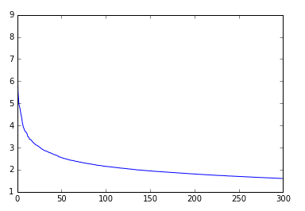
Perform LSA on NewsGroup
Use sparse SVD
Much faster
Concentration of variance in small number of PCs
More interesting results in larger corpi

Slide 31
Outline
Motivating Example: Document clustering
K-means
K-means for document clustering
Latent semantic analysis
Gaussian Mixture models (GMMs)
Expectation Maximization (EM) fitting of GMMs
Convergence of EM

Slide 32
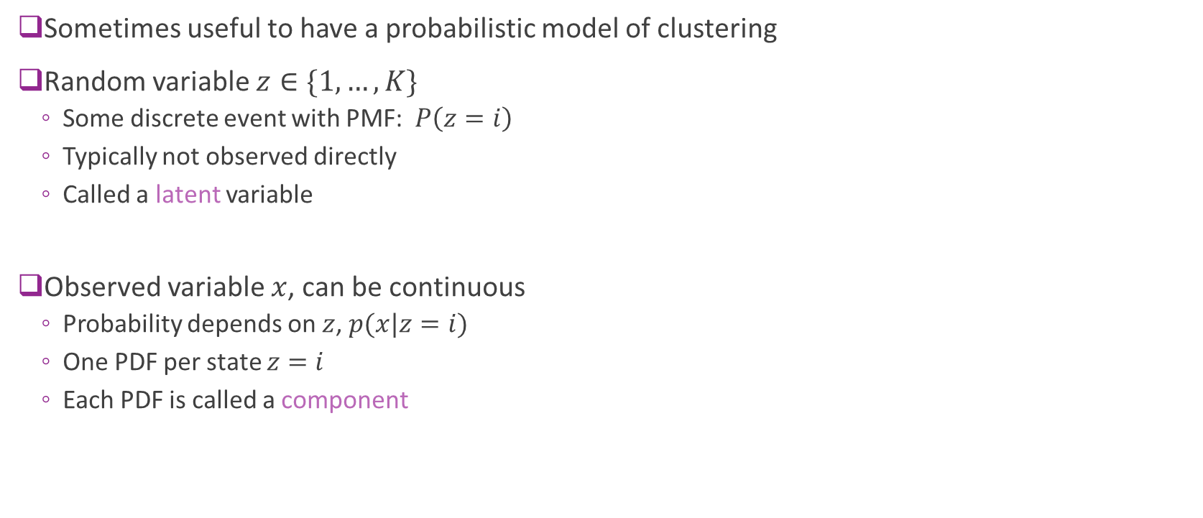
Mixture Models
Sometimes useful to have a probabilistic model of clustering
Random variable $z∈\{1,…,K\}$
Some discrete event with PMF: $P\left(z=i\right)$
Typically not observed directly
Called a latent variable
Observed variable $x$, can be continuous
Probability depends on $z$, $p(x|z=i)$
One PDF per state $z=i$
Each PDF is called a component

Slide 33
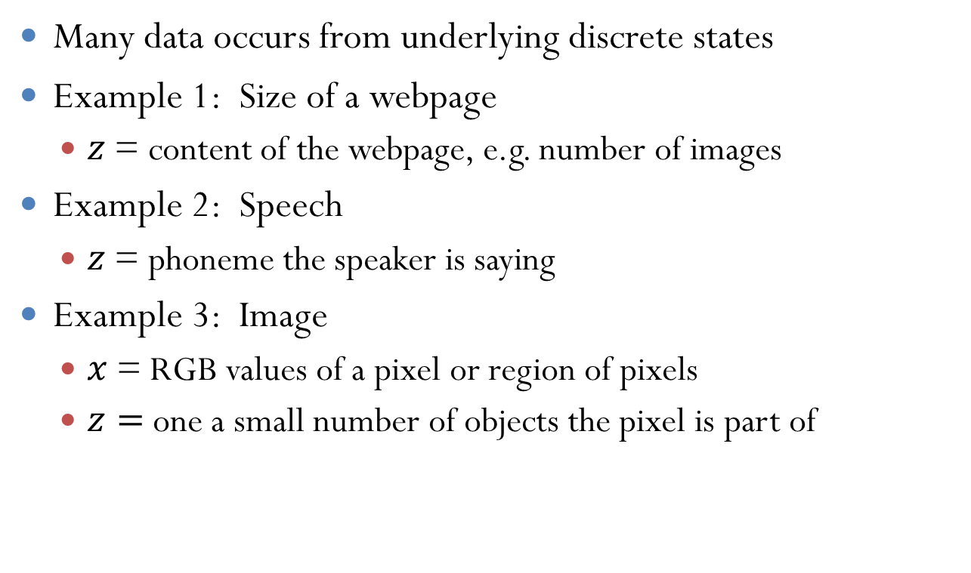
Examples
Many data occurs from underlying discrete states
Example 1: Size of a webpage
$z$ = content of the webpage, e.g. number of images
Example 2: Speech
$z$= phoneme the speaker is saying
Example 3: Image
$x$ = RGB values of a pixel or region of pixels
$z=$one a small number of objects the pixel is part of

Slide 34
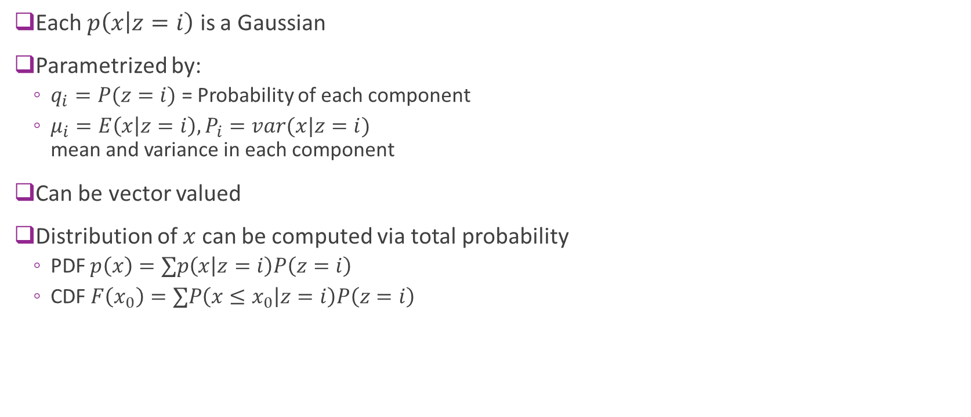
Gaussian Mixture Models
Each $p\left(x | z=i\right)$ is a Gaussian
Parametrized by:
$q_{i}=P(z=i)$ = Probability of each component
$μ_{i}=E\left(x | z=i\right), P_{i}=var(x|z=i)$ mean and variance in each component
Can be vector valued
Distribution of $x$ can be computed via total probability
PDF $p\left(x\right)=∑p\left(x | z=i\right)P\left(z=i\right)$
CDF $F\left(x_{0}\right)=∑P\left({x≤x}_{0} | z=i\right)P\left(z=i\right)$

Slide 35
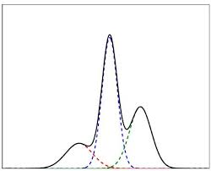
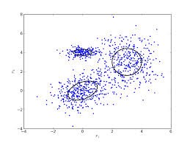
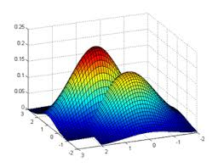
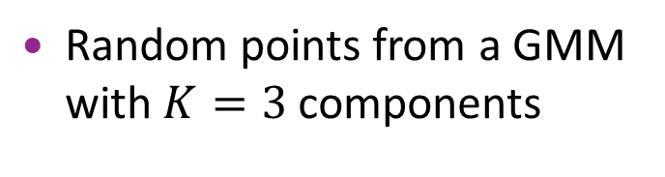

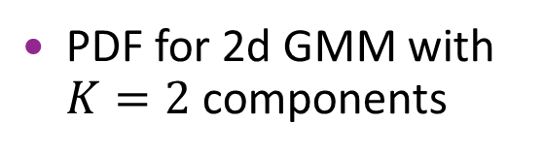
Visualizing GMMs
1d model with $K=3$ components
PDF for 2d GMM with $K=2$ components
Random points from a GMM with $K=3$ components

Slide 36
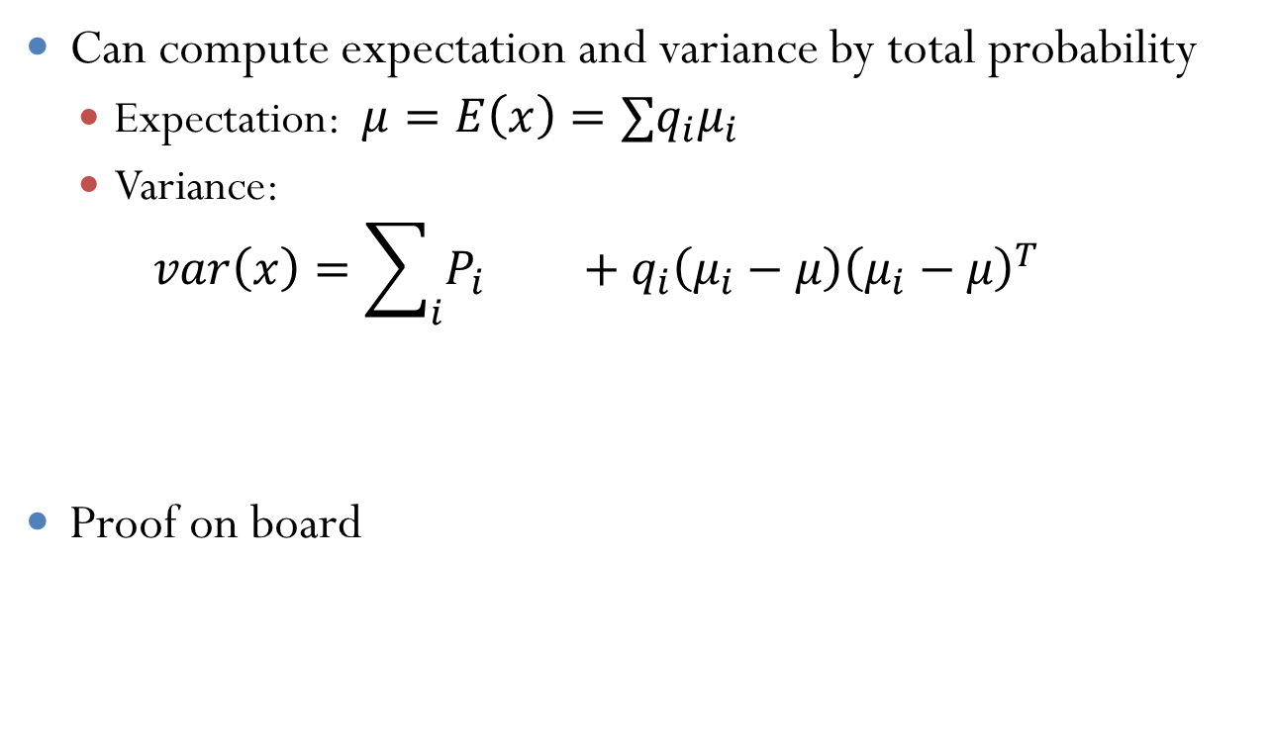
Expectation and Variance
Can compute expectation and variance by total probability
Expectation: $μ=E\left(x\right)=∑q_{i}μ_{i}$
Variance: $var\left(x\right)=\sum_{i}{P_{i} +q_{i}\left(μ_{i}−μ\right){\left(μ_{i}−μ\right)}^{T}}$
Proof on board
Variance within component
Variance between components

Slide 37
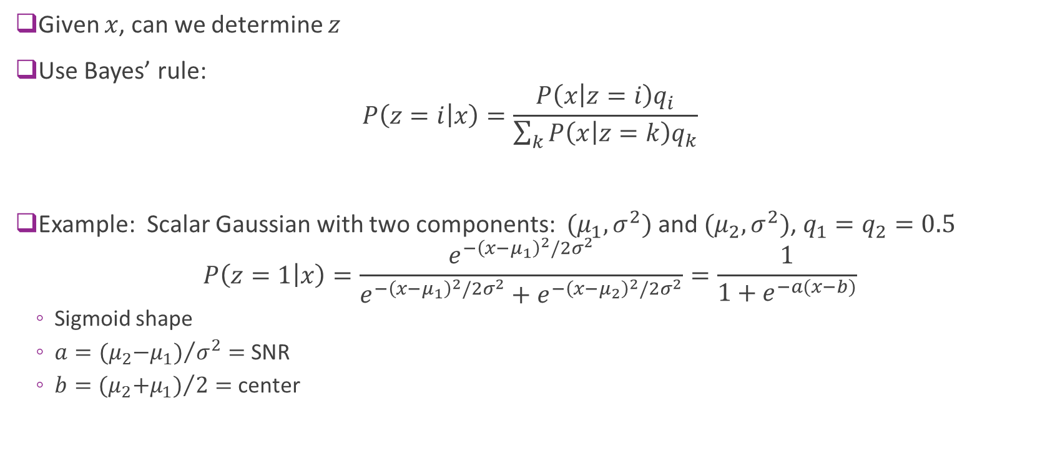
Determining the Component
Given $x$, can we determine $z$
Use Bayes’ rule: $P\left(z=i | x\right)=\frac{P\left(x | z=i\right)q_{i}}{\sum_{k}{P\left(x | z=k\right)q_{k}}}$
Example: Scalar Gaussian with two components: $(μ_{1},σ^{2})$ and $(μ_{2},σ^{2})$, $q_{1}=q_{2}=0.5$ $P\left(z=1 | x\right)=\frac{e^{−{\left(x−μ_{1}\right)}^{2}/2σ^{2}}}{e^{−{\left(x−μ_{1}\right)}^{2}/2σ^{2}}+e^{−{\left(x−μ_{2}\right)}^{2}/2σ^{2}}}=\frac{1}{1+e^{−a(x−b)}}$
Sigmoid shape
$a={{(μ}_{2}−μ_{1})}/{σ^{2}}=$ SNR
$b={{(μ}_{2}+μ_{1})}/2=$ center

Slide 38
Outline
Motivating Example: Document clustering
K-means
K-means for document clustering
Latent semantic analysis
Gaussian Mixture models (GMMs)
Expectation Maximization (EM) fitting of GMMs
Convergence of EM

Slide 39
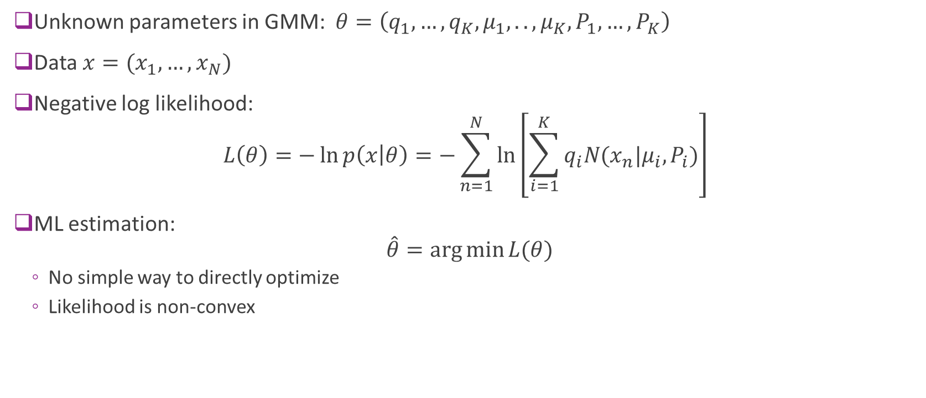
Maximum Likelihood Estimation
Unknown parameters in GMM: $θ=\left(q_{1},…,q_{K},μ_{1},..,μ_{K},P_{1},…,P_{K}\right)$
Data $x=(x_{1},…,x_{N})$
Negative log likelihood: $L\left(θ\right)=−\ln{p\left(x | θ\right)}=−\sum_{n=1}^{N}{\ln\left[\sum_{i=1}^{K}{q_{i}N(x_{n}|μ_{i},P_{i})}\right]}$
ML estimation: $\hat{θ}=\arg{\min{L(θ)}}$
No simple way to directly optimize
Likelihood is non-convex

Slide 40
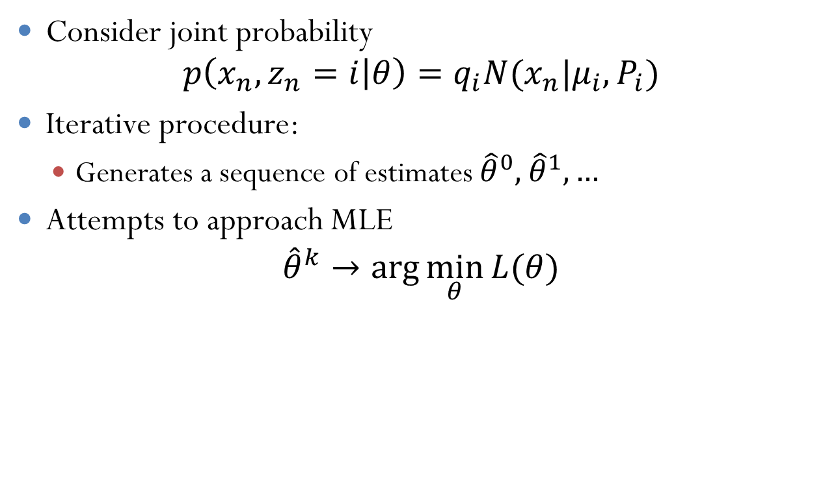
Expectation Maximization
Consider joint probability $p\left(x_{n},z_{n}=i | θ\right)=q_{i}N(x_{n}|μ_{i},P_{i})$
Iterative procedure:
Generates a sequence of estimates ${\hat{θ}}^{0},$ ${\hat{θ}}^{1},…$
Attempts to approach MLE ${\hat{θ}}^{k}→\arg{\min_{θ}{L(θ)}}$

Slide 41
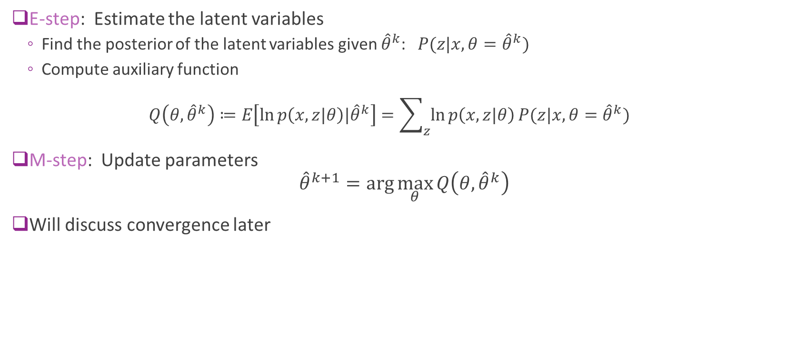
EM Steps
E-step: Estimate the latent variables
Find the posterior of the latent variables given ${\hat{θ}}^{k}$:$P(z|x,θ={\hat{θ}}^{k})$
Compute auxiliary function $Q\left(θ,{\hat{θ}}^{k}\right)≔E\left[\ln{p\left(x,z|θ\right)|{\hat{θ}}^{k}}\right]=\sum_{z}{\ln{p\left(x,z|θ\right)}P(z|x,}θ={\hat{θ}}^{k})$
M-step: Update parameters ${\hat{θ}}^{k+1}=\arg{\max_{θ}{Q\left(θ,{\hat{θ}}^{k}\right)}}$
Will discuss convergence later

Slide 42

E-Step for a GMM Finding the posterior
Given parameters $q_{i}, μ_{i},P_{i}$
Find posterior by Bayes rule
$$γ_{ni}=P\left(z_{n}=i | x\right)=\frac{P\left(x_{n} | z_{n}=i\right)q_{i}}{\sum_{k}{P\left(x_{n} | z_{n}=k\right)q_{k}}} =\frac{N\left(x_{n} | μ_{i},P_{i}\right)q_{i}}{\sum_{k}{P\left(x_{n} | μ_{k},P_{k}\right)q_{k}}}$$
A “soft” selection

Slide 43

E-Step for a GMM
Auxilliary function separates $Q\left(θ,{\hat{θ}}^{k}\right)=E\left[\ln{p\left(x,z\right)|{\hat{θ}}^{k}}\right]$ $=\sum_{i=1}^{K}{\sum_{n=1}^{N}{γ_{ni}ln{P\left(x_{n},z_{n}=i\right)}}}$ $=\sum_{i=1}^{K}{\sum_{n=1}^{N}{γ_{ni}\left[\ln{q_{i}}+\ln{N(x_{n}|μ_{i},P_{i})}\right]}}$

Slide 44

M-Step for the GMM
Maximize $Q\left(θ,{\hat{θ}}^{k}\right)$
Update for $q_{i}$ (proof on board) $q_{i}=\frac{N_{i}}{\sum_{j}{N_{j}}} , N_{i}=\sum_{n}{γ_{ni}}$
Update for $μ_{i}$ $μ_{i}=\frac{1}{N_{i}}\sum_{n}{γ_{ni}}x_{n}$
Update for $P_{i}$ $P_{i}=\frac{1}{N_{i}}\sum_{n}{γ_{ni}}{(x}_{n}−μ_{i})\left(x_{n}−μ_{i}\right)^T$

Slide 45
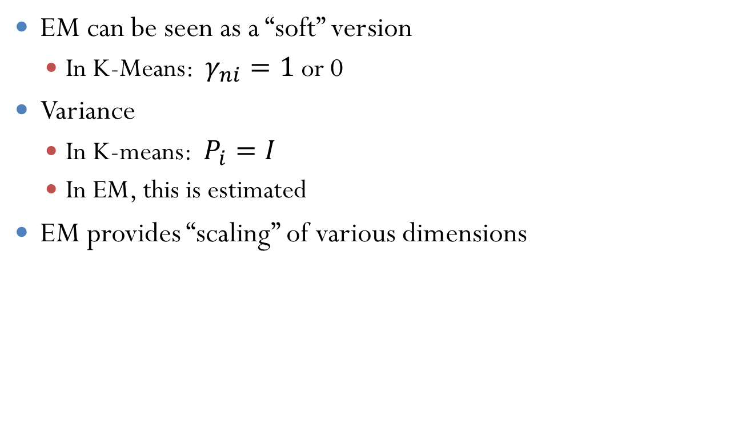
Relation to K-Means
EM can be seen as a “soft” version
In K-Means: $γ_{ni}=1$or 0
Variance
In K-means: $P_{i}=I$
In EM, this is estimated
EM provides “scaling” of various dimensions

Slide 46
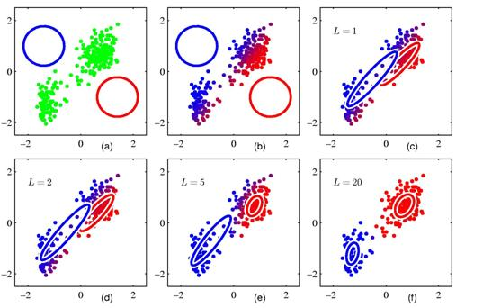
EM Illustrated
Simple example with K=2 clusters
Dimension = 2
Can have bad convergence from poor initial condition

Slide 47
Outline
Motivating Example: Document clustering
K-means
K-means for document clustering
Latent semantic analysis
Gaussian Mixture models (GMMs)
Expectation Maximization (EM) fitting of GMMs
Convergence of EM

Slide 48
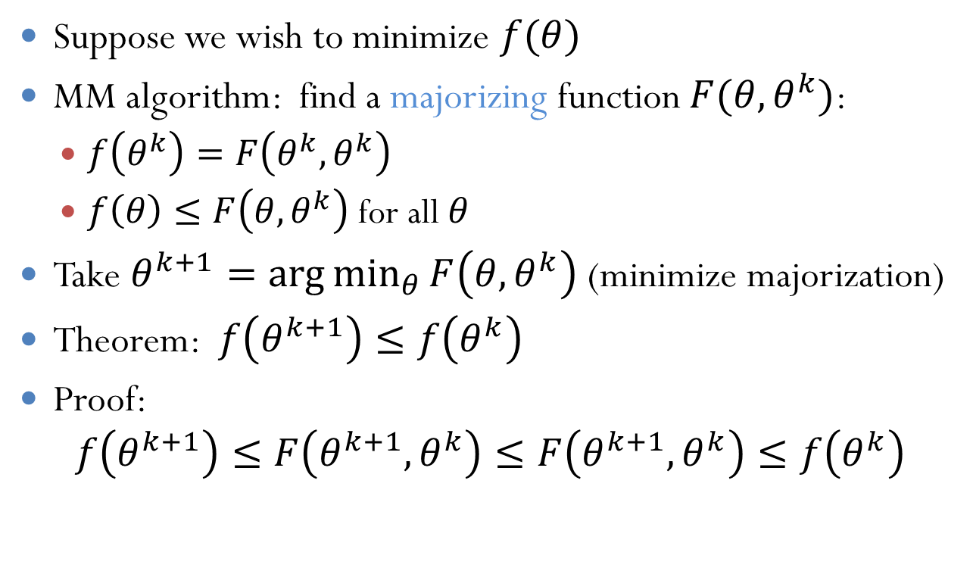
Majorization Minimization
Suppose we wish to minimize $f(θ)$
MM algorithm: find a majorizing function $F(θ,θ^{k})$:
$f\left(θ^{k}\right)=F\left(θ^{k},θ^{k}\right)$
$f\left(θ\right)≤F\left(θ,θ^{k}\right)$ for all $θ$
Take $θ^{k+1}=\arg{\min_{θ}{F\left(θ,θ^{k}\right)}}$ (minimize majorization)
Theorem: $f\left(θ^{k+1}\right)≤f\left(θ^{k}\right)$
Proof: $f\left(θ^{k+1}\right)≤F\left(θ^{k+1},θ^{k}\right)≤F\left(θ^{k+1},θ^{k}\right)≤f\left(θ^{k}\right)$

Slide 49
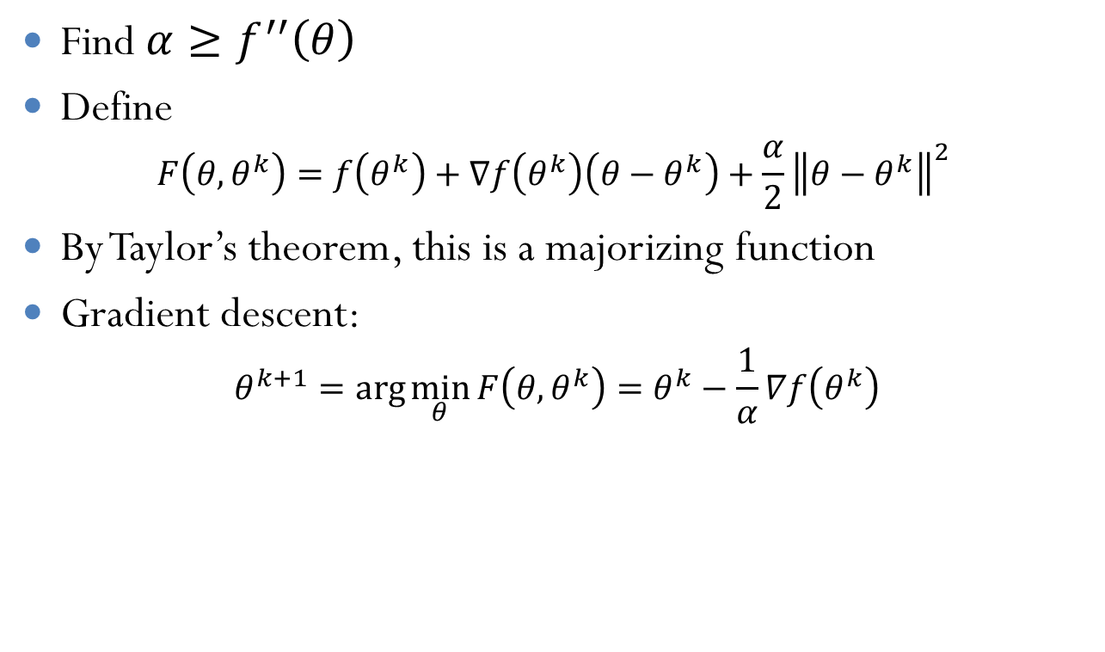
Gradient Descent as a MM
Find $α≥f^{′′}\left(θ\right)$
Define $F\left(θ,θ^{k}\right)=f\left(θ^{k}\right)+∇f\left(θ^{k}\right)\left(θ−θ^{k}\right)+\frac{α}{2}{\left\|θ−θ^{k}\right\|}^{2}$
By Taylor’s theorem, this is a majorizing function
Gradient descent: $θ^{k+1}=\arg{\min_{θ}{F\left(θ,θ^{k}\right)}}=θ^{k}−\frac{1}{α}∇f\left(θ^{k}\right)$

Slide 50
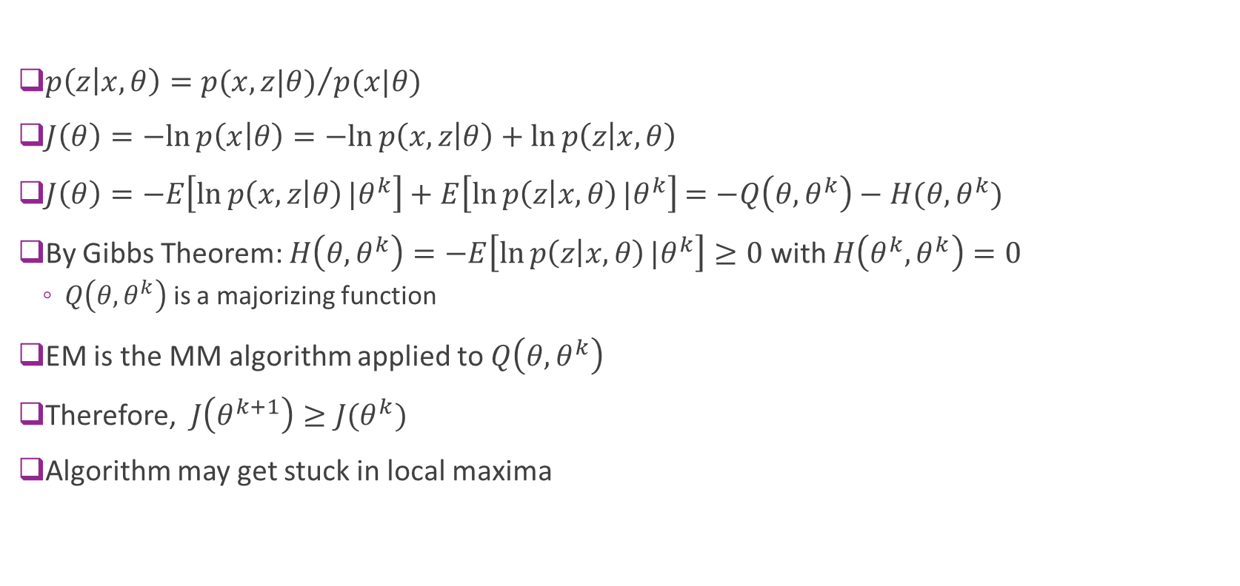
Convergence of EM
$p\left(z | x,θ\right)={p(x,z|θ)}/{p(x|θ)}$
$J\left(θ\right)=−ln{p\left(x | θ\right)}=−ln{p\left(x,z | θ\right)}+\ln{p\left(z | x,θ\right)}$
$J\left(θ\right)=−E\left[\ln{p\left(x,z | θ\right)}|θ^{k}\right]+E\left[\ln{p\left(z | x,θ\right)}|θ^{k}\right]$ $=−Q\left(θ,θ^{k}\right)−H(θ,θ^{k})$
By Gibbs Theorem: $H\left(θ,θ^{k}\right)=−E\left[\ln{p\left(z | x,θ\right)}|θ^{k}\right]≥0$ with $H\left(θ^{k},θ^{k}\right)=0$
$Q\left(θ,θ^{k}\right)$ is a majorizing function
EM is the MM algorithm applied to $Q\left(θ,θ^{k}\right)$
Therefore, $J\left(θ^{k+1}\right)≥J(θ^{k})$
Algorithm may get stuck in local maxima

