Slide 1

Presented BY: Monica Vohra

Slide 2

Introduction
Danny seriously loves Japanese food so in the beginning of 2021, he decides to embark upon a risky venture and opens up a cute little restaurant that sells his 3 favourite foods: sushi, curry and ramen.
Danny’s Diner is in need of your assistance to help the restaurant stay afloat - the restaurant has captured some very basic data from their few months of operation but have no idea how to use their data to help them run the business.
Problem Statement
Danny wants to use the data to answer a few simple questions about his customers, especially about their visiting patterns, how much money they’ve spent and also which menu items are their favourite. Having this deeper connection with his customers will help him deliver a better and more personalised experience for his loyal customers.
He plans on using these insights to help him decide whether he should expand the existing customer loyalty program - additionally he needs help to generate some basic datasets so his team can easily inspect the data without needing to use SQL.
Danny has provided you with a sample of his overall customer data due to privac
Danny has provided you with a sample of his overall customer data due to privacy issues - but he hopes that these examples are enough for you to write fully functioning SQL queries to help him answer his questions!
Danny has shared with you 3 key datasets for this case study:
Sales
Menu
Members
Presented BY: Monica Vohra

Slide 3

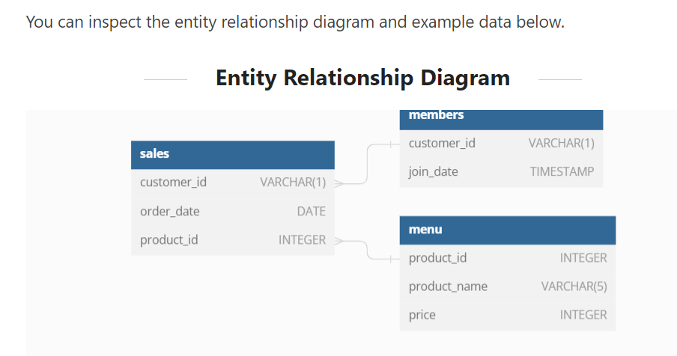

Entity Relationship Diagram
Presented BY: Monica Vohra

Slide 4

All datasets exist within the dannys_diner database schema - be sure to include this reference within your SQL scripts as you start exploring the data and answering the case study questions.
Table 2: menu
The menu table maps the product_id to the actual product_name and price of each menu item.
Table 1: sales
The sales table captures all customer_id level purchases with an corresponding order_date and product_id information for when and what menu items were ordered.
product_id | product_name | price
1 | sushi | 10
2 | curry | 15
3 | ramen | 12
customer_id | order_date | product_id
A | 2021-01-01 | 1
A | 2021-01-01 | 2
A | 2021-01-07 | 2
A | 2021-01-10 | 3
A | 2021-01-11 | 3
A | 2021-01-11 | 3
B | 2021-01-01 | 2
B | 2021-01-02 | 2
B | 2021-01-04 | 1
B | 2021-01-11 | 1
B | 2021-01-16 | 3
B | 2021-02-01 | 3
C | 2021-01-01 | 3
C | 2021-01-01 | 3
C | 2021-01-07 | 3
Table 3: members
The final members table captures the join_date when a customer_id joined the beta version of the Danny’s Diner loyalty program.
customer_id | join_date
A | 2021-01-07
B | 2021-01-09
Presented BY: Monica Vohra

Slide 5
CREATE SCHEMA dannys_diner;
SET search_path = dannys_diner;
CREATE TABLE sales ( "customer_id" VARCHAR(1), "order_date" DATE, "product_id" INTEGER );
INSERT INTO sales ("customer_id", "order_date", "product_id") VALUES ('A', '2021-01-01', '1'), ('A', '2021-01-01', '2'), ('A', '2021-01-07', '2'), ('A', '2021-01-10', '3'), ('A', '2021-01-11', '3'), ('A', '2021-01-11', '3'), ('B', '2021-01-01', '2'), ('B', '2021-01-02', '2'), ('B', '2021-01-04', '1'), ('B', '2021-01-11', '1'), ('B', '2021-01-16', '3'), ('B', '2021-02-01', '3'), ('C', '2021-01-01', '3'), ('C', '2021-01-01', '3'), ('C', '2021-01-07', '3’);
CREATE TABLE menu ( "product_id" INTEGER, "product_name" VARCHAR(5), "price" INTEGER ); INSERT INTO menu ("product_id", "product_name", "price") VALUES ('1', 'sushi', '10'), ('2', 'curry', '15'), ('3', 'ramen', '12'); CREATE TABLE members ( "customer_id" VARCHAR(1), "join_date" DATE ); INSERT INTO members ("customer_id", "join_date") VALUES ('A', '2021-01-07'), ('B', '2021-01-09');
Presented BY: Monica Vohra

Slide 6

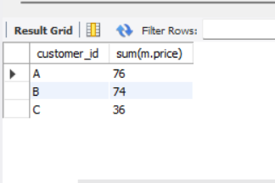
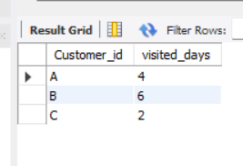
1.What is the total amount each customer spent at the restaurant?
2.How many days has each customer visited the restaurant?
select s.customer_id, sum(m.price)
from sales s
Join menu m
on s.product_id=m.product_id
group by customer_id;
select Customer_id,count(distinct order_date) as visited_days
from sales
group by Customer_id;
Presented BY: Monica Vohra

Slide 7

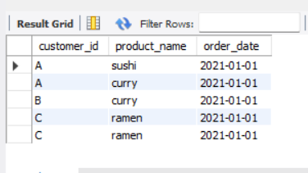
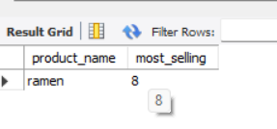
3.What was the first item from the menu purchased by each customer?
SELECT s.customer_id, m.product_name,s.order_date
FROM sales s
JOIN menu m ON s.product_id = m.product_id
WHERE s.order_date IN ( SELECT MIN(order_date)
FROM sales
GROUP BY customer_id)ORDER BY s.customer_id;
4.What is the most purchased item on the menu and how many times was it purchased by all customers?
Select m.product_name,count(s.product_id) as most_selling
from sales s join menu m
on m.product_id=s.product_idgroup by m.product_name
order by most_selling desc
limit 1;
Presented BY: Monica Vohra

Slide 8

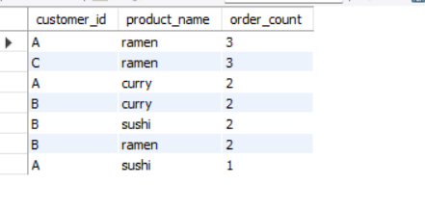
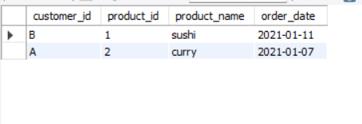
5.Which item was the most popular for each customer?
select s.customer_id,m.product_name,count(s.product_id) as order_countfrom sales sjoin menu m
On m.product_id=s.product_id
group by s.customer_id,m.product_name,s.product_id
order by
order_count desc;
6.Which item was purchased first by the customer after they became a member?
select s.customer_id,m.product_id,m.product_name,s.order_date
from sales s join menu m on m.product_id=s.product_id join members as me on s.customer_id=me.customer_id where s.order_date>= me.join_date and s.order_date=(select min(s2.order_date) from sales as s2 where s2.customer_id=s.customer_id and s2.order_date>=me.join_date);
Presented BY: Monica Vohra

Slide 9
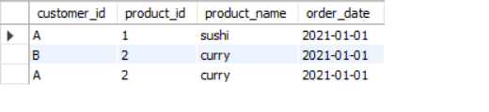

7.Which item was purchased just before the customer became a member?
select s.customer_id,m.product_id,m.product_name,s.order_date
from sales s join menu m on m.product_id=s.product_id join members as me on s.customer_id=me.customer_id
where s.order_date<= me.join_date and s.order_date=(select min(s2.order_date) from sales as s2
where s2.customer_id=s.customer_id and s2.order_date<=me.join_date);
8. What is the total items and amount spent for each member before they became a member?
select s.customer_id,sum(m.price) total_spend,count(s.product_id) as total_quantity
from sales s join menu m
on m.product_id=s.product_id join members me
on s.customer_id=me.customer_id
where me.join_date>s.order_date
group by s.customer_id
order by customer_id;
Presented BY: Monica Vohra

Slide 10
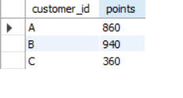
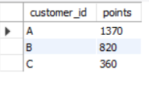
9. If each $1 spent equates to 10 points and sushi has a 2x points multiplier - how many points would each customer have?
SELECT s.customer_id, SUM( CASE
WHEN m.product_name = 'sushi' THEN m.price * 20 ELSE m.price * 10 END ) AS pointsFROM sales s
JOIN menu m ON s.product_id = m.product_id
GROUP BY s.customer_id;
10. In the first week after a customer joins the program (including their join date) they arn 2x points on all items, not just sushi - how many points do customer A and B ave at the end of January?
SELECT s.customer_id, SUM(CASE WHEN m.product_name = 'sushi' THEN m.price * 20 WHEN s.order_date >= mem.join_date AND s.order_date <= mem.join_date + 6 THEN m.price * 20 ELSE m.price * 10 END ) AS points
FROM sales s JOIN menu m ON s.product_id = m.product_id
LEFT JOIN members mem ON s.customer_id = mem.customer_id
WHERE s.order_date <= '2021-01-31’
GROUP BY s.customer_id;
Presented BY: Monica Vohra

Slide 11

Presented BY: Monica Vohra

