Slide 1
Uber

Slide 2
Potential reasons for the loss of Uber
Drivers are cancelling the requests for various reasons.
Cars are not available in the pickup location at the time of requests.

Slide 3
To analyze the reason for cancellation and non availability we have following data.
Request id: A unique identifier of the request
Time of request: The date and time at which the customer made the trip request
Drop-off time: The drop-off date and time, in case the trip was completed
Pick-up point: The point from which the request was made
Driver id: The unique identification number of the driver
Status of the request: The final status of the trip, that can be either completed, cancelled by the driver or no cars available

Slide 4
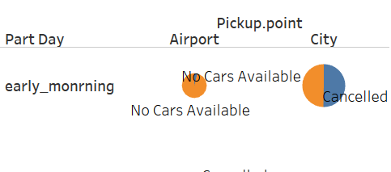

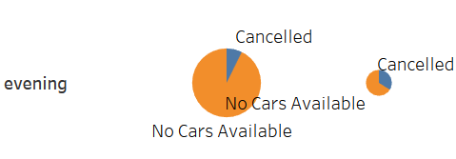


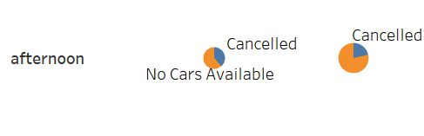
Representation of available information

Slide 5
Points incurred from available information
Issues faced at pickup point airport:
1. There is a car unavailability problem during early morning(12:01 AM to 6.00 AM), evening(4.00 PM to 8.00 PM) and night hours (8.00 AM to 11.59 PM)
2. Little portion of cancels happen during morning hours(6.00 AM to 11.AM)
Issues faced at pickup point city
1. Most of the requests are cancelled during morning hours (6.00 AM to 11.AM) and early morning hours(12.01AM and 6.00 AM)
2. Little portion of car unavailability is happened during afternoon hours.

Slide 6
Reasons for car unavailability and cancellation issues.
During morning hours Uber will get many requests to travel with in city. So drivers tend to travel with in city, they will have minimum wait time before they get another request with in city.
Traffic also plays major role in cancellation, as they take lot of time to reach the airport during morning hours
Drivers try to take some rest during night hours, so they will plan to take requests with in city instead of going to airport. Because of this the car unavailability issue is major during late night and early morning.

Slide 7
Solutions to these problems.
Uber can use more pool option during morning hours from city to airport. This way even if the driver don’t get return request from airport to city his money will be recovered.
Also even if the traffic is more during morning hours, he can makeup his money using Uber pool.
Uber can plan to construct parking area and dormitories near airport. So once the driver drops people near airport during night, he can take some rest. Later during early morning he will take the pickup request from airport. This way the car unavailability issue near airport will be resolved.
Based on car unavailability and cancellation requests at a point of day, Uber can increase the fare so that driver will be interested in taking the request.

