Slide 1
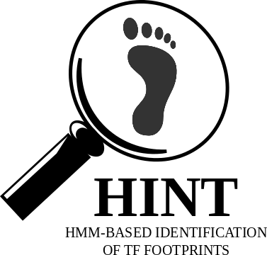

An atlas of transcriptional, chromatin accessibility, and surface marker changes in human mesoderm development
Koh, P., Sinha, R., Barkal, A. et al. An atlas of transcriptional, chromatin accessibility, and surface marker changes in human mesoderm development. Sci Data 3, 160109 (2016). https://doi.org/10.1038/sdata.2016.109
Sets of ATAC-peaks
1
Sets of footprints
Differential expressed genes
2
TEPIC DYNAMITE
TFs related to differential expressed genes
Footprints
Enriched TFs
Footprints of specific TFs
3
Finding target genes:
Nearest gene
Window-based
Association-based
BedTools
TEPIC
w
Lists of target genes
Differential expressed genes

