Slide 1
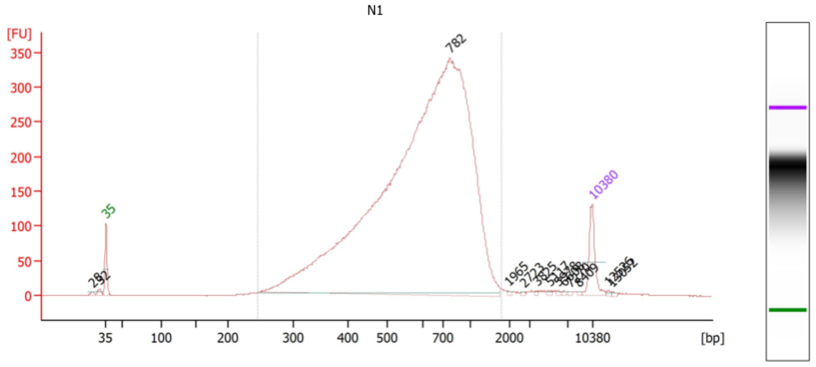
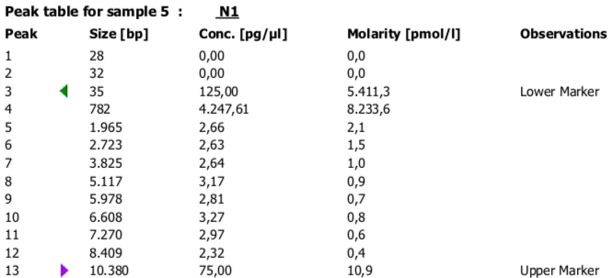
HSD1000
Tube nº
Hi-C_p53_WT+Nut_BR1
10ul
1:3 dilution
4.247 ng/ul → 16.988 ng/ul
169.88 ng total
Mean size 782bp
Barcode (number and sequence)
Index : 48

Slide 2
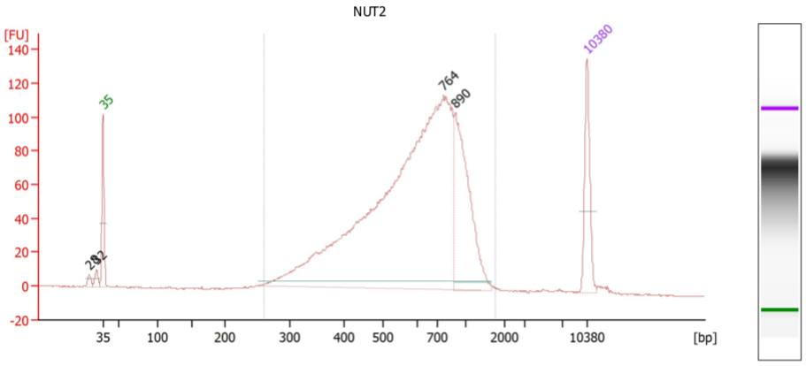
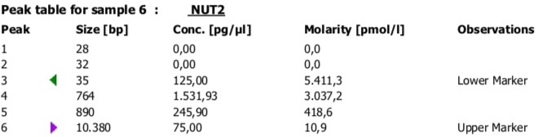
HSD1000
Tube nº
Hi-C_p53_WT+Nut_BR2
10ul
1:3 dilution
1.531 ng/ul → 6.124 ng/ul
61.24 ng total
Mean size 764bp
Barcode (number and sequence)
Index : 50

Slide 3
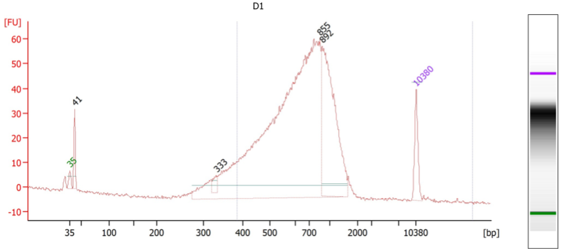
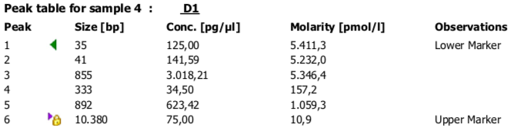
HSD1000
Tube nº
Hi-C_p53_WT+DMSO_BR1
10ul
1:3 dilution
3.018 ng/ul → 12.07 ng/ul
120 ng total
Mean size 855bp
Barcode (number and sequence)
Index : 47

Slide 4
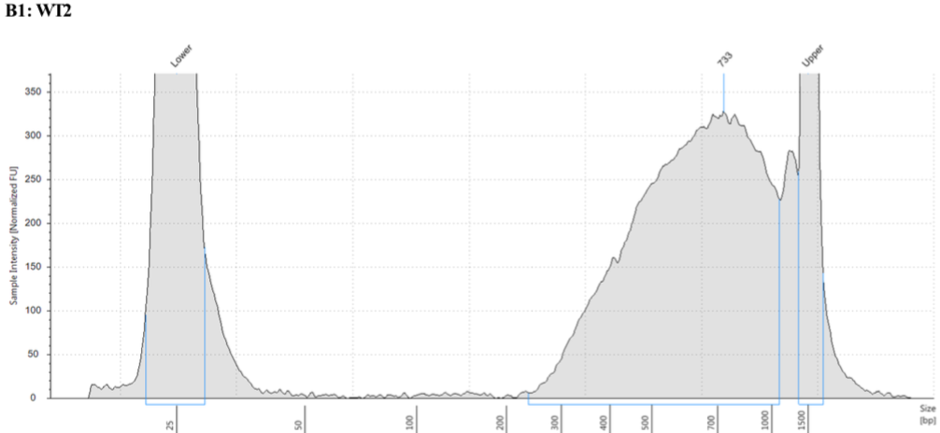
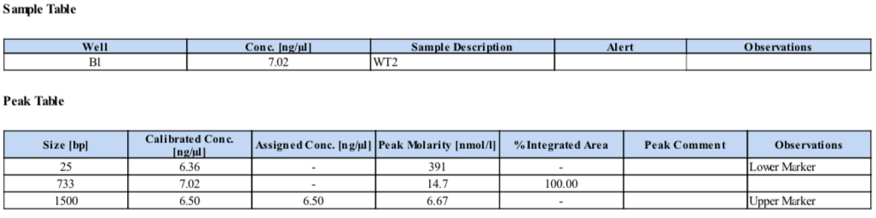
Tube nº
Hi-C_p53_WT+ DMSO _BR2
10ul
1:1 dilution
7.02 ng/ul → 14.04ng/ul
140.4 ng total
Mean size 733bp
Barcode (number and sequence)
Index : 49

Slide 5
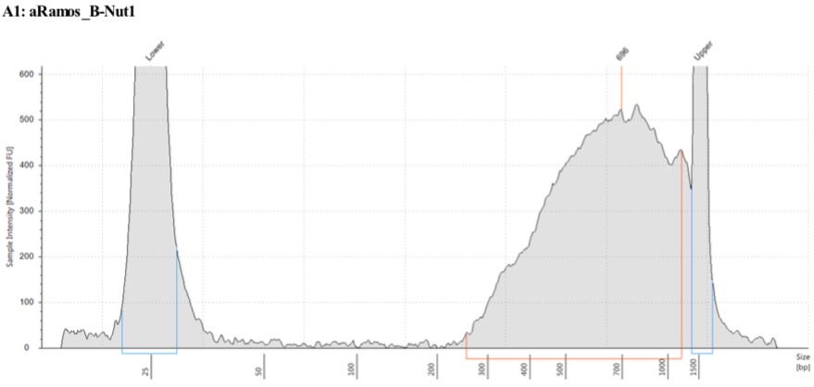
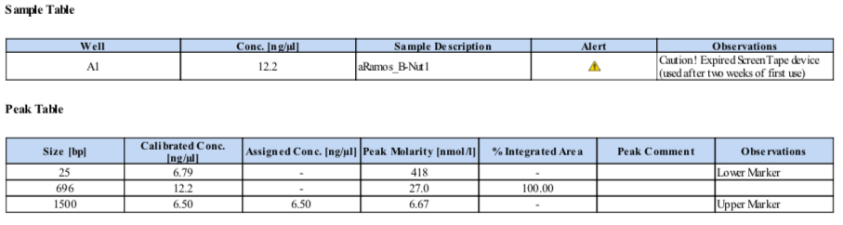
Tube nº
Hi-C_p53_KO+Nut_BR1
10ul
1:1 dilution
12.2 ng/ul → 24.4 ng/ul
244 ng total
Mean size 696bp
Barcode (number and sequence)
Index : 43

Slide 6
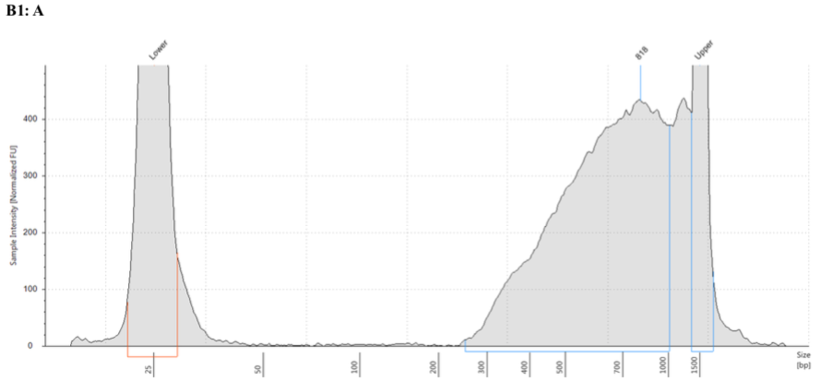
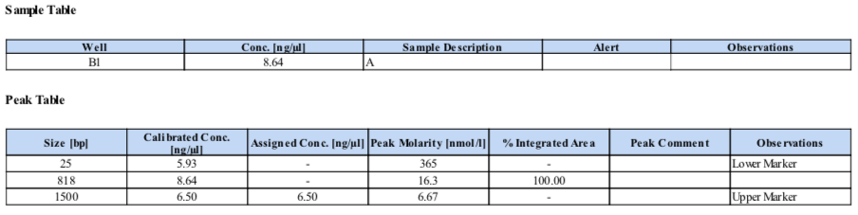
Tube nº
Hi-C_p53_KO +Nut_BR2
10ul
1:1 dilution
8.64 ng/ul → 17.28 ng/ul
172.8 ng total
Mean size 818bp
Barcode (number and sequence)
Index : 45

Slide 7
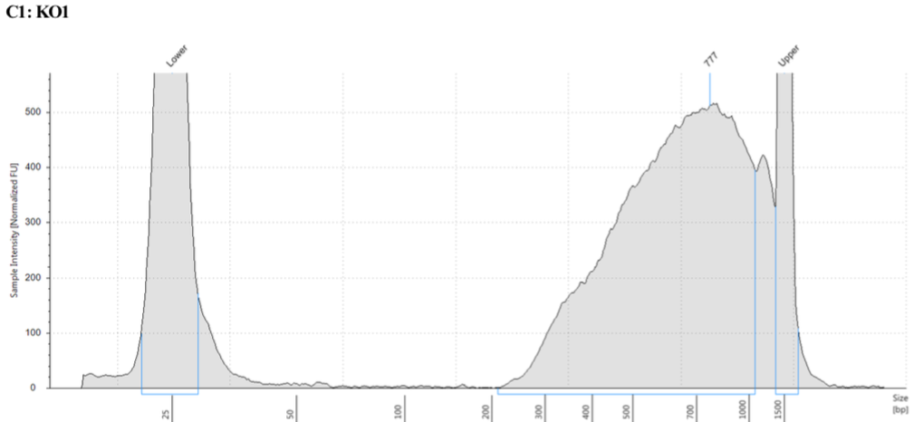
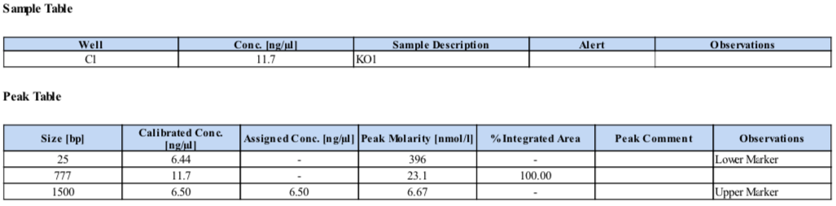
Tube nº
Hi-C_p53_KO+DMSO_BR1
10ul
1:1 dilution
11.7 ng/ul → 23.4 ng/ul
234 ng total
Mean size 777bp
Barcode (number and sequence)
Index : 42

Slide 8
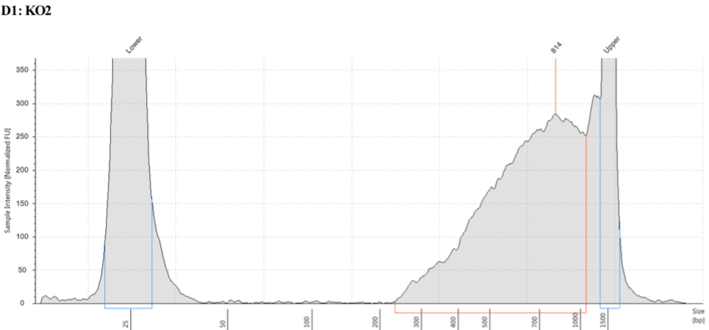
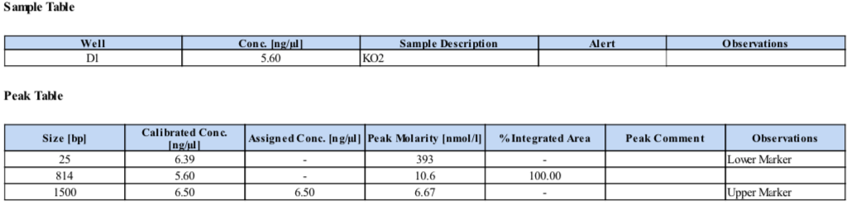
Tube nº
Hi-C_p53_KO+DMSO_BR2
10ul
1:1 dilution
5.6 ng/ul → 11.2 ng/ul
112 ng total
Mean size 814bp
Barcode (number and sequence)
Index : 44

