Slide 1
Paleta básica
telecom
granada
peel
ladys
beer
bette
aulaga
night
pear
donosti
sushi
sea
fruit
sky
persian
paradise

Slide 2
Desarrollo
aulaga
telecom
ladys
pear
beer
bette
night
donosti
granada
sea
sky
paradise
persian
sushi
peel
fruit
granada red: https://www.colorhexa.com/f44336
lady rose: https://www.colorhexa.com/e91e63
bette purple: https://www.colorhexa.com/9c27b0
night purple: https://www.colorhexa.com/673ab7
donosti blue: https://www.colorhexa.com/3f51b5
sea blue: https://www.colorhexa.com/2196f3
sky blue: https://www.colorhexa.com/03a9f4
paradise cyan: https://www.colorhexa.com/00bcd4
persian teal: https://www.colorhexa.com/009688
Fruit green: https://www.colorhexa.com/4caf50
sushi green: https://www.colorhexa.com/8bc34a
Pear lime: https://www.colorhexa.com/cddc39
Aulaga yellow: https://www.colorhexa.com/ffeb3b
Beer Amber: https://www.colorhexa.com/ffc107
Peel Orange: https://www.colorhexa.com/ff9800
telecom Orange: https://www.colorhexa.com/ff5722
rgb(76,175,80)
rgb(205,220,57)
rgb(255,87,34)
rgb(255,152,0)
rgb(255,193,7)
rgb(63,81,181)
rgb(0,188,212)
rgb(139,195,74)
rgb(255,235,59)
rgb(244,67,54)
rgb(0,150,136)
rgb(233,30,99)
rgb(3,169,244)
rgb(156,39,176)
rgb(33,150,243)
rgb(103,58,183)

Slide 3
Paletas office
MiPaleta
MiPaleta2
rgb(244,67,54)
rgb(233,30,99)
rgb(156,39,176)
rgb(103,58,183)
rgb(63,81,181)
rgb(33,150,243)
rgb(3,169,244)
rgb(0,188,212)
rgb(76,175,80)
rgb(0,150,136)
rgb(205,220,57)
rgb(139,195,74)
rgb(255,193,7)
rgb(255,235,59)
rgb(255,87,34)
rgb(255,152,0)

Slide 4
Text
Text 1: El murciélago hindú comía cardillos rgba(255, 255, 255)
Text 2: El murciélago hindú comía cardillos. Rgba (33, 33, 33)
Text 3: El murciélago hindú comía cardillos. Rgba (75, 75, 75)
Text 4: El murciélago hindú comía cardillos. Rgba (189, 189, 189)

Slide 5
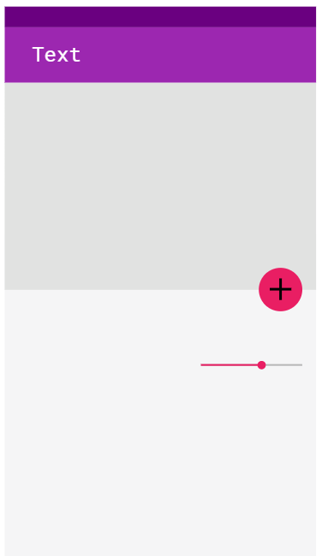
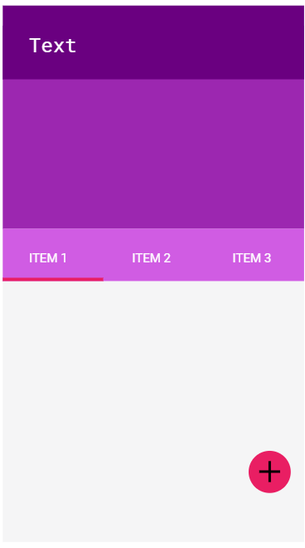
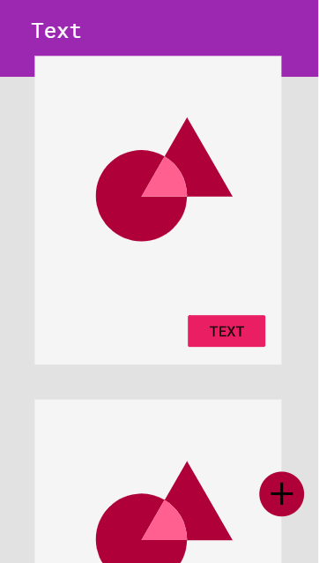
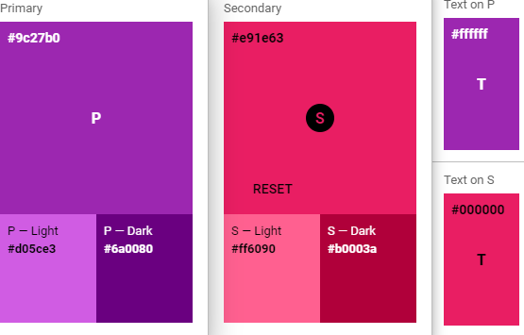
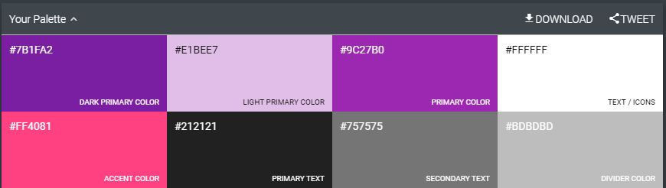
Layouts

Slide 6
Recursos
https://www.viget.com/articles/add-colors-to-your-palette-with-color-mixing/
https://www.viget.com/articles/naming-colors/
https://www.viget.com/articles/tints-tones-shades/
https://www.viget.com/articles/color-contrast/
https://www.viget.com/articles/shades-of-gray-yes-really/
https://palx.jxnblk.com/da291c
https://www.colorhexa.com
Rojo Foral
#d9291c
Rgb(217, 41, 28)
Hsl(4º,77%, 48%)

