Slide 1
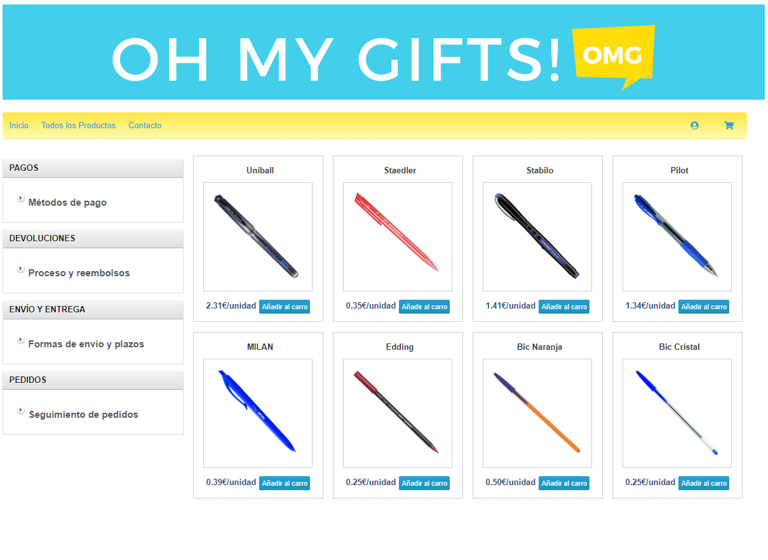
AOIA
AOIB
AOIC

