Slide 1
The Battle of Neighbourhoods
Explore Indian restaurants in New York City
-By monica.J

Slide 2
INTRODUCTION –Business Scenario
Shortlisting Indian restaurant/s to be featured on a show under the “Travel and Tourism “ category.

Slide 3
DATA SOURCES
https://cocl. us/new_york_dataset
Foursquare API to get list and attributes of Indian restaurants in NYC

Slide 4
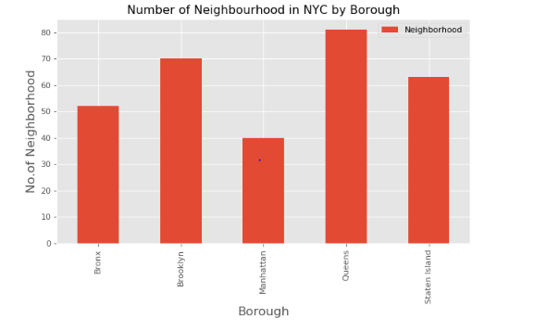
RESULTS
1) On analysing the data in https://cocl.us/new_york_dataset. It is observed, that NYC has 5 Boroughs and Queens has the highest number of Neighbourhoods with a count of 81.

Slide 5
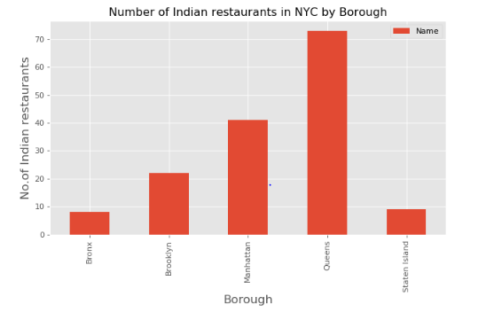
RESULTS (contd.)
2) Using the Foursquare API, I extracted the data for all Indian restaurants across Boroughs and could see the Queens borough has the highest number of Indian restaurants with a value of 73.

Slide 6
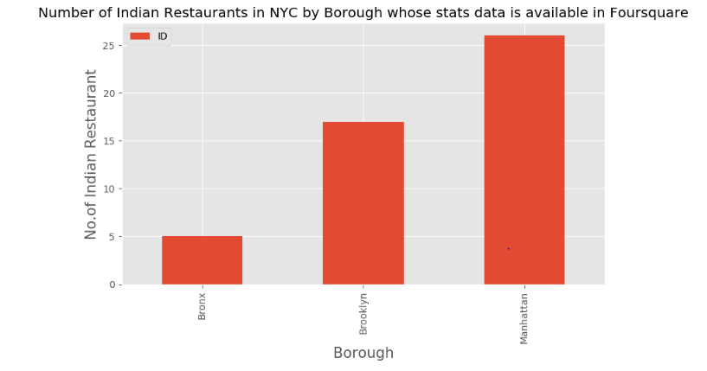
RESULTS (contd.)
3) Out of 154 Indian restaurants , only 48 have relevant stats in the Foursquare API.

Slide 7
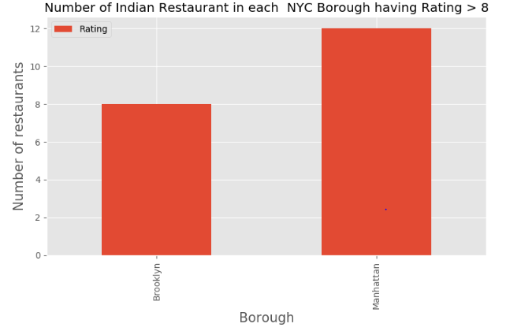
RESULTS (contd.)
4) Out of the 48, 20 restaurants have a rating greater than 8 and are mostly spread across Manhattan and Brooklyn boroughs.

Slide 8
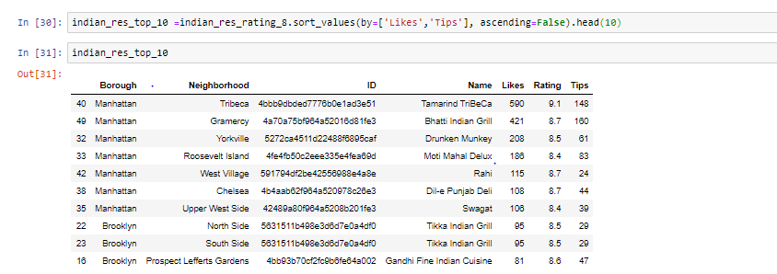
RESULTS (contd.)
5) List of the Top 10 restaurants based on rating, likes and tips. 7 in Manhattan and 3 in Brooklyn.

Slide 9
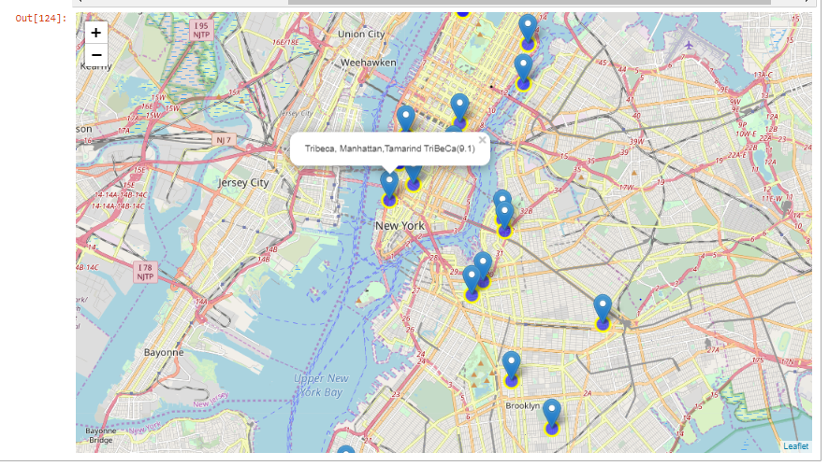
RESULTS (contd.)
6) Plot restaurants having rating > 8 on the Map using Folium

Slide 10
DISCUSSION
Though the data shows Queens has more Indian restaurants, the top restaurants in New York City are spread across Manhattan and Brooklyn. This implies multiple things:
Is the data accurate?
Is it a good option to go by the outcome of this data analysis or should we consider other methods to shortlisting the restaurant? For example: word of mouth or advertisements look for Michelin starred restaurants, etc.
The number of people using the Foursquare application may be very less or the number of people rating Indian restaurants in particular maybe less or inconsistent. Should Foursquare work more on promoting the usage of the application or create awareness among people?
Should data be considered from other similar apps such as the Google Places App or Yelp?

Slide 11
CONCLUSION
Based on the data set taken, Queens Borough has the highest neighbourhoods as well as the highest number of Indian restaurants.
Most of the Indian restaurants having a rating of more than 8.0, highest likes and tips are in Manhattan, followed by Brooklyn.
Out of the top 10 restaurants listed as part of the analysis, 7 are in Manhattan and 3 are in Brooklyn.
Manhattan is the better option as there is more number of highly rated restaurants.
Tamarind TriBeCa looks like a go-to option for the show with a rating of 9.1, 591 likes and 148 tips.

