Slide 1
AgriData Explorer
Understanding Indian Agriculture with EDA
Presented by: Your Name
Tools Used: Python, SQL, Power BI, Streamlit

Slide 2
Problem Statement
India's agriculture is rich but underutilized due to scattered data.
Difficulties in data-driven decisions for farmers, policymakers, researchers.
Need for unified data access and visualization.

Slide 3
Objective
🎯 Create a platform for:
• Visualizing crop production trends
• Region-wise insights on yield & area
• Empowering farmers, policymakers, and researchers

Slide 4
Project Architecture
Modules:
Data Collection & Cleaning
SQL Modeling
EDA with Python
Dashboards in Streamlit & Power BI
🧰 Tools:
Python | SQL | Pandas | Plotly | Power BI

Slide 5
Stakeholder Use Cases
👨‍🌾 Farmers:
• Historical yield analysis
• Informed crop selection
🧑‍⚖️ Policymakers:
• Identify low-yield zones
• Policy planning
🧑‍🔬 Researchers:
• Trend analysis
• Recommend Agri-innovations

Slide 6
Data Overview
🔍 ICRISAT District Level Data
• 20+ crops with Area, Production, Yield
• Timeframe: 50+ years
• Levels: District, State

Slide 7
SQL Data Model
🛠️ Tables:
• Crops, Districts, States, Stats
• Keys: District, State, Year, Crop

Slide 8
EDA & Visualizations
📊 Examples:
Top Rice States (Bar)
Wheat Share (Pie)
Sugarcane Trends (Line)
Sorghum Kharif vs Rabi (Grouped Bar)
Area vs Yield (Scatter)

Slide 9
Streamlit and Power BI
🧑‍💻 Role-based Access:
Farmer 🌾
Policymaker 📈
Researcher 🔬
🎯 Features:
Interactive charts
Login control
📍 Visuals:
Charts and setting values
Trends & KPIs
Filters & Slicers

Slide 10
Key Insights
Top Producers
Productivity Gaps
50-year Trends
Crop-specific patterns

Slide 11
Recommendations
🌾Farmers:
High-yield crops
📊Policymakers:
Focus investments
🔬 Researchers:
Analyse outliers

Slide 12
Challenges & Solutions
🚧 Missing data → Cleaned & standardized
📉 Visual overload → Role-specific dashboards

Slide 13
EDA Analysis Demo

Slide 14
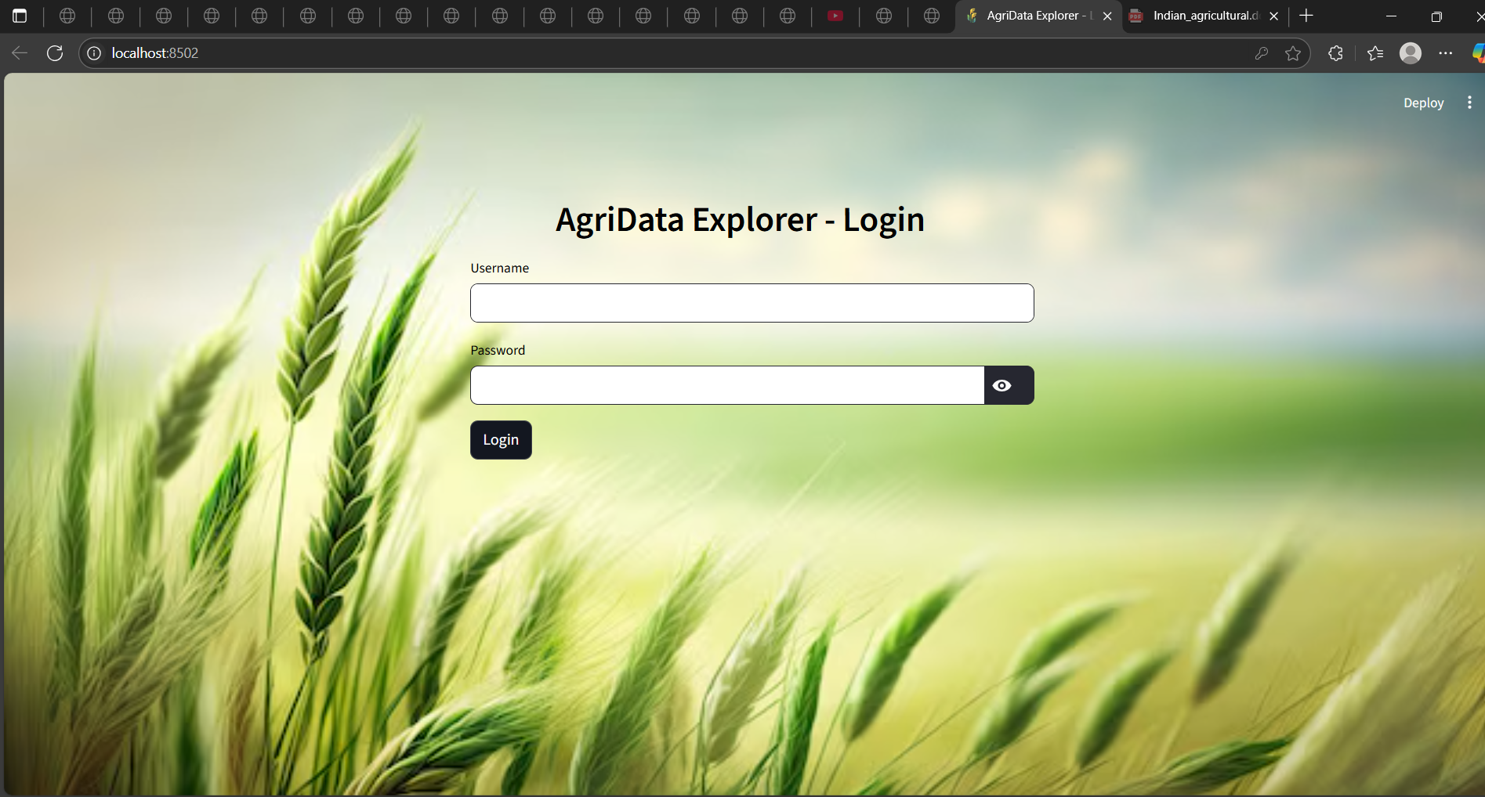
Login Page

Slide 15
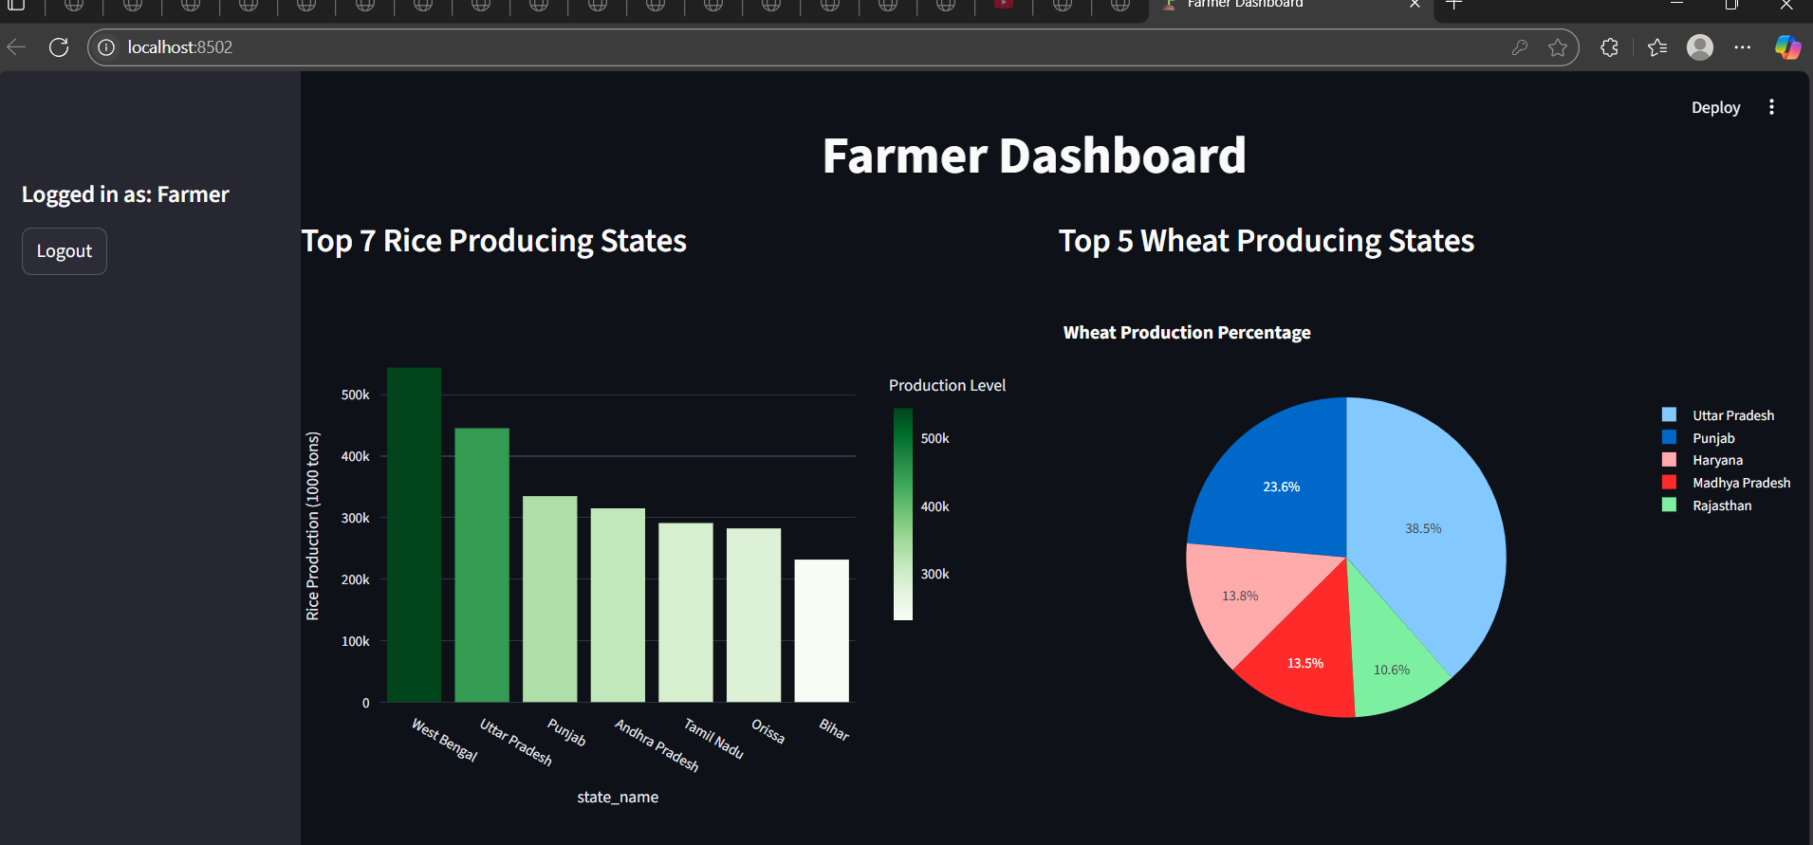
Farmer Dashboard

Slide 16
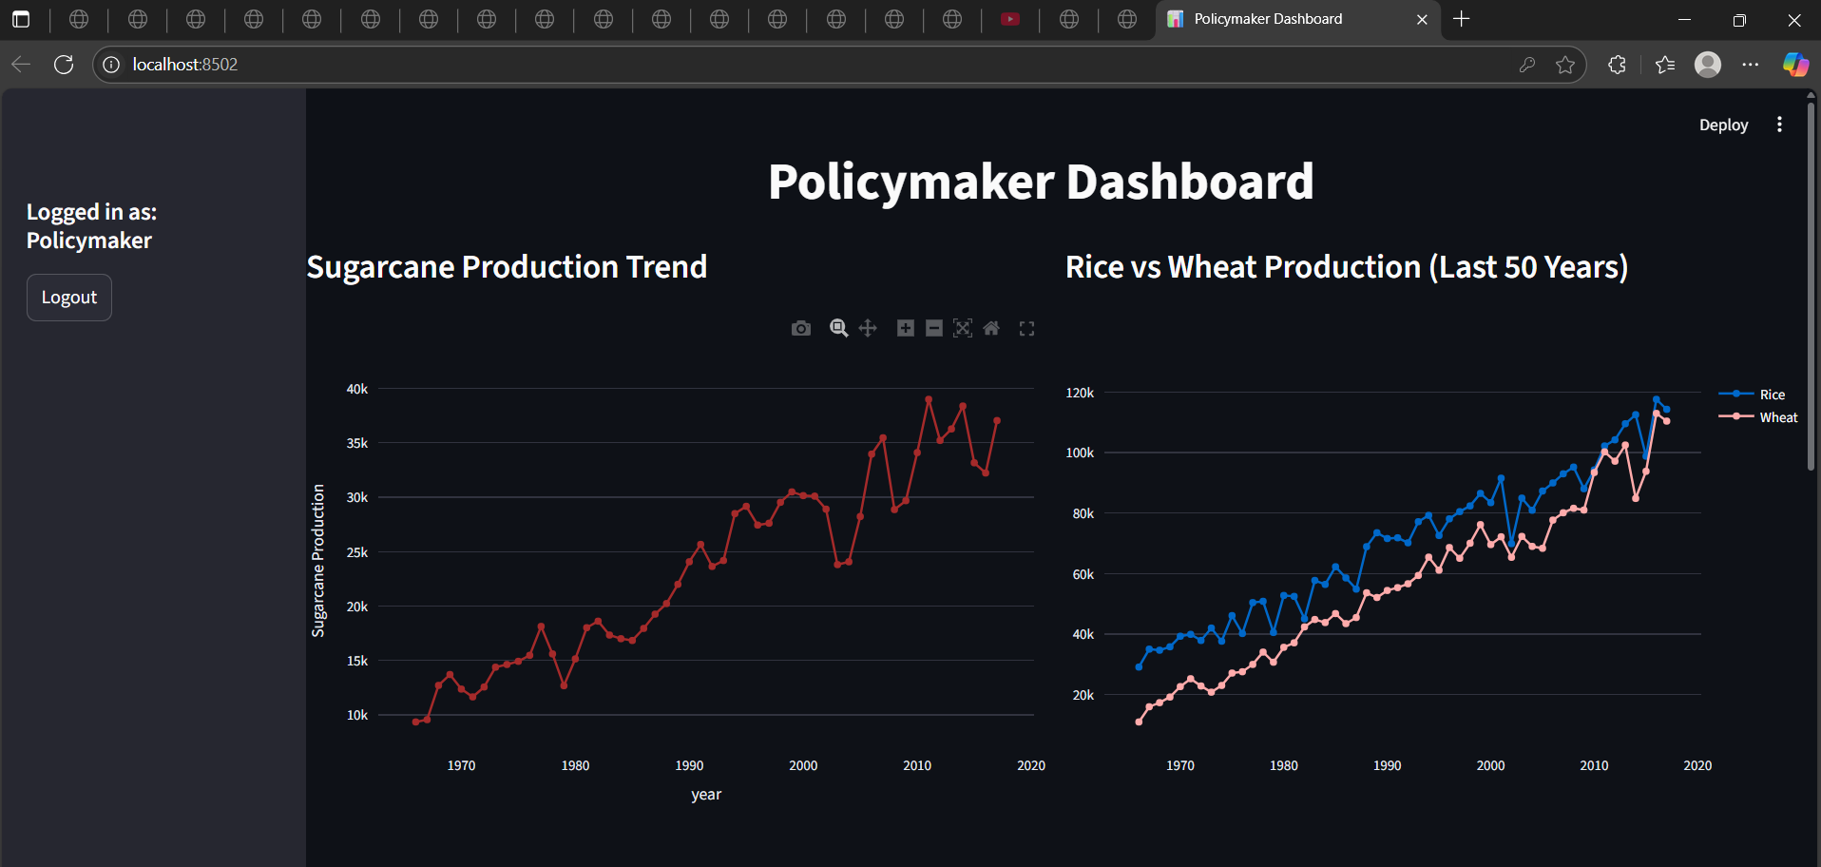
Policymaker Dashboard

Slide 17
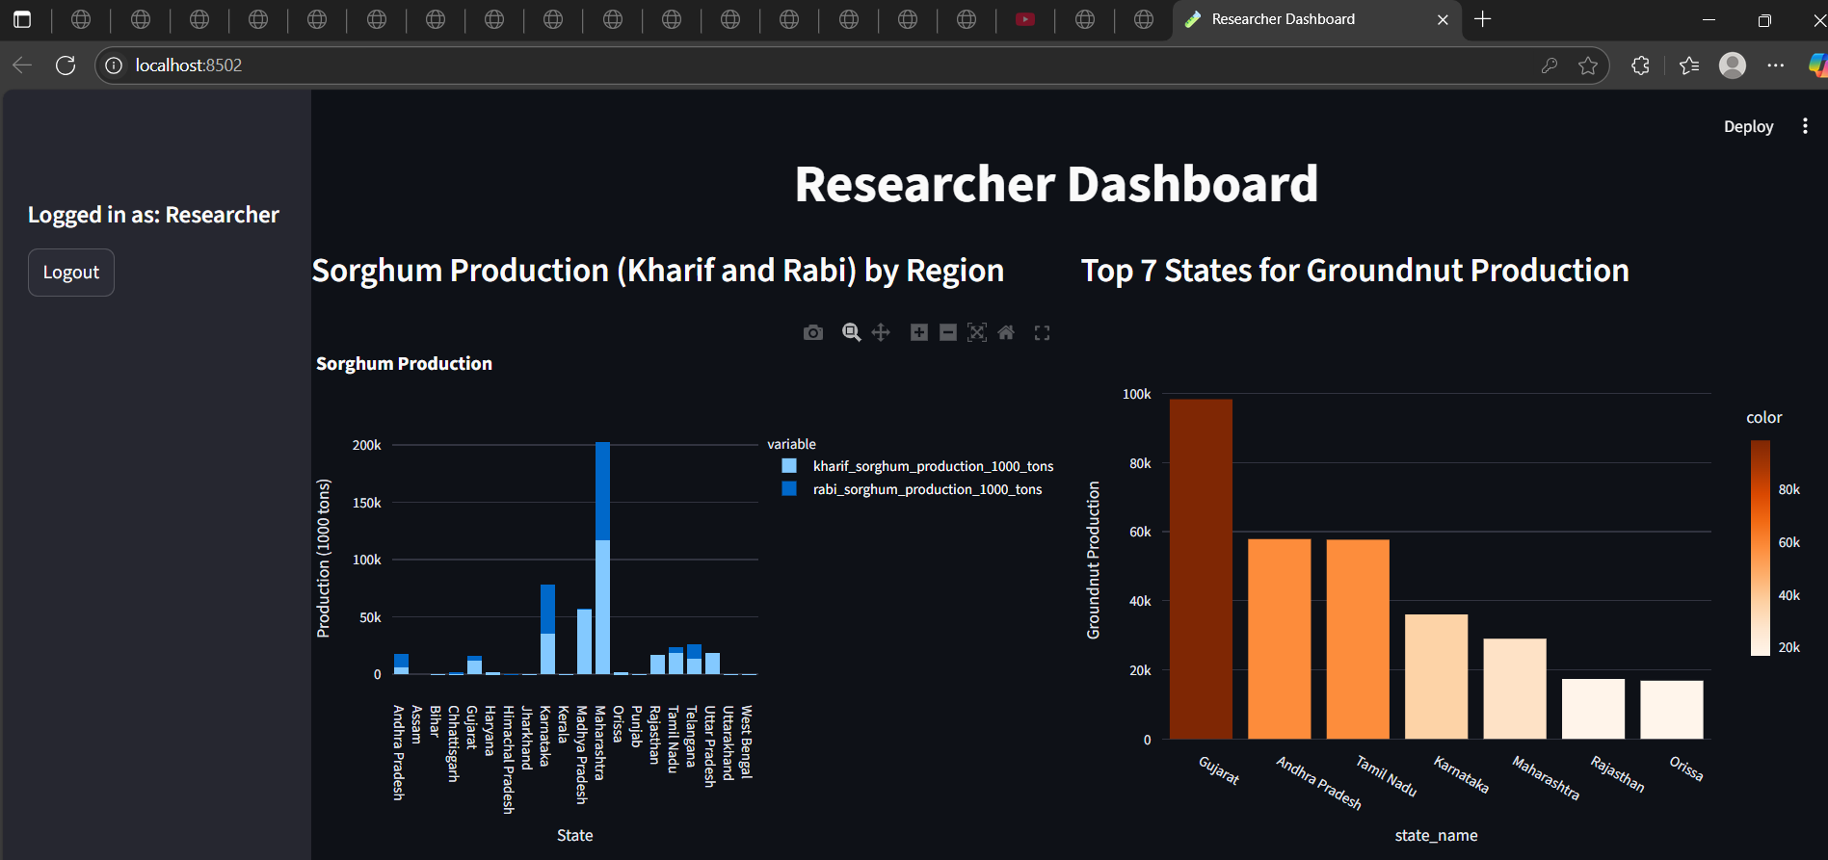
Researcher Dashboard

Slide 18
Power Bi Analysis

Slide 19
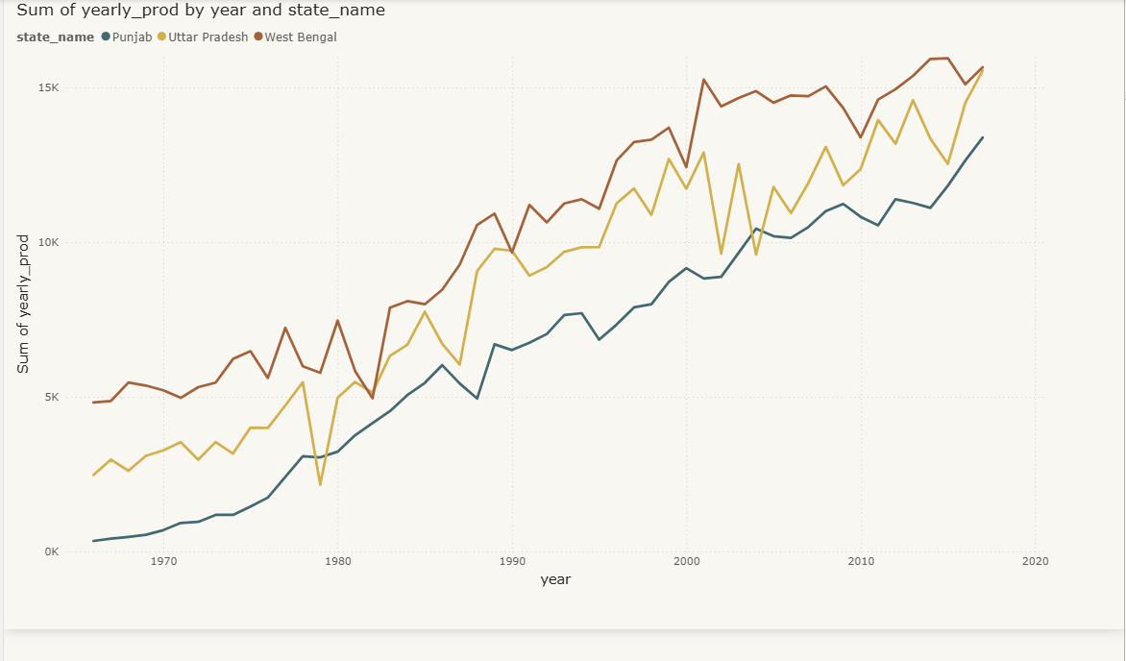
Year-wise Trend of Rice Production Across States (Top 3)

Slide 20
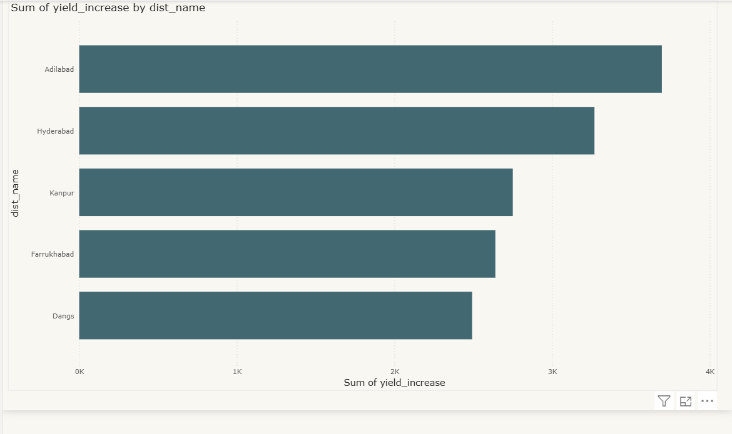
Top 5 Districts by Wheat Yield Increase Over the Last 5 Years

Slide 21
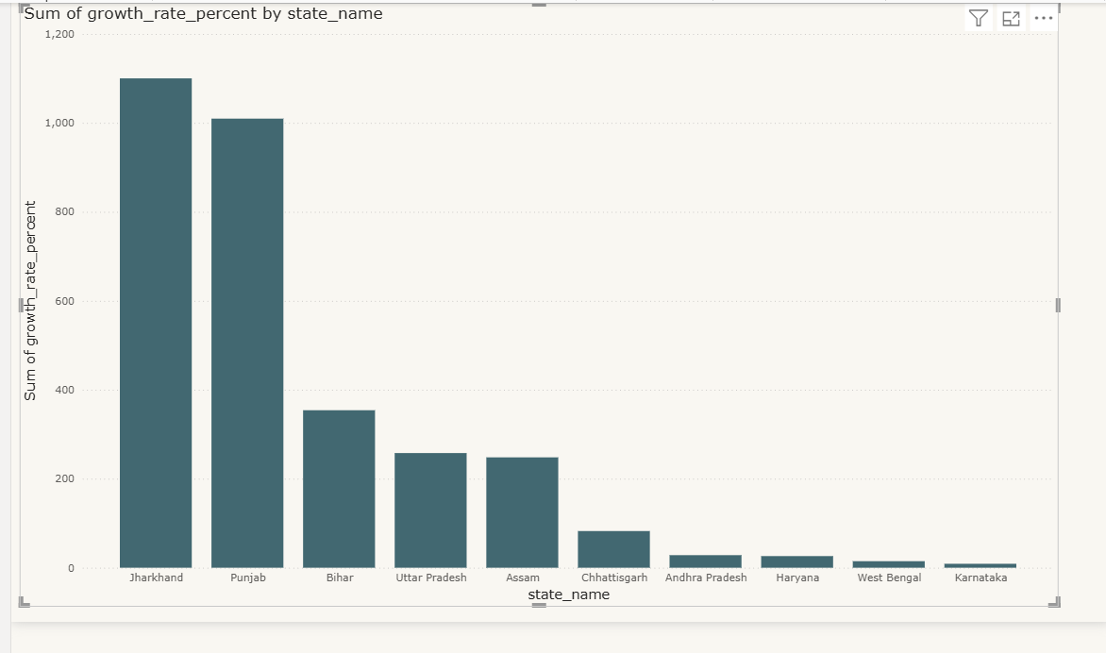
States with the Highest Growth in Oilseed Production (5-Year Growth Rate)

Slide 22
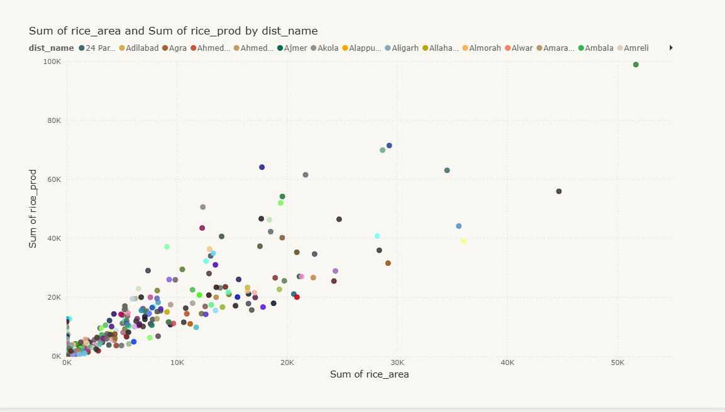
District-wise Correlation Between Area and Production for Major Crops (Rice)

Slide 23
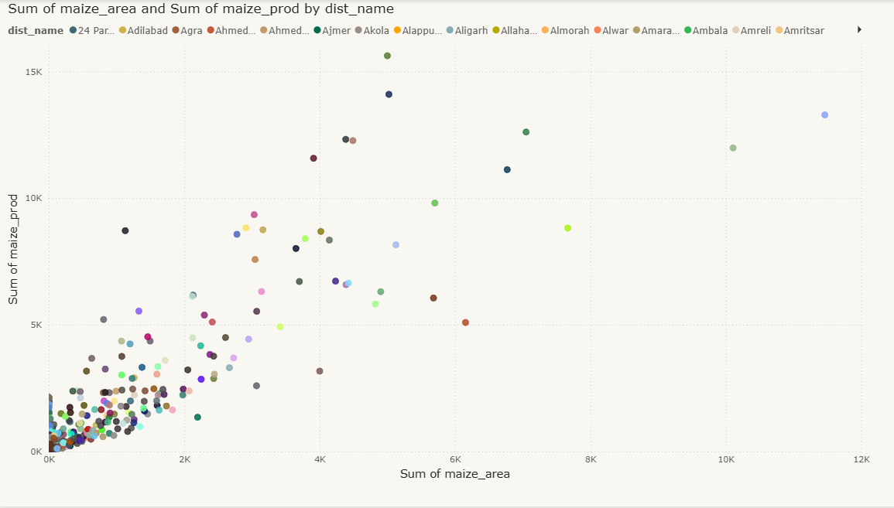
District-wise Correlation Between Area and Production for Major Crops (Maize)

Slide 24
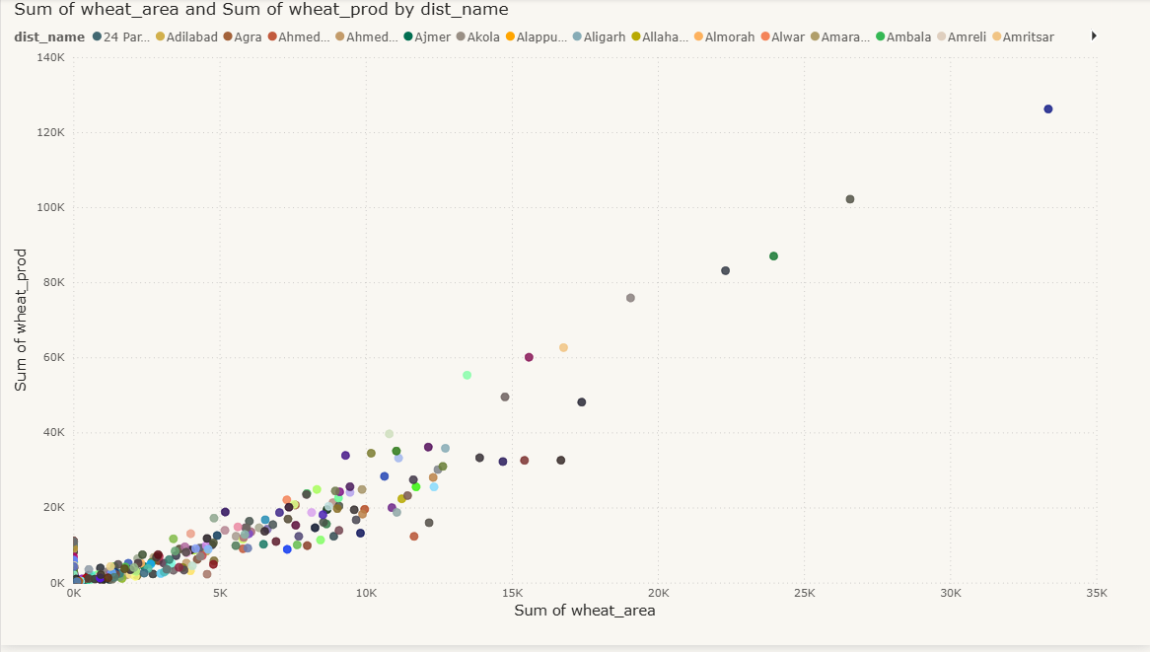
District-wise Correlation Between Area and Production for Major Crops (Wheat)

Slide 25
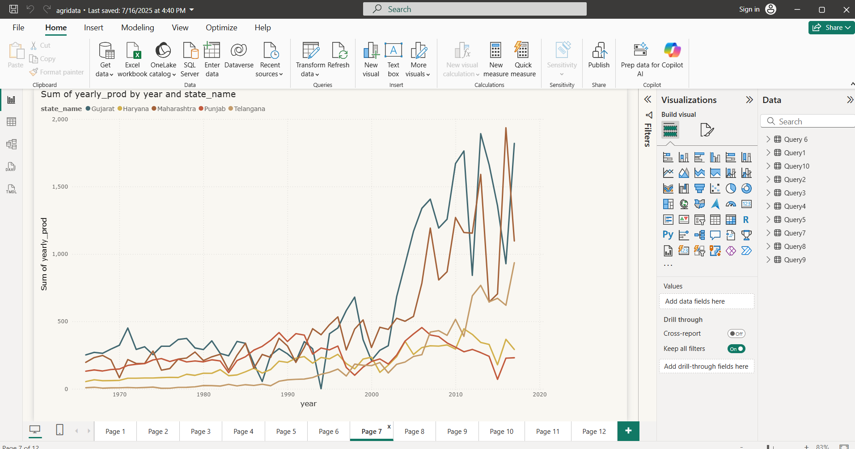
Yearly Production Growth of Cotton in Top 5 Cotton Producing States

Slide 26
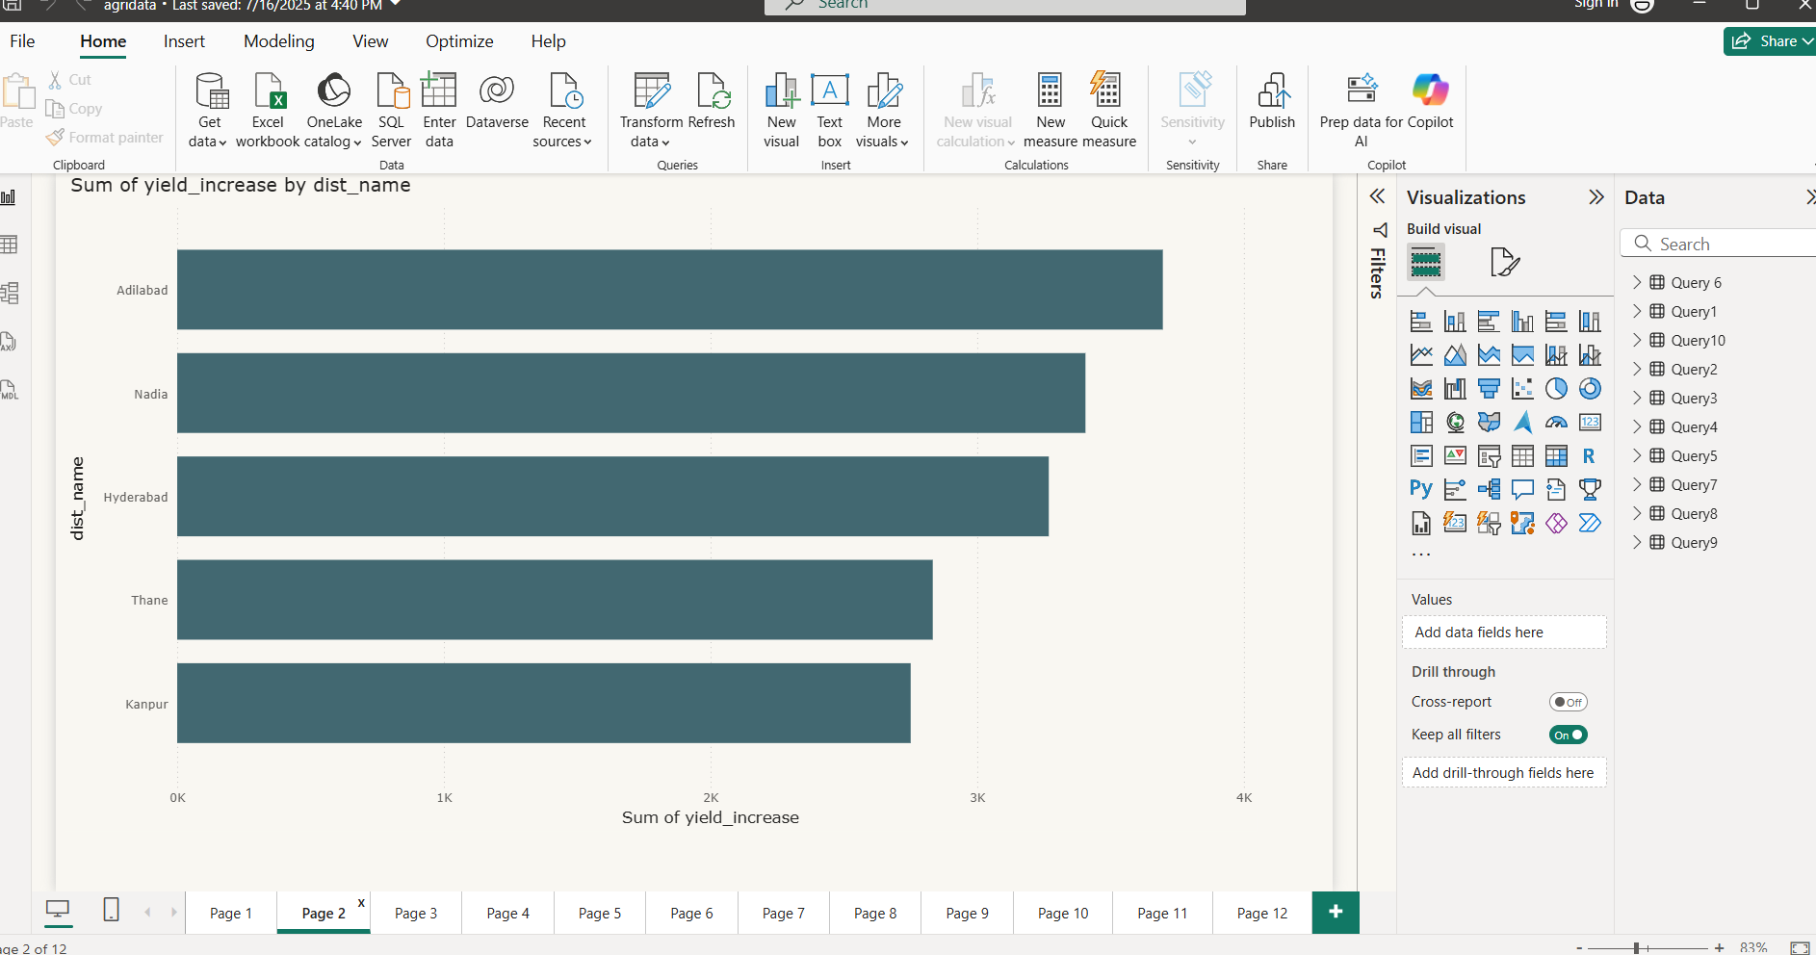
Districts with the Highest Groundnut Production in 2020

Slide 27
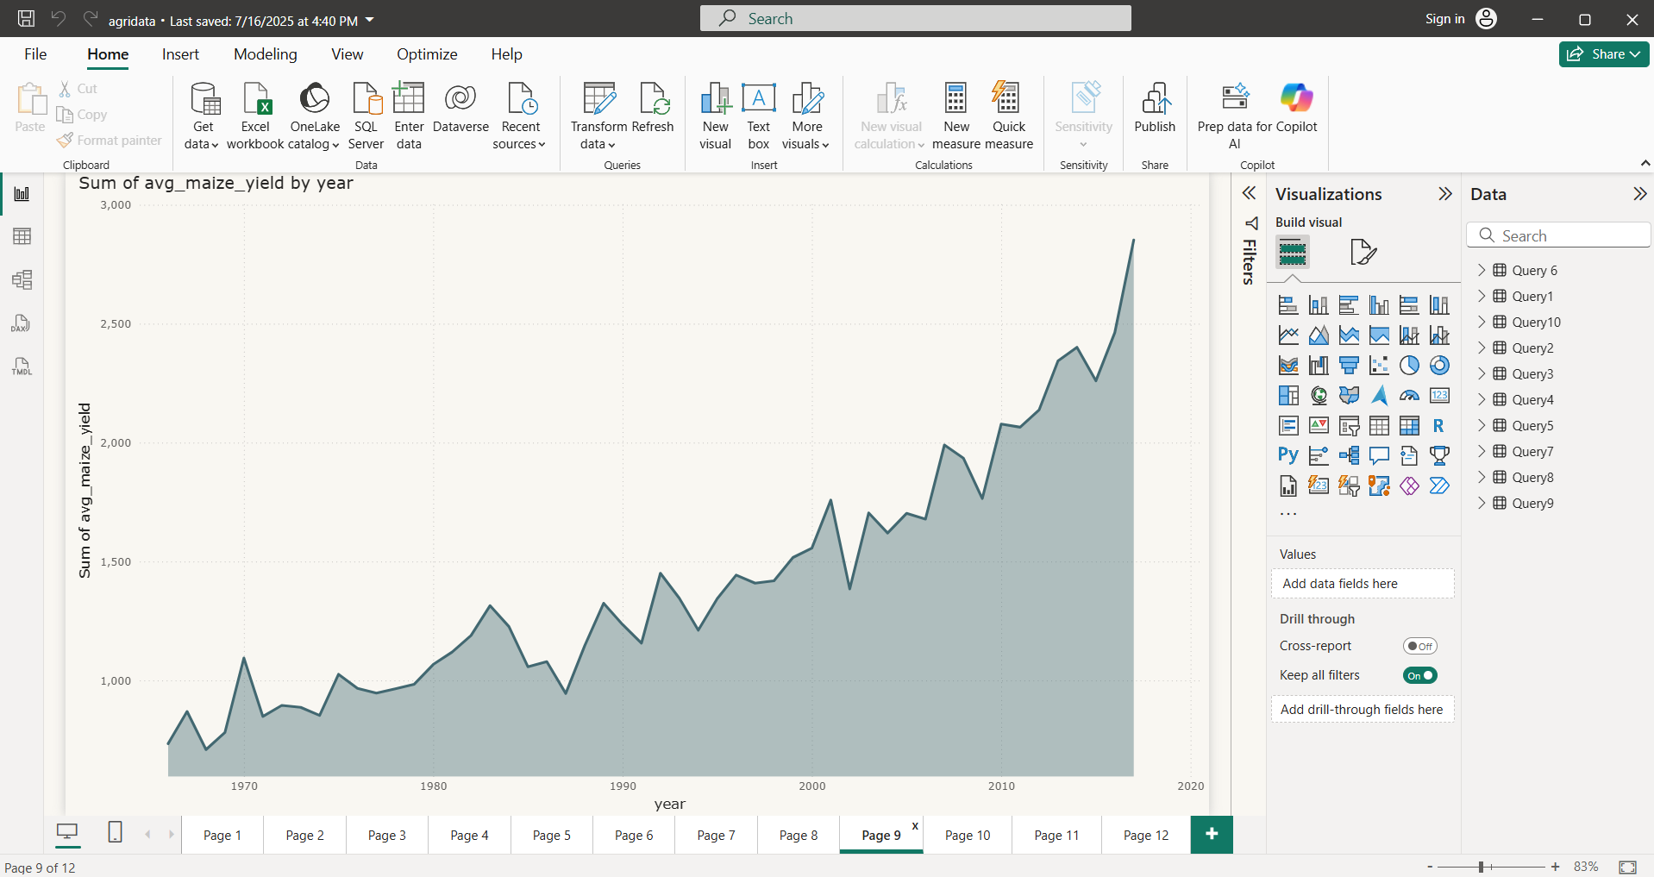
Annual Average Maize Yield Across All States

Slide 28
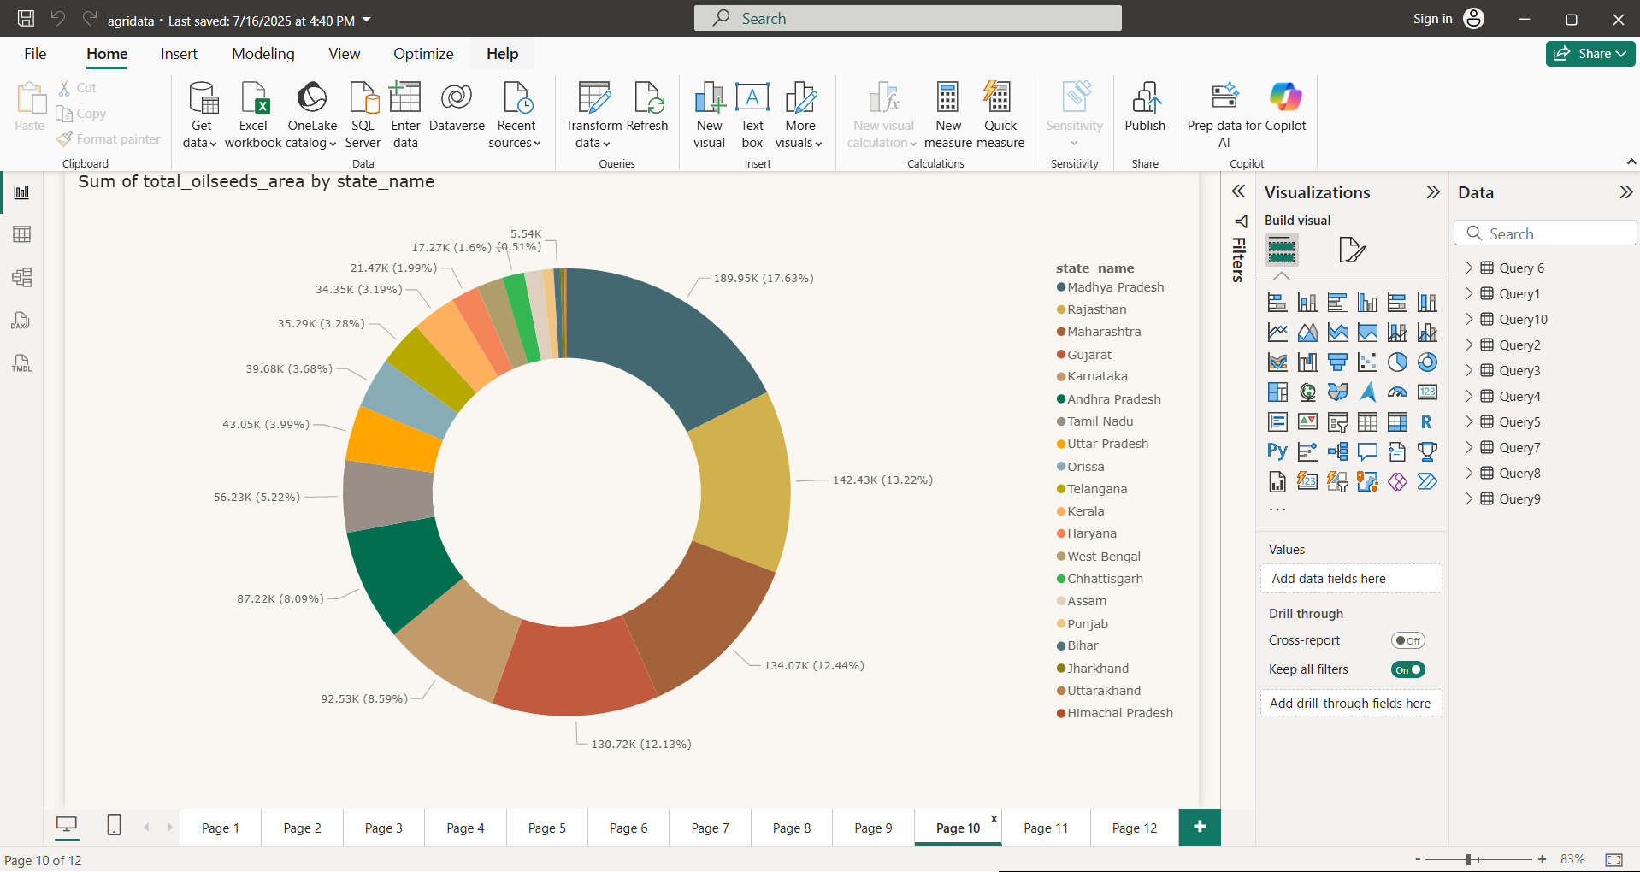
Total Area Cultivated for Oilseeds in Each State

Slide 29
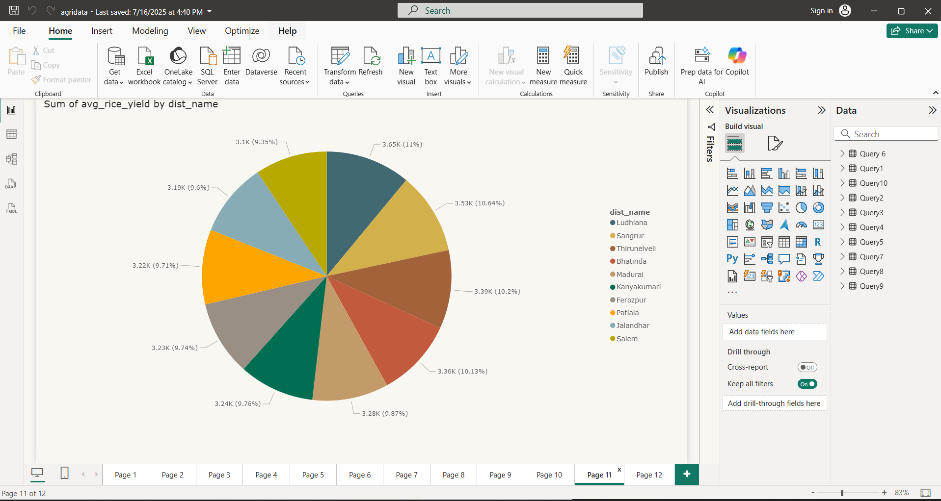
Districts with the Highest Rice Yield

Slide 30
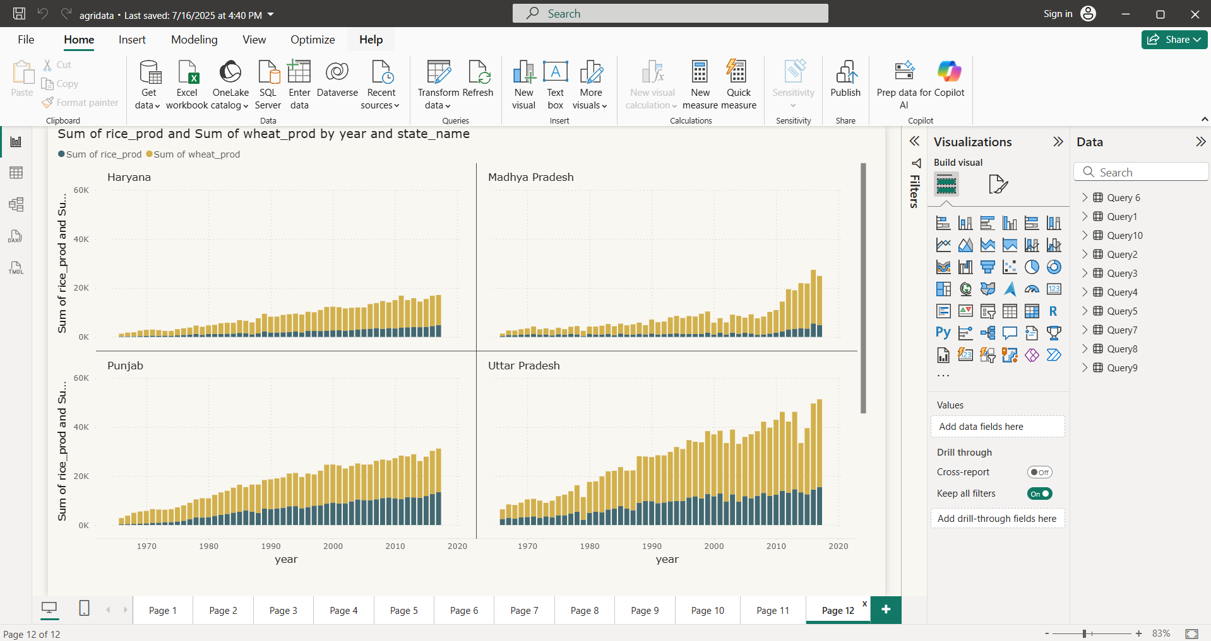
Compare the Production of Wheat and Rice for the Top 5 States Over 10 Years

Slide 31
References
Dataset: AgriDataset_Cleaned
SQL & Python
Power BI Files
Documentation & Guides

