Slide 1
Combatting Dashboard Fatigue: Voice-Powered Queries in AWS
Team 3: Alaine Banninga, Farhad Mughal,
Monica Ou, Ramsey Shaffer, Gene Su
Notes:
#f6a20e
#ffbc45
SCRIPT:
Hello and welcome to our presentation. We’re team 3, and we’ll be presenting on how to combat dashboard fatigue using voice-powered queries in AWS

Slide 2
AGENDA
Motivation: Dashboard Fatigue
Overview of Voice Pipeline
Demo
Use Cases
Limitations
Notes:
SCRIPT:
We’d like to start out by laying out the agenda for our presentation. First, we’ll outline the problems associated with dashboard fatigue as our motivation for utilizing voice-powered queries. We’ll give an overview of our example of a voice pipeline built in AWS along with a demo of voice-powered queries, and we’ll finish with some business use cases and limitations for this approach.

Slide 3
Combatting Dashboard Fatigue
Traditional reporting is over-reliant on dashboard-centric approaches
Over
reliance
Physically logging in to a variety of controls, views, windows, and utilities¹
Display a lot of info and KPIs could be spread across multiple dashboards
Fatigue
Learning curve
Info overload
¹ https://www.loomsystems.com/blog/dashboard-fatigue-is-real
Notes:
SCRIPT:
So, current business intelligence approaches face some issues.
(click)
First, there’s a general over-reliance on dashboard-centric approaches to business intelligence. Dashboards can be great, but they may not be the best solution for every scenario.
(click)
Secondly, with dashboards can come a steep learning curve. Technical and non-technical users alike have to learn how to physically log in to a dashboard, then figure out how to navigate the variety of controls, views, and other functions employed in the dashboard. This takes time and can leave users frustrated after struggling through the process, especially if the people building the dashboard design it how they like, not how the people who actually use the dashboard would like it.
(click)
Lastly, dashboards can give a sense of information overload. There can be so many dashboards, and each dashboard can display a ton of information, leaving your specific KPI tough to find. This is amplified when the KPIs you’re interested in are spread across multiple dashboards. More logging in, more searching, more time consuming.
(click)
All three of these issues combine to induce dashboard fatigue in business intelligence end-users. Surely there must be a more flexible solution.

Slide 4
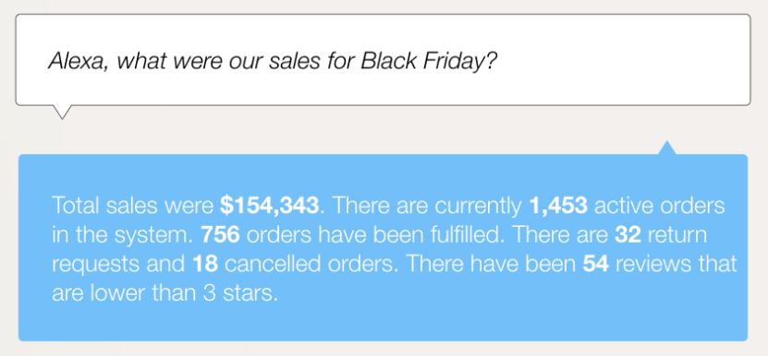
Enter Voice-Powered Queries
https://blog.openbridge.com/4-reasons-why-you-should-be-using-conversational-assistants-like-alexa-for-business-intelligence-d918043ed6ea
Notes:
SCRIPT:
Enter voice-powered queries. Can you imagine as a manager, instead of logging into possibly multiple dashboards, searching for the specific KPI you’re interested in and finally finding it amongst a ton of other information irrelevant to you at the time, simply asking:
(click)
“Alexa, what were our sales for Black Friday?” And she answers with this?
(click)
Voice-queries are a way to reimagine the way we access information. Yes, dashboards can represent very complex information in a more digestible visual way, but what if you only need quick facts that don’t need to be visualized?

Slide 5


Voice-Powered Queries Streamline Access
Managers have more flexible option for accessing KPIs
End users can simply ask questions
Receive only the info you ask for
Over-reliance
Learning curve
Info overload
Saving time and brain power
Notes:
SCRIPT:
Voice-powered queries can streamline access to information, and can address areas where dashboard-centric approaches are lacking.
(click)
Instead of companies solely relying on dashboards for their business intelligence needs,
(click)
companies are afforded the flexibility of information on-the-spot, when quick answers are needed. For end users, there is far less of a learning curve since they can simply ask questions for the information they’re interested in. They also get back only the information they asked for, so there’s no need to sift through a bunch of visualizations or other KPIs that are irrelevant to the current situation.
(click)
All this contributes to saving time and brain power, since answers are quick and to the point.

Slide 6
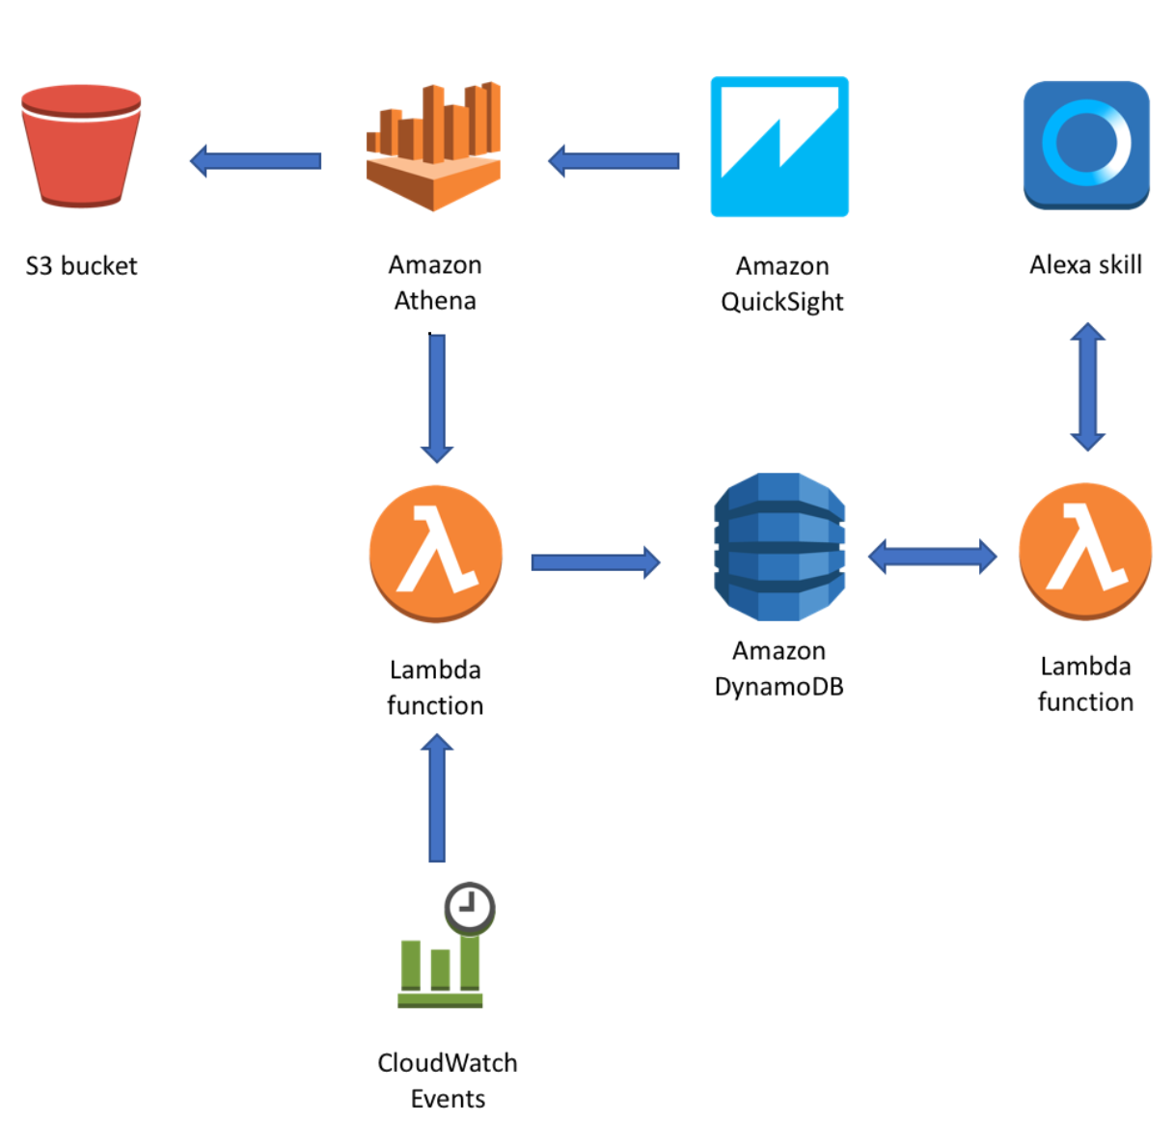
Overview of Voice Pipeline
Athena queries data stored in S3
Alexa triggers lambda based on audio & returns result
Data is stored in S3
The latest query result is stored in a DynamoDB table
Lambda function containing SQL query is triggered to extract value from Athena
Lambda function is set to retrieve data from DynamoDB
Lambda function is scheduled to run every x minutes
Notes:
SCRIPT:
Here’s an overview of the data pipeline, and We will leverage S3, Athena, Lambda function, DynamoDB and Cloudwatch in the backend, and a voice-based user interface through a custom Alexa skill on the front end
First, we assume that data is already stored at S3, and we will use Athena to query S3 at rest using standard SQL language to create an external table. Next, we would use a Lambda function containing an SQL query to extract the pre-identified metric from Athena table. The lambda function is automated via Cloudwatch events to run on a regular schedule and the latest query result is inserted into a DynamoDB table.
Next, an Alexa skill is built and it contains a single intent or an action, in which a user provides an utterance with a single slot value from the metric they wish Alexa to retrieve. The intent handler in Lambda function resolves the intent, and reads the respective data store in the DynamoDB table and gets back to Alexa, and Alexa output the complete answer to the audience

Slide 7
DEMO
https://www.youtube.com/watch?v=pabiGByAr-Y
Notes:
SCRIPT:
Let’s see voice-powered queries in action. Here’s a youtube video that demonstrates using Alexa to share sales performance metrics.

Slide 8
Use Cases
Marketing & Sales
“What is our YTD sales volume for product X?”
“What was our revenue growth in 2019?”
Internal business use
Real-Time Answers
“How many units have we completed so far today?”
“What is the current average customer wait time?”
Public Spaces
“What are the coffee shop hours?”
“Where is the non-fiction section?”
Customer- facing
Private business
“What time of day do most people use this facility?”
“What is the highest rated dish on the menu?”
Notes:
SCRIPT:
There are many different ways that companies/organizations can take advantage of voice powered analytics
(click)
One area that we saw in the demo is for internal business use. Voice queries can be utilized by people in
(click)
Marketing and sales for example, asking questions like “What is our YTD sales volume for product X?” or “What was our revenue growth in 2019?”, rather than relying on a dashboard for these simple questions, especially in meetings or other scenarios when dashboards may be inaccessible.
(click)
Voice would also be great for situations that require fast, real-time answers. These could be manufacturing questions like “How many units have we completed so far today?” or relating to current company traffic: “What is the current average customer wait time?” In addition to internal business use, voice queries also present opportunities for the general public,
(click)
or more customer-facing scenarios. These could be in public spaces or common areas,
(click)
Like hospitals, libraries, or universities, where people could ask questions like “What are the coffee shop hours?” or “Where is the non-fiction section?”. Customers could also benefit from using voice queries
(click)
within private businesses like gyms, restaurants, or hotels, asking questions such as “What time of day do most people use this facility?” and “What is the highest rated dish on the menu?”, especially if there isn’t an employee around that can help them. This gives customers the ability to ask questions and get answers when they want, without waiting for an employee to notice and help them. The opportunities are endless; it is a completely different way to think about how we currently access this kind of information.

Slide 9
Limitations
Intuitive backend configuration
WHO can access WHAT data
Ensure people get the right info & ask in a way Alexa understands
User permissions
WHAT & HOW to ask
Notes:
SCRIPT:
Of course, there are a few limitations with this approach.
(click)
Companies probably won’t want everyone having access to all the data they have, so user permissions to be able to ask certain queries would have to be configured.
(click)
Anyone using Alexa or other voice-enabled device would have to know what to ask and how to ask their question. Certain phrasing may not be recognized by Alexa, depending on how the program was designed and which phrases or keywords Alexa recognizes. Developers also have to make sure the right result comes back for the right question.
(click)
Both of these limitations stem from configuring the backend. In order to implement these voice-queries, it requires companies to have people on hand that have the technical knowledge to be able to configure the backend side of the queries. Although there are helpful resources online, there are still issues that could arise from a mis-configuration of the voice-queries’ development. However, as long as a company has competent developers, these limitations are far outweighed by the benefits and flexibility voice-powered queries provide, compared to dashboard-centric approaches.

Slide 10
THANK YOU!
Alaine Banninga banni037@umn.edu
Ramsey Shaffer shaff177@umn.edu
Farhad Mughal mugha004@umn.edu
Gene Su su000167@umn.edu
Monica Ou ou000004@umn.edu
Notes:
SCRIPT:
So, that concludes our presentation. Thank you for giving us your time, and we look forward to any questions you may have!

