Slide 1

Is Chicago Safe? A story about crime rate trends in the city of Chicago and implications for Real Estate development
Powered by
Data Visualization and Analysis Project
________________________________________________________________________________________________________________________________________________________
Monica Rossetti
Dec 6th, 2018

Slide 2
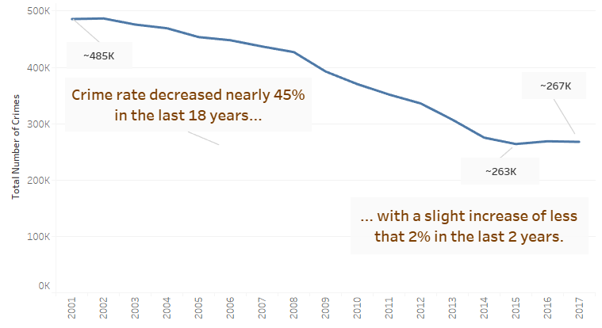
Historically Chicago has a bad reputation of being a violent city, but data shows a different story…
Note that Chicago’s population has dropped only ~7% from 2000 to 2017.
(http://worldpopulationreview.com/us-cities/chicago-population/)

Slide 3
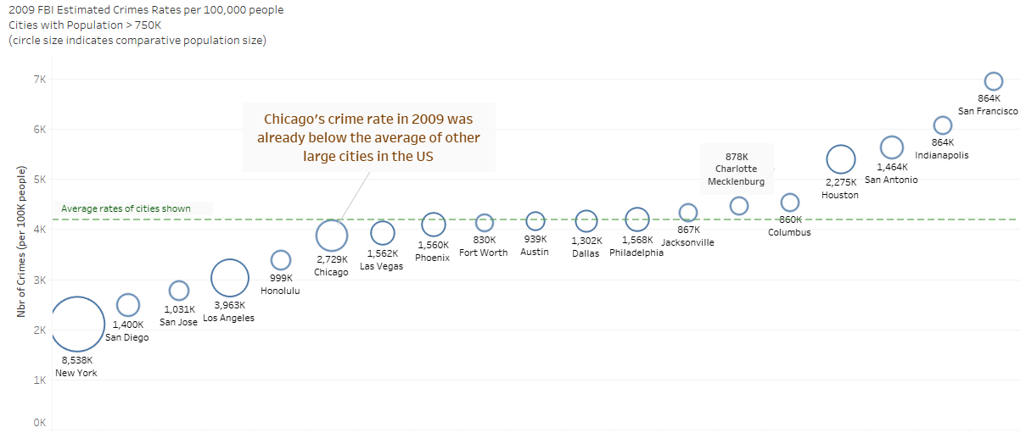
How does Chicago’s crime rates compare to other US major cities?

Slide 4
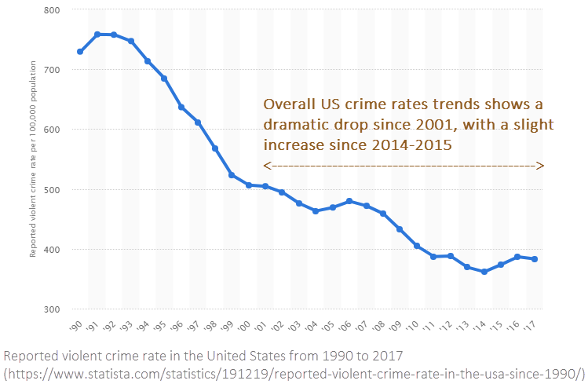
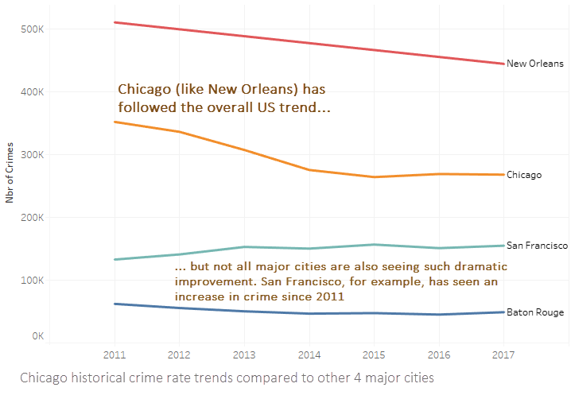
How does Chicago’s crime trend compare with the U.S. as a whole?

Slide 5
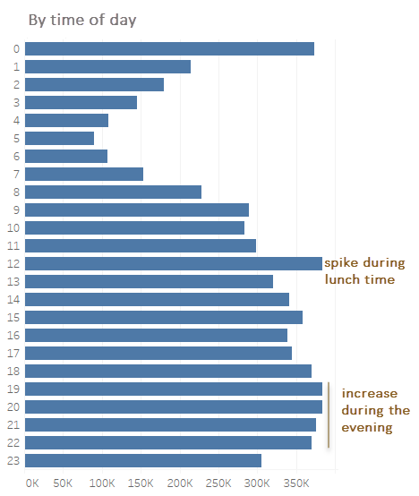
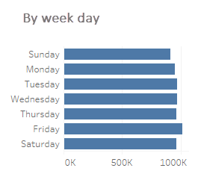
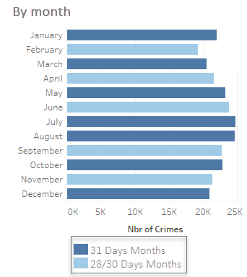
Are there any crime rates seasonality patterns (2017 data)?
One could expect that the harsh winter months in Chicago would bring lower crime rates, and that is supported by the data. July and August have about 20% higher rates than December and January. Crime is mainly evenly distributed over the 7 days of the week with a small increase on Fridays. Evenings and late nights have considerably higher rates than morning and afternoons, with a small spike during lunch time.

Slide 6
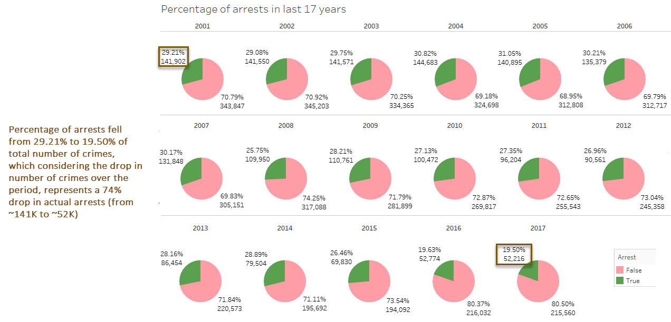
Does the decrease in the number of crimes correlate with rates of arrests?

Slide 7
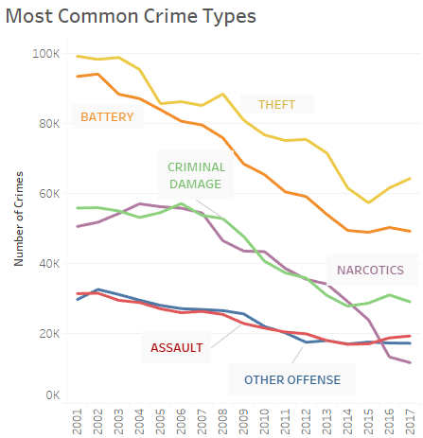
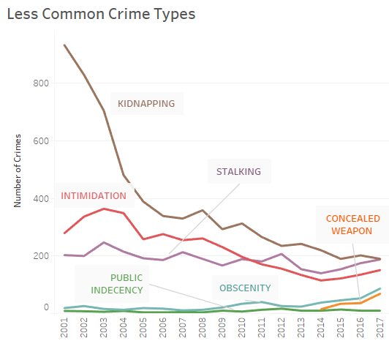
Most common X less common crime types

Slide 8
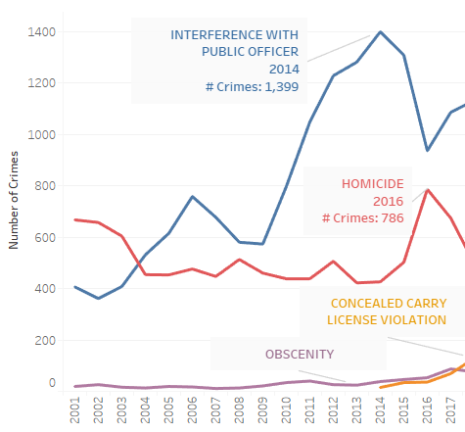
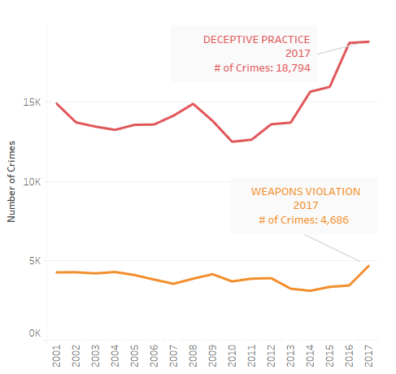
Which crime types are increasing?
A few crimes have increased in numbers such as homicide, obscenity, weapons licenses violations, interference with officer and deceptive practice. Except for homicide, most of those are non-violent.

Slide 9
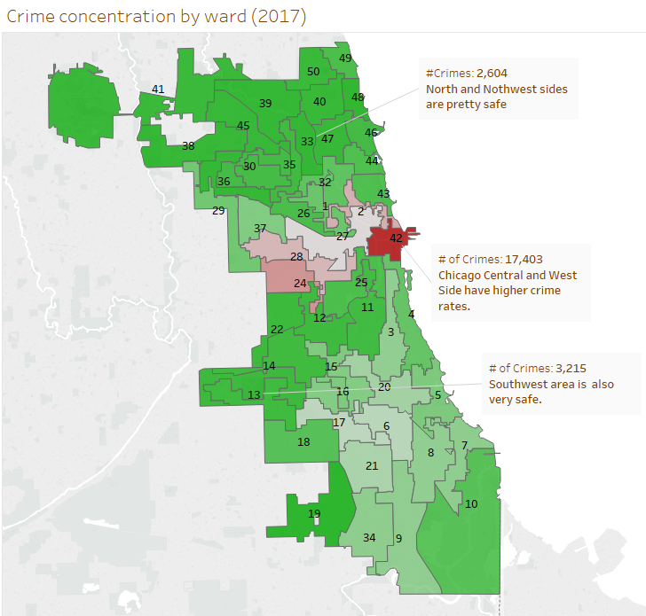
How is the crime rate distributed geographically across town?

Slide 10
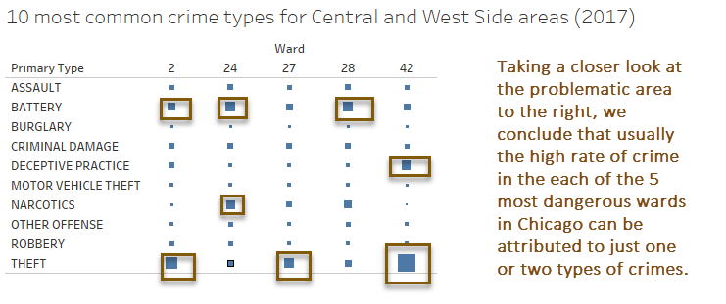
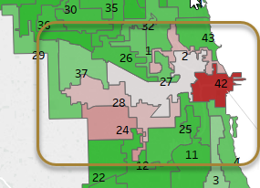
A closer look at Central and West Side areas

Slide 11
Summary and Recommendations
In line with overall national trends, Chicago’s crime rate has decreased significantly in the last 17 years which is a strong selling point for real state property development in the city. Comparatively, not all large US cities have followed this trend. Furthermore, the city per capita crime rate is below the average for other large cities in the U.S.
Crime rates increase during the summer months and over the course of the day, incidents are concentrated in the evening and late night.
The percentage of arrests over the years has decreased significantly with significant less offenders being brought to justice relative to the overall number of crimes over the years.
The 4 most common crimes are theft, battery, criminal damage and narcotics. Their relative frequency has remained the same over the years. A few types of crimes have increased and except for homicide, they are mainly non-violent.
There are distinctive areas in the city that concentrate a high number of crimes (Central and West Side) and should be avoided for real state development. Should a project be considered in those areas, planning for avoidance or solutions to the few specific types of crimes that dominate the area, such as theft, could be considered.
New development projects should focus on low crime areas such as North, Northwest and Southwest.

