Slide 1
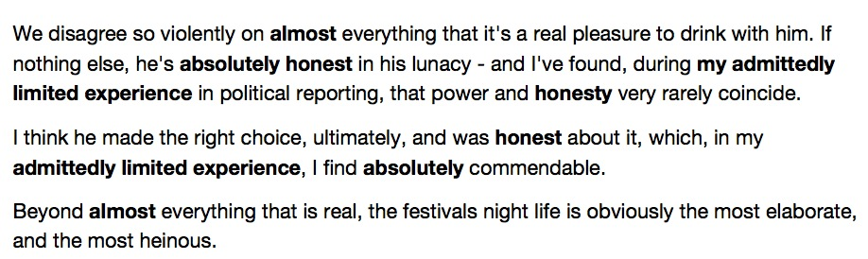

Slide 2
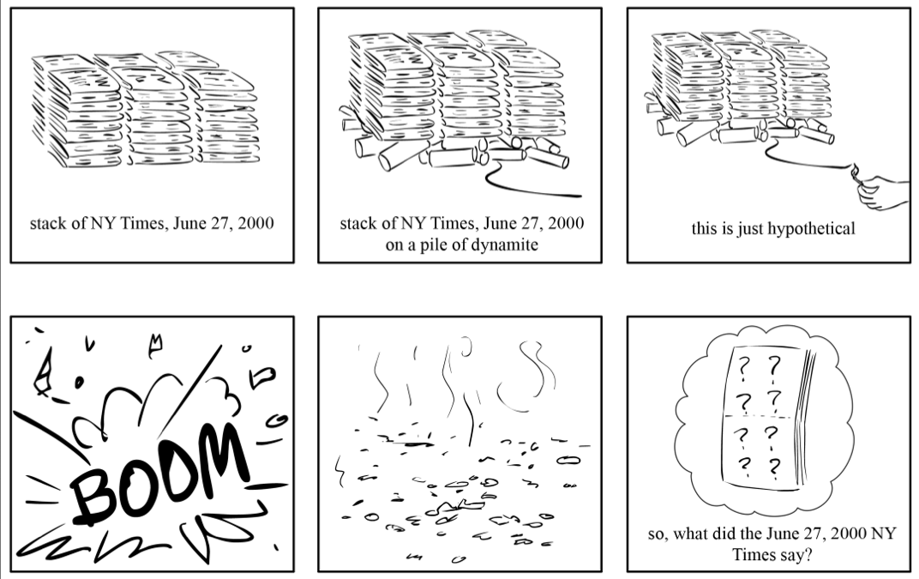
Compeau & Pevzner 2010 http://cseweb.ucsd.edu

Slide 4
d_absolutely_c

Slide 5
_and_honesty_v

Slide 6
ely_honest_in_

Slide 7
ely_honest_in_
_and_honesty_v
d_absolutely_c

Slide 9

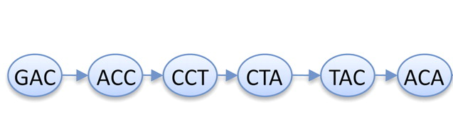
de Bruijn graphs
Developed outside of DNA-related work
Best solution for very short reads ≤100 nt
Read
GACCTACA
GAC
ACC
CCT
CTA
TAC
ACA
de Bruijn graph
K-mers (K=3)
K-1 bases overlap

Slide 10
de Bruijn graphs
Draw the De Bruijn Graph of this read
Using k = 4
GCTGATCGATTT

Slide 11
de Bruijn graphs
Now add the second read
Using k = 4
NOTE check whether some of the nodes are already in your graph!
GCTGATCGATTT
CGATTTTCGGCG

Slide 12
GCTGATCGATTT
CGATTTTCGGCG

Slide 13
de Bruijn graphs
Now add the third read
Using k = 4
NOTE check whether some of the nodes are already in your graph!
GCTGATCGATTT
CGATTTTCGGCG
TTTCGGCGAAAA

Slide 14
GCTGATCGATTT
CGATTTTCGGCG
TTTCGG
AAAA

Slide 15
Install the Jupyter notebook and some python packages
IF YOU ARE ON vetur OR vor, type:
ssh nordur OR ssh austur
Everyone:
pip install --user jupyter pandas numpy pysam
(this may take a few minutes)

Slide 16
mkdir assembly
cd assembly
rsync –av username@cod3.hpc.uio.no:/data/assembly/DeBruijnGraph.ipynb ./
jupyter notebook DeBruijnGraph.ipynb
OR
ipython notebook DeBruijnGraph.ipynb

Slide 17
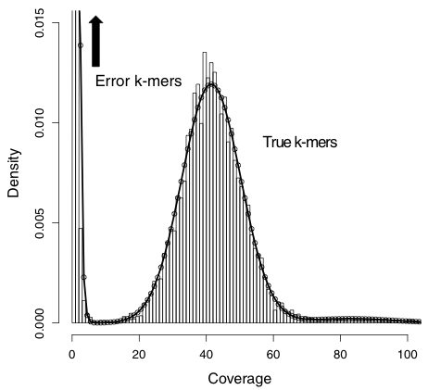
Quality matters
Sequencing errors
add complexity to graph
create new k-mers
Correction of errors
k-mer frequency
Kelley et al. Genome Biology 2010 11:R116

