Slide 1


High Throughput Sequencing and applications
Lex Nederbragt
Norwegian High-Throughput Sequencing Centre (NSC)
and
Centre for Ecological and Evolutionary Synthesis (CEES)

Slide 2
Illumina HiSeq 1000 1500 2000 2500 3000 4000
Illumina HiSeq X (Five and Ten)
Illumina NextSeq 500
Illumina MiSeq
Pacific Biosciences RSII
Ion Torrent PGM
Ion Torrent Proton
Ion Torrent S5 and S5XL
Oxford Nanopore MinION (MkI), PromethION, GridIO
Roche 454 GS FLX, Junior
SOLiD 1 2 3 4 5500 5500XL
BGI revolocity
HeliScope
ABI Sanger 3730xl
Special types
10X genomics
Moleculo/TruSeq synthetic reads
BioNano Genomics

Slide 3
Read lengths versus throughput
for each sequencing instrument still being sold, find the specifications on the company’s website
make a plot in a google spreadsheet with the read length on the x-axis and the per-run throughput in Gigabp on the Y axis
make both axis log scale

Slide 4
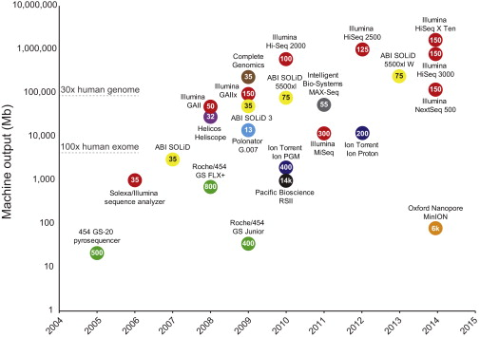
Reuter et al (2015): http://dx.doi.org/10.1016/j.molcel.2015.05.004

Slide 5
Pacific Biosciences
Zero-mode waveguide
Metzker 2010 Nat Rev Genet.11(1):31-46

Slide 6
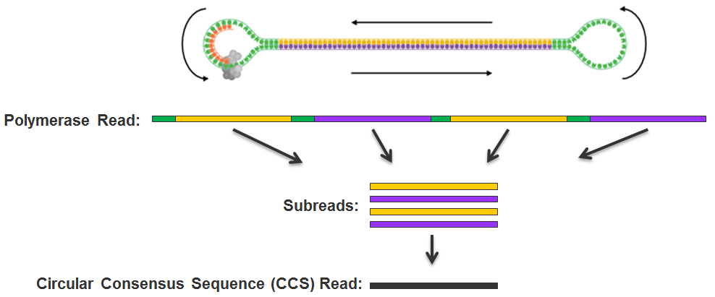
PacBio SMRTBell
http://files.pacb.com/software/smrtanalysis/2.2.0/doc/smrtportal/help/!SSL!/Webhelp/Portal_PacBio_Glossary.htm

Slide 7
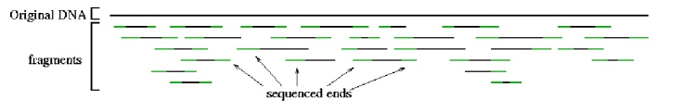

Single end, paired end mate pairs
Paired end reads → 100-500 bp insert
original DNA
fragments
Sequenced ends
Mate pairs → 2-20 kb insert
Repeat copy 1
Repeat copy 2
mate pair reads

Slide 8
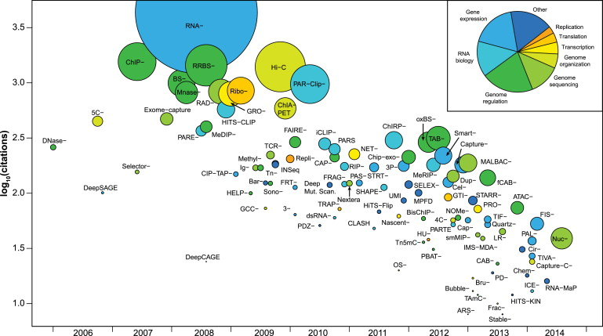
Reuter et al (2015): http://dx.doi.org/10.1016/j.molcel.2015.05.004

Slide 9
Data
Amount of data
Finding data
Getting data in the right shape
Scrubbing
Understanding the data
Data management
Sharing data

Slide 10
Software
Understanding the algorithms
Installing software
Choosing program from all possible
Can not always use the same tool
Not always the same tool that is best
Software parameter space
Validation of computational results

Slide 11
Compute resources
Local versus HPC versus cloud
Computational time
Getting access
Optimal use of HPC resources

Slide 12
User interfaces
unix shell
web-based
GUI-based

Slide 13
Skills
Unix skills
Programming skills
Statistics

Slide 14
Ethics
Ethical approval
Sensitive data
Reproducibility

Slide 15
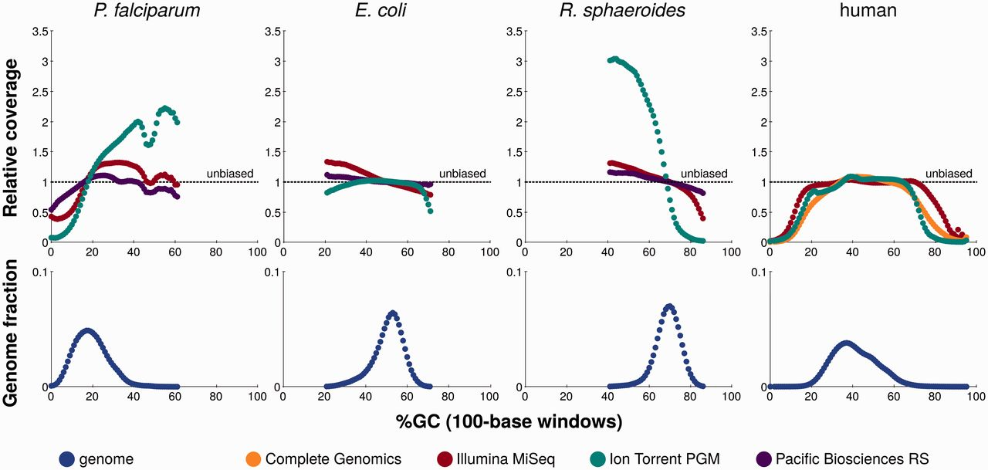
GC bias
Laehnemann et al 2015 () http://bib.oxfordjournals.org/content/early/2015/05/29/bib.bbv029
(after http://www.genomebiology.com/content/14/5/R51)

Slide 16
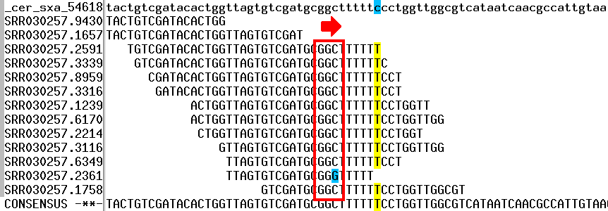
GGCxG motifs and Illumina
Reference
http://mira-assembler.sourceforge.net/docs/DefinitiveGuideToMIRA.html

