Slide 1


ChIP-seq / stranded RNA-seq
Gregor Gilfillan
Department of Medical Genetics,
Oslo University Hospital

Slide 2
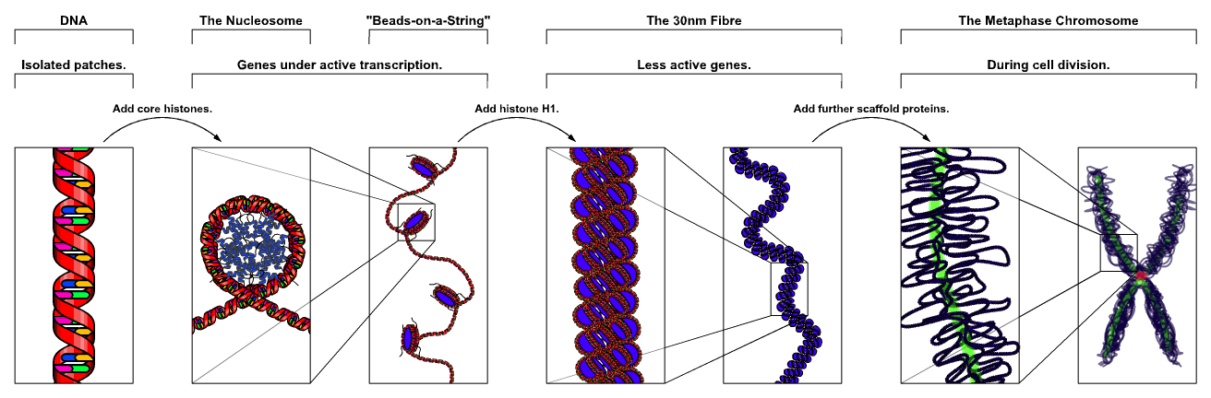
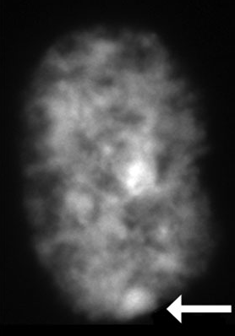
Epigenetics: Heritable traits not encoded in the DNA sequence.
-Me
wikipedia
Mediated by:
-DNA methylation
-Histone variants
-Histone covalent modification
-Non-coding RNAs (miRNAs, long non-coding RNAs)
-Nucleosome remodelling (positioning) and chromatin compaction
-Nuclear position

Slide 3
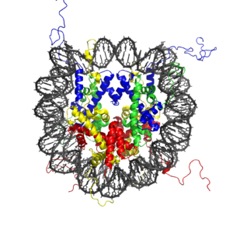
Histones
Post-translational modifications
-acetylation
-methylation
-phosphorylation
-Ubiquitylation
-SUMOylation
-Citrullination / deimination
-Proline isomerisation
-ADP-ribosylation
-Palmitoylation
-GlcNac
Luger et al, 1997

Slide 4
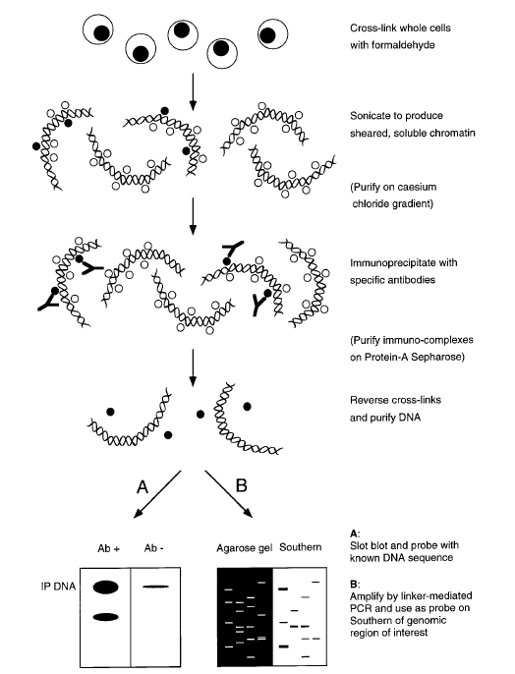

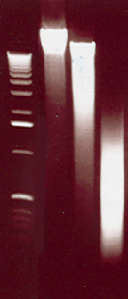
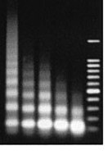
Chromatin IP: X-ChIP vs N-ChIP
X-ChIP (cross-linked)
N-ChIP (Native)
Sonication
MNase
Orlando et al,
Methods (1997) 11(2):205-14.
Advantages: Wide use Stronger signals, higher resolution
Disadvantages: Artifacts possible Limited to histones

Slide 5
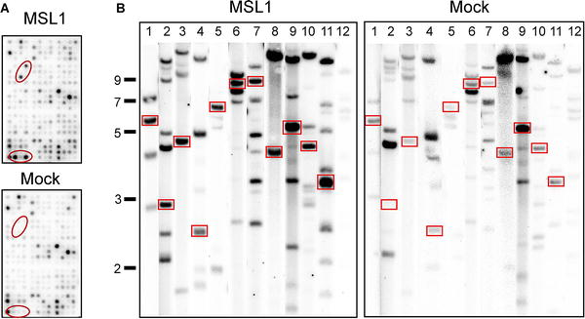
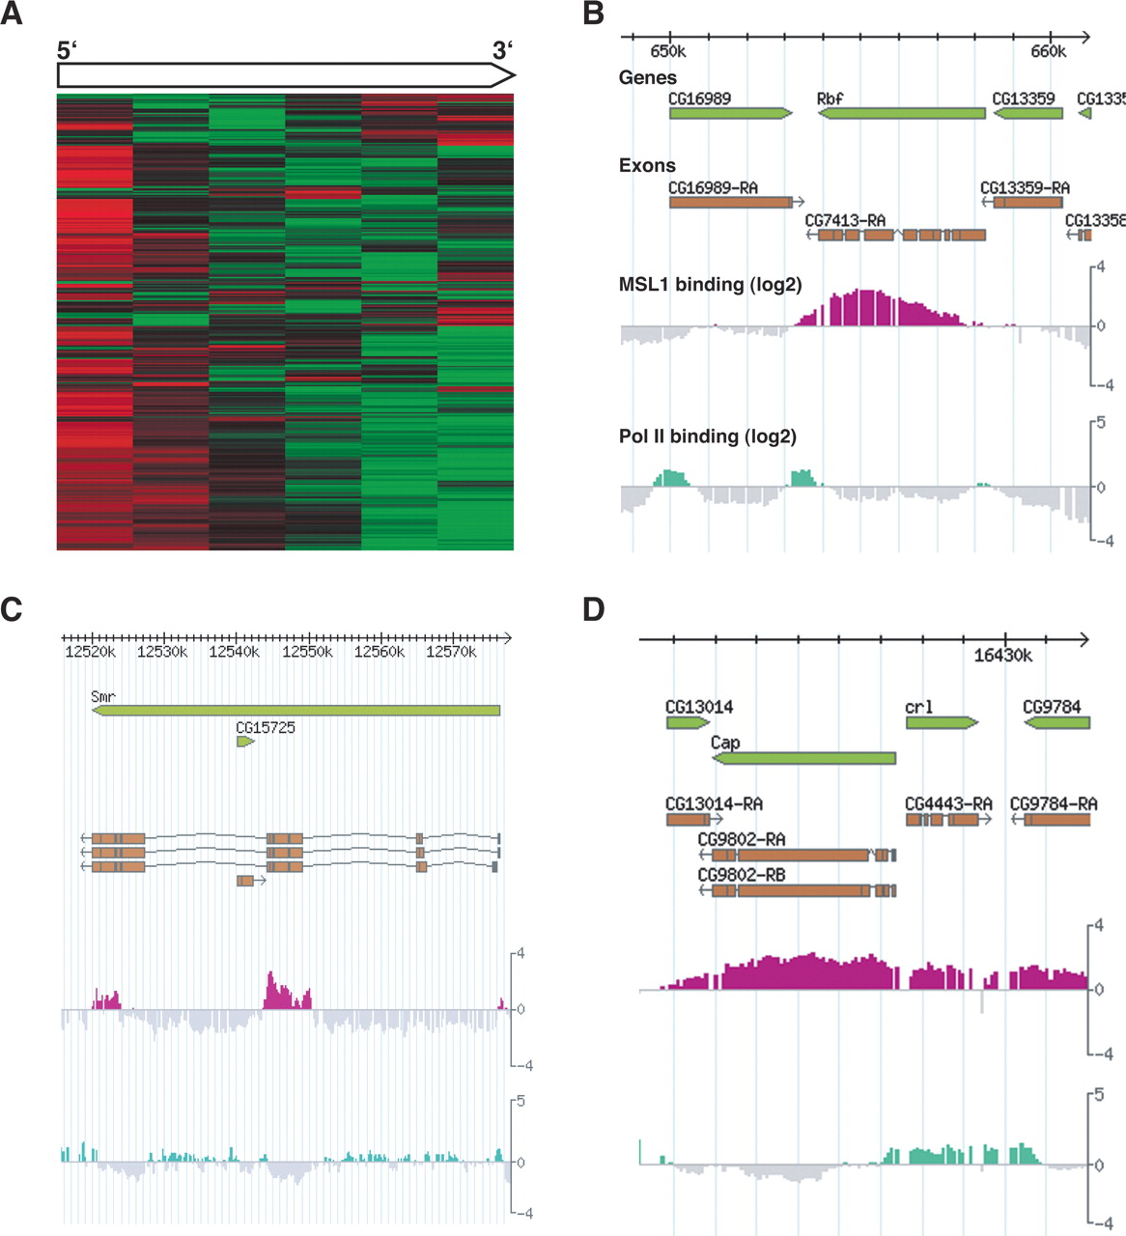
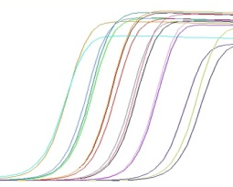
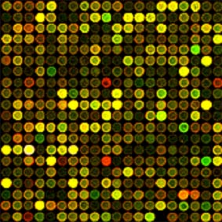
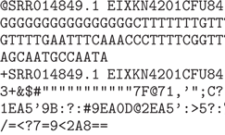
ChIP: data readout
(Where in the genome was my protein bound?)
Specific IgG
Southern
Hybridisation
IP’d DNA
qPCR
Microarray
(ChIP-chip)
NGS
(ChIP-seq)

Slide 6
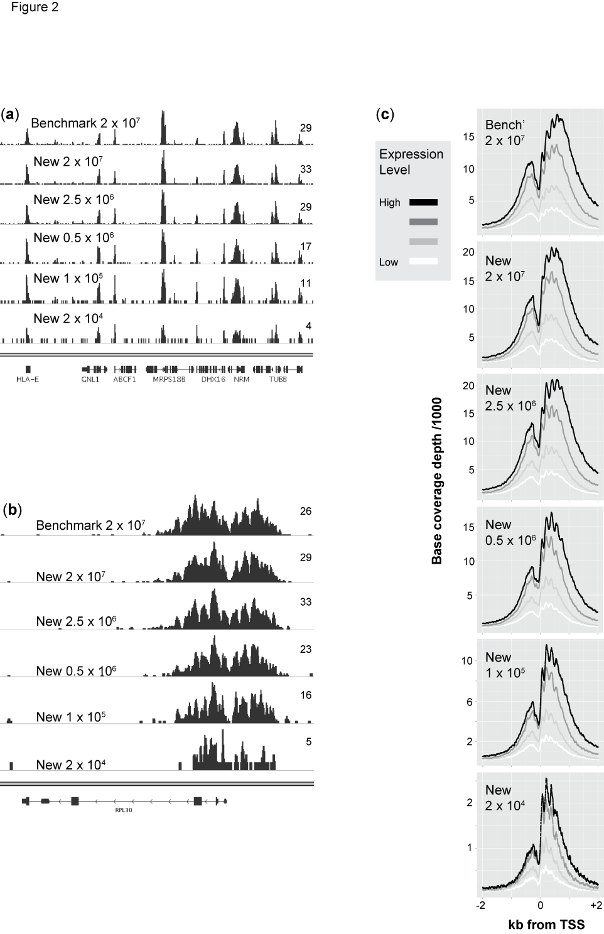
A. Low-input Native-ChIP-seq protocol development
ChIP with anti-H3K4me3 antibody:
MHC (330 kb)
Read
Depth
RPL30 locus (6 kb)
Read
Depth
- BMC Genomics 2012, 13:645

Slide 7
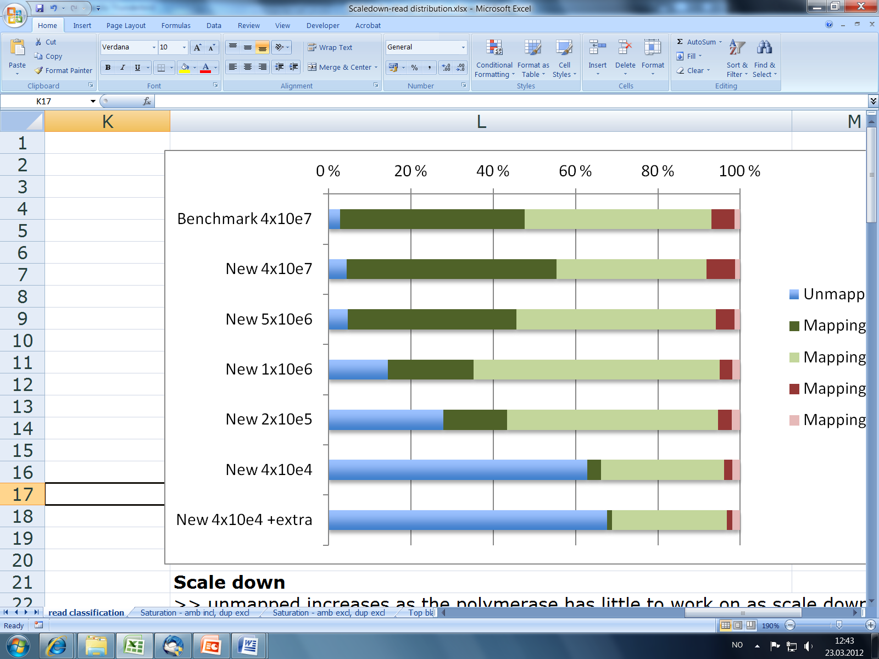
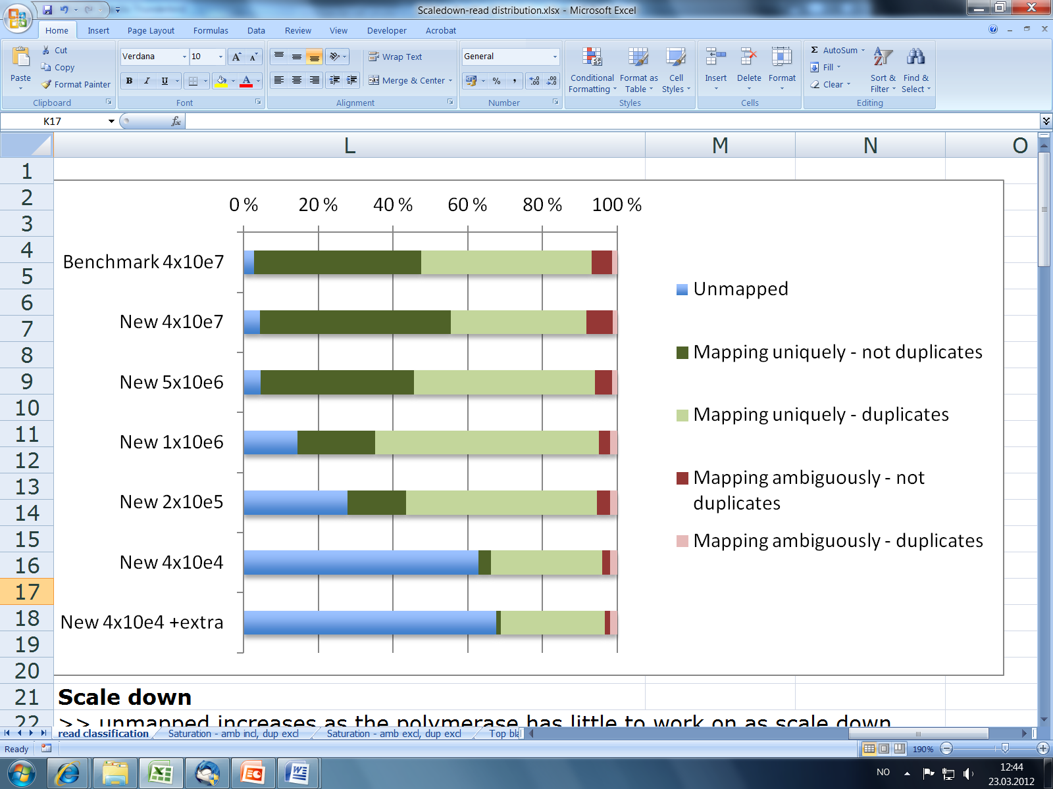
Illumina reads: yield & mapping to human genome
Total read number (millions)
ChIP & Input cell number
% SequenceReads
Benchmark
2.0 x 10⁷
13.4
New
13.8
2.0 x 10⁷
New
14.1
2.5 x 10⁶
New
16.7
0.5 x 10⁶
1.0 x 10⁵
15.6
New
New
2.0 x 10⁴
17.1
Problems of scaling down = PCR duplicates, PCR nonsense

Slide 8
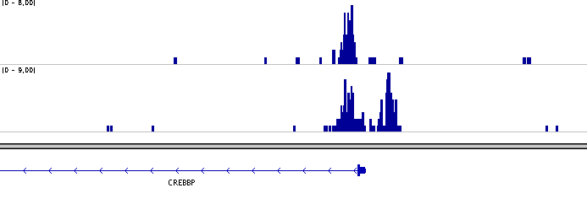


B. Epigenetic study of human MZ twins discordant for psoriasis:
Magnetic-isolated CD4⁺ lymphocytes. Peaks called using ChIPDiff. Differentially methylated site displayed in IGV genome browser.
Twin 1
Twin 2

Slide 9
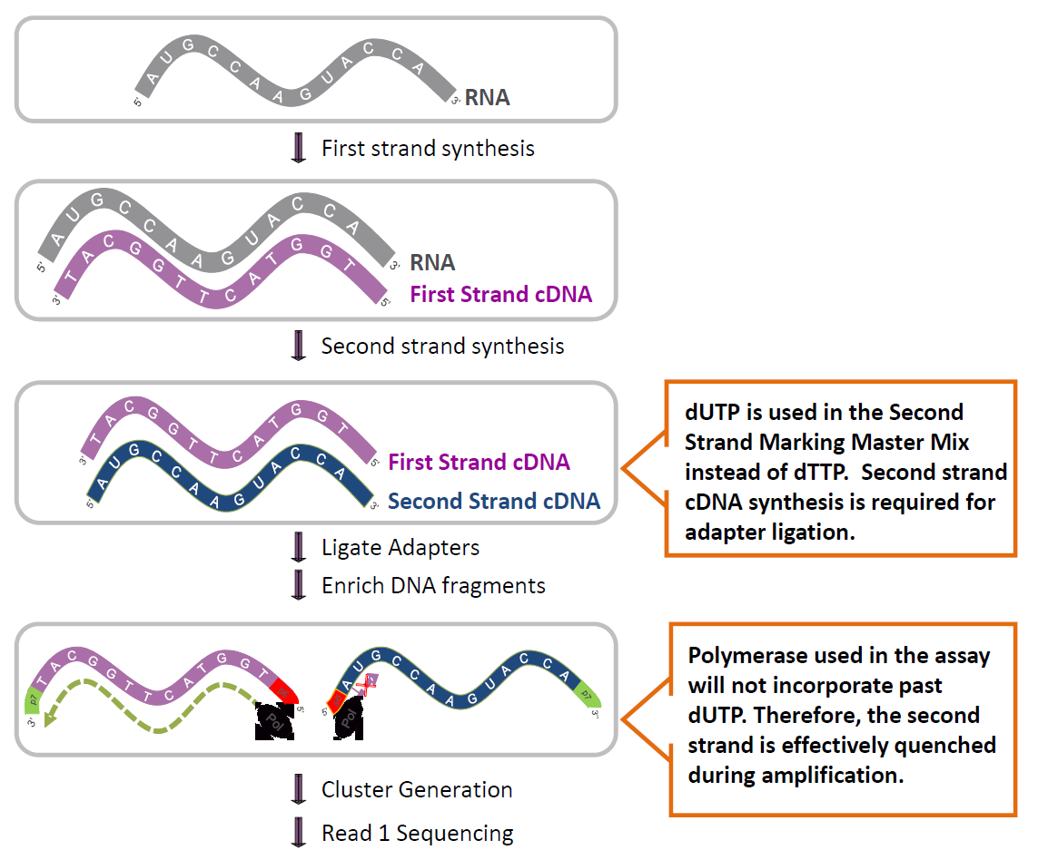
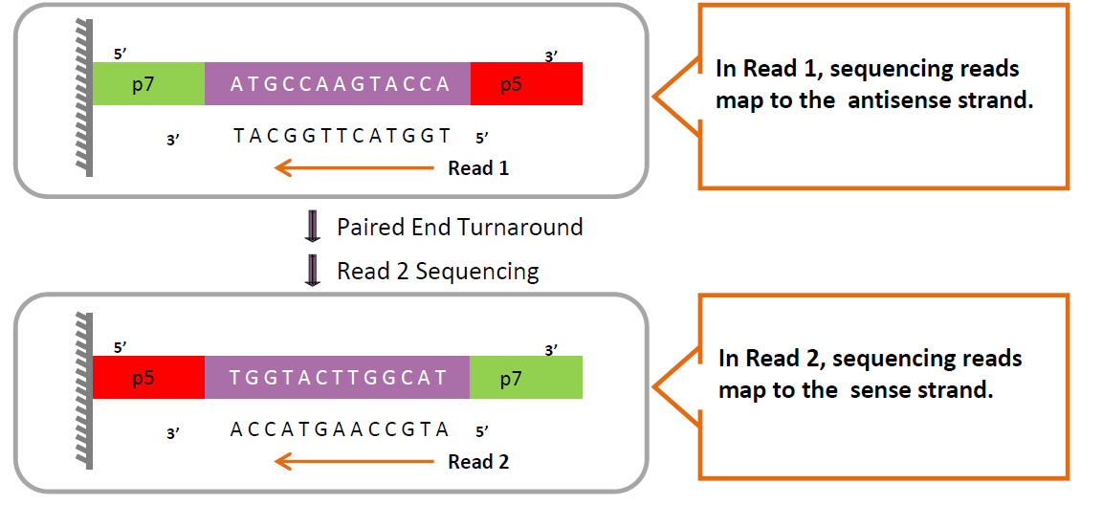
Strand-specific RNA-seq

Slide 10
Thanks for your attention
www.sequencing.uio.no
post@sequencing.uio.no
gregorg@medisin.uio.no

