Slide 1
Builder pattern
by Monica Stoica
and Rosen Danev
DPR course

Slide 2

Definition:
The builder pattern is a design pattern that allows for the step-by-step creation of complex objects using the correct sequence of actions. The construction is controlled by a director object that only needs to know the type of object it is to create.
Purpose:
Separates the construction of a complex objects from its representations so that the same construction process can create different representations.

Slide 3
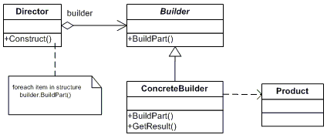
Components of the pattern
-Builder (e.g. IHouseBuiler) interface which is in charge of creating pars of a Product object
- ConcreteBuiler(e.g.VacationHouseBuilder) class constructs and puts together parts by implementing the interface.
- Director (e.g. ArchitectDirector) class constructs the complex object using the Builder interface
- Product (e.g. House) represents the complex object that is being built.

Slide 4
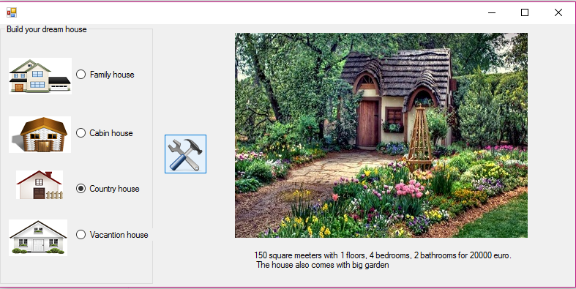
House builder

Slide 5
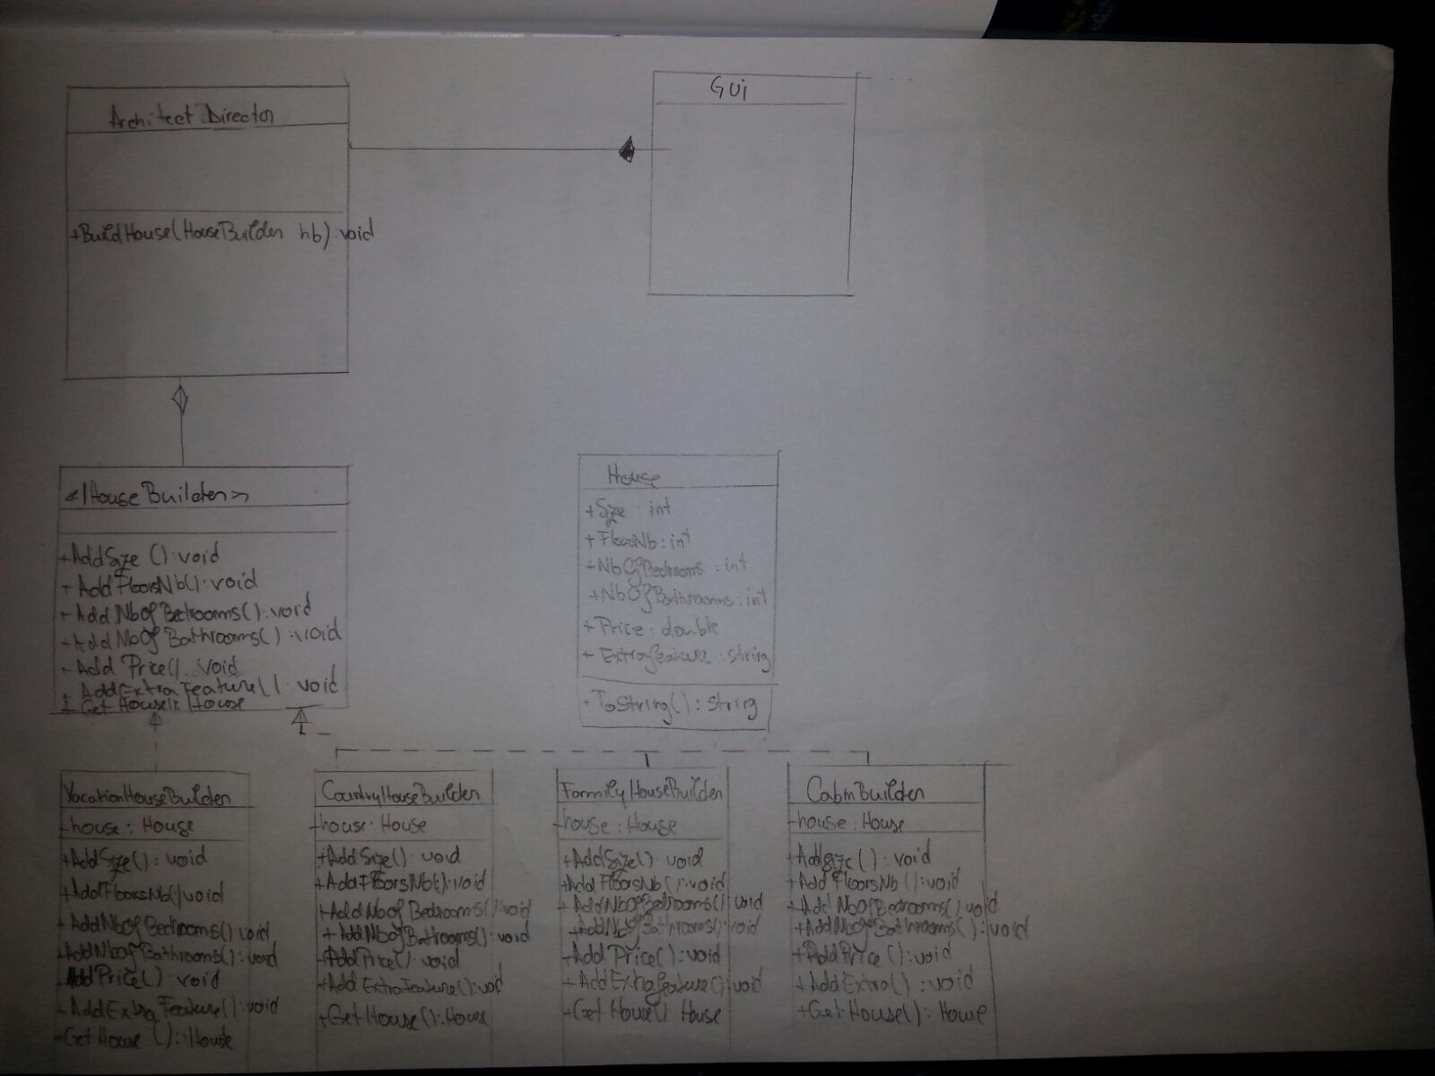
UML Diagram

Slide 6

Advantages:
Objects have different internal representation.
Control over the steps of the construction process.
Provides encapsulation.
Notes:
When using the builder pattern, the objects can have different internal representation. For example, the extra property of our house is different for all our concrete builders. It is also possible to control the steps of the construction process – first build the foundation and in the end the roof. If the number of objects is very big, it is easier to maintain the code and only the final product. The pattern provides encapsulation; therefore the fully constructed object will be available to the client

Slide 7

Disadvantages:
Duplication of code
Becomes too complex when there are too many concrete builders
Notes:
The main disadvantage of the builder pattern is that when a new type of product is added, a new concrete builder has to be added. Moreover, if the product is very complex then code duplication will be high.

Slide 8
Related patterns
Abstract Factory
both separate the system from product creation and representation.
Calls methods directly

Slide 9
Questions?

