Slide 1






E-commerce Data Analysis
By Monika HS and Shrushti K yalagi

Slide 2
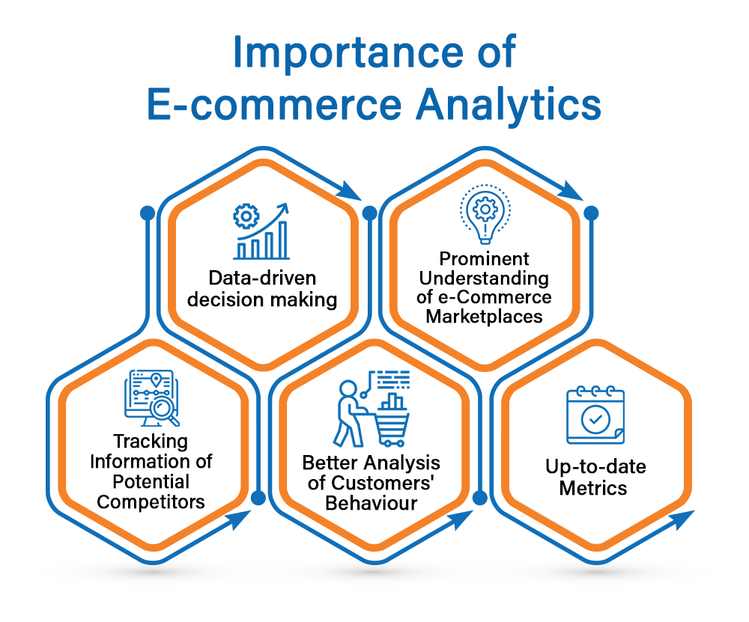

Slide 3


Slide 4
Applications of This Schema
Sales Analysis:
Analyze customer purchase behavior (e.g., most popular products or categories).
Identify high-performing sellers or regions.
Customer Insights:
Analyze reviews to determine customer satisfaction.
Segment customers based on geography or buying patterns.
Operational Efficiency:
Monitor delivery times and improve logistics using geolocation data.
Track inventory or seller performance based on product demand.
Payment Insights:
Understand customer preferences for payment methods.
Geographic Trends:
Identify top regions for sales or delivery challenges using ZIP codes.

Slide 5


