Slide 1

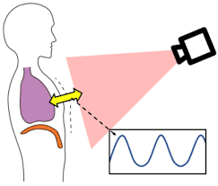
Post Graduate Diploma in Big Data Analytics (PG-DBDA)
March 2023 Batch
Real Time Camera-Based Adaptive Breath Analyser System
Group No. 1
Project Team Members:
Lokesh Sali
Monica Jha
Shivani Phuke
Guided By:
Dr. Priyanka Jain

Slide 2
Contents
Introduction
Problem definition
Scope of project
Technologies Used
Workflow diagram
Working of Project

Slide 3
Introduction
This system consists of the real-time camera-based acquisition of breathing data of a human being.
On the basis of the acquired data , the respiratory rate is monitored so as to primarily conclude whether the person at test is stressed or not.

Slide 4
Problem definition
Breathing is one of the vital signs used to assess the physical health of a subject .
Non contact , real time- based measurements of both breathing rate and changes in breathing rate can help monitor the health conditions of the subjects more flexibly.

Slide 5
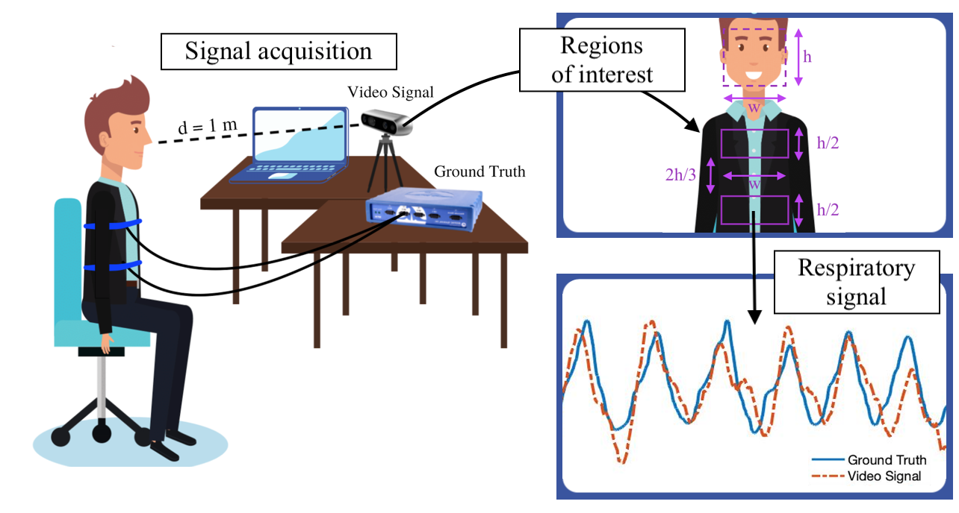
Scope of project
The scope here is to create a model that predicts the normal respiration rate of a human being.
Once the model has achieved a great accuracy, then this model can be used to predict based on a real time video feed, whether a human is stressed or not.
This would be detected using the respiration rate of that person.

Slide 6
Technologies Used
Front-End:
a. Hardware: Webcam for video feed of respiratory motion
b. Software: OpenCV
Back-End:
a. Machine Learning: Jupyter/Google Collab for generating model
b. Programming language: Python with libraries: Numpy,Pandas, matplotlib

Slide 7
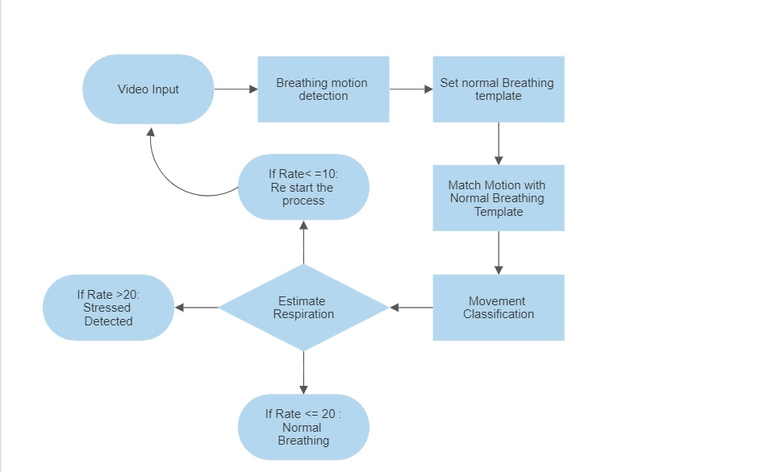
Workflow Diagram

Slide 8
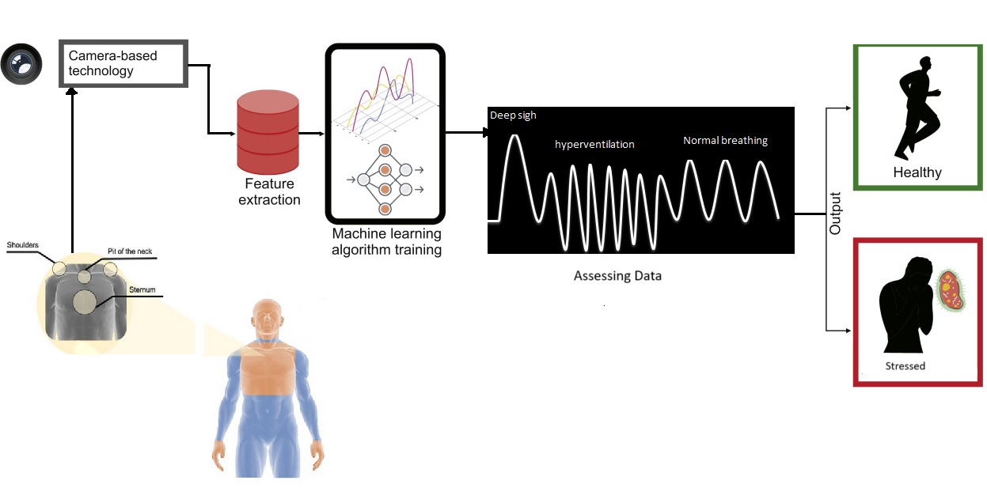
Working of project

Slide 9
ML Model

Slide 10
Thank You

