Slide 1


Implementation of Deep Learning on Image dataset
Department of Electronics and Telecommunication Engineering
AICTE-ISTE Sponsored one-week online Induction/Refresher Programme
Dr. Monica Mundada
Research Scientist

Slide 2

Deep Learning – CNN
What is Image classification?
Image classification Dataset
End-to-End project implementation
Analysis and Conclusion

Slide 3
About Me
Research Scientist, Data analyst, Consultant, Entrepreneur, brand influencer, blogger, YouTuber, Love reading books
Expertise in
Text Analytics & Data Science
Natural Language Processing
Speech and Signal processing
email-id - monicamundada5@gmail.com
Medium blog - https://monicamundada5.medium.com/
YouTube - Tech Research

Slide 4
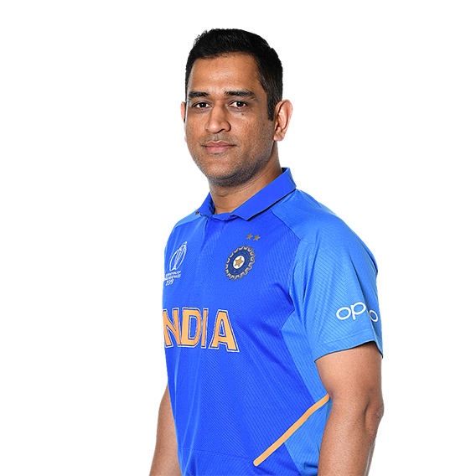
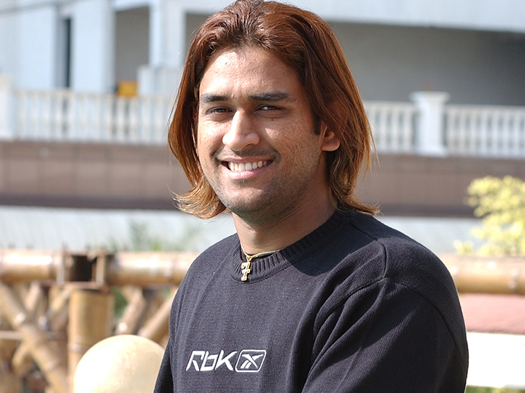
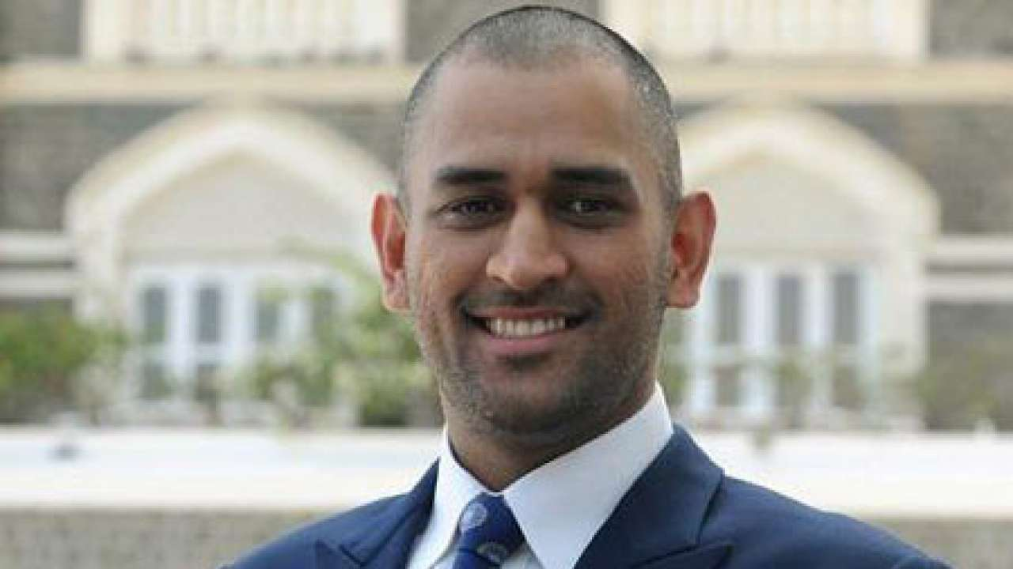
Learning Images

Slide 5

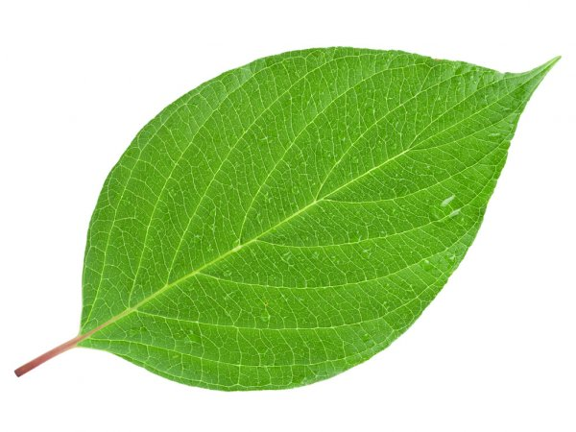
Learning Images

Slide 6
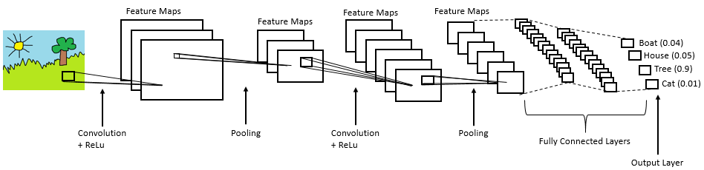
Convolution Neural Network

Slide 7
Applications of CNN
Gesture Control in Mobile Applications
Surveillance – object detection and people detection
Automotive – Autonomous driving
AR/ VR – Google glasses

Slide 8
Working of CNN
Convolution Layer
Relu Layer
Pooling Layer
Fully Connected Layer

Slide 9
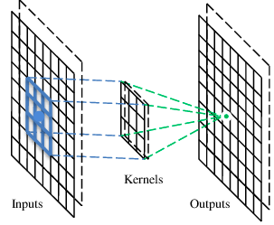
Convolution Layer
A CNN is a neural network with some convolutional layers (and some other layers).
A convolutional layer has a number of filters that does convolutional operation

Slide 10
Convolution
These are the network parameters to be learned.
1 | -1 | -1
-1 | 1 | -1
-1 | -1 | 1
1 | 0 | 0 | 0 | 0 | 1
0 | 1 | 0 | 0 | 1 | 0
0 | 0 | 1 | 1 | 0 | 0
1 | 0 | 0 | 0 | 1 | 0
0 | 1 | 0 | 0 | 1 | 0
0 | 0 | 1 | 0 | 1 | 0
Filter 1
-1 | 1 | -1
-1 | 1 | -1
-1 | 1 | -1
Filter 2
……
6 x 6 image
Each filter detects a small pattern (3 x 3).

Slide 11
Convolution
1 | -1 | -1
-1 | 1 | -1
-1 | -1 | 1
Filter 1
stride=1
1 | 0 | 0 | 0 | 0 | 1
0 | 1 | 0 | 0 | 1 | 0
0 | 0 | 1 | 1 | 0 | 0
1 | 0 | 0 | 0 | 1 | 0
0 | 1 | 0 | 0 | 1 | 0
0 | 0 | 1 | 0 | 1 | 0
Dot
product
3
-1
6 x 6 image

Slide 12
Convolution
1 | -1 | -1
-1 | 1 | -1
-1 | -1 | 1
Filter 1
If stride=2
1 | 0 | 0 | 0 | 0 | 1
0 | 1 | 0 | 0 | 1 | 0
0 | 0 | 1 | 1 | 0 | 0
1 | 0 | 0 | 0 | 1 | 0
0 | 1 | 0 | 0 | 1 | 0
0 | 0 | 1 | 0 | 1 | 0
3
-3
6 x 6 image

Slide 13
Convolution
1 | -1 | -1
-1 | 1 | -1
-1 | -1 | 1
Filter 1
stride=1
1 | 0 | 0 | 0 | 0 | 1
0 | 1 | 0 | 0 | 1 | 0
0 | 0 | 1 | 1 | 0 | 0
1 | 0 | 0 | 0 | 1 | 0
0 | 1 | 0 | 0 | 1 | 0
0 | 0 | 1 | 0 | 1 | 0
3
-1
-3
-1
-3
1
0
-3
-3
-3
0
1
3
-2
-2
-1
6 x 6 image

Slide 14
Convolution
-1 | 1 | -1
-1 | 1 | -1
-1 | 1 | -1
Filter 2
stride=1
Repeat this for each filter
1 | 0 | 0 | 0 | 0 | 1
0 | 1 | 0 | 0 | 1 | 0
0 | 0 | 1 | 1 | 0 | 0
1 | 0 | 0 | 0 | 1 | 0
0 | 1 | 0 | 0 | 1 | 0
0 | 0 | 1 | 0 | 1 | 0
3
-1
-3
-1
-1
-1
-1
-1
-3
1
0
-3
-1
-1
-2
1
Feature
Map
-3
-3
0
1
-1
-1
-2
1
3
-2
-2
-1
6 x 6 image
-1
0
-4
3
Two 4 x 4 images
Forming 2 x 4 x 4 matrix

Slide 15
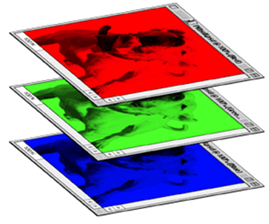
Color image: RGB 3 channels
1 | -1 | -1
-1 | 1 | -1
-1 | -1 | 1
-1 | 1 | -1
-1 | 1 | -1
-1 | 1 | -1
1 | -1 | -1
-1 | 1 | -1
-1 | -1 | 1
-1 | 1 | -1
-1 | 1 | -1
-1 | 1 | -1
1 | -1 | -1
-1 | 1 | -1
-1 | -1 | 1
-1 | 1 | -1
-1 | 1 | -1
-1 | 1 | -1
Filter 1
Filter 2
Color image
1 | 0 | 0 | 0 | 0 | 1
0 | 1 | 0 | 0 | 1 | 0
0 | 0 | 1 | 1 | 0 | 0
1 | 0 | 0 | 0 | 1 | 0
0 | 1 | 0 | 0 | 1 | 0
0 | 0 | 1 | 0 | 1 | 0
1 | 0 | 0 | 0 | 0 | 1
0 | 1 | 0 | 0 | 1 | 0
0 | 0 | 1 | 1 | 0 | 0
1 | 0 | 0 | 0 | 1 | 0
0 | 1 | 0 | 0 | 1 | 0
0 | 0 | 1 | 0 | 1 | 0
1 | 0 | 0 | 0 | 0 | 1
0 | 1 | 0 | 0 | 1 | 0
0 | 0 | 1 | 1 | 0 | 0
1 | 0 | 0 | 0 | 1 | 0
0 | 1 | 0 | 0 | 1 | 0
0 | 0 | 1 | 0 | 1 | 0

Slide 16
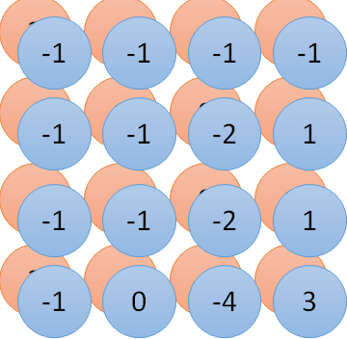
Convolution v.s. Fully Connected
1 | 0 | 0 | 0 | 0 | 1
0 | 1 | 0 | 0 | 1 | 0
0 | 0 | 1 | 1 | 0 | 0
1 | 0 | 0 | 0 | 1 | 0
0 | 1 | 0 | 0 | 1 | 0
0 | 0 | 1 | 0 | 1 | 0
1 | -1 | -1
-1 | 1 | -1
-1 | -1 | 1
-1 | 1 | -1
-1 | 1 | -1
-1 | 1 | -1
convolution
image
1 | 0 | 0 | 0 | 0 | 1
0 | 1 | 0 | 0 | 1 | 0
0 | 0 | 1 | 1 | 0 | 0
1 | 0 | 0 | 0 | 1 | 0
0 | 1 | 0 | 0 | 1 | 0
0 | 0 | 1 | 0 | 1 | 0
Fully-connected
……
……

Slide 17
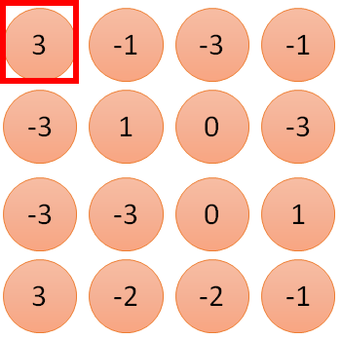
1 | -1 | -1
-1 | 1 | -1
-1 | -1 | 1
1
1
Filter 1
2
0
3
0
3
4:
0
1 | 0 | 0 | 0 | 0 | 1
0 | 1 | 0 | 0 | 1 | 0
0 | 0 | 1 | 1 | 0 | 0
1 | 0 | 0 | 0 | 1 | 0
0 | 1 | 0 | 0 | 1 | 0
0 | 0 | 1 | 0 | 1 | 0
…
0
8
1
9
0
10:
0
…
13
0
6 x 6 image
14
0
fewer parameters!
15
Only connect to 9 inputs, not fully connected
1
16
1
…

Slide 18
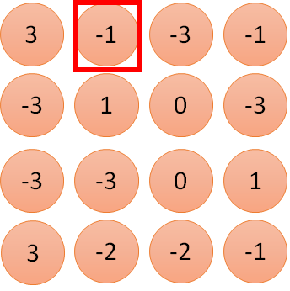
1 | -1 | -1
-1 | 1 | -1
-1 | -1 | 1
1:
1
Filter 1
2:
0
3:
0
3
4:
0
1 | 0 | 0 | 0 | 0 | 1
0 | 1 | 0 | 0 | 1 | 0
0 | 0 | 1 | 1 | 0 | 0
1 | 0 | 0 | 0 | 1 | 0
0 | 1 | 0 | 0 | 1 | 0
0 | 0 | 1 | 0 | 1 | 0
…
7:
0
8:
1
-1
9:
0
10:
0
…
13:
0
6 x 6 image
14:
0
Fewer parameters
15:
1
16:
1
Shared weights
Even fewer parameters
…

Slide 19
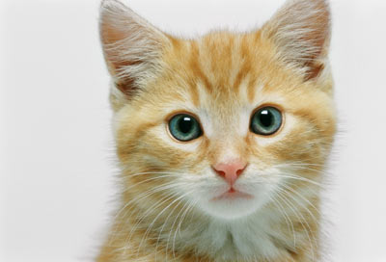
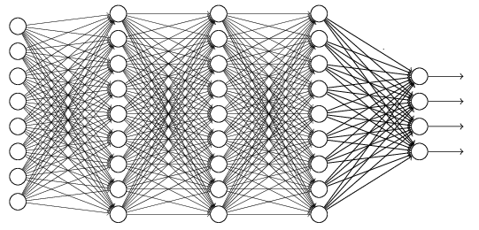
The whole CNN
cat dog ……
Convolution
Max Pooling
Can repeat many times
Fully Connected Feedforward network
Convolution
Max Pooling
Flattened

Slide 20
Max Pooling
1 | -1 | -1
-1 | 1 | -1
-1 | -1 | 1
-1 | 1 | -1
-1 | 1 | -1
-1 | 1 | -1
Filter 1
Filter 2
3
-1
-3
-1
-1
-1
-1
-1
-3
1
0
-3
-1
-1
-2
1
-3
-3
0
1
-1
-1
-2
1
3
-2
-2
-1
-1
0
-4
3

Slide 21
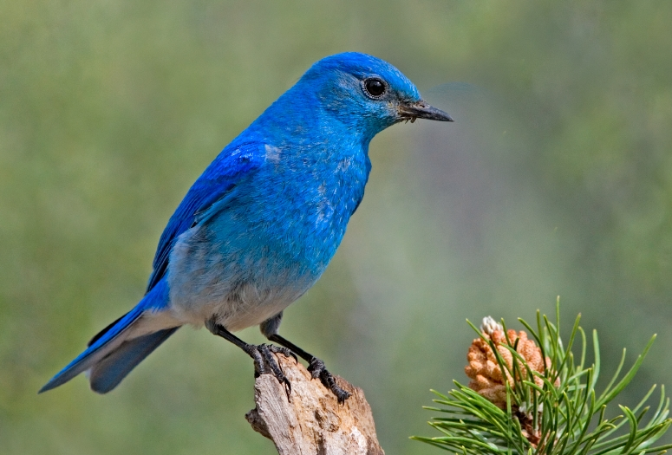

Why Pooling
Subsampling pixels will not change the object
bird
bird
Subsampling
We can subsample the pixels to make image smaller
fewer parameters to characterize the image

Slide 22
A CNN compresses a fully connected network in two ways:
Reducing number of connections
Shared weights on the edges
Max pooling further reduces the complexity

Slide 23
Max Pooling
New image
but smaller
1 | 0 | 0 | 0 | 0 | 1
0 | 1 | 0 | 0 | 1 | 0
0 | 0 | 1 | 1 | 0 | 0
1 | 0 | 0 | 0 | 1 | 0
0 | 1 | 0 | 0 | 1 | 0
0 | 0 | 1 | 0 | 1 | 0
Conv
3
0
-1
1
Max
Pooling
3
1
0
3
2 x 2 image
6 x 6 image
Each filter
is a channel

Slide 24
The whole CNN
3
0
-1
1
Convolution
3
1
0
3
Max Pooling
Can repeat many times
A new image
Convolution
Smaller than the original image
The number of channels is the number of filters
Max Pooling

Slide 25
The whole CNN
cat dog ……
Convolution
Max Pooling
Fully Connected Feedforward network
A new image
Convolution
Max Pooling
Flattened
A new image

Slide 26
Flattening
3
0
1
3
0
-1
1
3
3
1
-1
0
3
Flattened
1
Fully Connected Feedforward network
0
3

Slide 27


CNN in Keras
Only modified the network structure and input format (vector -> 3-D tensor)
input
Convolution
1 | -1 | -1
-1 | 1 | -1
-1 | -1 | 1
-1 | 1 | -1
-1 | 1 | -1
-1 | 1 | -1
There are 25 3x3 filters.
……
Max Pooling
Input_shape = ( 28 , 28 , 1)
28 x 28 pixels
1: black/white, 3: RGB
Convolution
3
-1
3
Max Pooling
-3
1

Slide 28
CNN in Keras
Only modified the network structure and input format (vector -> 3-D array)
Input
1 x 28 x 28
Convolution
How many parameters for each filter?
9
25 x 26 x 26
Max Pooling
25 x 13 x 13
Convolution
How many parameters
for each filter?
225=
25x9
50 x 11 x 11
Max Pooling
50 x 5 x 5

Slide 29
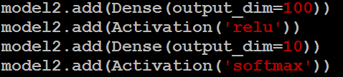
CNN in Keras
Only modified the network structure and input format (vector -> 3-D array)
Input
1 x 28 x 28
Output
Convolution
25 x 26 x 26
Fully connected feedforward network
Max Pooling
25 x 13 x 13
Convolution
50 x 11 x 11
Max Pooling
1250
50 x 5 x 5
Flattened

Slide 30
Practical Demonstration
Image_classification.ipynb

