Slide 1

CAPSTONE PROJECT
HOSPITAL APPOINTMENT BOOKING USING QUE
CSA0315 – DATA STRUCTURES
UNDER THE SUPERVISION OF:
RAJESH KUMAR
PRESENTED BY:
Moniga V (192521184)
Dhivyabharathi (192521233)
Sugiritha M (192471020)

Slide 2
INTRODUCTION
• The Hospital Appointment Booking System is designed to manage patient appointments in an organized and efficient manner using the Queue data structure..
• The system allows patients to register their details, book appointments, and enter a waiting queue based on their order of arrival.
• Patients are assigned to available doctors systematically, ensuring that patients are served according to their position in the queue.
• The system reduces manual work, minimizes appointment confusion, and improves the overall flow of patients within the hospital.
• The project demonstrates how the FIFO (First In, First Out) principle can be applied to a real-world healthcare management problem.

Slide 3
PROBLEM STATEMENT
Managing a large number of patients manually can result in long waiting times, scheduling conflicts, and difficulty maintaining appointment order.
Hospital staff may find it difficult to monitor waiting patients and available doctors simultaneously.
Patients may experience confusion when appointments are not handled according to their arrival order.
Manual appointment records make it difficult to track completed and pending appointments.
Therefore, a queue-based system is required to provide systematic, fair, and efficient patient scheduling.

Slide 4
OBJECTIVE
• To develop an efficient system for registering patients and managing appointment information.
• To implement the FIFO Queue principle for scheduling patients according to their arrival order.
• To provide an organized mechanism for assigning waiting patients to available doctors.
• To maintain appointment statuses such as Waiting, Assigned, Completed, and Cancelled • To generate useful appointment information and basic statistics for hospital management.

Slide 5
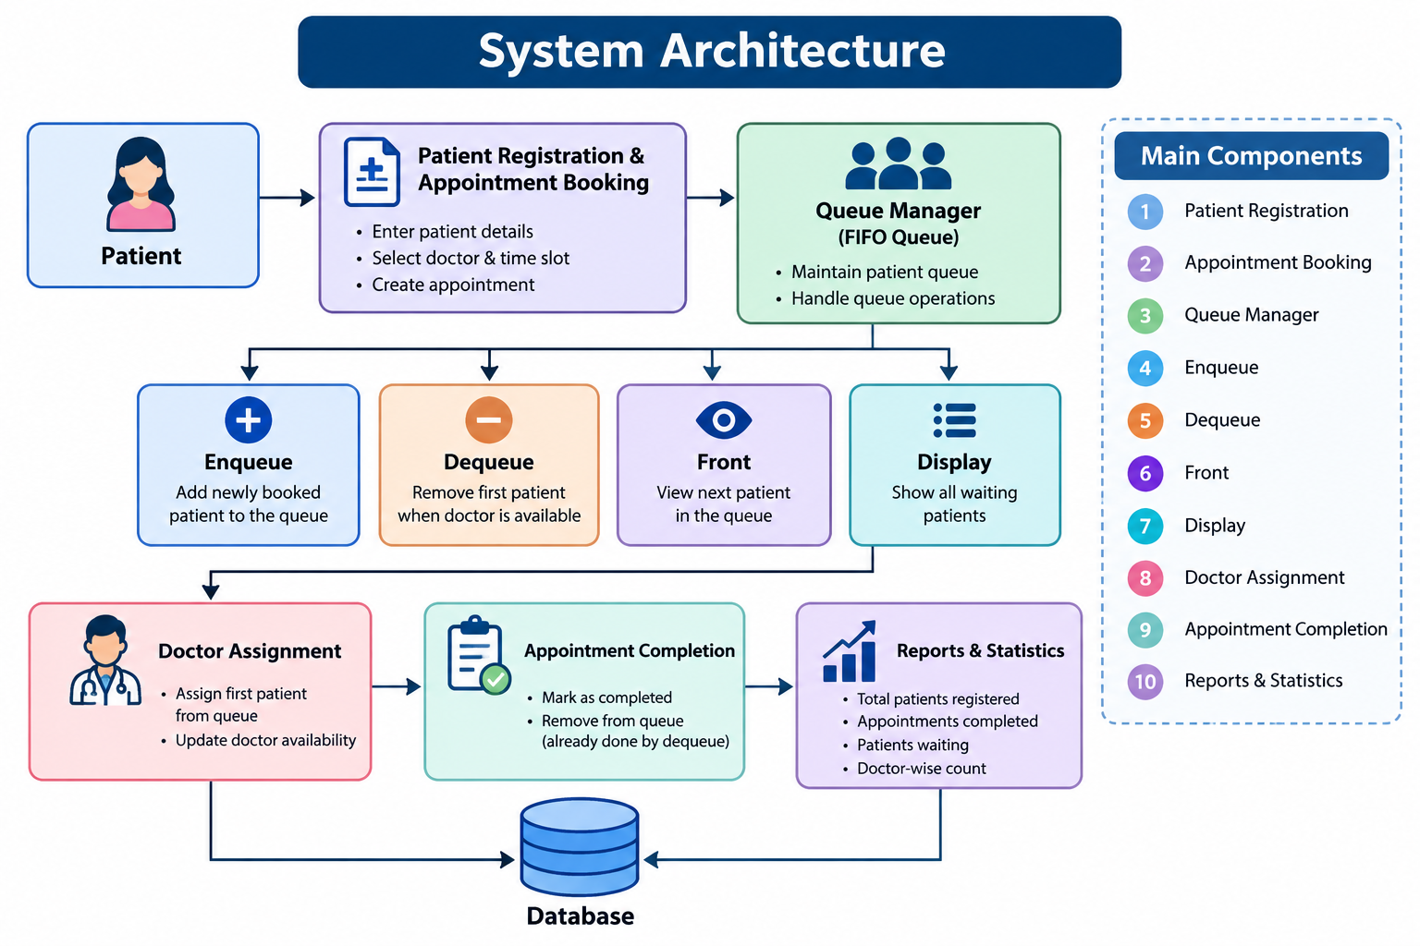

Slide 6
MODULE 1 – PATIENT REGISTRATION AND APPOINTMENT BOOKING
The module collects essential patient information such as Patient ID, Name, Age, Gender, Contact Number, and Appointment Details.
Patients can select an available doctor or department according to their healthcare requirements.
After booking, the system generates a unique appointment or queue number for the patient
The registered patient is added to the waiting queue in the appropriate order
This module provides the basic patient and appointment information required for further processing.
MAIN FUNCTIONS :
-> Patient Registration
-> Patient Information Entry
-> Doctor Selection
-> Appointment Booking
-> Queue Number Generation
->Appointment Confirmation

Slide 7
MODULE 2 – QUEUE-BASED PATIENT SCHEDULING AND DOCTOR ASSIGNMENT
• This module manages patients using the FIFO (First In, First Out) principle.
Monitor temperature, pressure, current, and vibration.
• New patients are added to the rear of the queue using the Enqueue operation.
• When a doctor becomes available, the patient at the front of the queue is selected.
• The selected patient is assigned to the available doctor and their appointment status is updated.
• After assignment, the patient is removed from the queue so that the next waiting patient can be processed.
• Monitor temperature, pressure, current, and vibration.
MAIN FUNCTIONS
-> Add Patient to Queue
-> View Waiting Patients
-> Check Doctor Availability
-> Assign Patient to Doctor
-> Remove Patient from Queue
->Update Appointment Status

Slide 8
MODULE 3 – APPOINTMENT COMPLETION, REPORTING AND STATISTICS
• After consultation, the patient's appointment status is updated to Completed.
• The system maintains appointment records for future reference and reporting.
• Hospital staff can monitor waiting, assigned, completed, and cancelled appointments.
• The system can generate daily appointment summaries and doctor-wise appointment information.
• Basic statistics can help identify patient flow and doctor workload.
• Display dashboard with KPI cards and equipment overview.
MAIN FUNCTIONS
-> Complete Appointment
-> Update Patient Status
-> Maintain Appointment History
-> Generate Reports
-> Calculate Statistics
-> Display Daily Summary

Slide 9
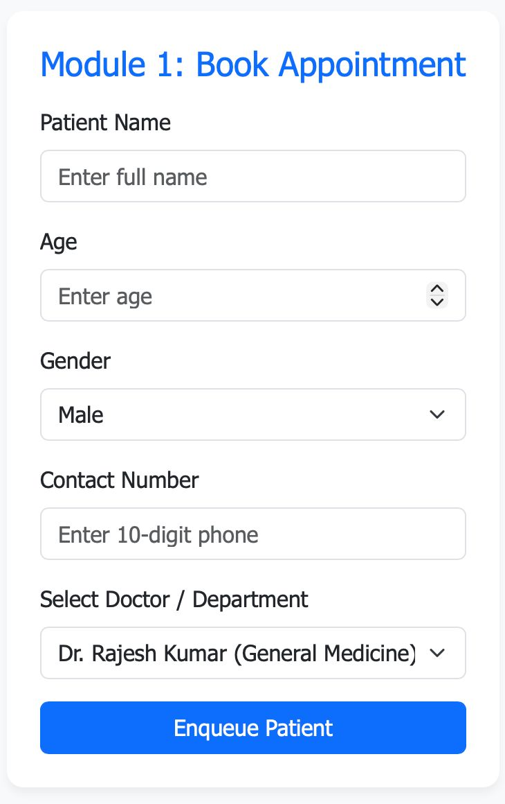
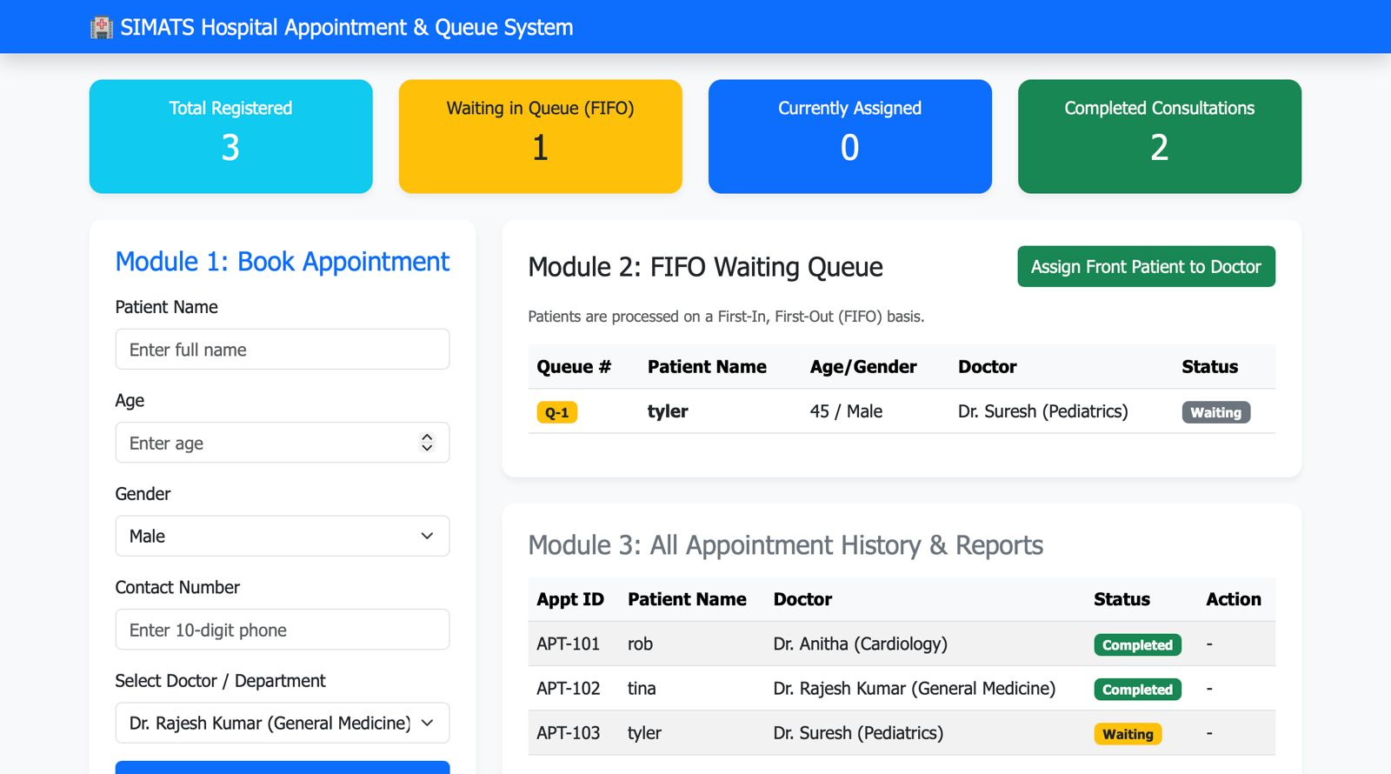
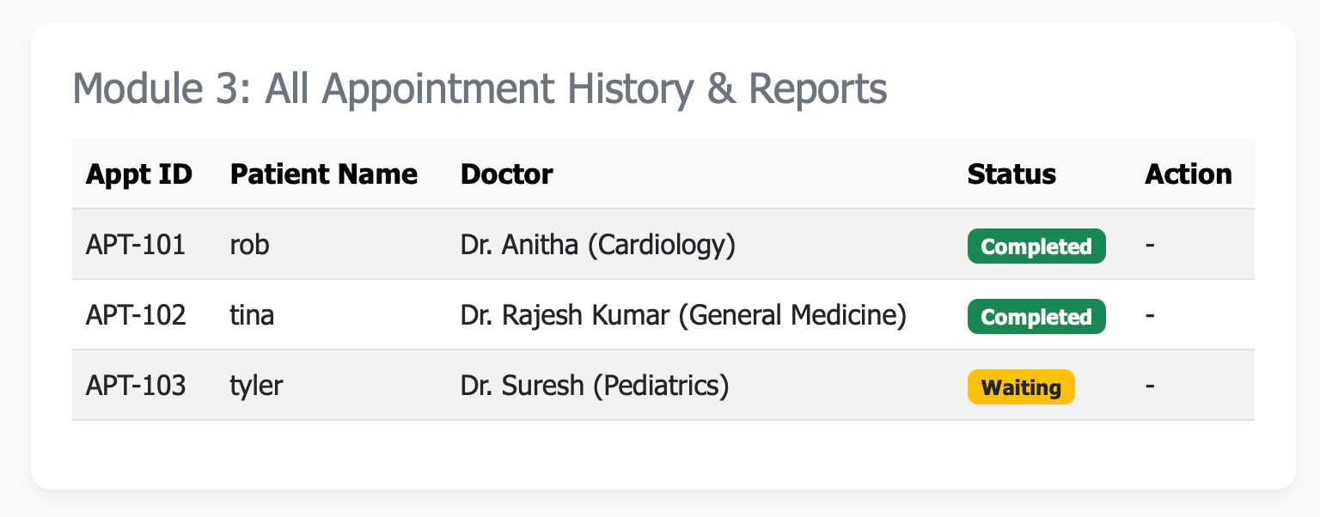
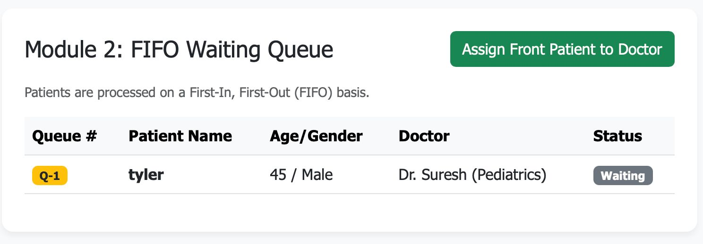

Slide 10
FUTURE ENHANCEMENTS
• Online appointment booking can be added.
• Multiple doctors and departments can be handled using separate queues.
• Priority Queue can be introduced for emergency patients.
• Real-time queue status can show the patient's position and estimated waiting time.
• Patient history can be stored and accessed.
• SMS/notification system can inform patients about their appointment.
• Reports and statistics can be improved using graphs and charts.
• The system can later be connected to a hospital management system.

Slide 11
CONCLUSION
• The system provides an efficient method for hospital appointment management.
• It uses the Queue data structure based on the FIFO principle.
• Patients are served fairly in their order of arrival.
• Enqueue and Dequeue operations manage patient appointments effectively.
• Doctors can be assigned systematically based on queue order and availability.
• The system helps reduce waiting confusion and improve patient flow.
• Appointment completion and basic reports and statistics can be maintained.
• The project demonstrates a real-world application of Queue data structures.
• Overall, it provides a simple, organized, and reliable appointment scheduling solution.

Slide 12
THANK YOU

