Slide 1
Project :Restaurant Success
Submitted by :
Monika Bhakuni (PGD/2020/2157)

Slide 2
Contents
Introduction
Dataset
Data Preprocessing
Gaining Insights
Hypothesis Testing
Conclusion

Slide 3
Introduction
The basic idea of analyzing the dataset is to get a fair idea about the factors affecting the establishment of a restaurant at different places in Bengaluru through zomato.
Bengaluru being an IT capital of India. Most of the people here are dependent mainly on the restaurant.
The analysis can be done using the data, by studying the factors such as
• Location of the restaurant.
• Approx Price of food.
• Location of the Restaurant
• The needs of people who are striving to get the best cuisine.
• Is a particular neighborhood famous for its own kind of food.

Slide 4
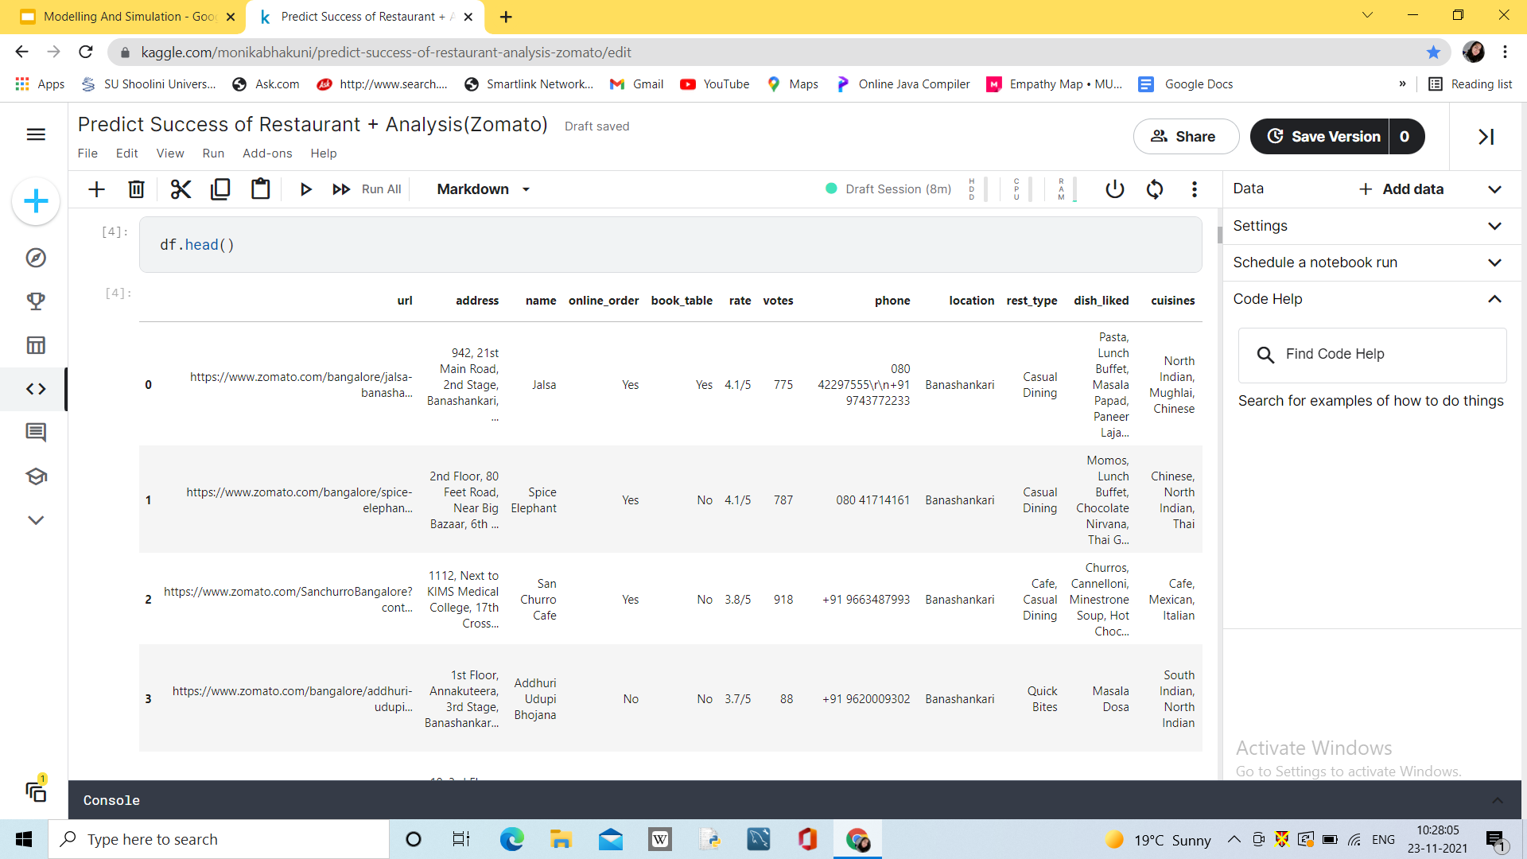
DATA SET
DataSet Source:https://www.kaggle.com/himanshupoddar/zomato-bangalore-restaurants

Slide 5
Data Pre-Processing
Data Cleaning
Data Type Handling
DATA
Missing Data Handling
Duplicate Data Handling
Data Manipulation
Feature Engineering

Slide 6
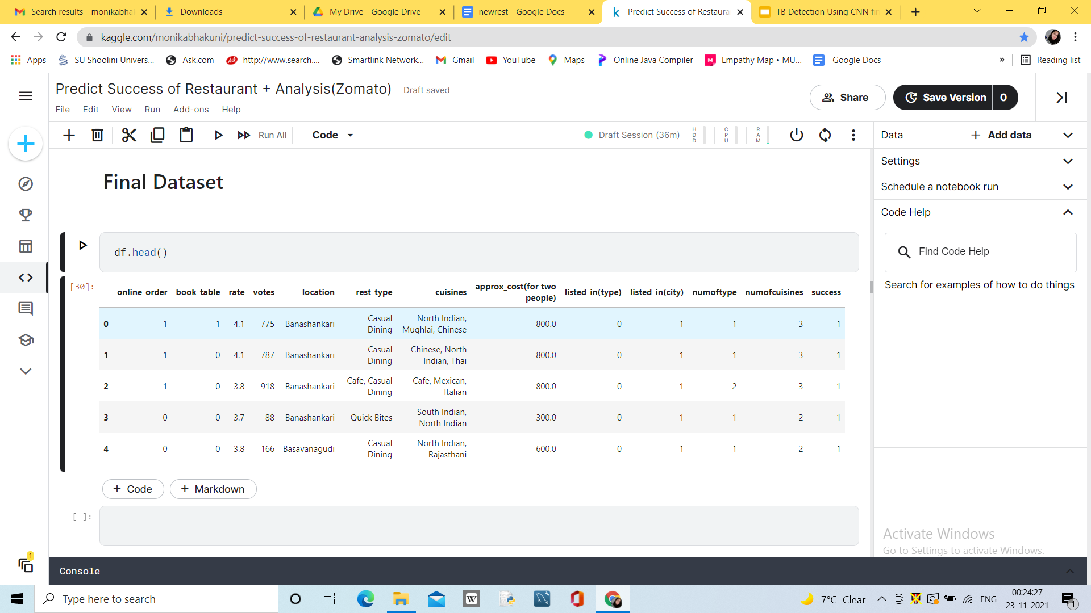
Pre-Processing Results

Slide 7
GAINING INSIGHTS

Slide 8
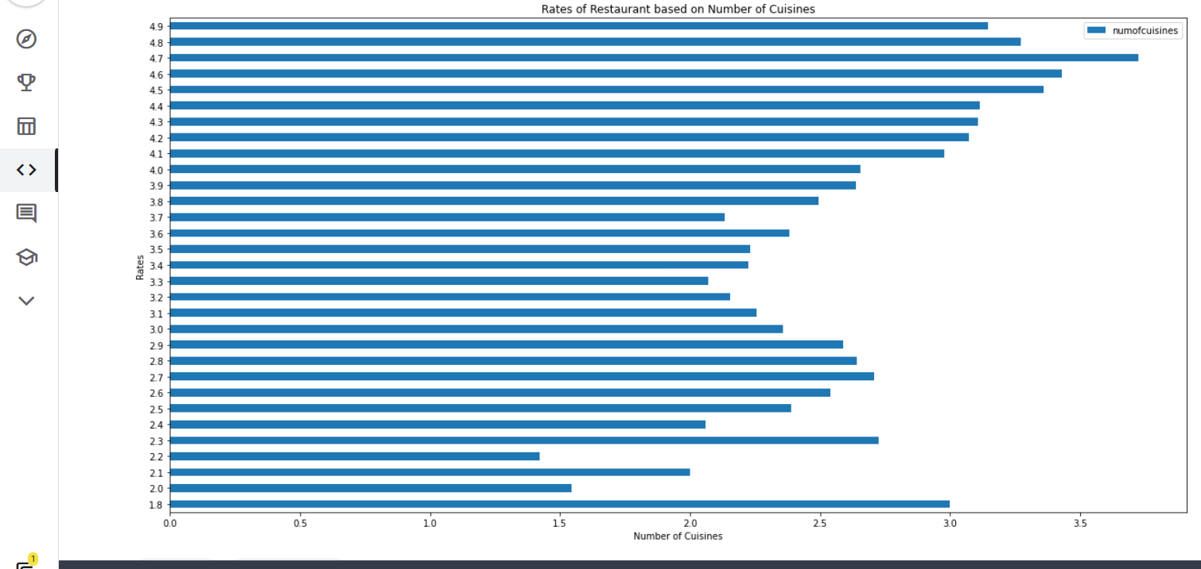
1 : To make sure we get to the root of the source of a successful restaurant seeing from the Rate we will start with the first Question which is 'What makes a restaurant has a good rating?'
Ratings based on the number of cuisine

Slide 9
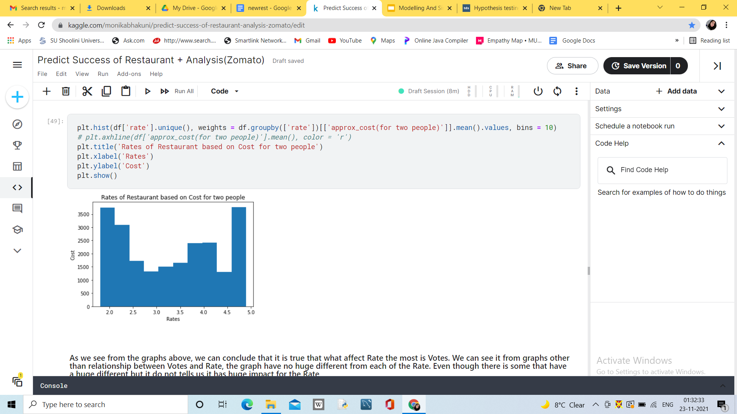
Ratings of restaurant based on cost for two

Slide 10
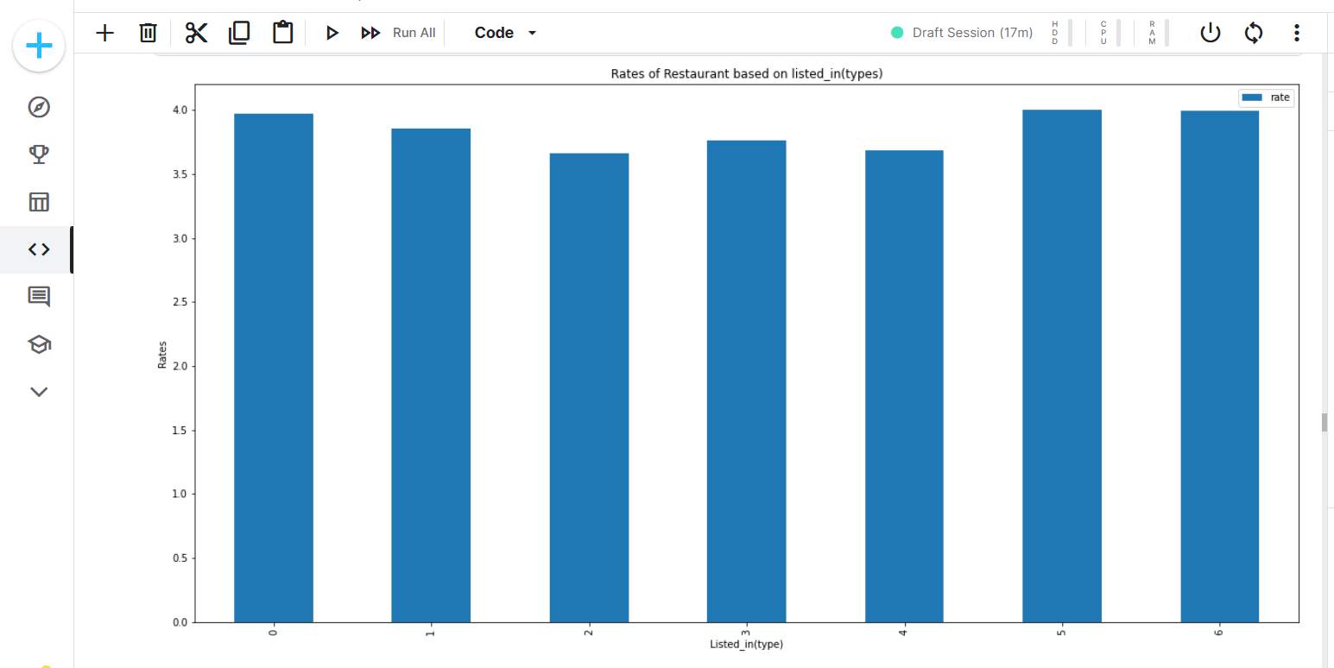
Ratings based on Type of Restaurant

Slide 11
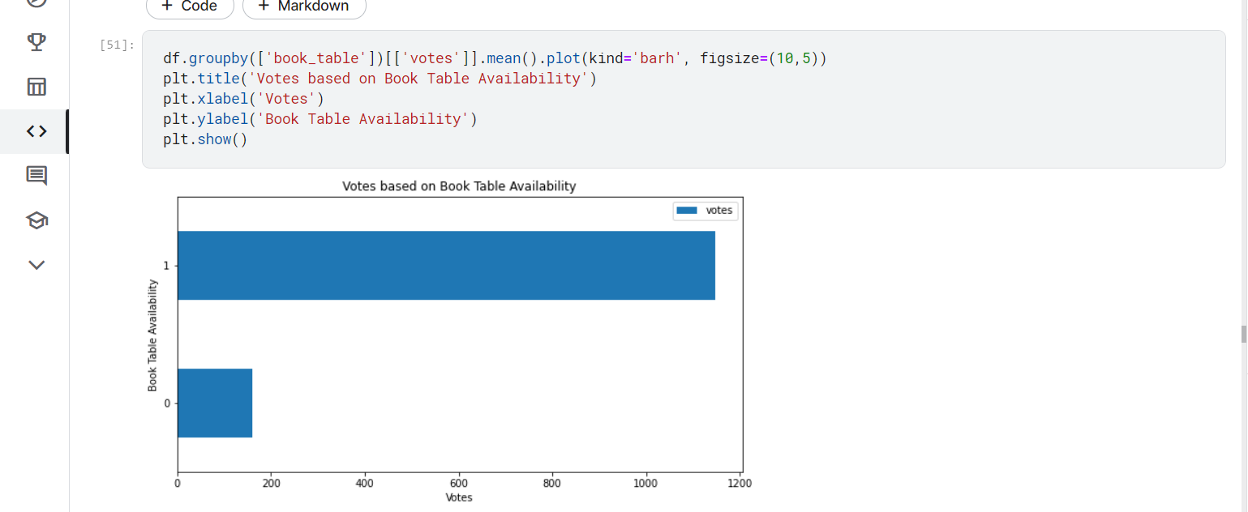
2 : It brings us to the 2nd question, which is 'What makes a restaurant obtain a huge amount of votes?
Votes Based on Table Availability

Slide 12
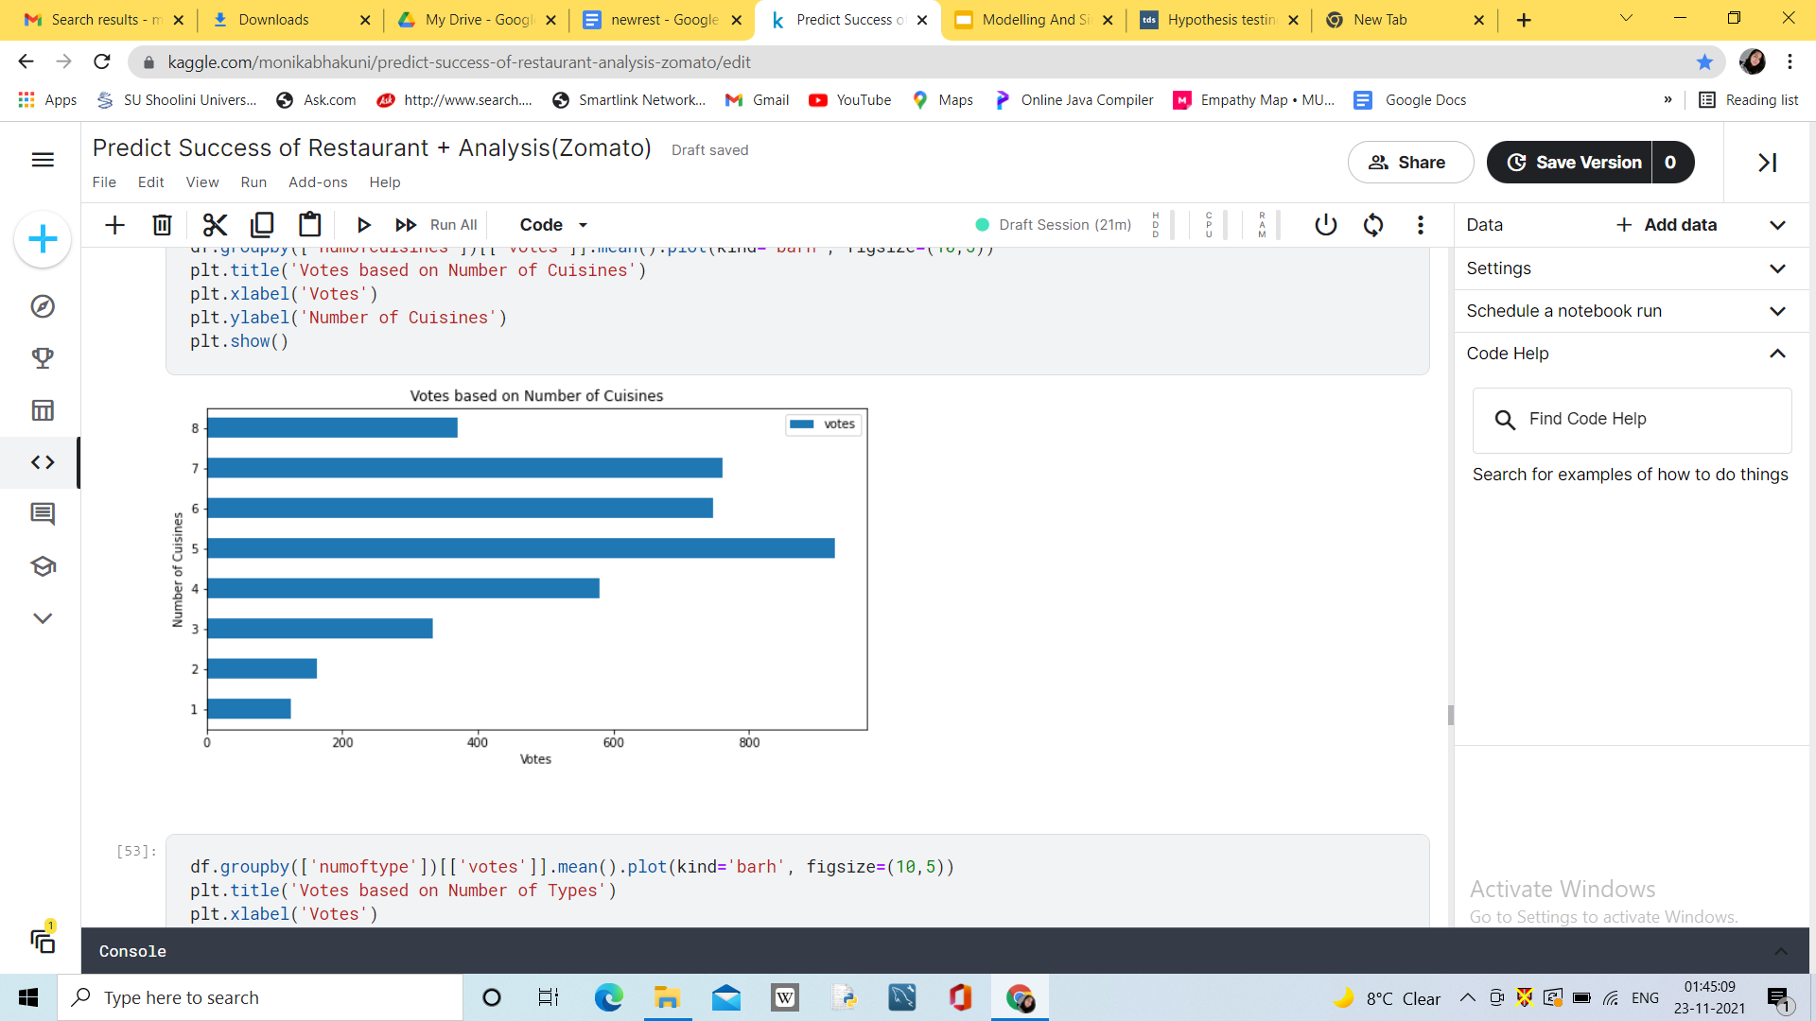
Votes based on cuisine

Slide 13
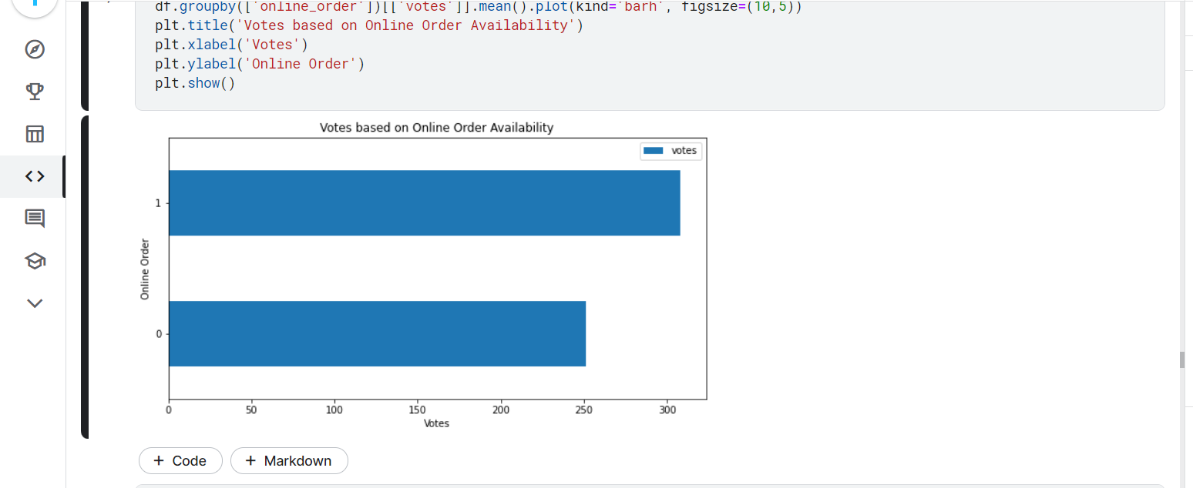
Votes based on Online Order Availability

Slide 14
HYPOTHESIS TESTING

Slide 15
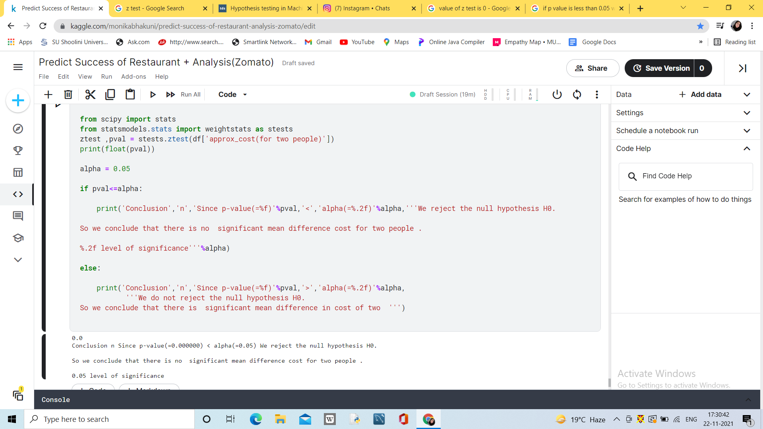
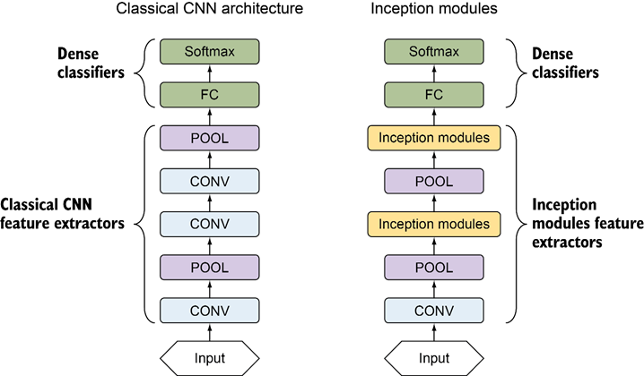
Single Sample Z-Test
Assumptions :
Ho : There is significant mean difference cost for table of two people .
H1: There is no significant mean difference cost for table of two people .
Result :Since our p value is less than level of significance we reject the hypothesis stating there is a significant mean difference cost for table of two .

Slide 16
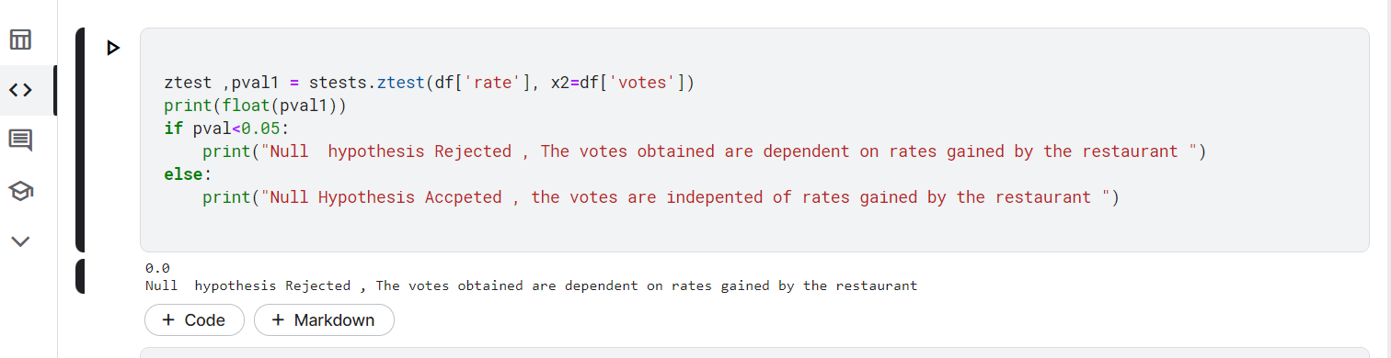
Two Sample Z-test
Assumptions :
Ho : Restaurant rating and votes are independent of each other .
H1: Restaurant rating are depended on votes obtained.
Result : Since our p value is less than level of significance we reject the hypothesis stating Restaurant rating and votes obtained by the restaurant are dependent

Slide 17
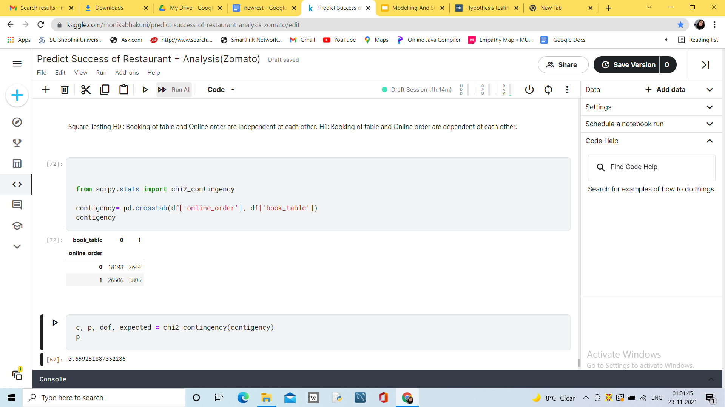
Chi -Square Testing
Assumptions :
Ho : Booking of table and Online order are independent of each other..
H1: Booking of table and Online order are dependent of each other.
Contingency Table

Slide 18
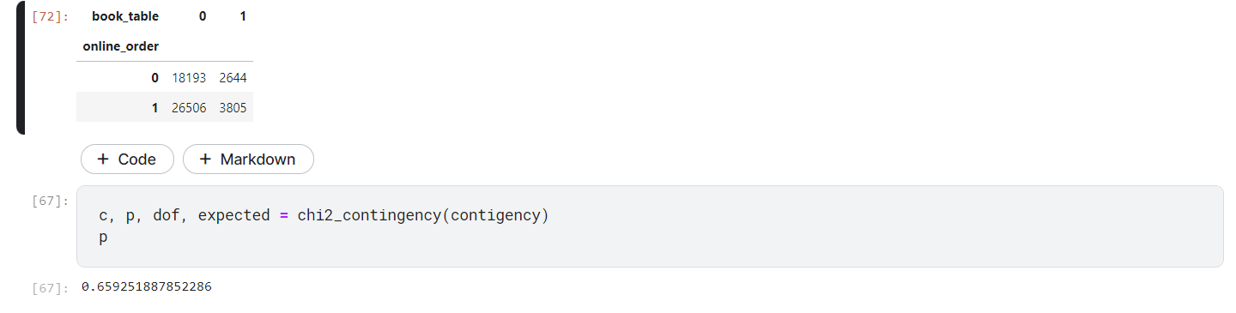
Calculations
Result : Since our p value is more than level of significance we accept the hypothesis stating Booking a table in the restaurant is independent of online orders.

Slide 19
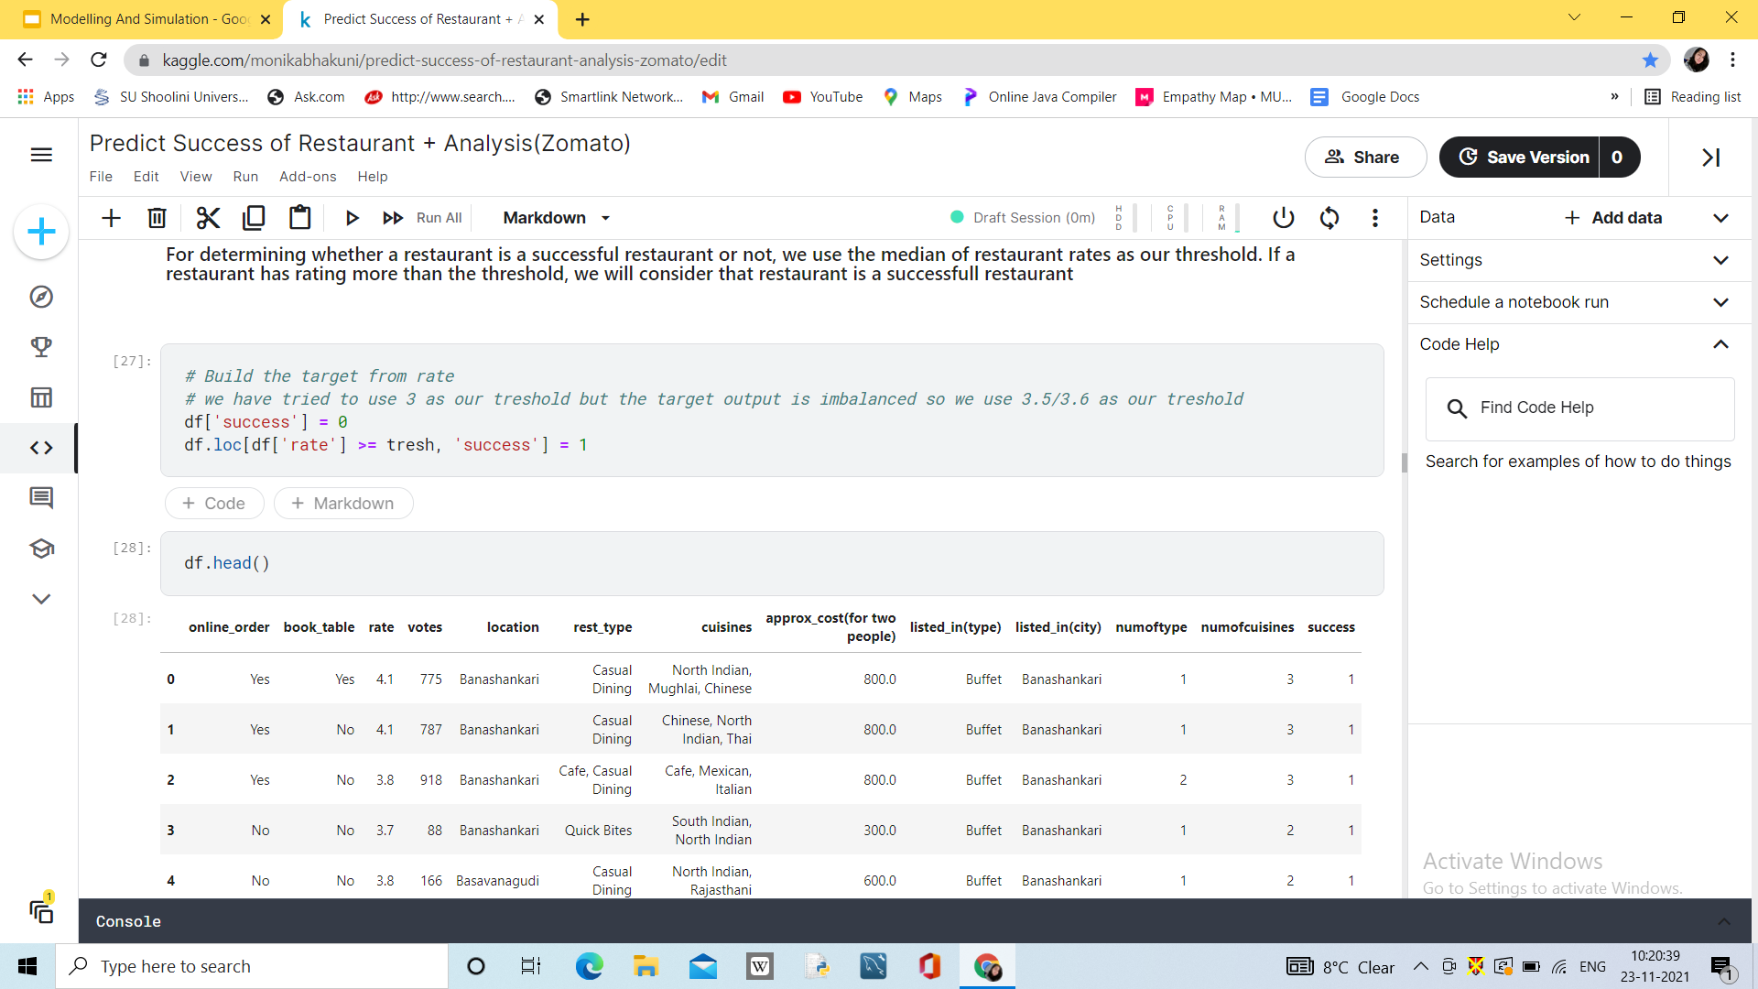
Prediction

Slide 20
Conclusion
A restaurant must be able to reserve a table because it can be seen from the graph plot above, it is evident that the ratings of restaurants that can book a table differ greatly from those who cannot
Online Ordering it's a step better for a restaurant to be ordered online because it can increase the number of votes
Affordable prices means high votes, therefore to build a considered successful restaurant, one must built it with affordable prices to pay
As the prediction is considered any Restaurant that as higher rating than 3.5 will be a successful restaurant .

