Slide 1
Employee Data Analysis using Excel
STUDENT NAME: MONIKA M
REGISTER NO : 312203332 (11D073F9BE33ED89E4B4D06A93FBB5CF)
DEPARTMENT : Commerce
COLLEGE : Prince Shri Venkateshwara Arts & Science College

Slide 2
PROJECT TITLE
Employee Performance Analysis using Excel

Slide 3


AGENDA
Problem Statement
Project Overview
End Users
Our Solution and Proposition
Dataset Description
Modelling Approach
Results and Discussion
Conclusion
3/21/2024 Annual Review

Slide 4

PROBLEM STATEMENT
Employee analysis involves evaluating various aspects of employee performance and behavior to optimize organizational effectiveness.
It includes assessing skills, productivity, and job satisfaction to identify strengths and areas for improvement.
This analysis helps in making informed decisions about training, promotions, and resource allocation.
Additionally, it can aid in developing tailored strategies for employee development and retention.
Ultimately, effective employee analysis contributes to a more motivated and efficient workforce.

Slide 5

PROJECT OVERVIEW
.
Highlight Important Data: Make key data points stand out with different colors, fonts, or styles.
Identify Trends and Patterns: Quickly spot trends or patterns in data by applying visual cues.
Improve Data Analysis: Enhance data readability and make analysis easier by visually distinguishing between different types of data.
Detect Errors or Outliers: Spot anomalies or errors in data by applying specific formatting rules. Overall, conditional formatting makes easier to interpret and analyze data efficiently
.

Slide 6
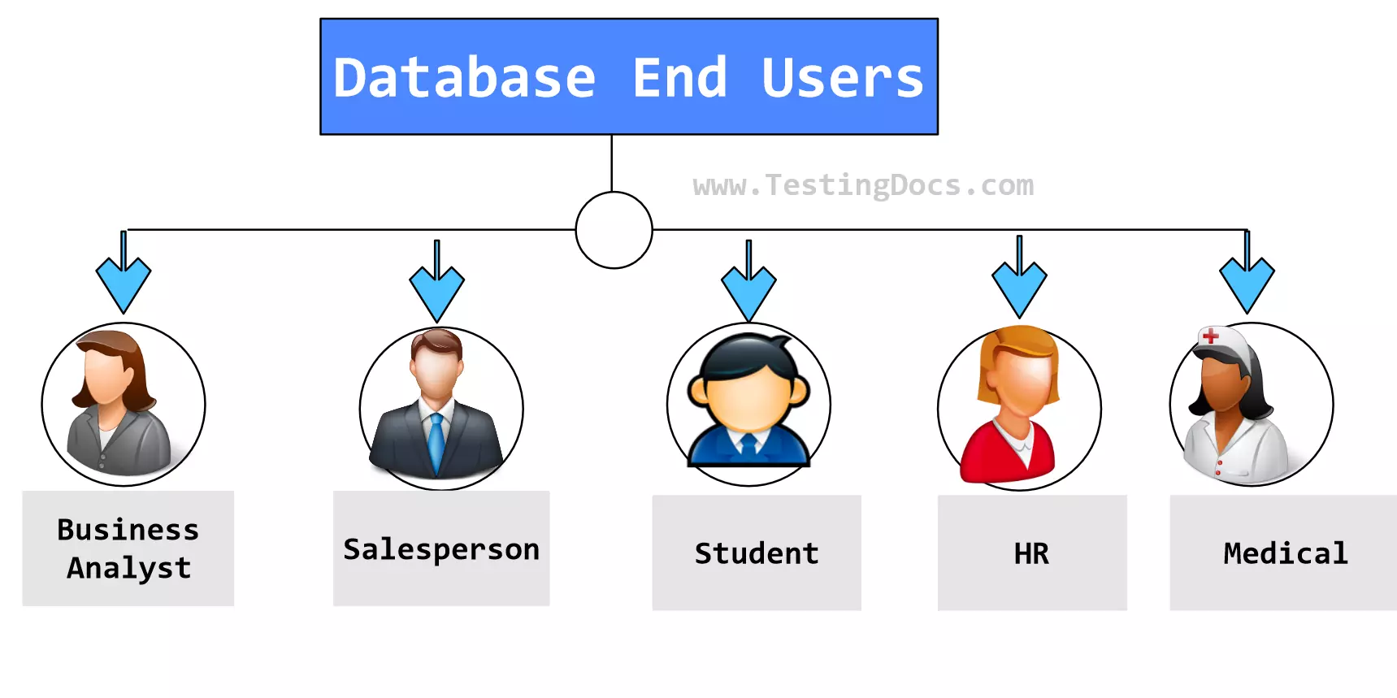

WHO ARE THE END USERS?
Employer
Employee
Organisation

Slide 7

OUR SOLUTION AND ITS VALUE PROPOSITION
Conditional Formatting –Highlight the Missing value
Filter – Remove the missing value
Formulae – Find out the Performance level using formula
Pivot – Summary
Graph – Data Visualization

Slide 8
Dataset Description
Employee dataset – Kaggle
26 Features
Employee ID- DE5B5E0E981696191474813EBC226A7F
Name – Text Performance Level – Very High , High , Medium , Low
Gender – Male , Female
Employee Ratings
Business Unit

Slide 9

THE "WOW" IN OUR SOLUTION
Performance level
=IFS(Z8>=5,"VERY HIGH“Z8>=4,"HIGH",Z8>=3,"MED", TRUE, "LOW")
3/21/2024 Annual Review
9

Slide 10
MODELLING
DATA COLLECTION :
Collected data from Kaggle
Identify the features classification
Employee Classification
DATA CLEANING :
Identify the missing value
Filter out the missing value using conditional formatting
PERFORMANCE LEVEL :
Very high
High
Medium
Low
10

Slide 11
PIVOT TABLE
we created a pivot table to analyze the number of members in various performance levels across different business units.
Then added a slicer to filter by employee type (Part-time, Full-time, Contract) and visualized the results with a graph that compares performance levels among business units.
DATA VISUALIZATION
Data visualization involves representing data in graphical formats like charts, graphs, and maps to make it easier to understand and analyze.
Effective visualizations can reveal patterns, trends, and insights that might be hidden in raw data.

Slide 12
RESULTS
12

Slide 13
conclusion
In summary, a comprehensive conclusion for a data analysis in a research study involves a strategic synthesis of key finding of the performance level of an each employee specifically and their implications, contribution to the organization as a brief .

