Slide 1
Analysing IPL All Seasons Data
A Data Science Approach to Clean, Preprocess, and Interpret Cricket Statistics
IV year Computer Science and Design
Foundations of Data Science
Mini Project
211701032 MIRUTHULASRI S
211701034 MONIKA VARSHA S

Slide 2
Abstract
This project aims to analyse the Indian Premier League (IPL) data using essential data science techniques. The primary purpose of analysing the IPL dataset is to gain meaningful insights into the performance of players, teams, and match trends over multiple seasons. This analysis is beneficial for sports analysts, coaches, and fans to better understand key factors driving success in cricket.
Through data cleaning, handling missing values, and removing anomalies, the dataset will be transformed for accurate analysis. Pre-processing will involve categorizing and normalizing data for better interpretability. The final analysis will extract insights on player consistency, team strategies, win probabilities, and match outcomes, offering valuable predictions and trends for the future.
This project also aims to demonstrate the power of data science in sports, bridging statistical analysis and real-world cricket performances. The project will culminate with the generation of insights through data visualization and statistical interpretation, providing a deeper understanding of the IPL seasons' cricket dynamics.
Indian Premier League (IPL) - All seasons

Slide 3
Understanding the dataset 1. Dataset Attributes
Match_ID: A unique identifier for each match.
Season: The year in which the IPL season took place.
Team1 and Team2: Names of the two teams that played the match.
Name: Name of the players
Winner: The name of the team that won the match.
Player_of_the_Match: The player who was awarded the 'Player of the Match' title.
Runs_Scored: The total runs scored by a team or a player in a particular match.
Fours, Sixes: Count of fours and sixes hit by each players.
Batting_Strike_Rate: The strike rate of a player, calculated as (Runs Scored / Balls Faced) * 100.
Venue: The stadium where the match took place.
Commentary

Slide 4
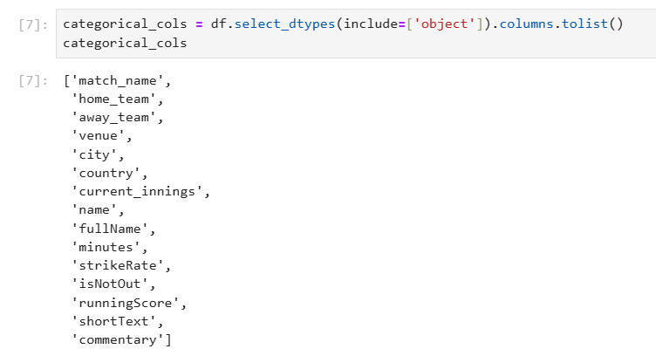
Types of Data
Categorical Data:
Attributes such as Team1, Team2, Winner, Player_of_the_Match, and Venue represent categorical data because they denote specific categories (e.g., team names, player names, stadium names). These attributes can be used to group and compare performances across different matches and teams.

Slide 5
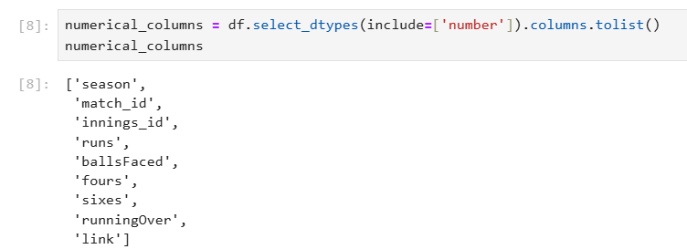
Numerical Data:
Attributes like Runs_Scored, Fours, Sixes, Batting_Strike_Rate are numerical variables. These continuous data points allow for quantitative analysis, such as calculating averages, correlations, and trends over time.

Slide 6
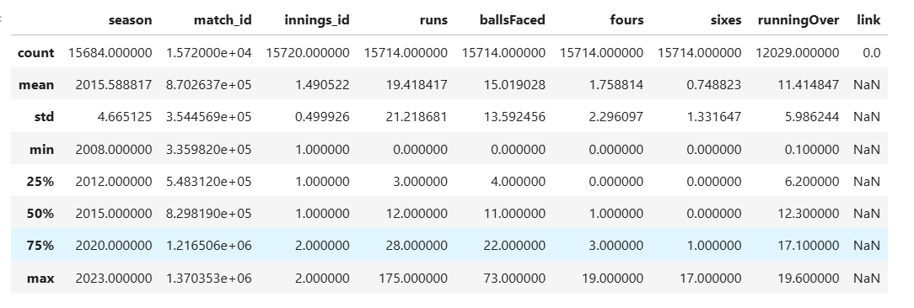
Description of Dataset
The description of the dataset gives the count, mean, min value, standard deviation etc., for all the numerical values of the dataset. This helps to know the necessary values which can be used for the data cleaning process.

Slide 7
Relationship Between Features
Runs_Scored vs. Batting_Strike_Rate: A player's strike rate is directly affected by the runs they score and the number of balls they face. Higher runs generally lead to higher strike rates, making this relationship important for evaluating batting performance.
Match Outcomes vs. Player and Team Statistics: By analyzing the match outcomes (e.g., winner of the match), one can assess how individual player performances (e.g., Player_of_the_Match, Runs_Scored) influence a team's success. This relationship helps in understanding the key contributors to match victories.
Venue and Match Performance: The venue plays a role in the dynamics of a match. Some venues may favor batting due to shorter boundaries, while others may assist bowlers. By examining the relationship between the venue and match statistics, we can derive insights into home advantage and venue-specific strategies.

Slide 8
Data Cleaning Process
Data cleaning is a critical first step in any data analysis project. It ensures that our dataset is accurate, complete, and ready for further analysis. Raw data often contains errors, inconsistencies, missing values, or irrelevant information that can distort the results of any analysis or model we apply. By cleaning the data, we remove inaccuracies and make the dataset suitable for accurate insights and reliable predictions.
Drop Irrelevant Columns ( the ‘link’ column is dropped)
Handle Missing Values
Check for Duplicate Values
Normalize or Standardize the Data
Check for Outliers
Feature Encoding

Slide 9

Dropping irrelevant columns
The column ‘Link’ is dropped from the dataset because it is not useful for the analysis. It also take the data type as number by default. It would also make the dataset unfit for further process.

Slide 10
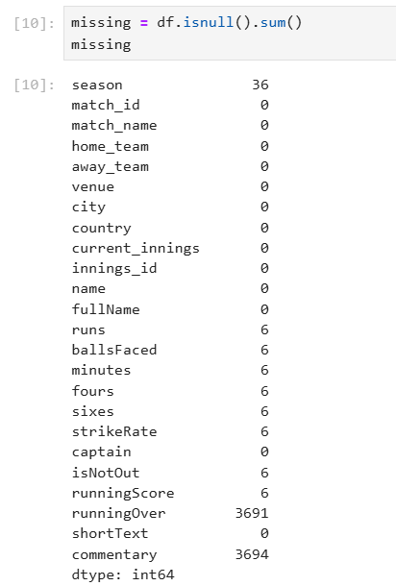
Handling missing values
First, we found out, in what are the columns null values are there.
There are 11 columns that has null values.
We use mean, median and mode to fill these null values based on the columns.

Slide 11

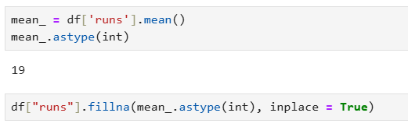
Column ‘season’:
We filled the null values of this column by ‘2023’, because the years are arranged in the sequential descending order. So according to the sequence the value filled must be ‘2023’. The row before and after the null values are filled with ‘2023’.
Column ‘runs’:
Since the 'runs' column is likely to represent a continuous and normally distributed set of values (assuming most players have typical performance levels without extreme variability), the mean serves as a reasonable estimate for missing values.

Slide 12


Column ‘balls_faced’:
Since 'balls_faced' is a continuous metric, using the mean helps ensure that missing values are replaced with a value that reflects typical performance and it is the numerical column.
Column ‘minutes’:
In this column there are ‘-’ which indicate the value ‘0’. So we replaced ‘-’ with ‘0’.
Column ‘commentary’:
We found that all columns has null values in the row where the commentary has null values. As this column is not necessary for the analysis we dropped the column commentary.

Slide 13
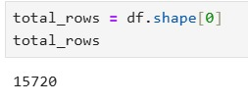
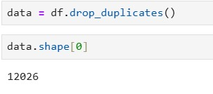
Removing Duplicates
We checked for the duplicates in the dataset and dropped it.
Before removing
After removing

Slide 14
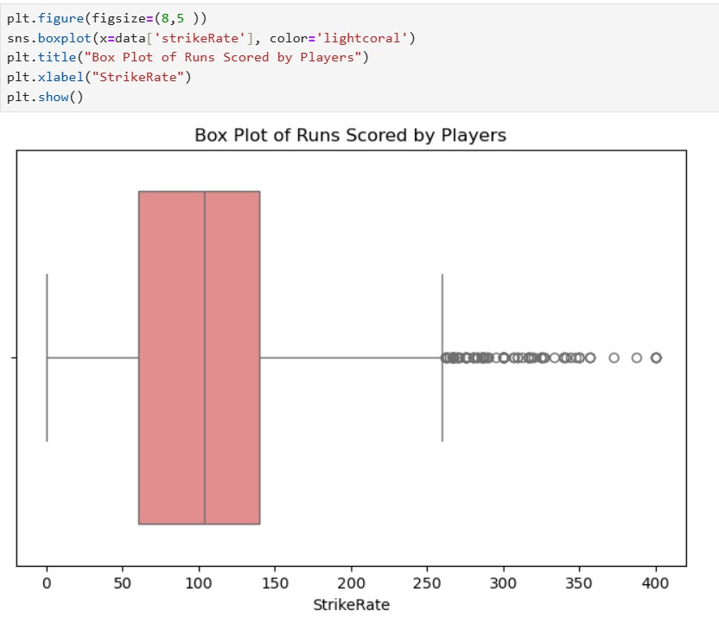
Handling Outliers
We checked for the outliers in the dataset using IQR method. The column ‘strikeRate’ has the outliers. We used boxplot to represent the outliers.

Slide 15
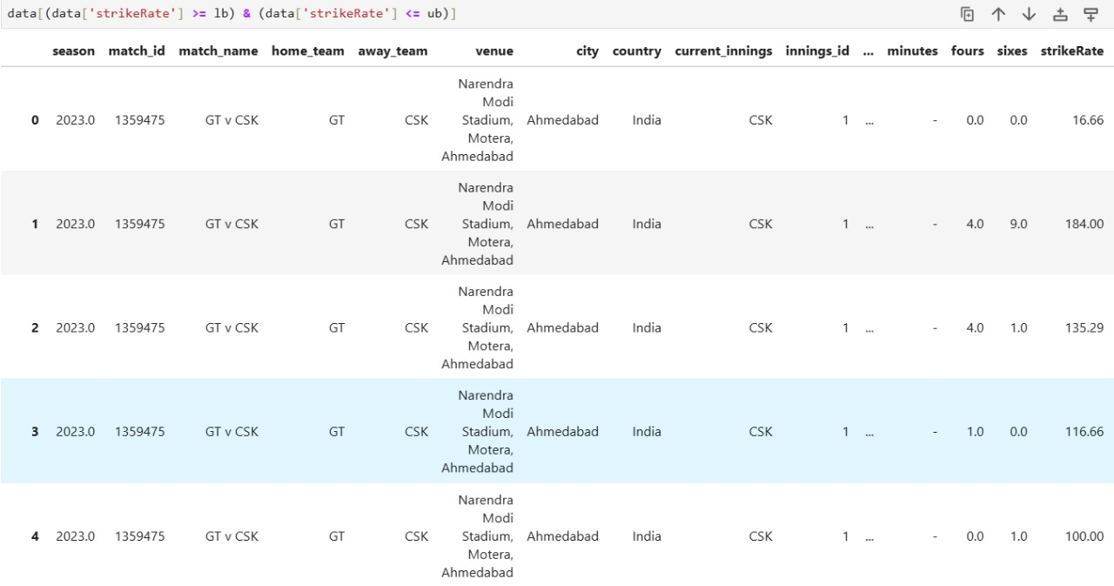
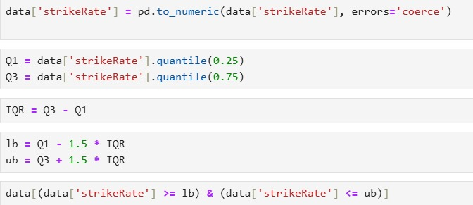
Handling Outliers

Slide 16
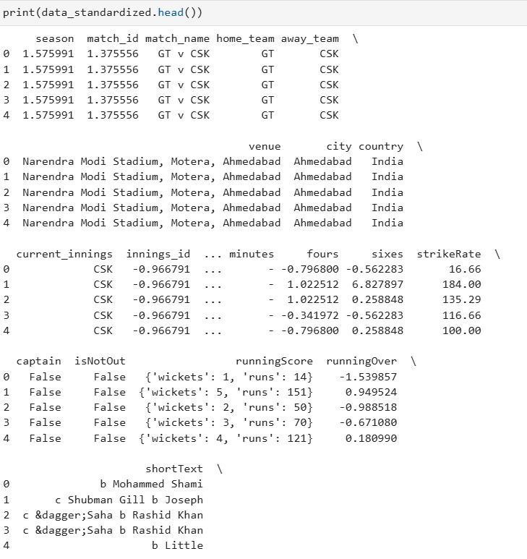
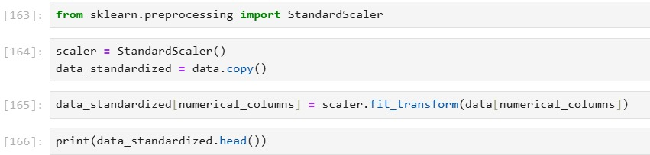
Feature Standardization
Standardization is used to make sure that all the features contributes equally for the analysis.

Slide 17
Exploratory Data Analysis (EDA)
Exploratory Data Analysis (EDA) is the critical first step in understanding your data. By examining the data’s structure, trends, and relationships, we uncover hidden patterns, anomalies, and initial insights that guide further analysis. EDA allows us to ensure the data quality before building models or drawing conclusions..
Histograms
Box Plots for Outlier Detection
Correlation Matrix
Pair Plots for Multivariate Analysis

Slide 18
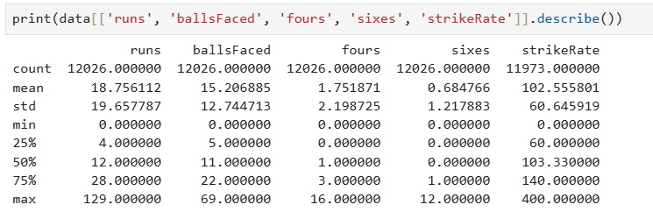
Summary Statistics
Description of the numerical columns after cleaning the dataset.

Slide 19
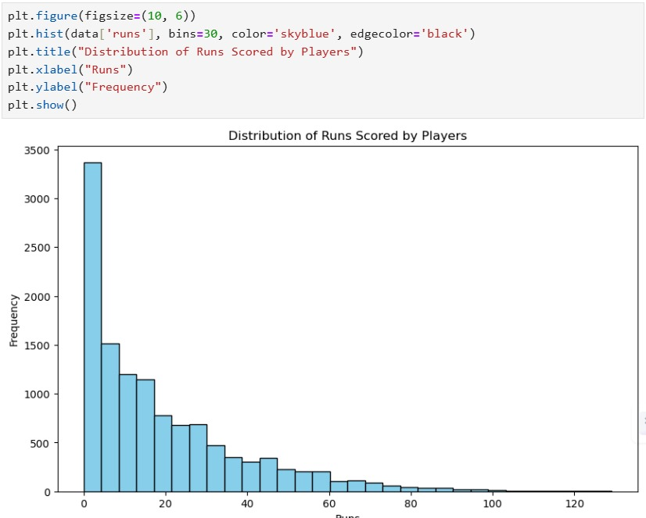
Histogram
Through the histogram the distribution of runs scored by players is shown.

Slide 20
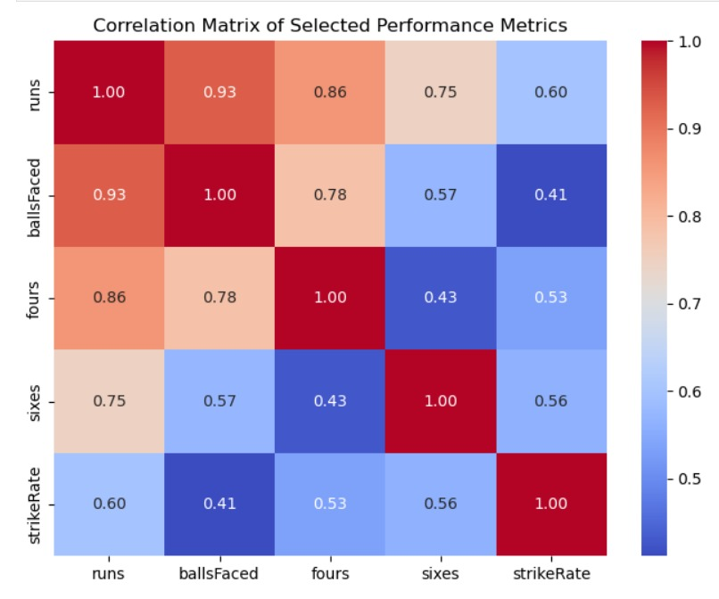
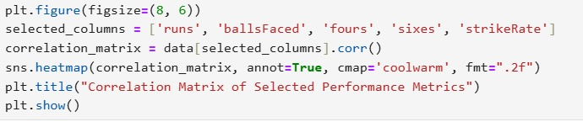
Correlation Matrix
It shows the correlation coefficients between variables in the dataset. It helps to identify the variables which are more related to each other.

Slide 21
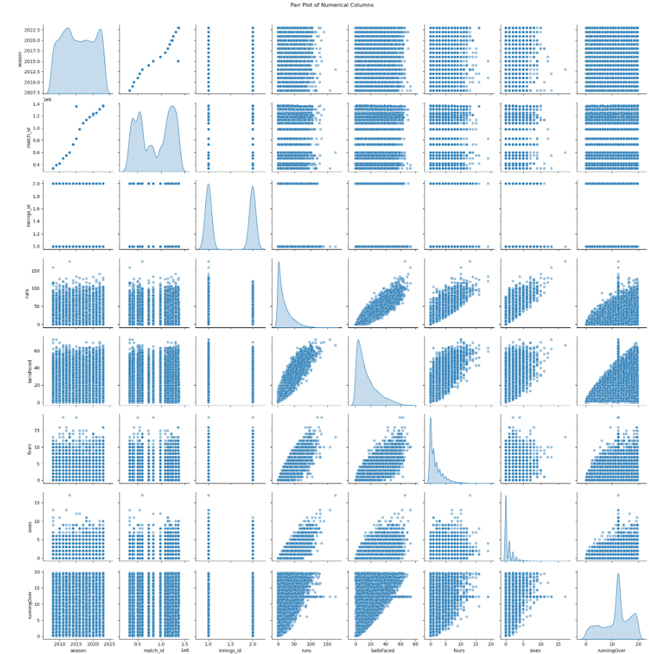
Pair Plot
Pair plot is used to show the relationship between multiple variables in the dataset.

Slide 22
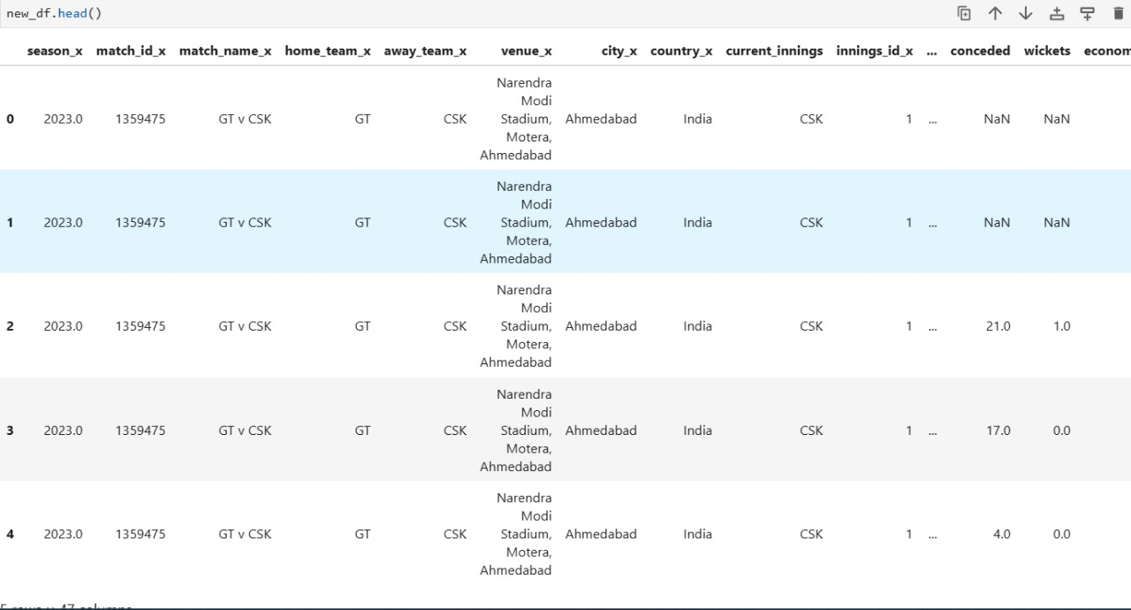
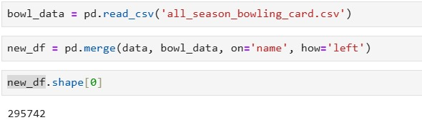
Data Integration
The dataset ‘all_season_batting_card’ gives almost good prediction. But the most accurate prediction the dataset ‘all_season_bowling_card’ is integrated with the previous dataset. It would help to give the most accurate outcome of winning or losing.

Slide 23
Data Transformation
Raw data often contains variables with different scales, formats, or units. Transforming the data ensures that all variables are comparable and can be analyzed meaningfully. For example, in sports data, player statistics may be recorded on different scales (runs scored vs. strike rate). By normalizing these values, we can bring them into a comparable range, which helps when running algorithms that rely on distance metrics (like clustering or machine learning).
Min-Max Scaling
Aggregation
Log Transformation

Slide 24
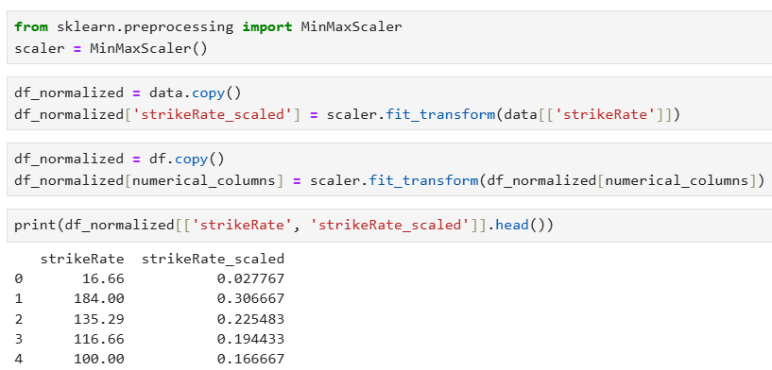
Min-Max Scalar
The column ‘strikeRate’ is normalized to the range of [0,1] using the Min-Max Scaling.

Slide 25
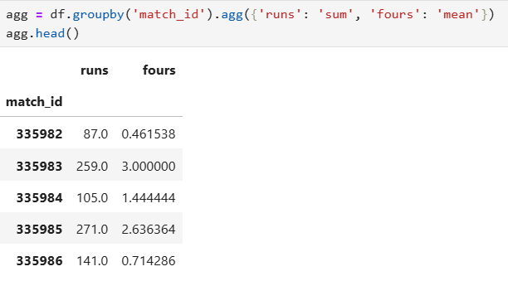
Data Aggregation
The average of runs scored by each player is identified. It can be used for the prediction.

Slide 26
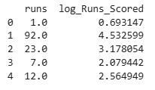
Log Transform
There are many players playing so, it would be difficult to plot the runs of them which has large range. So log transformation is used for the runs scored.

Slide 27
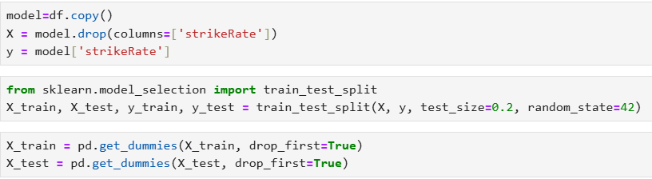
Model Building
Model building involves selecting appropriate algorithms and training them on preprocessed data to establish a relationship between input features and the target variable. The process includes splitting the data into training and testing sets, choosing algorithms like Random Forest, and optimizing parameters to improve performance. It results in a trained model ready for evaluation and deployment

Slide 28
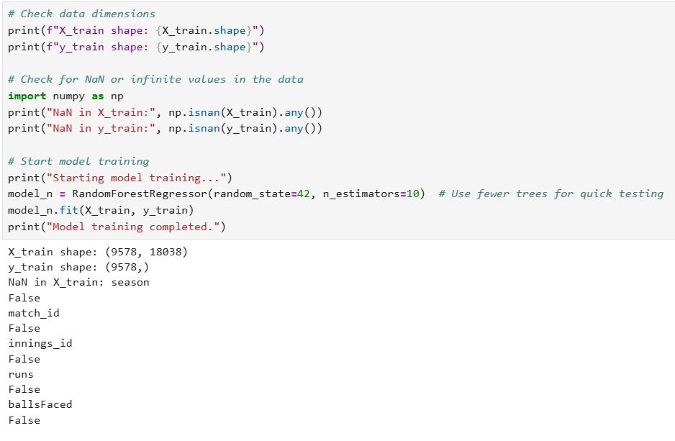
Random Forest Algorithm
An ensemble method that uses multiple decision trees to reduce overfitting and enhance prediction accuracy for regression and classification tasks.

Slide 29
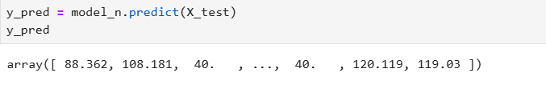
Random Forest Algorithm
Tested Output

Slide 30
Visualization Techniques
Visualization techniques transform data into graphical representations to highlight trends, patterns, and relationships, aiding in better data understanding. Common methods include scatter plots, histograms, box plots, and heatmaps. These visualizations reveal feature importance, data distribution, and correlations.
Histogram
Scatter plot
Heat map
Box plot
Pair plot
Pivot table
Residual plot
Probability plot

Slide 31
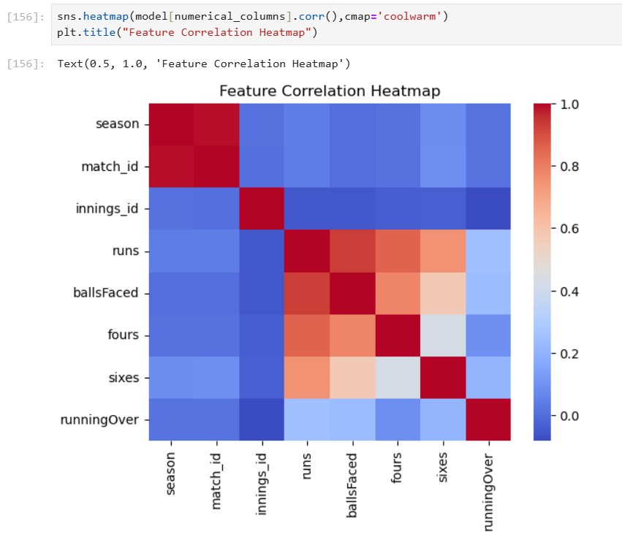
Heatmaps
A heatmap shows correlations between numerical features, helping to identify highly correlated variables for feature engineering or removal.

Slide 32
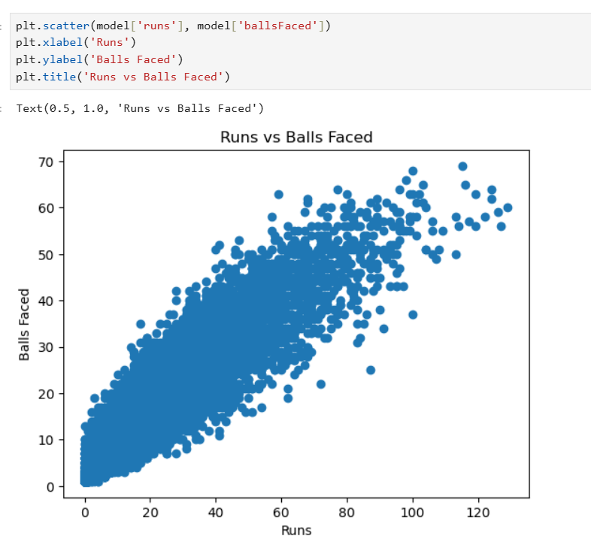
Scatter Plots
Scatter plots visualize relationships between two numerical variables, revealing trends and potential linear or non-linear associations.

Slide 33
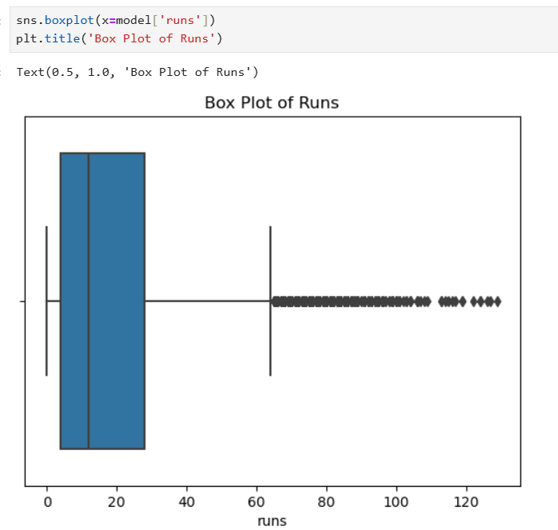
Box Plots
Box plots help detect outliers and summarize data distribution by showing quartiles and the interquartile range.

Slide 34
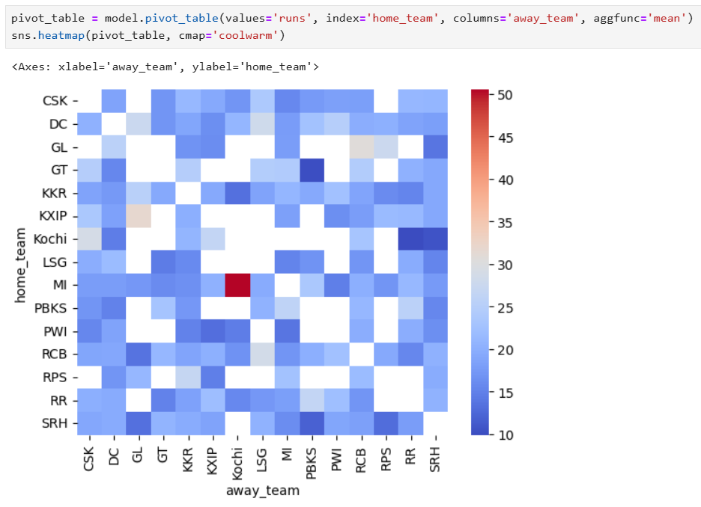
Pivot Table
A pivot table is a data summarization tool that aggregates data based on one or more categorical variables. It’s commonly used for grouping, aggregation, and multi-dimensional analysis.

Slide 35
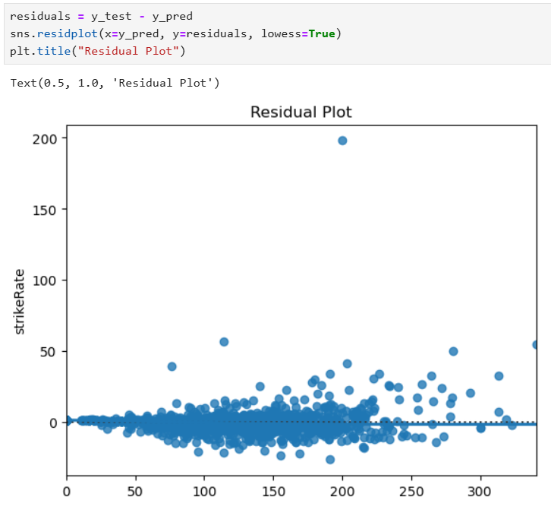
Residual Plot
Residual plots display the differences between predicted and actual values, helping to identify patterns or biases in predictions.

Slide 36
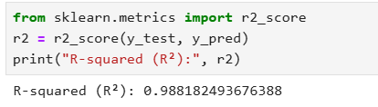
Model Evaluation
Model evaluation is the process of assessing how well a trained machine learning model performs on unseen data. It uses metrics like R-squared for regression tasks, or accuracy, precision, recall, and F1-score for classification tasks. Visual tools such as learning curves and residual plots help analyze performance trends, detect overfitting or underfitting, and identify systematic errors. Effective evaluation ensures the model is robust, generalizes well, and meets the problem's requirement.
R-Squared:

Slide 37
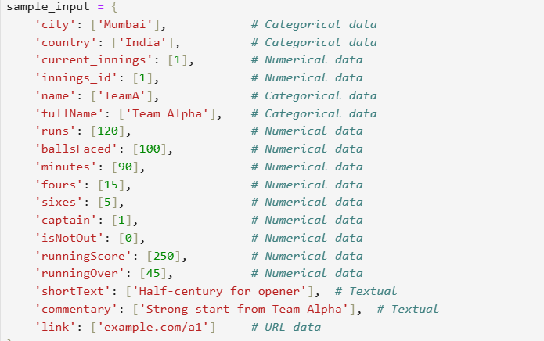

Sample Test

Slide 38
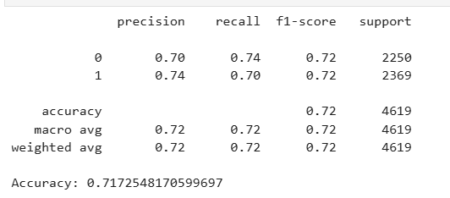
Confusion Matrix
A confusion matrix is a performance evaluation tool used for classification models, showing the number of correct and incorrect predictions. It compares the predicted values to the actual values, providing insight into errors made by the model. In a multiclass setting, it contains rows and columns representing each class, helping assess the model's accuracy and identify where misclassifications occur.

Slide 39
Conclusion
Our analysis concludes that the runs scored by players serve as a strong indicator of a team’s likelihood to win a match. In cricket, the team with the higher score wins, making runs scored a critical factor in determining match outcomes. By focusing solely on runs, we create a simplified and easily interpretable model that can make quick predictions based on this key metric. This approach has the advantage of being straightforward, as it allows us to predict match outcomes without complex variables, making it accessible even to non-technical audiences.
However, relying on runs alone doesn’t capture the complete picture; factors such as bowling performance, fielding quality, and match conditions also play crucial roles in a team’s success. While our model is effective, it may have limitations in situations where these other factors heavily influence the result. In the future, incorporating additional features like strike rate or wickets taken could help improve the accuracy and depth of the predictions, allowing for a more comprehensive analysis of match outcomes.

