Slide 1
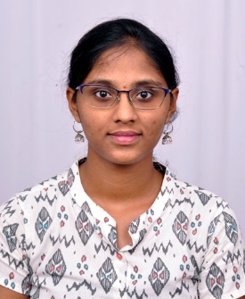



Monika M
Education and certificates
Bachelor of Engineering
Computer Science : 2017-21
Analyst/Software Engineer
Base Location: Mumbai
Skills
Email ID: monika.b.m@capgemini.com
Java | Java Basics, OOPS, Arrays, loops, Collections.
Add on skills | Communication, peer learning
Framework | Spring Core, Spring Boot, Spring Data JPA, Spring Data REST.
Spring REST | REST Controller, Implementation of GET, POST, PUT, and DELETE. Controller and Repository layer
Database | PostgreSQL, MongoDB
Tools | Git, Eclipse, Spring Tool Suite, Postman, Visual Studio Code, PgAdmin 4, Swagger
UI Tech | HTML 5, CSS 3, JavaScript, React
React | Components, Hooks, Event Handling, Redux, Reducer.
Mobile No: +91 7825919611
Grade: A4
Strengths
Achievement
Full Stack Developer trained on Java Hands on experience on
E-Commerce Shopping Cart Application
Done case study of Shopping Cart System using Microservice along with Swagger, Junit, JWT. Responsive UI using HTML5, CSS3, Bootstrap, and React for user interface.
Cooking Hire System – Spring boot application
It is a backend application which is built using spring boot thereby customers to post cooking jobs and the cooks can apply the particular job posting.
Hands on experience in creating microservices with spring boot, spring security, spring API and Eureka
Hands on experience in developing webpages using HTML 5, CSS 3, JavaScript.
Git and GitHub
Currently improving skills on Itransform-platform.
Ready to learn new technologies and implement them for the future knowledge improvement.
Note Making System – React application
Note-taking application allow people to store all notes and important information digitally which is developed using React
.

