Slide 1
Greyatom Hackathon
Stayze Rent Prediction
Team: Soumya, Monika, Abhineet, Nilay

Slide 2
Problem Statement
Stayze is an online market for providing lodging or primary homestays. The company does not own any real estate or properties, it acts as a broker receiving commission from each booking. The hosts rent out their property, its availability, area, type of room, price etc. and the travellers can book accordingly. The travellers put in their reviews, which is visible to others.
Data can be used to gain business insights, make decisions, improve security, understand the customers' and providers' (hosts) behaviour and performance on the platform, guiding marketing initiatives, implementation of innovative additional services and much more.
The stakeholders with the help of the available data want to know the ideal prices at which the properties can be rented, as it will help them decide upon the ideal investment to be done.
Lets build Machine leaning model to predict rent.

Slide 3
Business Insights:
1. Find if any particular neighbourhood's showing higher price.
2. Find out neighbourhood group's showing higher price of the property.
3. Find out if particluar room types showing higher price of the property.
4. Check skewness in the data and handle it.
5. detect outliers in the data and handle them.
6. do analysis to detect correleation among the columns and handle it.
7. Which neighbourhood is booking most frequent in Maximum_night column.
8. How ‘minimum_nights’ column is effecting the price and frequency of booking.
Evaluation Metric:
Evaluation metric for this problem is root-mean-squared error (RMSE)

Slide 4
Data :Dataset Information: data contains 34226 bookings of the properties, 15 predictors and 1 target column(price). Features and target variable:
Column name | description
Id | Listing id
name | Name of the listing
host_id | host_id
host_name | Name of the host
neighbouthood_group | location
neighbourhood | area
latitude | Latitude coordinates
longitude | Longitide coordinates
room_type | Listing space type
price | Price in dollars
minimum_nights | Amount of nights minumum
number_of_reviews | Number of reviews
last_review | Last review
reviews_per_month | Number of reviews per month
Calculated_host_listing | Amount of listing per host
availability_365 | Number of days when listing is available for booking

Slide 5
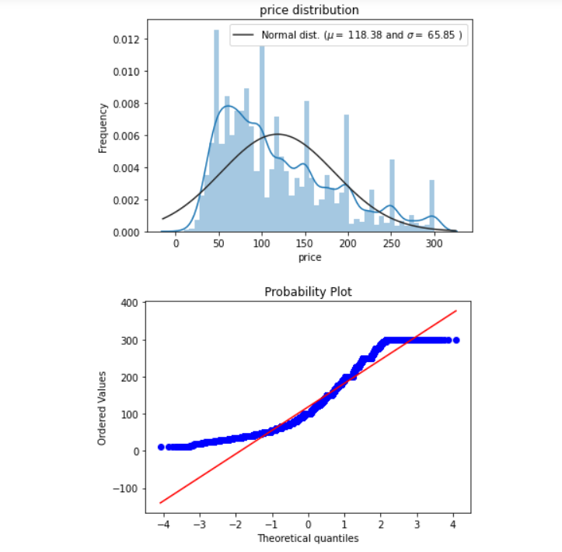
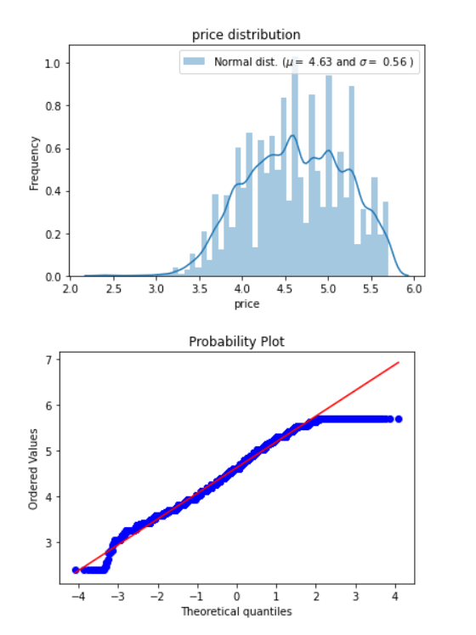
EDA:
1. Dropped Id, host_id, host_name
2. reviews_per_month and last_review have null values. reviews_per_month and is filled with ‘0’ and last_review with minimum date in that column
3 Price column:
- Dependant column 'price' is positively skewed, so outliers present in price column.
- to handle outliers we have scaled the column values using log.
- Min value for price is '0', Some properties (i think around 10) are listed with '0' price, so we have filled the '0' values with median of the groupby data of 'neighbourhood' column
Before normalization
After normalising

Slide 6
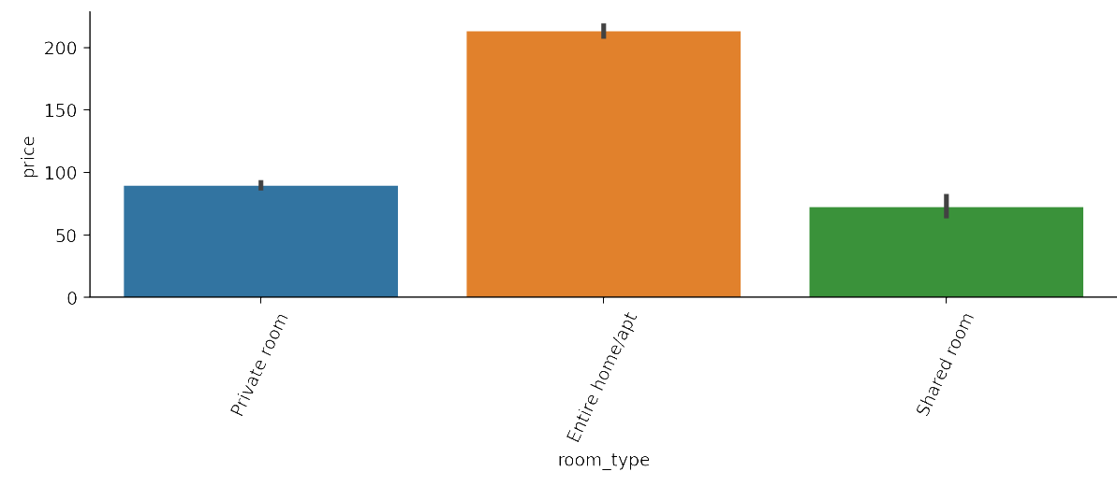
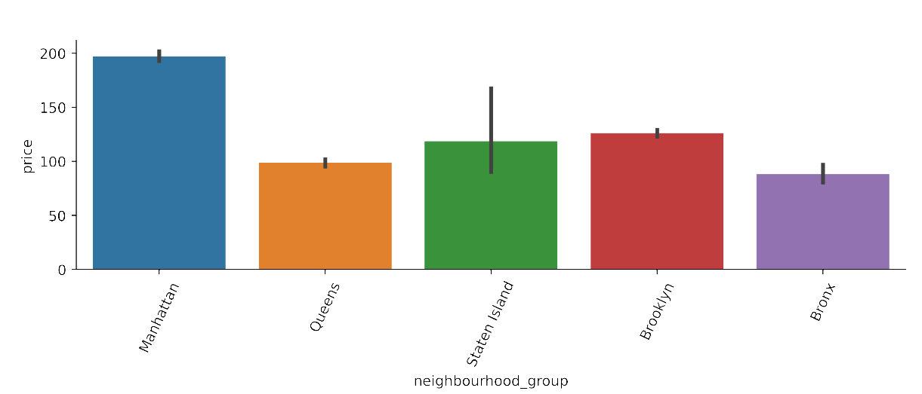
room_type : Bivaraite analysis of room_type vs price
neighbourhood_group vs price
Insights: Manhattan has costlier properties after that comes Brokyln and Staten Island.

Slide 7
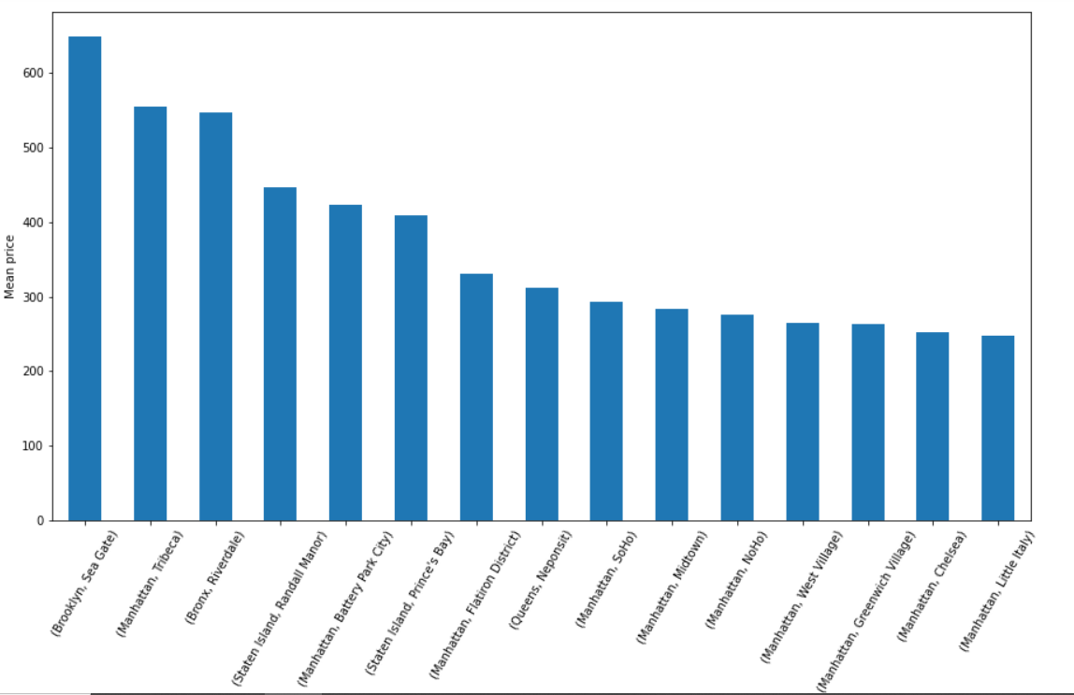
-
mean price Vs grouped neighbourhood and neighbourhood_group
Insights: Properties in Brooklyn, Seagate are more priced than Manhattan properties.

Slide 8
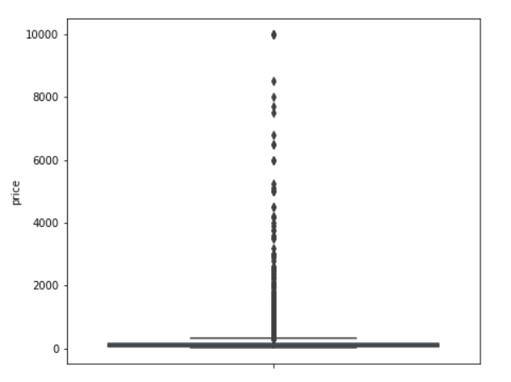
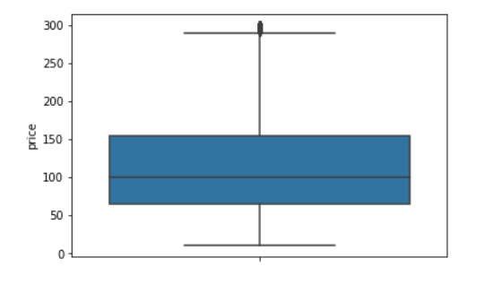
Outliers in Price column
Outlier in price column were dropped.

Slide 9
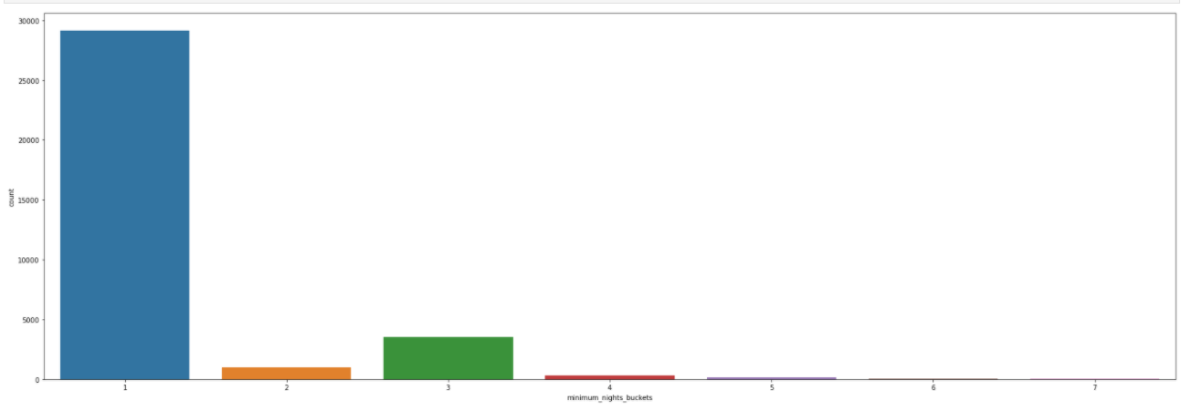
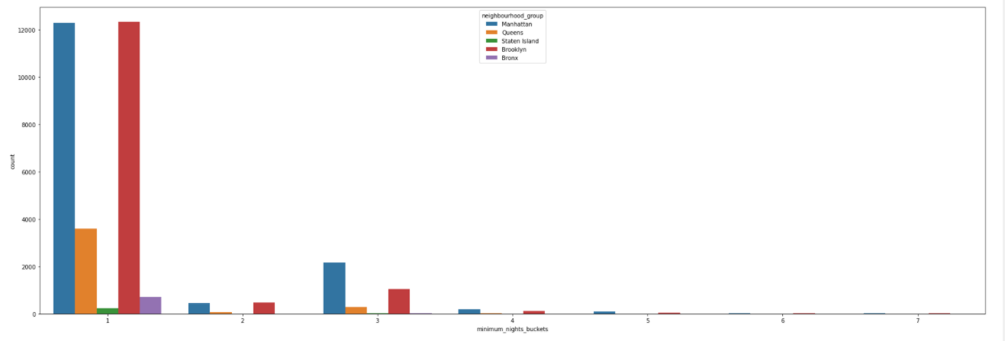
Insights from Minimum_nights column:
Bins | Labels
0 - 7 | 1
7 - 14 | 2
14 - 30 | 3
30 - 60 | 4
60 - 120 | 5
120 - 240 | 6
240 - max(column) | 7
Created buckets for ‘minimum_nights’ column, to get insights.
- Insights : Most frequent bookings are for 1 – 7 night stays.
- Insights : neighbourhood group 'Brooklyn' and 'Manhatten' has got most bookings for 1-7 nights

Slide 10
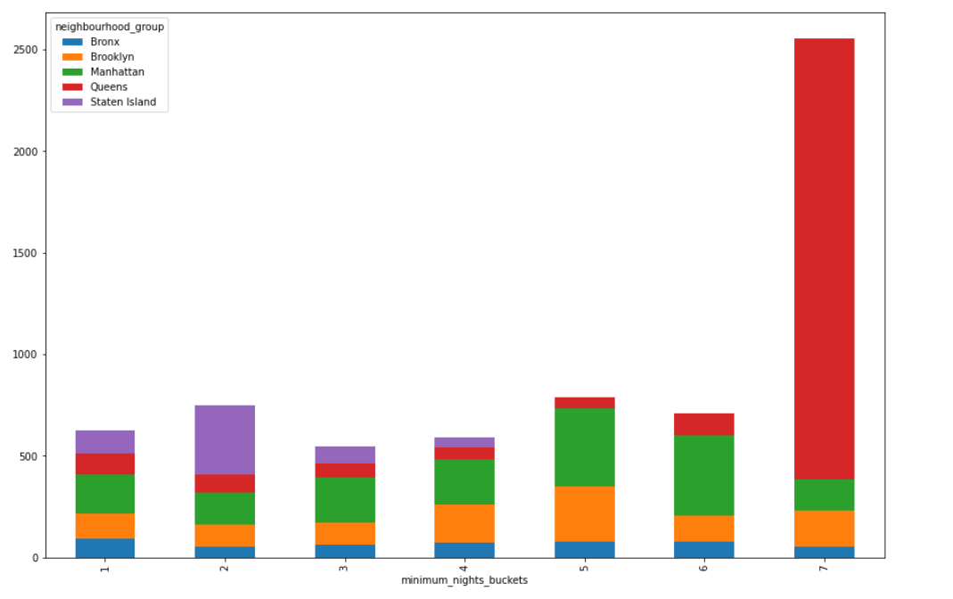
Insights: Properties which are booked for more than ‘8 months’ are most priced and is in Queens neighbourhood.

Slide 11
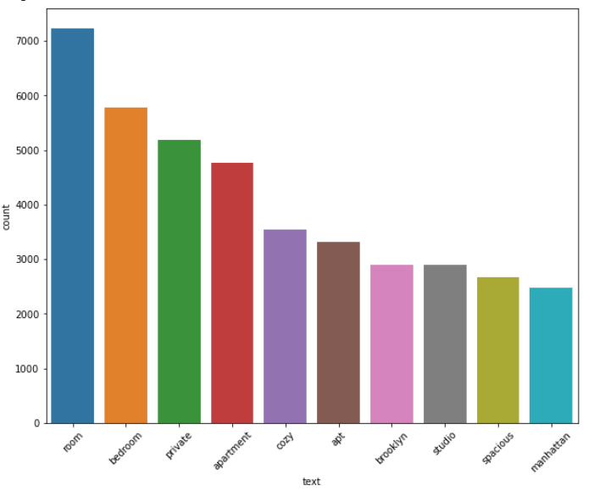
Name column is unstructured data, explaining about the property. Following graph gives most common words in the ‘name’ column and the frequency.

Slide 12
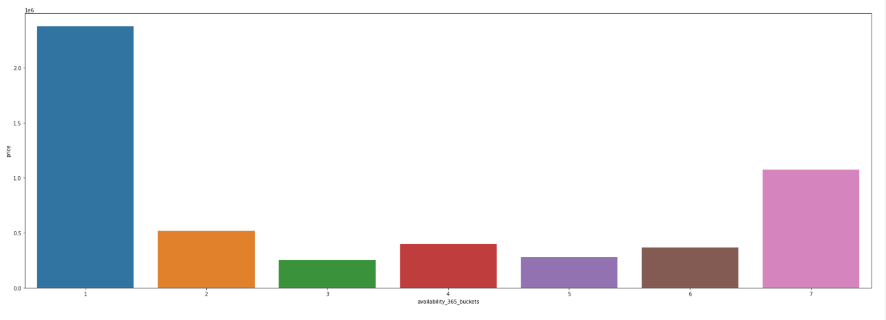
Insights: Price of the house is more for 100 -150 availability.

Slide 13
Missing Values and treating Categorical values
1. Missing values in last_review was imputed with the earliest date i.e., 2011-03-23.
2. Basic NLP was done on name column to remove punctuation and stopwords.
3. reviews_per_month null values were imputed with 0.
4. All Categorical columns were converted in Int values using Pandas.cat.codes.
Feature engineering:
1. DISTANCE: Latitude and Longitude columns were used to calculate distance of property from center of earth. after this Latitude and Longitude were dropped.
2. days_last_review: last_review date was subtracted from earliest review date to get days since last review. last_review was dropped after this.
3. Minimum_nights, is binned and created new column
4. availability_365 is binned and created new column

Slide 14
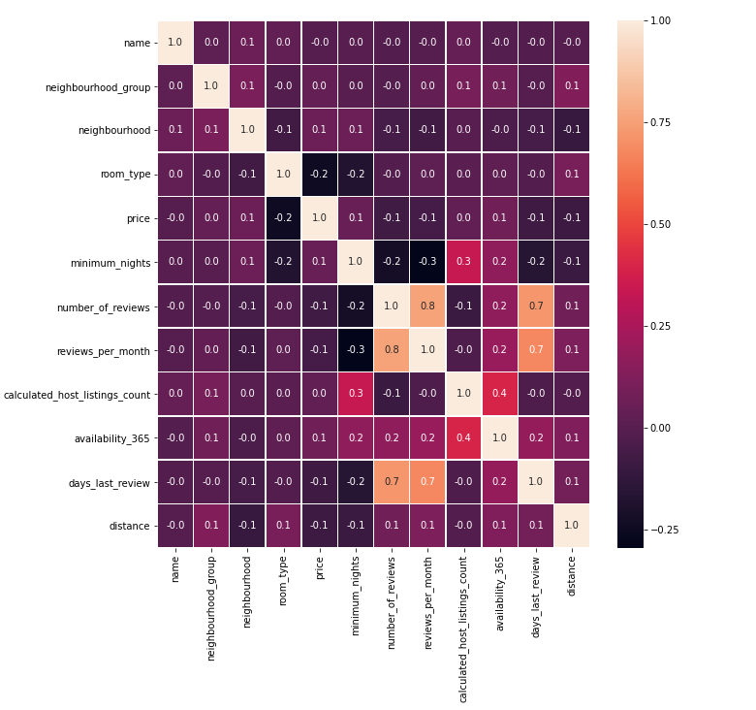
Feature Selection :
Following methods were used for feature selection :
- Correlation
- RFECV
Best features found:
'name', 'neighbourhood_group', 'neighbourhood',
'room_type','minimum_nights', 'number_of_reviews',
'reviews_per_month', 'distance',
'calculated_host_listings_count', 'availability_365',
'days_last_review'

Slide 15
Models and Approaches
Various Vanilla models were assessed and also hyperparameter tuning were tried on the models. The models were:
- LinearRegression
- RandomForestRegressor
- Lasso
- Ridge
- DecisionTreeRegressor
- XGBRegressor
- StackingRegressor
- GradientBoostingRegressor
- SVR

Slide 16
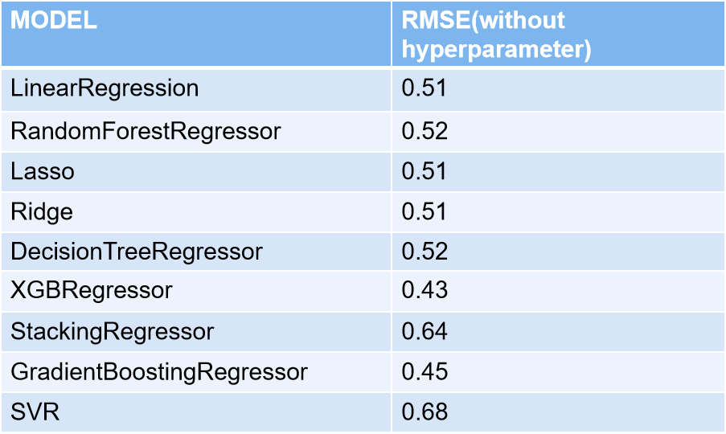
Results of the Models:
Finally from the observations above GradientBoostingRegressor was selected as the best model for the price prediction. we avoided XGBRegressor although it gave a better result as we are still unaware on how XGB really works.

Slide 17
Insights
- Properties in Brooklyn, Seagate are more priced than Manhattan properties.
- customers have to pay more for 'Entire home/apt'.
- Most number of bookings are for 1 – 7 night stays
- Neighbourhood group 'Brooklyn' and 'Manhatten' has got most bookings for 1-7 nights
- Properties which are booked for more than ‘8 months’ are most priced and is in Queens neighbourhood

Slide 18
Next Steps
If time permitted, could have tried the following :
1. Do some research on the name column and extract meaningful words by using NLP.

