Slide 1
TASK 3: INTERACTIVE SALES DASHBOARD DESIGN
INTERNSHIP: Data Analytics
TOOL USED: Microsoft Power BI
DATASET: Sales Data
SUBMITTED BY: Monika V
DATE: 14 August 2026

Slide 2
OBJECTIVE
The objective of this task was to develop an interactive sales dashboard using Microsoft Power BI to transform raw sales data into meaningful and easily understandable business information.
KEY OBJECTIVES:
Create an interactive and user-friendly dashboard.
Display important sales KPIs.
Analyze sales performance across different categories.
Analyze regional and sales representative performance.
Understand sales distribution across different sales channels.
Analyze transaction patterns based on payment methods.
Enable interactive filtering using slicers.

Slide 3
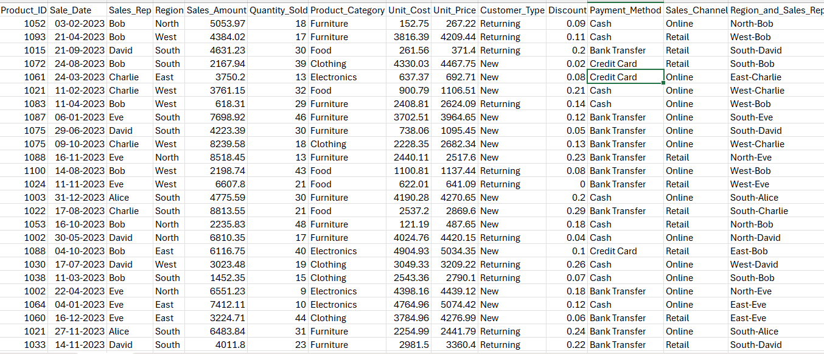
DATASET OVERVIEW
Sales Dataset
Dataset used: Sales Data
The dataset contains information required to analyze sales performance, transactions, customers, products and sales channels.
Important fields used in the dashboard:
Region
Product Category
Sales Channel
Customer Type
Sales
Profit
Sales Representative
Payment Method
Transaction information

Slide 4
KPI CARDS
Key Performance Indicators
KPI | Purpose
Total Sales | Measures overall sales generated
Total Profit | Measures overall profit generated
Quantity Sold | Shows total quantity of products sold
Profit Margin | Measures profitability of sales

Slide 5
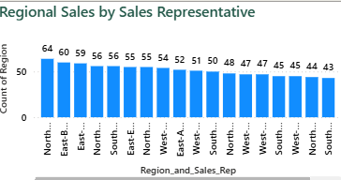
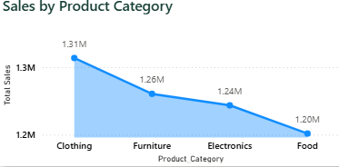
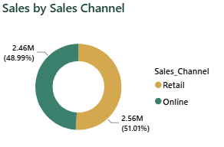
SALES ANALYSIS
Sales Performance Analysis
This section explains the sales-related visualizations.
Charts included:
2. Regional Sales by Sales Representative
Helps understand sales performance across regions and representatives.
1. Sales by Product Category
Helps identify which product categories generate higher sales.
3. Sales by Sales Channel
Shows how sales are distributed across different sales channels.

Slide 6
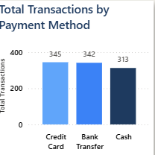
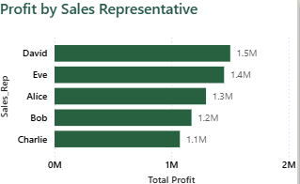
PROFIT & TRANSACTION ANALYSIS
Charts included:
1. Profit by Sales Representative
Used to identify representatives contributing higher profit.
Helps understand individual sales performance from a profitability perspective.
2. Total Transactions by Payment Method
Shows the number of transactions made using different payment methods.
Helps identify commonly used payment methods.

Slide 7
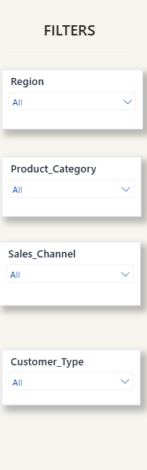
INTERACTIVE FILTERS
Dashboard Slicers
Four interactive slicers were added to make the dashboard dynamic:
1. Region
Filters the dashboard according to geographical region.
2. Product Category
Allows analysis of individual product categories.
3. Sales Channel
Filters sales based on the channel used.
4. Customer Type
Allows comparison between different customer types.

Slide 8
DASHBOARD DESIGN
Dashboard Design & Visualization Approach
Design principles followed:
Clean and minimal dashboard layout.
Light background for better readability.
Consistent blue gradient colour theme.
Separate visual sections for KPIs and charts.
Slicers positioned on the left for easy filtering.
Consistent font and formatting across visuals.
Limited colours to avoid unnecessary visual clutter.
Charts selected according to the type of information being analyzed.

Slide 9
INSIGHTS & CONCLUSION
Key Insights
From the dashboard, users can:
Identify the strongest-performing product categories.
Analyze regional sales performance.
Identify high-performing sales representatives.
Understand profit contribution by sales representative.
Identify the most commonly used sales channels.
Analyze transaction preferences by payment method.
Compare customer types and regions using interactive slicers.
Conclusion
The Task 3 dashboard successfully transformed sales data into an interactive business intelligence report. Power BI was used to create KPI cards, analytical charts and interactive slicers, enabling users to explore sales, profit, regional, customer and transaction performance efficiently.

