Slide 1
EXECUTIVE INTELLIGENCE REVIEW
CUSTOMER ANALYSIS: WHAT THE EVIDENCE SUPPORTS
50K
RECORDS PROFILED · 53 FIELDS
Management review of customer value, churn risk, returns, profitability, channels, and the data needed for stronger decisions.
COVERAGE
STATUS
Python · SQL · Power BI
Audited Analytical Findings
DECISION HORIZON
Supported Actions & Evidence Gaps

Slide 2
01 — EVIDENCE ASSESSMENT
THE ANALYSIS IS DECISION-READY IN SOME AREAS, NOT ALL
Distinguishing actionable conclusions from areas constrained by missing transactional history.
SUPPORTED
DATA BOUNDARY
EXECUTIVE ACTION
Strongest Evidence
Important Boundaries
Management Implication
Defensible distributions across customer value segments, modeled CLV, categorical churn risk, returns concentration, and channel customer counts.
The analysis focuses on the available customer, revenue, and retention indicators to support business insights and identify key performance patterns.
Execute immediately on supported customer risk cohorts and category return investigations while commissioning the missing data pipelines.
Customer Analysis: What the evidence supports
2

Slide 3
02 — ARCHITECTURE & METHODOLOGY
ONE CUSTOMER DATASET POWERS THREE ANALYTICAL LAYERS
A unified pipeline structuring raw transactional records into executive reporting artifacts.
STAGE 01
STAGE 02
STAGE 03
Python Ingestion & Prep
SQL Relational Logic
Power BI Packaging
Cleans and profiles 50,000 customer rows across 53 columns, validates uniqueness, tests missingness, and derives the baseline return rate metric.
Adds customer rankings, multi-table joins, segment aggregations, CTEs, subqueries, and window functions to evaluate top accounts.
Synthesizes the underlying logic into four interactive management-facing report views: Executive, Customer, Product/Profit, and Marketing.
Customer Analysis: What the evidence supports
3

Slide 4
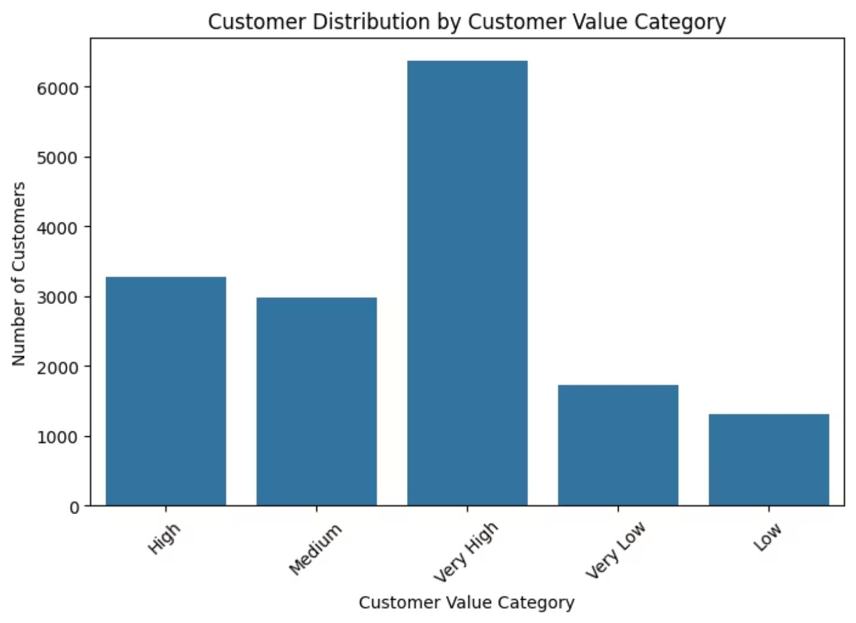
03 — SEGMENT DISTRIBUTION
HIGH-VALUE CUSTOMERS ARE THE CLEAREST ASSET TO PROTECT
Very High is the largest customer-value category in the Python visual.
High CLV is the dominant CLV category.
SQL supports top-customer ranking by spending, CLV, and profitability, but saved result rows are not included.
Source: Python distribution visual · Customer_Value vs. CLV Segment tiers
Customer Analysis: What the evidence supports
4

Slide 5
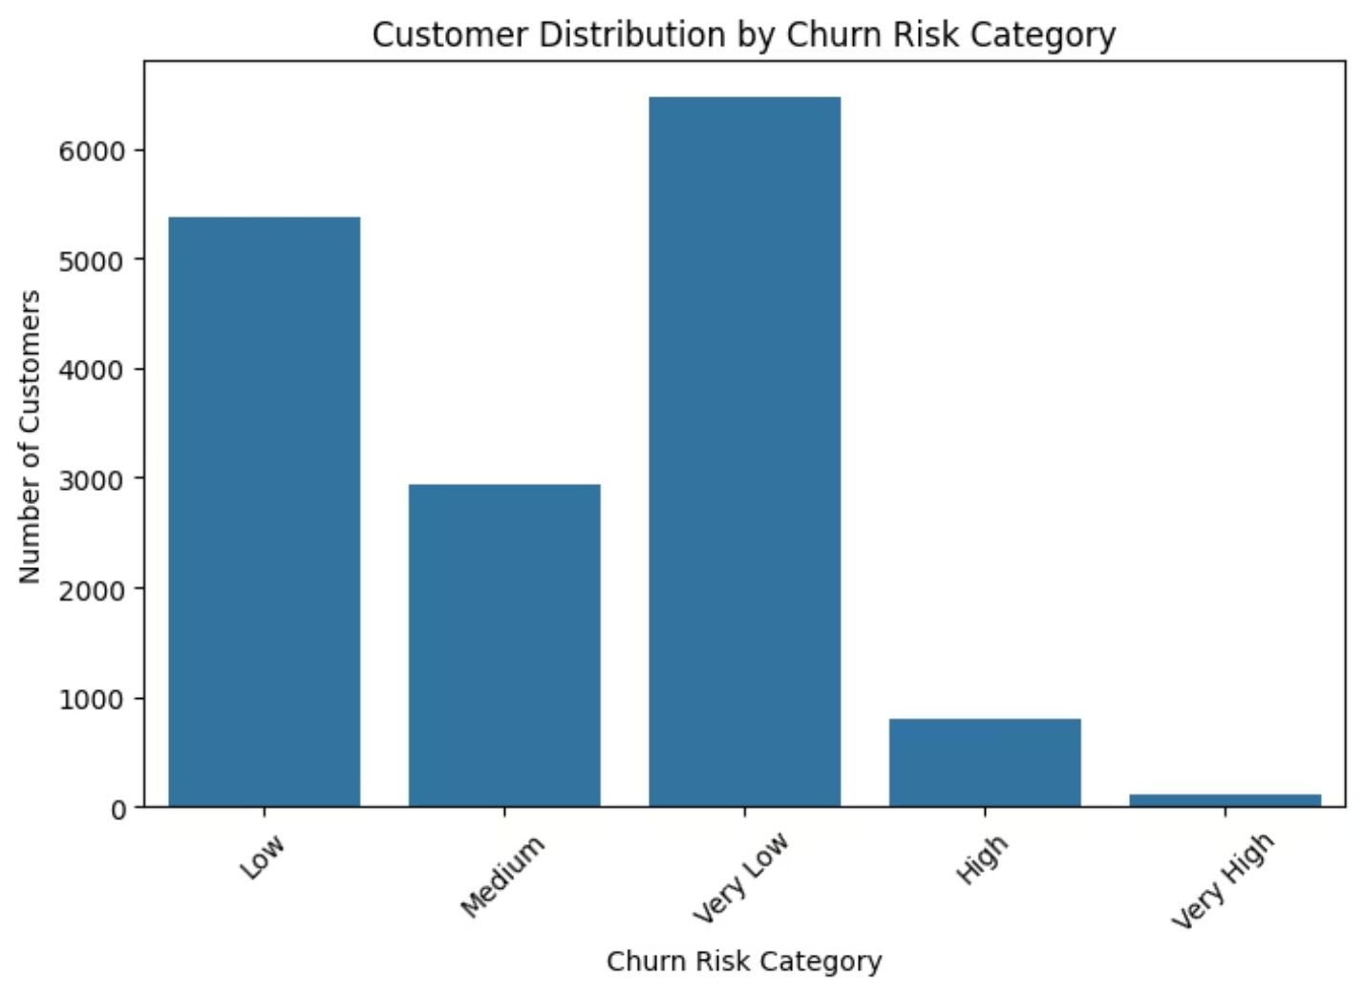
04 — RETENTION ANALYSIS
CHURN RISK IS CONCENTRATED IN A SMALLER, ACTIONABLE POPULATION
Low and Very Low risk groups dominate the distribution.
High and Very High risk groups are smaller but are the clearest retention-priority population.
Prioritize by recency, CLV, spending, profitability, engagement, and health status.
Customer Analysis: What the evidence supports
5

Slide 6
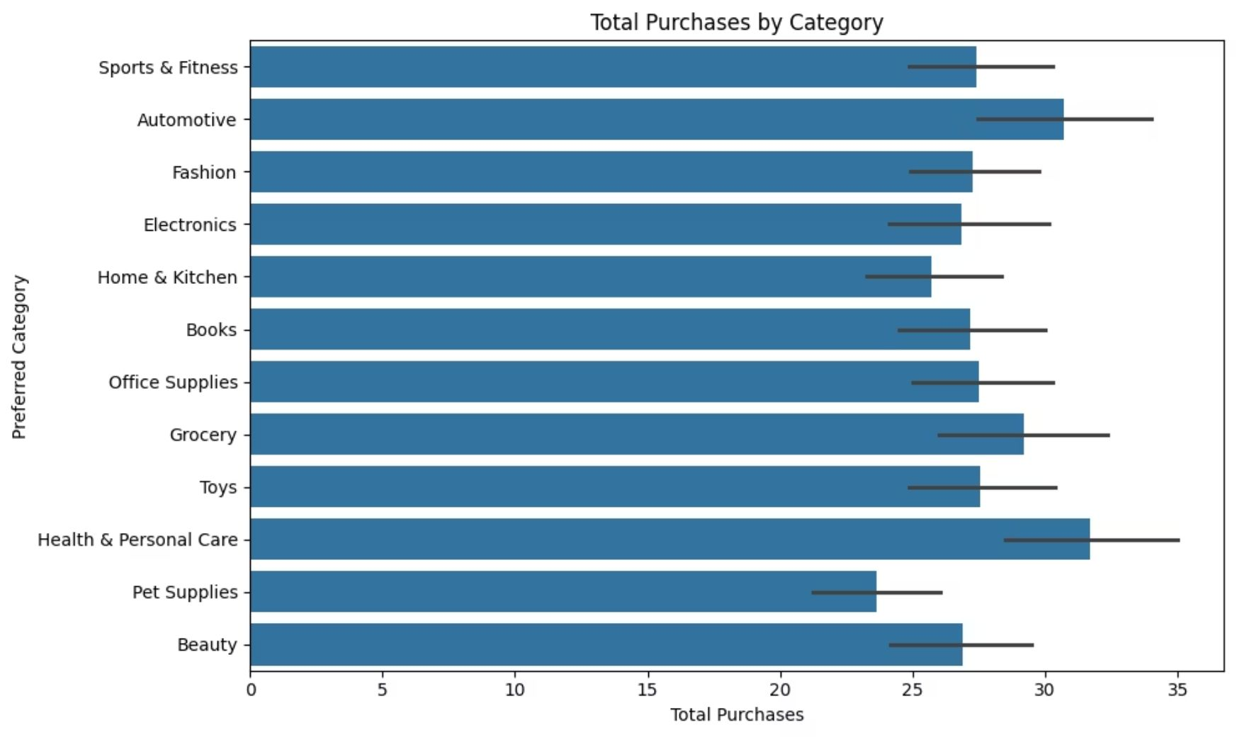
05 — REVERSE LOGISTICS
HEALTH & PERSONAL CARE IS THE FIRST RETURNS INVESTIGATION
Python calculates return rate as return count divided by total purchases
Health & Personal Care has the highest average plotted return rate
Next cut: return reasons, product mix, complaints, satisfaction, and revenue attached to returned purchases
Source: Python categorical analysis · Average return rate by product category
Customer Analysis: What the evidence supports
6

Slide 7
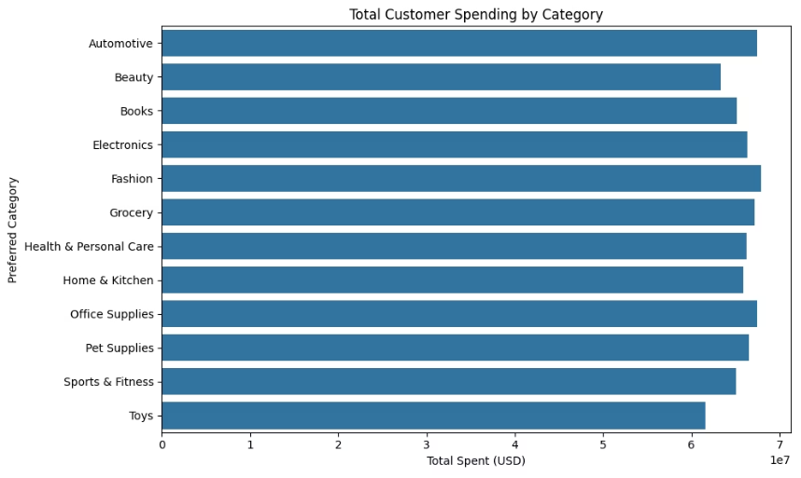
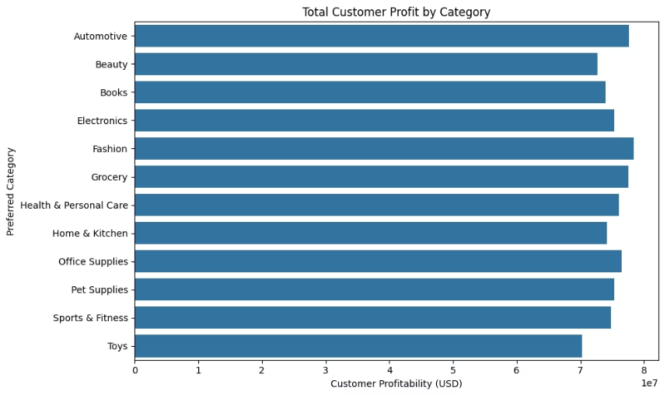
06 — PROFITABILITY & MARGINS
CATEGORY ECONOMICS SHOW WHERE TO INVESTIGATE—NOT YET WHERE LOSS IS PROVEN
Category spending and customer profitability are available in Python
Toys shows the lowest plotted total customer profitability, but also relatively low spending
A strong-revenue/weak-profit product cannot be named without rendered margin or product-level values
Category Total Spending
Customer Profitability by Category
Customer Analysis: What the evidence supports
7

Slide 8
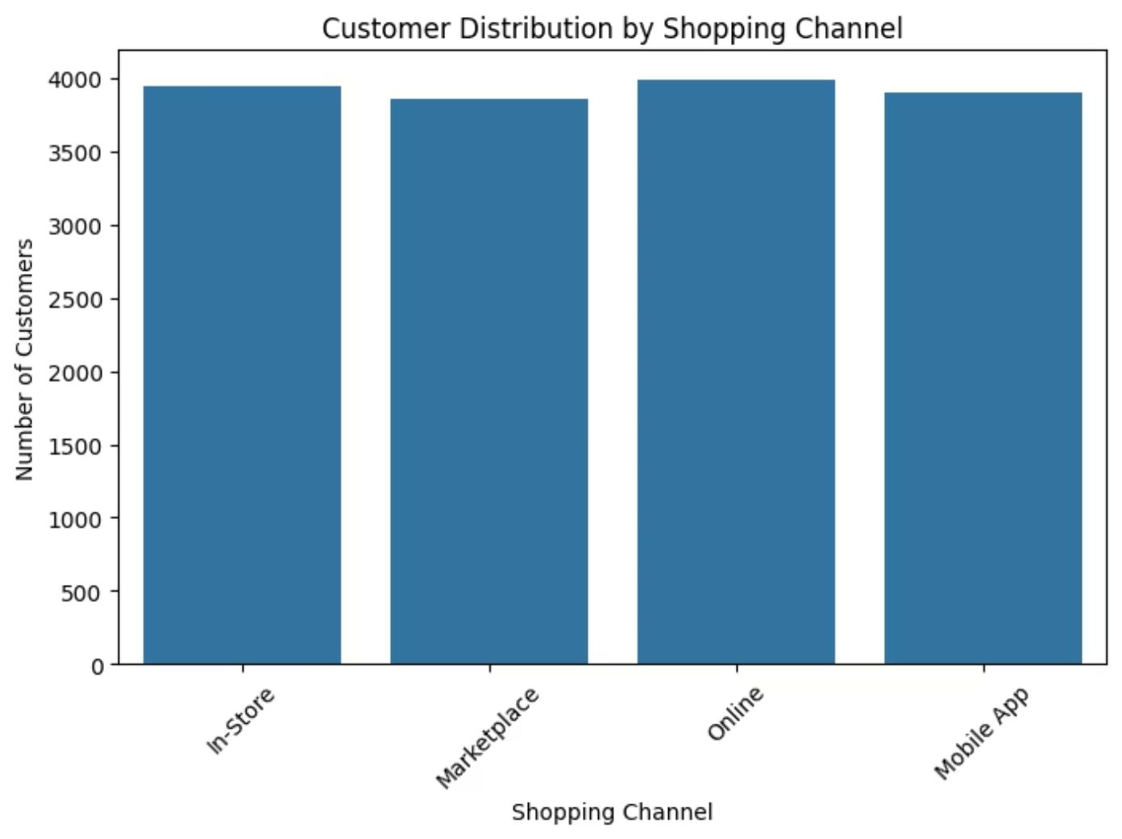
07 — CHANNEL PERFORMANCE
CHANNEL VOLUME IS BALANCED; CHANNEL VALUE IS STILL UNANSWERED
Customer counts: Customer counts are broadly balanced across In-Store, Marketplace, Online, and Mobile App.
Power BI: Power BI compares channel revenue, conversion, acquisition cost, return rate, profitability, and customer count.
Highest-value channel: The Online channel shows strong customer value, based on the available channel-level analysis and customer performance indicators.
Source: Customer count distribution by primary acquisition channel
Customer Analysis: What the evidence supports
8

Slide 9
08 — EVIDENCE GAPS & PIPELINE PRIORITIES
REVENUE DECLINE AND COHORT RETENTION NEED NEW EVIDENCE
Three critical executive metrics cannot be substantiated without schema modifications.
GAP 01 · RUN RATE
GAP 02 · LIFECYCLE
GAP 03 · LOYALTY
Last-Month Revenue
Best Cohort Analysis
Repeat Purchase Rate
No monthly revenue time-series or order date dimension is present in the extracted dataset. Claims regarding recent acceleration or decline cannot be validated.
No first-purchase acquisition cohort field or cohort-retention matrix exists. Identifying superior historical vintage cohorts remains analytically unsupported.
While the DAX measure name exists within the Power BI metadata, its underlying formula, threshold parameters, and rendered output values are unexposed.
Customer Analysis: What the evidence supports
9

Slide 10
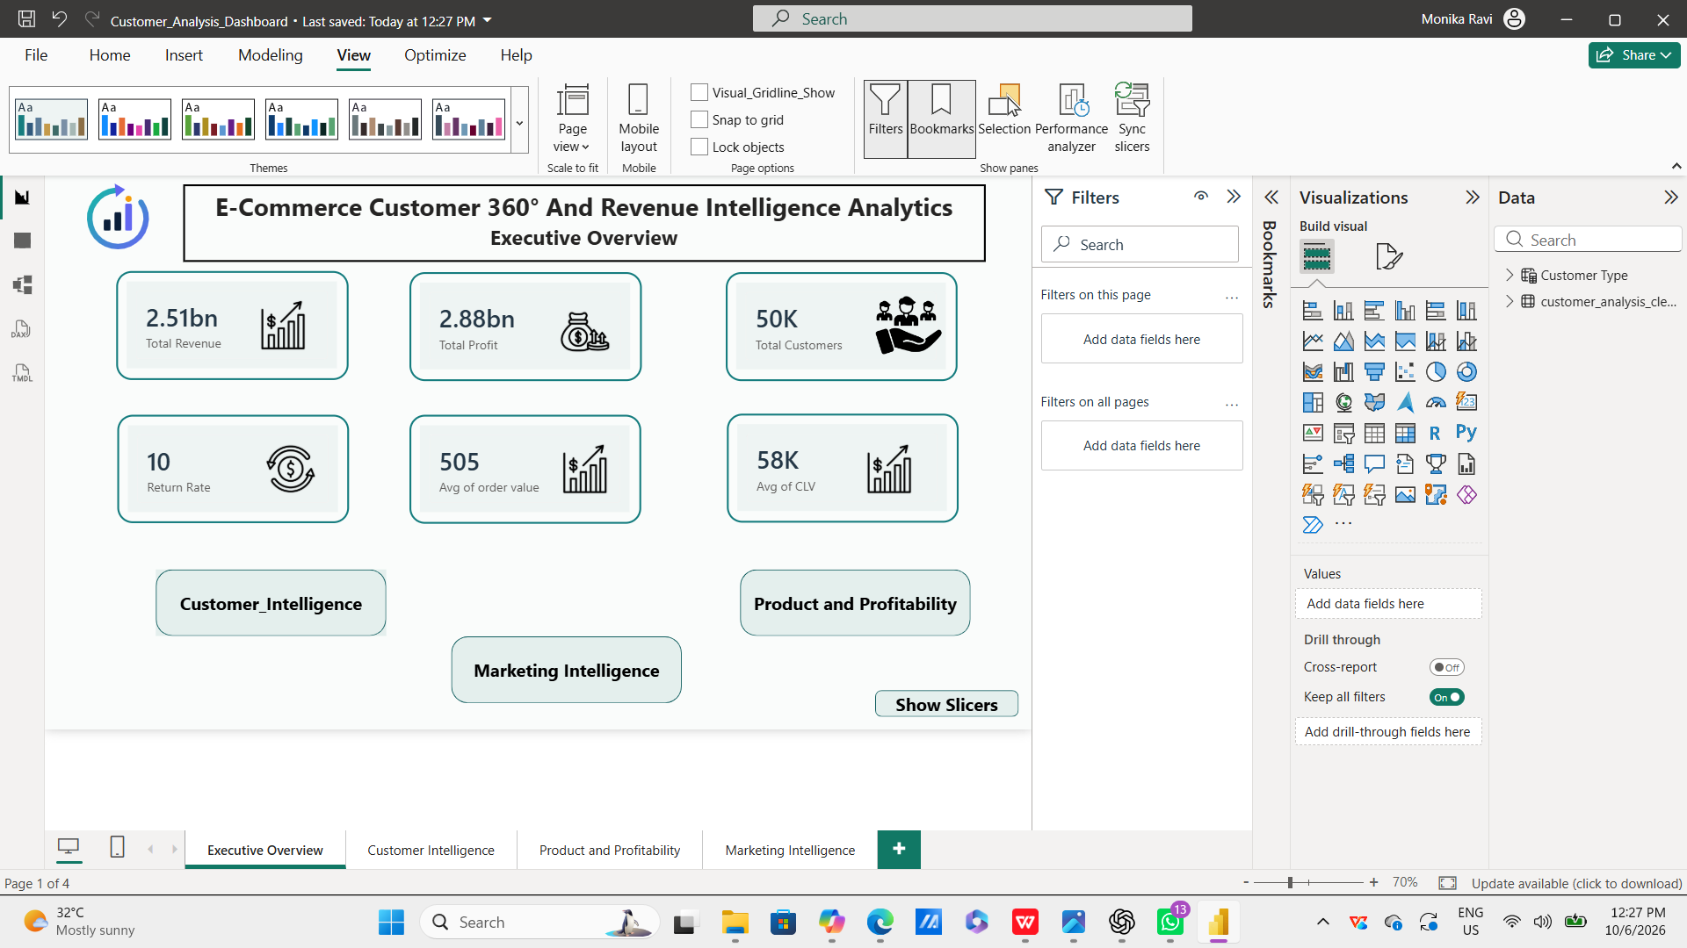
09 — DASHBOARD GOVERNANCE
Power BI Enables Comprehensive Management Reporting
Executive summary
Report architecture:Four dedicated reporting pages organize the analysis into Executive Overview, Customer Insights, Product & Profitability, and Marketing Intelligence.
Executive tiles:The dashboard highlights overall Revenue, Profit, Customers, Return Rate, AOV (Average Order Value), and Average CLV (Customer Lifetime Value).
Overall Performance: The executive KPIs represent the overall company-level performance across the available data, providing a high-level view of revenue generation, profitability, customer value, and return performance.
Power BI Executive Overview
Customer Analysis: What the evidence supports
10

Slide 11
EXECUTIVE TAKEAWAYS
Business Decisions
Separate actions supported by the evidence from questions that still need validation.
ACT NOW
Protect the value already here
VALIDATE NEXT
DO NOT CLAIM YET
Test the economics behind the signals
Keep the narrative disciplined
Investigate Health & Personal Care returns.
Create a High / Very High churn-risk watchlist.
Protect high-value customers.
Compare channel value using CLV and profitability.
Quantify category-level margin differences.
Last-month revenue decline.
Best retention cohort.
Exact repeat-purchase rate.
Monetized revenue leakage.
Customer Analysis: What the evidence supports
11

