Slide 1
Kathanak ”you become what you read”
Project name: “Kathanak” – A storytelling platform
To whom : Scrabble club of KCT
Project by,
Monika M ,
2nd Year of BE(ISE),Kumaraguru College Of Technology,Tamilnadu.
Notes:
1

Slide 2
Project Abstract
Kathanak:
Kathanak is a Sanskrit word meaning “plotline of a story". Kathanak is a platform which brings readers, writers and their stories together.
It allows writers to publish the original works such as stories, poetry, essays, blogs and articles.
It allows the readers to read the story and also allow them to participate in events.
To whom this project is for :
“Scrabble club of Kumaraguru college of Technology”.
It’s all about writing!”, say and assume many. Scrabble has been one of the burgeoning clubs of KCT and it aims to provide knowledge and understanding through writing.
Notes:
2

Slide 3
Categories:
Kathanak has 7 sections:
1) Home
2)Category
3)Write
4)Events
5)About and contact
6)Account(profile, notification, followers, following…)
Functions in Home page :
Sign in/Sign up page
Some details about the website
Contact form
A few story to read

Slide 4
Functions in Category page :
All kind of stories are present in their respective category.
Can select the needed category and read the stories.
Search and select the category
Display top-rated stories
Display Recently uploaded stories
Categories like horror, thriller, action,…
Function in Write page:
Write your original story/blogs/journal/essays..
Can save, delete, edit, preview and publish the works.
Can add story title , cover image and the category of the story
Function in event page:
Display the upcoming and the ongoing events .
The Admin will create a event
The users will participate in those events

Slide 5
Functions in Profile page:
Name
Email
Number of Content written
Followers and Followings, Profile pic, pen name
About
Function in about page:
This contain the information about the website.
Also has email so that any problem occurs, user can mail.

Slide 6
Functional requirements :
Admin:
Accept request from users
Check and Verify the users
Assign a role to members
Manage the database
Manage the events co-ordinations
Manage the notifications
Create a post
Conduct a event
Invite a people
Manages the roles and permissions
Manages group
Manages the site
And so many
Notes:
6

Slide 7
Users(students(reader), club members(writer))
Create account
Can read the stories, essays, blog, articles,..
Can follow any author or reader
Can search for an any work or any author
View the already read stories and also currently reading
Can share the authors work to their friends/family..
Can participate in events
Can communicate with the admin
Register a complaint
Can subscribe to the portal
Can be assigned to roles
And so
Notes:
7

Slide 8
What are the rights of Users with respect to their User Information?
Registration: Users have the option to not register on the Website/Application if they do not want to share the mandatory personally identifiable information required to do so. Their ability to use the Website/Application may be restricted as reasonably determined by Company.
Modification or Deletion: Users may modify or delete their profile details from their account settings on the Website/Application. Users are encouraged to keep their information up-to-date.

Slide 9
Deletion of Profile: Users may ask for deletion of their profile and their personally identifiable information will be deleted along with any content they may have published on the Website/Application. However, some fragments of the User Information may still be available on the internet.
Notifications: Company would like to engage with Users through notifications for suggested reading etc via the Website/Application and email. A User can set the frequency of such notifications through their account settings or completely opt-out of the same. However, notifications regarding the User’s account and the Website/Application itself will continue to be sent.
Opt-out: If a User desires Company to cease usage of his User Information on the Website/Application for any of the purposes mentioned herein, User may write to email. Admin will endeavour to assist Users with its requests and fulfil the requests. However, any such action may adversely affect the User experience on the Website/Application.

Slide 10
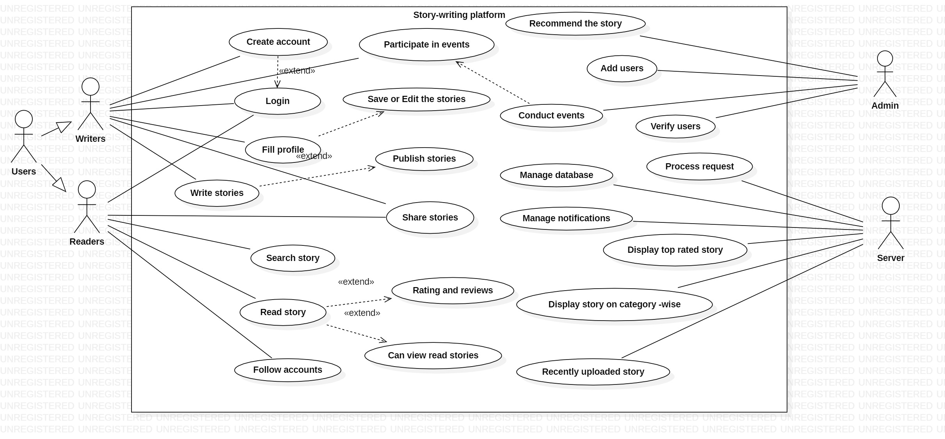
Use case diagram:

Slide 11
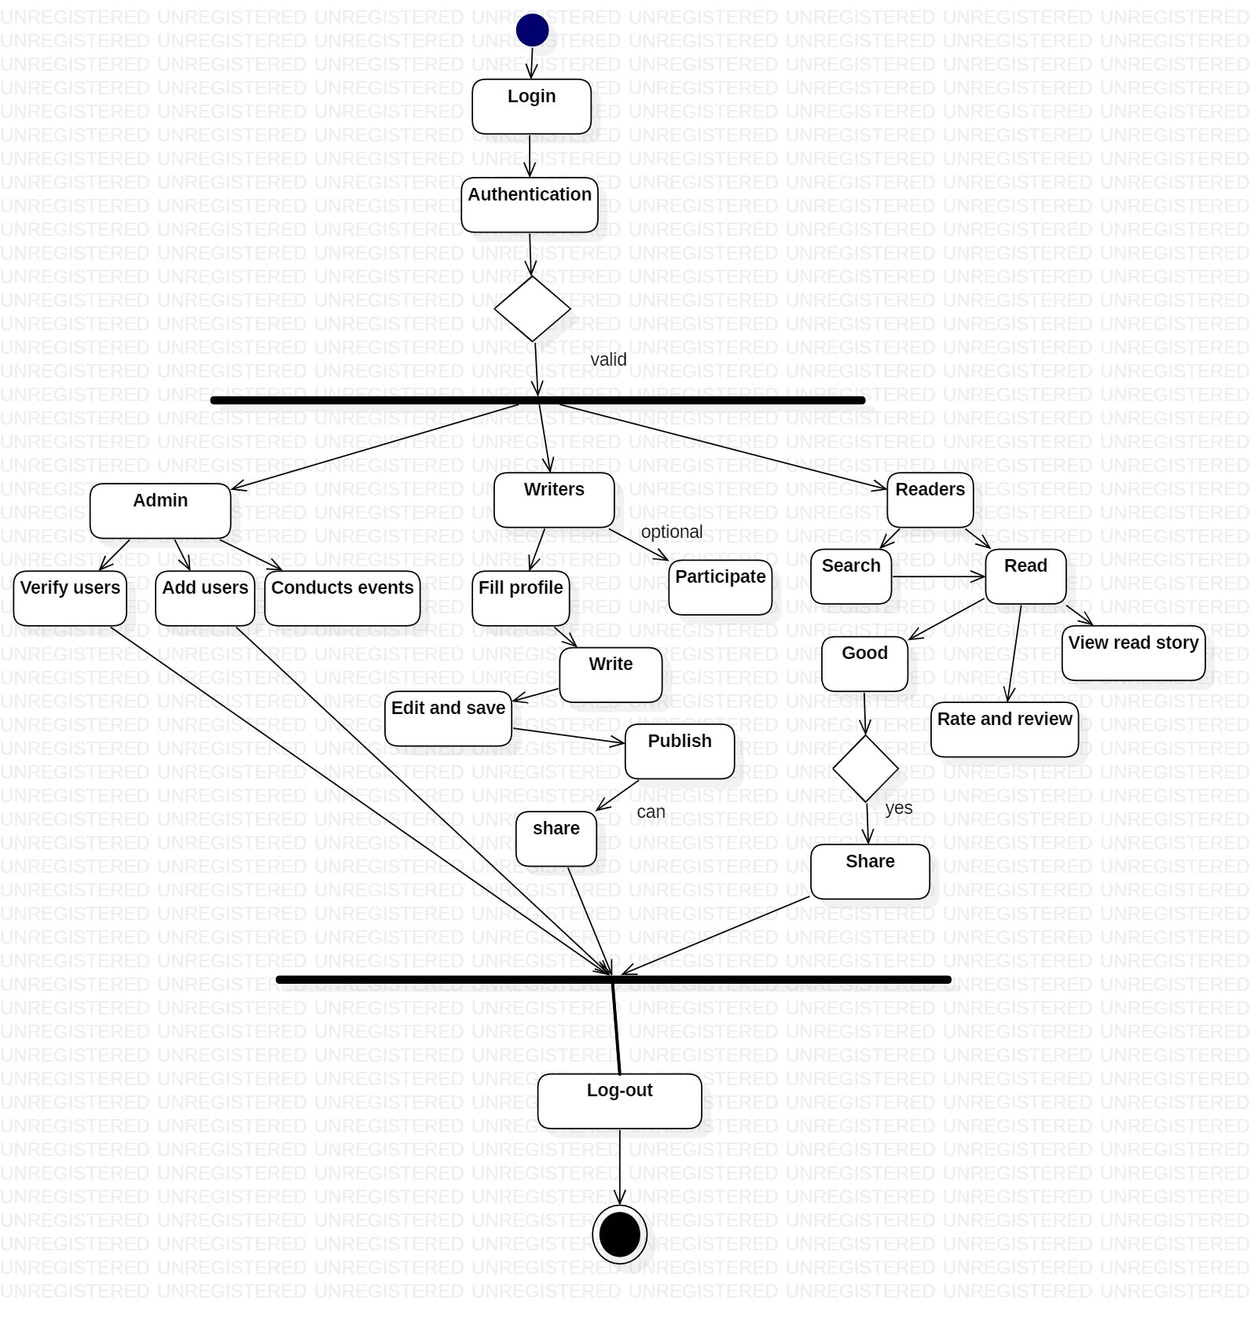
Activity diagram:

Slide 12
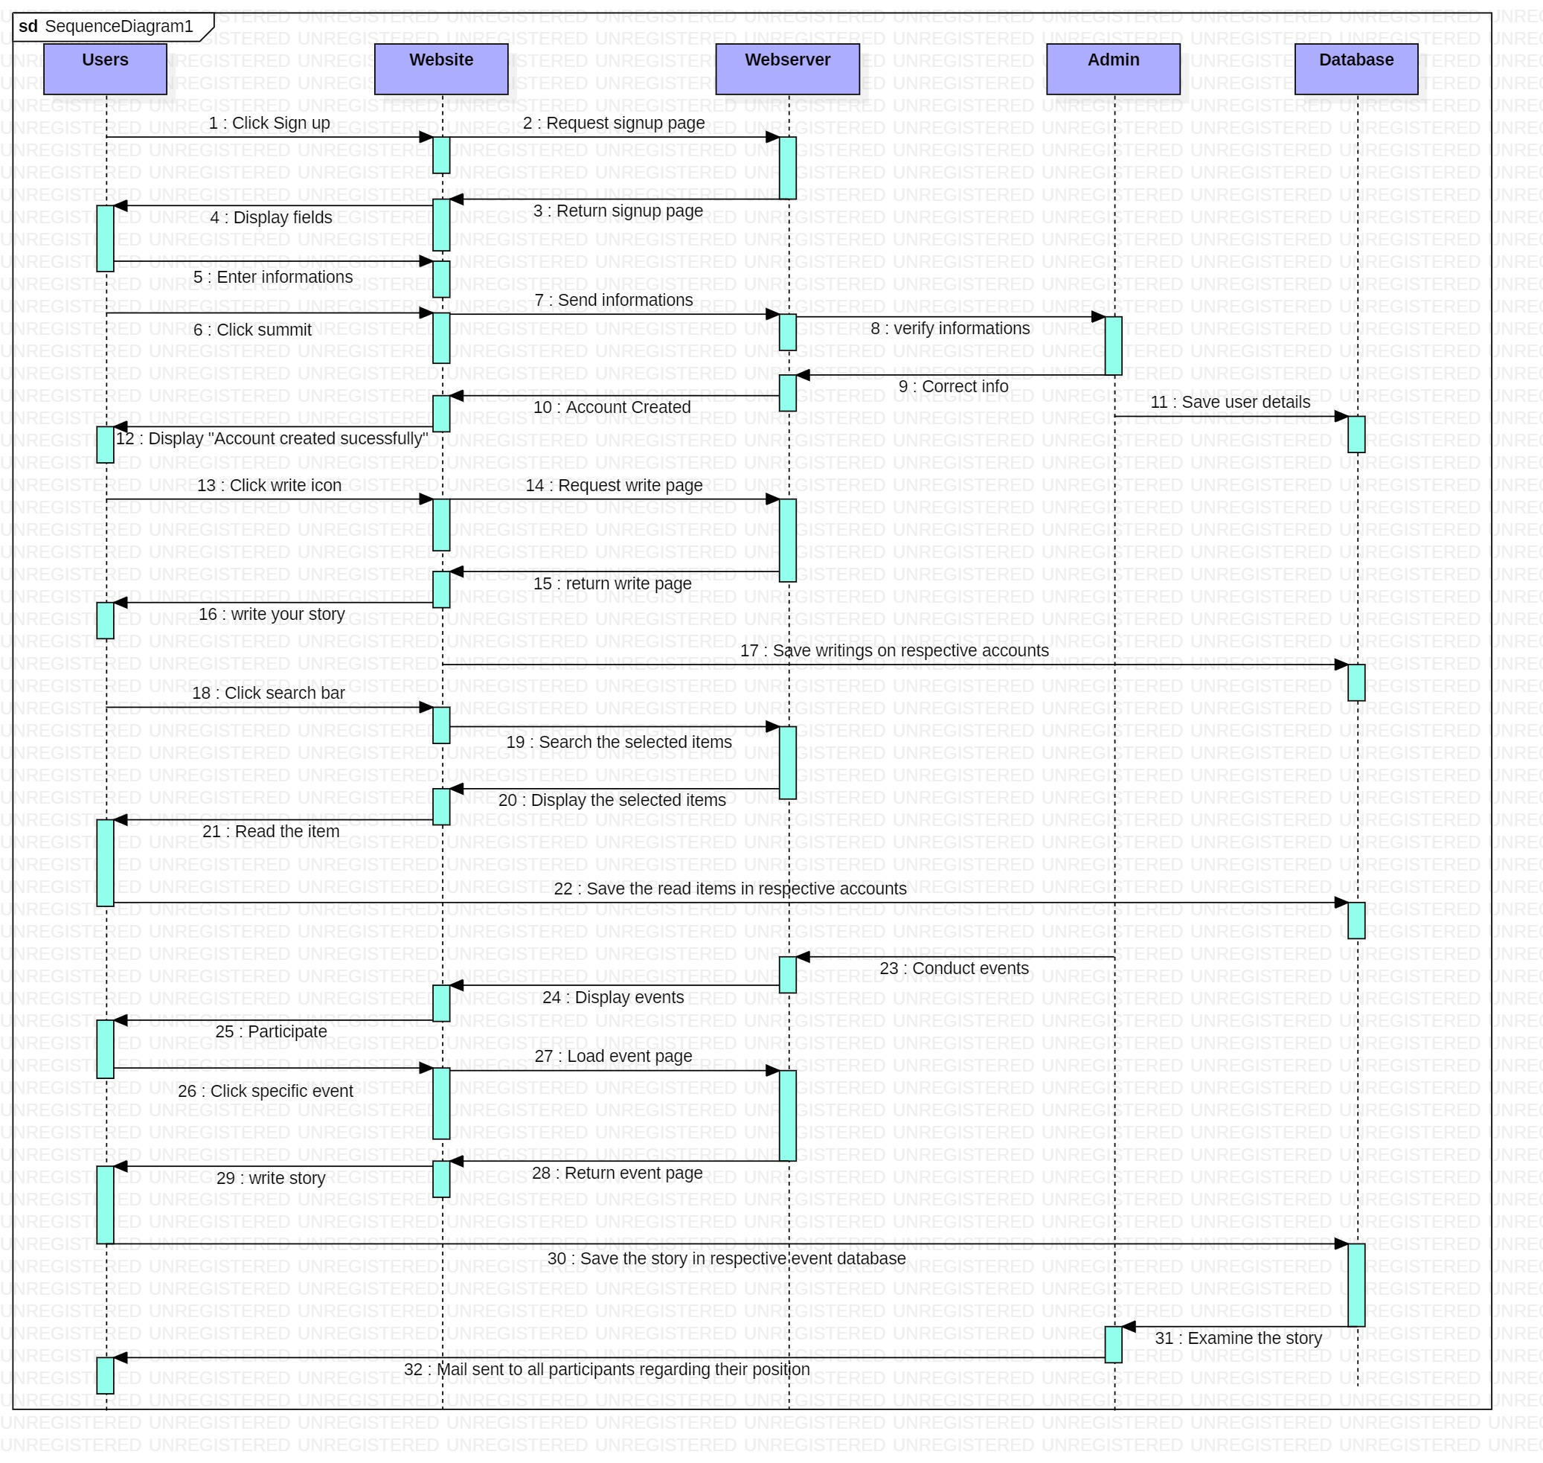
Sequence diagram

Slide 13
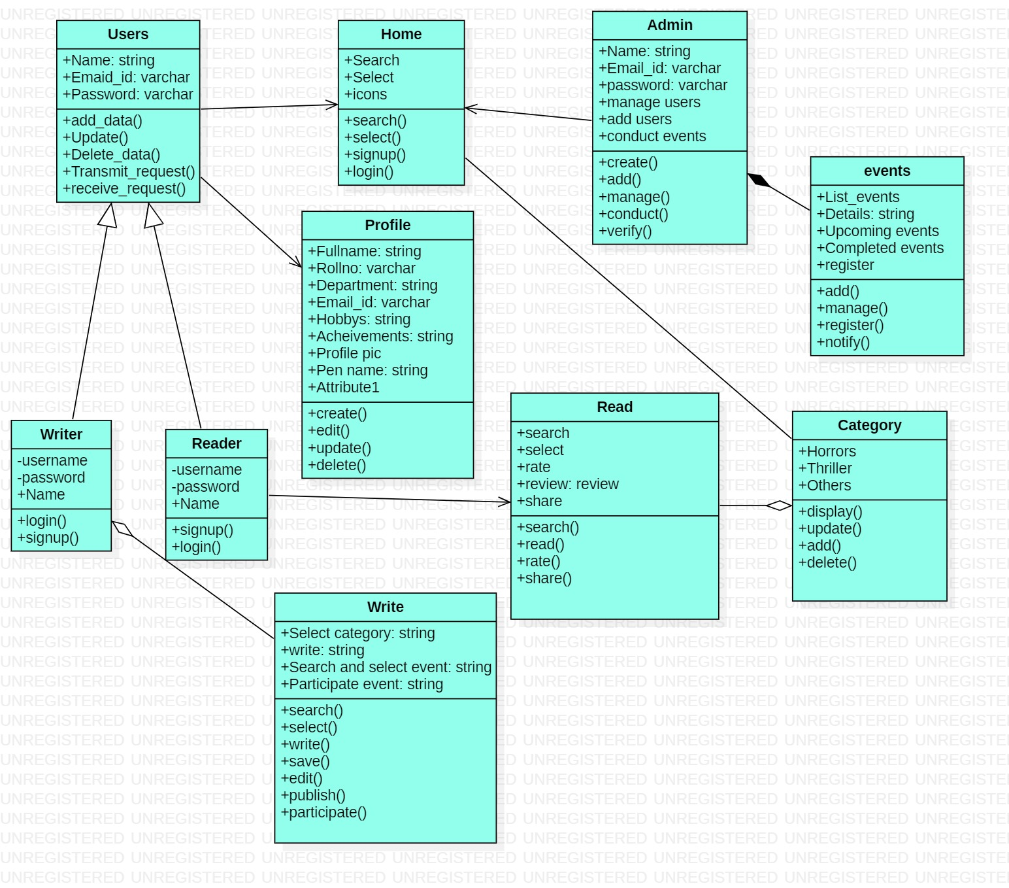
Class diagram:

Slide 14
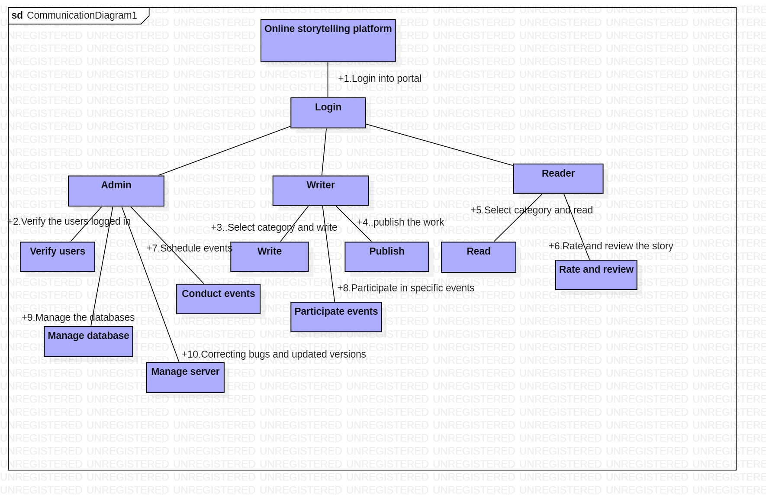
Collaboration diagram

Slide 15
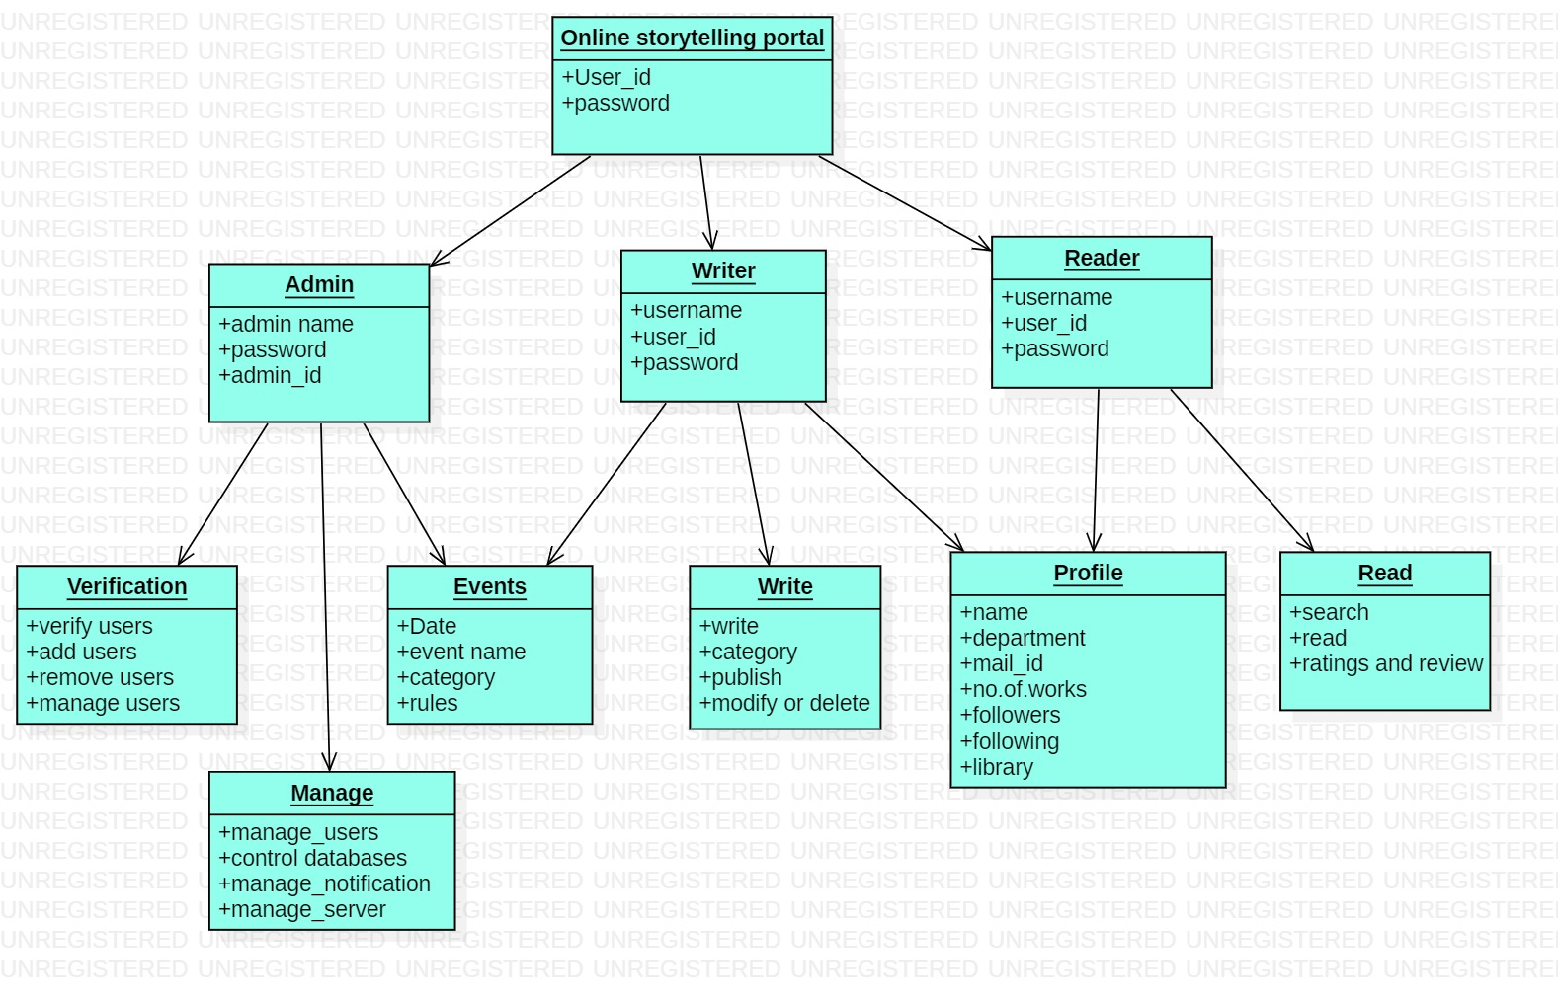
Object diagram

