Slide 1



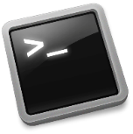
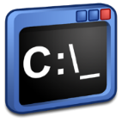

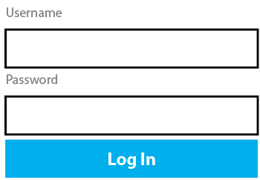
Eclipse Dirigible Setup on
Click on the cloud button and install the Cloud Foundry Command Line Interface
Login to the Cloud Foundry Platform
cf login -a [CloudFoundry Platform Host]
Deploy on the Cloud Platform supporting Cloud Foundry
cf push dirigible -p [path to the target directory]/dirigible.war -b https://github.com/dirigible-io/java-buildpack
Open a web browser and go to
Choose me!
http://dirigible.[CloudFoundry Platform Host]/
dirigible
Login with the default user name and password
dirigible
YOU CAN VISIT US AT www.dirigible.io

