Slide 1

CARPOOL

Slide 2


Summary
App that gives you opportunity to travel and make new connections

Slide 3

What can I do?
Create your own trip and share it with other travelers
Apply for another traveler’s trip

Slide 4
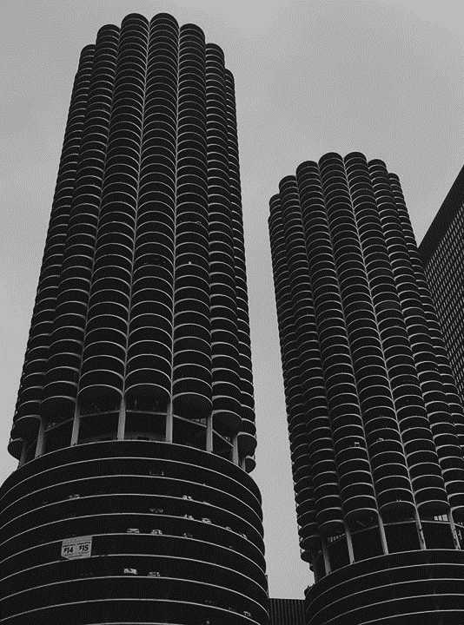
Mission
Meet new people
Save money
Earn money
Flexibility

Slide 5
THANK YOU

