Slide 1


Cause Of Death
Submitted To: Submitted By:
Ms.Khushboo Garg Monika Lathar

Slide 2
Outline
Background
Introduction
Methods : Main Issues for calculating causes of death
Cause and Manner of Death
Key Findings
Conclusions

Slide 3
Background
Causes of Death(COD) is one of the most fundamental metrics for population health.
Each death is attributed to a single underlying cause — the cause that initiated the series of events leading to death.
The lack of historical individual-level data on cause of death has been a key limitation.
Usually COD assessments show success and failures of Health Information System and provide directions of how to improve them.

Slide 4
INTRODUCTION
The dataset consist of 37 columns, 34 of them gives the dead counts (estimates?) for each death cause.
Also, year and country information is provided.
Each row represents combinations country/year pair.
The key features of this Dataset are: Meningitis, Alzheimer's Disease and Other Dementias, Parkinson's Disease, Nutritional Deficiencies, Malaria, Drowning, Interpersonal Violence, Maternal Disorders, HIV/AIDS, Drug Use Disorders, Tuberculosis, Cardiovascular Diseases, Lower Respiratory Infections, Neonatal Disorders, Alcohol Use Disorders, Self-harm, Exposure to Forces of Nature, Diarrheal Diseases, Environmental Heat and Cold Exposure, Neoplasms, Conflict and Terrorism, Diabetes Mellitus, Chronic Kidney Disease, Poisonings, Protein-Energy Malnutrition, Road Injuries, Chronic Respiratory Diseases, Cirrhosis and Other Chronic Liver Diseases, Digestive Diseases, Fire, Heat, and Hot Substances, Acute Hepatitis.

Slide 5
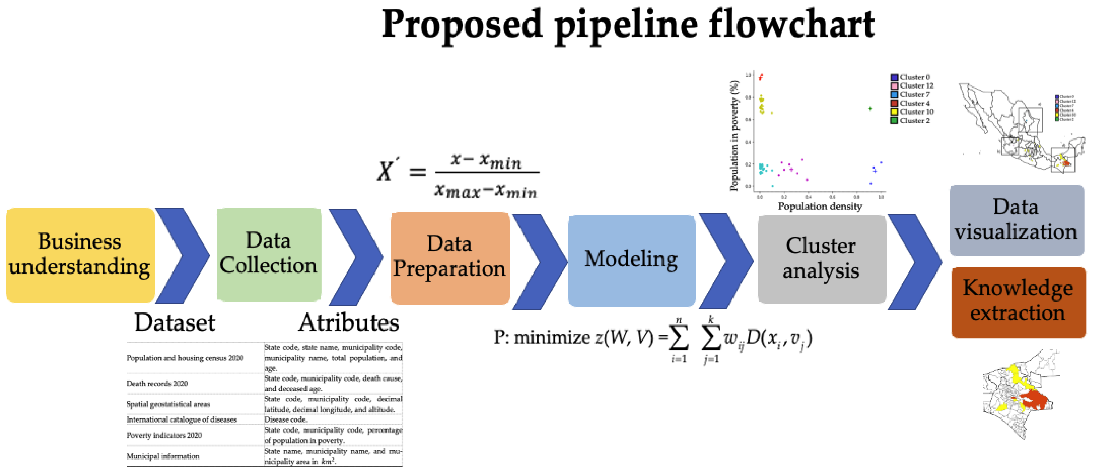

Slide 6
Cause and Manner of Death
The Manner of Death The manner of death can be Natural, the most common, caused by interruption and failure of body functions resulting from age or disease
Accidental
Suicidal
Homicidal
Undetermined
Sometimes the manner of death is difficult to determine
A man with a heart condition is attacked and dies from a heart attack during the assault.
An elderly woman dies after being kept from receiving proper health care by her son.

Slide 7
Cause and Mechanism of Death
The reason someone dies is called the cause of death.
Proximate cause of death refers to an underlying cause of death as opposed to the final cause.
Example: radiation cancer = radiation exposure
Mechanism of death describe the specific change in the body that brought about the cessation of life.**usually only “Cause” and “Mechanism” are listed on the dead certificate**

Slide 8
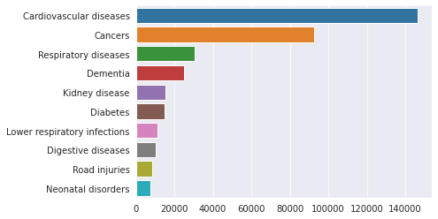
Top 10 causes of death for Turkey in the latest available year, 2019

Slide 9
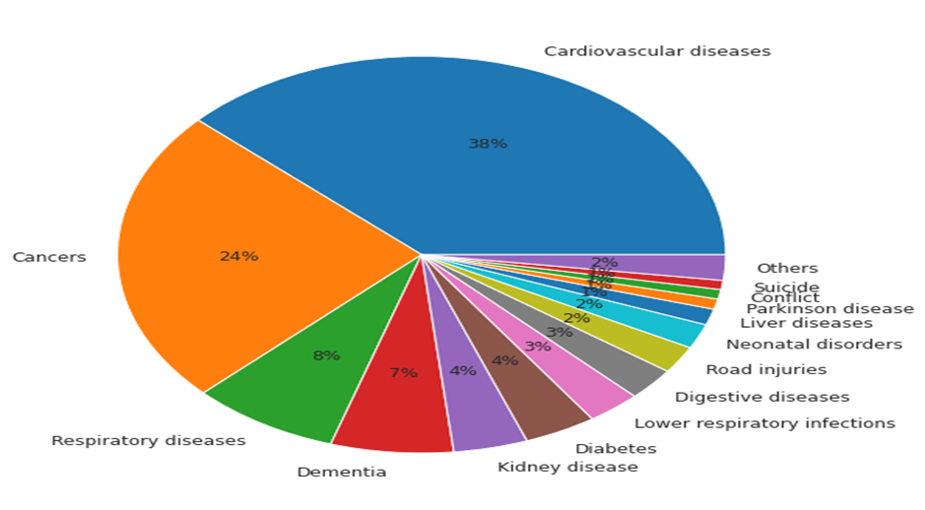
Percentages in Pie Graph
Almost 4 out 10 deaths in Turkey are caused by Cardiovascular diseases in 2019

Slide 10
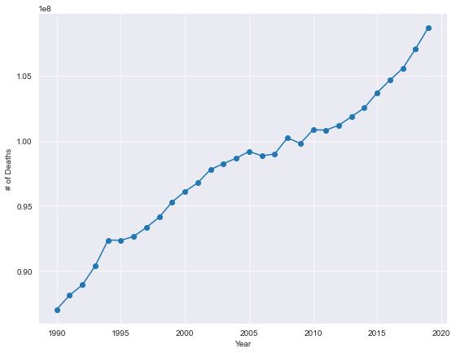
Death Rate Per Year
2009 was the deadliest year with almost 4% of the population was died.

Slide 11
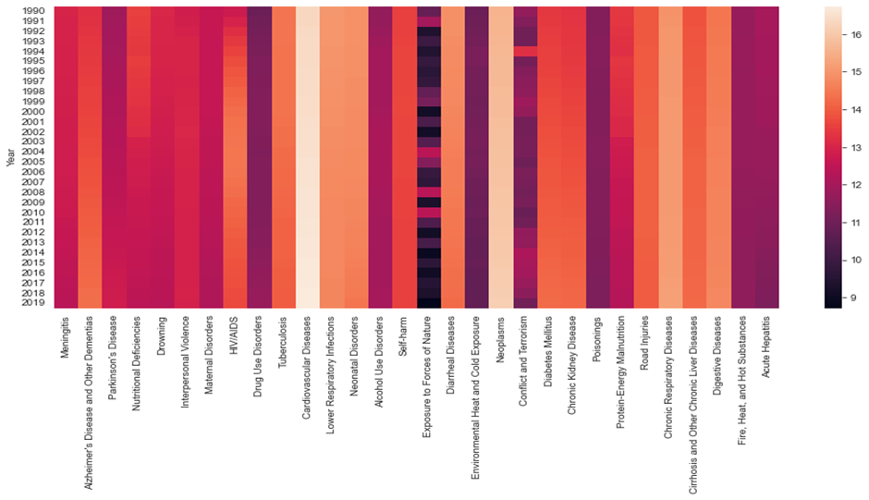
Heat Map
Conflict line of the heat map shows an interesting light colour on year 2009 (the lighter the colour the higher the number of deaths)

Slide 12
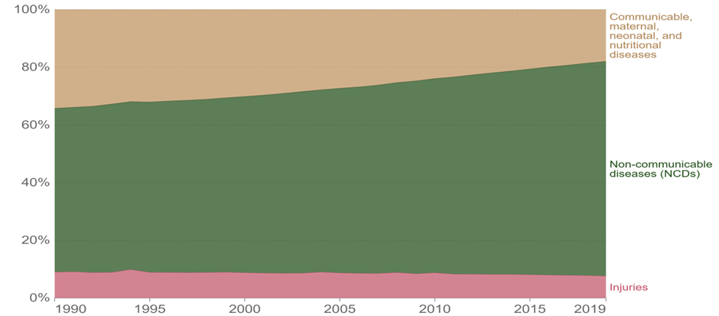
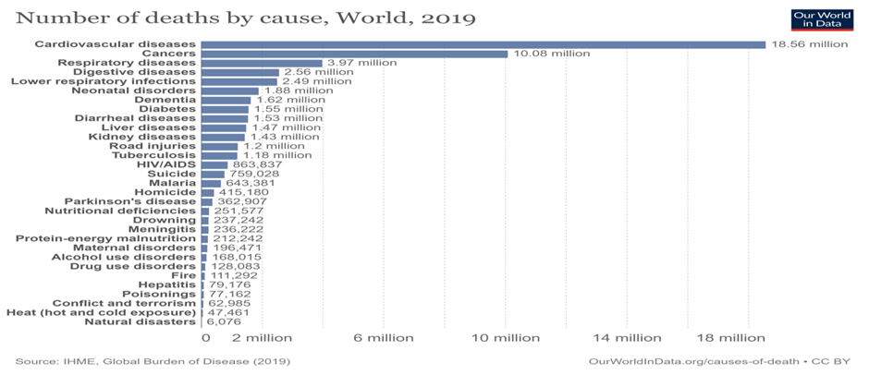
Causes of Death by category

Slide 13
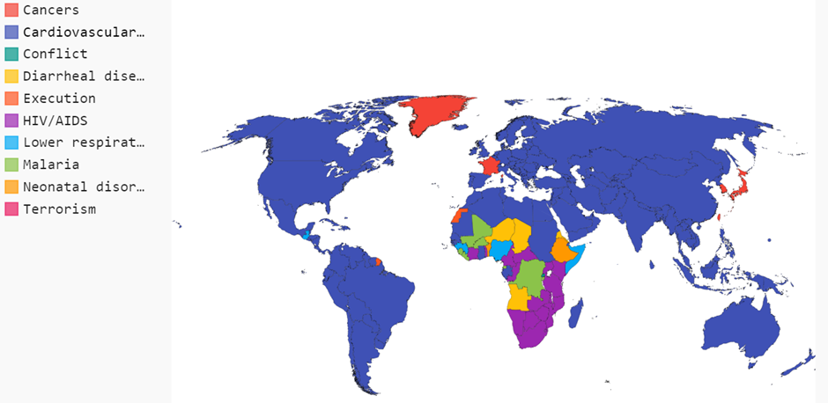
Country suffers from what disease the most
Cardiovascular Disease dominate death toll all over the world

Slide 14
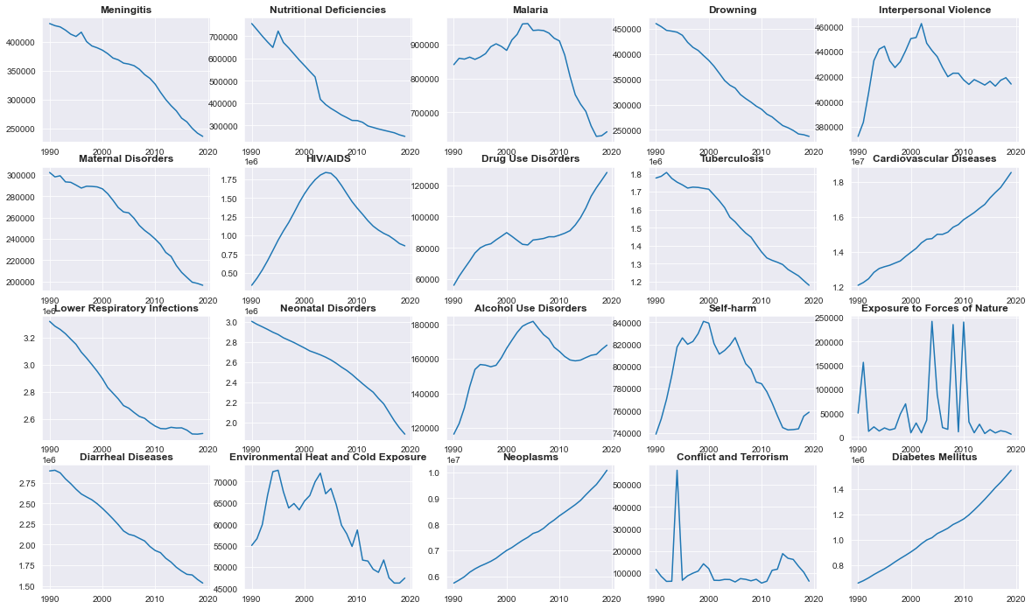
Monotonic Decrease Trend over years

Slide 15
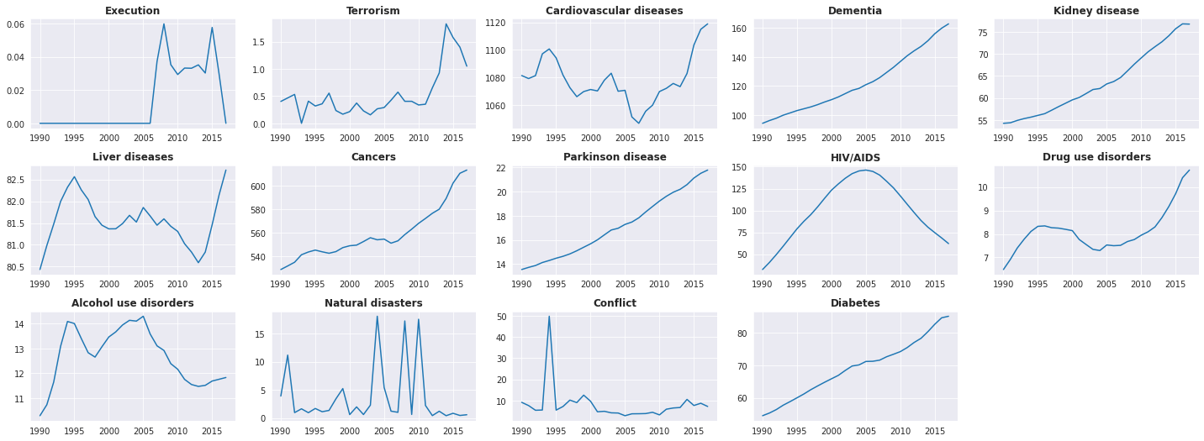
Death causes Exhibiting an Increasing or No Trend over time

Slide 16
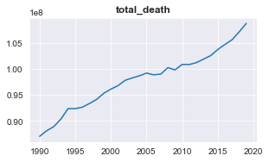
Result

Slide 17
THANK YOU

