Slide 2
OUTLINE
Introduction
Problem Statement
Project Specification
Dataset
Pipeline
Data Cleaning
Feature Engineering
Outlier Detection
Outlier Removal
One Hot Encoding
Model Creation
Grid Search Cross Validation
Result
Output

Slide 3
Introduction
Problems faced during buying a house:1)Buying a house is a stressful thing
Buyers are generally not aware of factors that influence the house prices.
Many problems are faced during buying a house.
Hence real estate agents are trusted with the communication between buyers and sellers as well as laying down a legal contract for the transfer. This just creates a middle man and increases the cost of houses.

Slide 4
PROBLEM STATEMENT
Prices of real estate properties are very high and sophisticatedly linked with our economy.
Despite this,we do not have accurate measures of house prices based on the vast amount of data available.
Proper and justified prices of properties can bring I a lot of transprency and trust back to the real estate industry,which is very important for most consumers especially in India.

Slide 5
PROJECT SPECIFICATION
A Surprise Housing US-based housing company has decided to enter the Australian market. The company uses data analytics to purchase houses at a price below their actual values and flip them at a higher price.The goal of this project is to predict house prices in Australia city based on some features.
We are required to model the price of houses with the available independent variables. This model will then be used by the management to understand how exactly the prices vary with the variables.
We are using Machine Learning Algorithm to create a predictive model.
Multiple Linear Regression algorithm is used to train and test the model in our project.

Slide 6
DATASET
Dataset provided by the Flip Robo Technology.
Datasets are in the form of CSV Train and Test Files.
Data contains 1460 entries each having 81 variables.
Data contains Null values. You need to treat them using the domain knowledge and your own understanding.
Extensive EDA has to be performed to gain relationships of important variable and price.
Data contains numerical as well as categorical variable.

Slide 7
PIPELINE
DATA CLEANING
FEATURE ENGINEERING
ONE HOT ENCODING
OUTLIER DETECTION
OUTLIER REMOVAL
MODEL CREATION

Slide 8
DATA CLEANING
The main aim of Data Cleaning is to identify and remove errors & duplicate data, in order to create a reliable dataset.
The process of data cleaning is done by using a very famous library Pandas.
Initially, those columns features are dropped from our dataset who are not important in deciding the final price.
The rows having a null value in any columns are dropped from our dataset.
The columns having characters as well as integer values are converted into integer values only.
Many more data cleaning techniques are used to improve the qualities of our dataset.

Slide 9
FEATURE ENGINEERING
Feature engineering is the process of using domain knowledge to extract features from raw data via data mining techniques. These features can be used to improve the performance of machine learning algorithms. Feature engineering can be considered as applied machine learning itself.
Dimensionality reduction techniques are used in our dataset to reduce those rows who are not very much important to decide the house price.

Slide 10
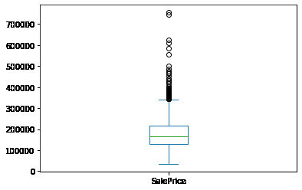
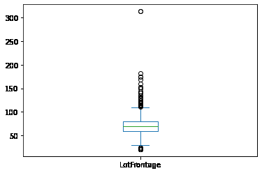
OUTLIER DETECTION
In simple words, an outlier is an observation that diverges an overall pattern or an sample
There are many types of outlier detection techniques such as Z-Score or Extreme Value Analysis, Probabilistic and Statistical Modelling ,Information Theory Models, Standard Deviation etc.
We have used simple domain knowledge of real estate market to detect the outliers in our dataset.

Slide 11
OUTLIER REMOVAL
After detecting the outlier, correct that errors if possible and if you can not fix it, then remove that observation.
In our dataset, we observed variations in the relation between values of some attributes.
So that these type of rows are dropped from the dataset.
Scatter plots are used to detect some more outliers and they are also removed from our dataset.

Slide 12
ONE HOT ENCODING
This technique is used to convert the categorical variables into numeric values.
Our dataset contains a categorical variable which is “MSSubClass_1-1/2 STORY FINISHED ALL AGES”.
We have used one hot encoding method to convert them as numeric values.
As we can see the location name 1st Block MsSubClass_1 having the value 1 and the rest of the locations are treated as 0.

Slide 13
MODEL CREATION
The process of modelling means training a machine learning algorithm to predict the labels from the features.
We have used Linear Regression algorithm for training and testing of the model.
The accuracy rate of our model is 9o% which is pretty good.

Slide 14
GRID SEARCH CROSS VALIDATION
This is a technique which is used o find the best algorithm for modelling and give the best parameters as well.
We applied grid search cross validation method on our dataset with Linear Regression, Ridge and Lasso regression.
We find the Linear Regression algorithm is giving the best accuracy score as more than 90%

Slide 15
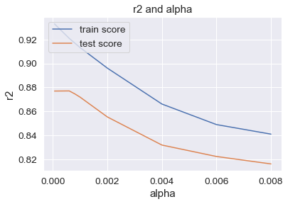
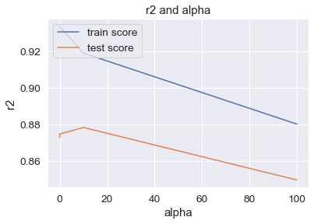
OUTPUT
Ridge : Train :91.72 Test :75.84
Lasso : Train :90.9 Test :74.0

