Slide 1
Speech to Text Corpus Presentation
Team 11, Cohort 5
Johan Fornstedt
Francisco Coelho
Orlina Machado
Monika Isahakyan
Luis Rodas
Zhihao Wang
Date: 02/10/2020

Slide 2
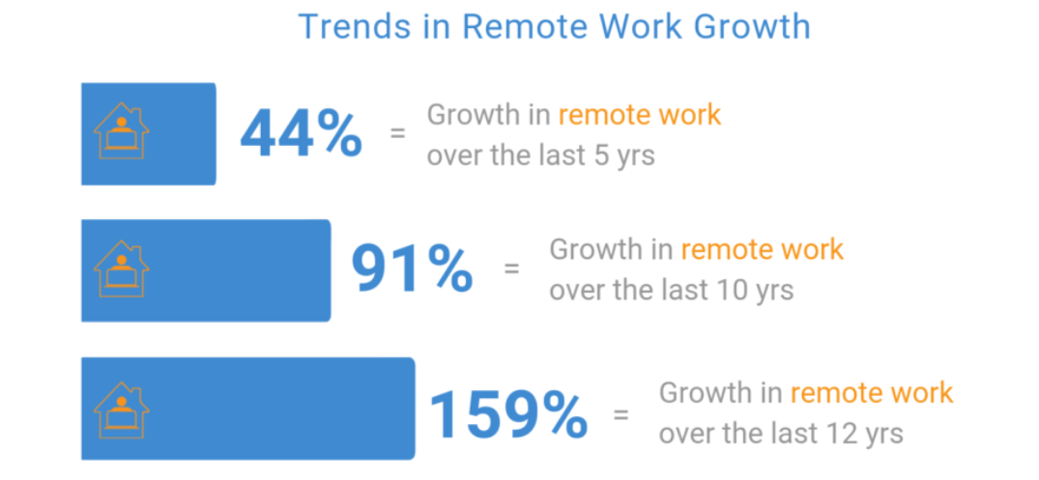
Notes:
As the word develops, the technology develops and it is becoming easier to work and communicate without coming out from the house.
According to global workspace analysis the remote work is increasing and here are growth of trends during past 12 years

Slide 3

DO HULT STUDENTS PREFER WORKING FROM HOME MORE THAN GOING TO OFFICE ?
How do you like to spent your time?
Do you like to socialize?
Do you have kids ?
How do you like to commute ?
What kind of clothes you wear at work ?
Notes:
To check the validity of the trend, we were curious what our future entrepreneurs and business people think. We decided to survey 28 student from hult asking their preference weather working in the office or at home. Our business question was “DO HULT STUDENTS PREFER WORKING FROM HOME MORE THEN GOING TO OFFICE ?
“
To better understand their preference we created 5 questions which are the fallowing
How do you like to spent your time?
To understand weather person likes to go out or stay at home
Do you like to socialize?
Is he/she introvert or extrovert ?
Do you have kids ?
Kids can be a reason to work from home and spent more time with them
How do you like to commute ?
Is it easy for them to commute or it’s a headache
What kind of clothes you wear at work ?
if they were home clothes when they work means they do their work at home

