Slide 1

The way car buying should be!
Net Promoter Score Analysis
Presented by,
Monika Saradha, Consumer Insights Analyst
Prachi Sharma, Consumer Insights Analyst

Slide 2

PROFIT!!!
$16 million → 2% Increase in NPS
31.1% decrease in gross profits over a three-month period Financial Report 2023 Q3
NPS → it's a key driver of profitability
12% Growth in Customer Trust
10% Increase in NPS
Strengthened Profit Margins
Increased Sales

Slide 3
Recommendations
Five critical levers that drive NPS
Initiative | Expected Increase in NPS | Revenue Increase (USD) | Profit Increase (USD)
Enhance Service Plans | 2% | $200 million | $16 million
Proactive Customer Engagement | 1% | $100 million | $8 million
Inventory Management | 1.5% | $150 million | $12 million
Streamline Test Drive Processes | 1% | $100 million | $8 million
Understand Customer Preferences | 1% | $100 million | $8 million
Total Combined Impact |  | $650 million | $52 million
Calculations based on Financial Report CarMax 2023

Slide 4
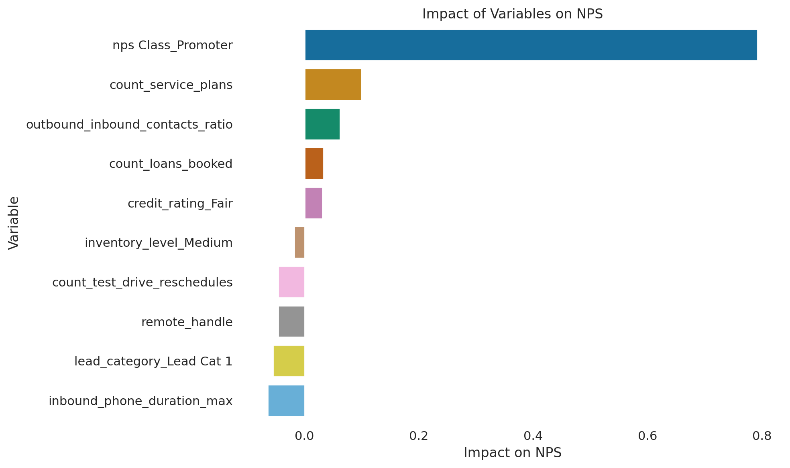
Impact of various levers on NPS

Slide 5
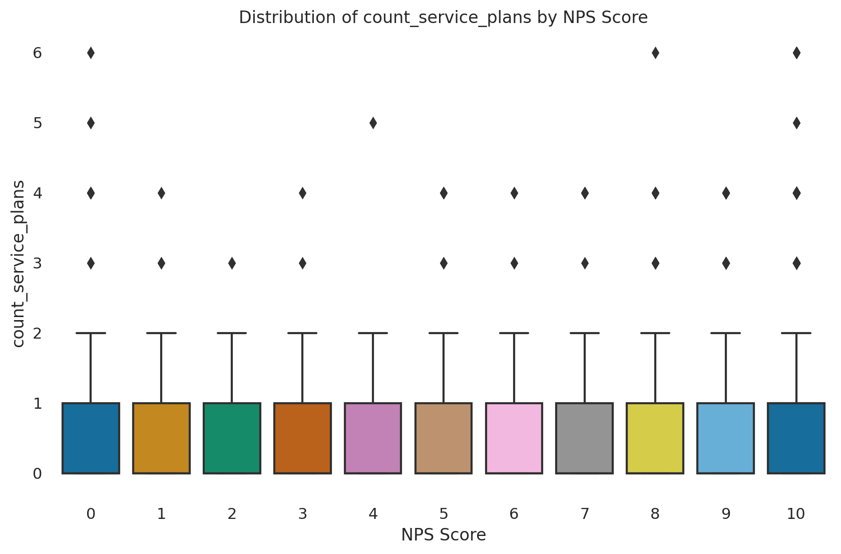
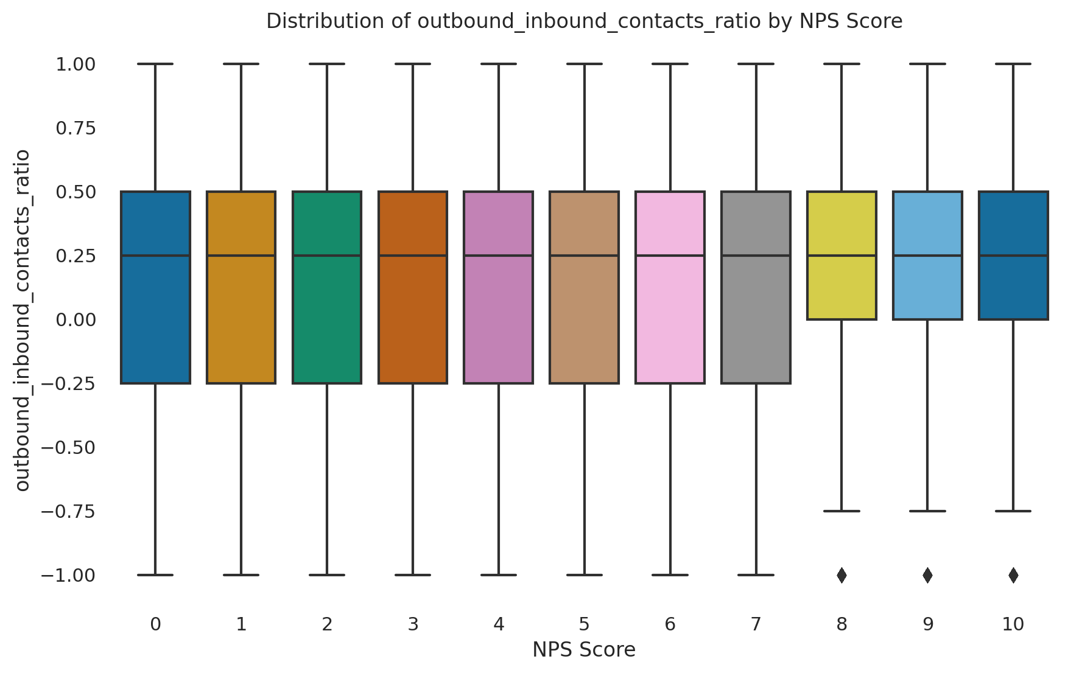
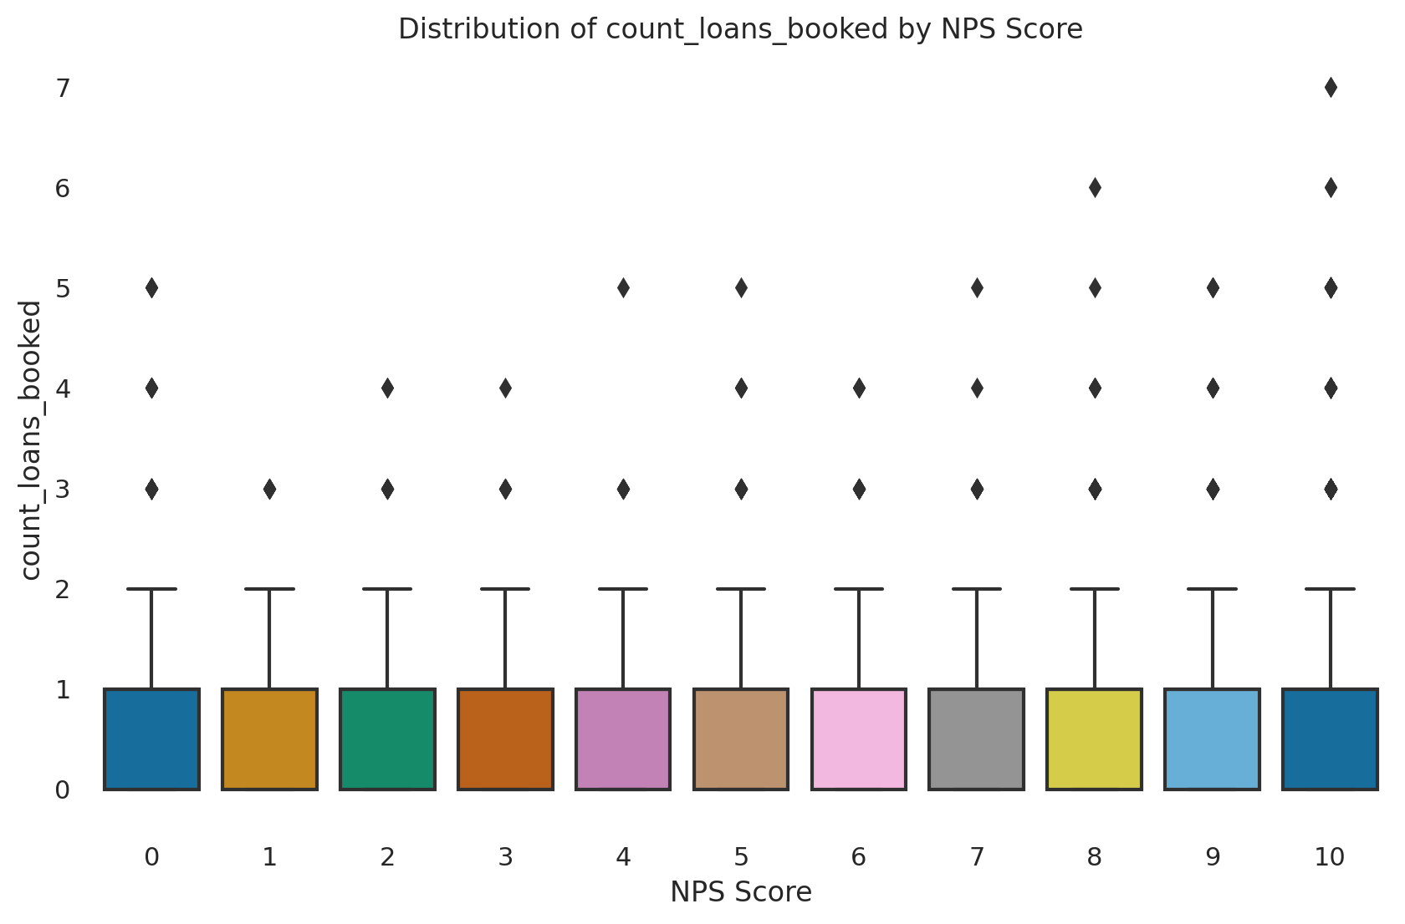
Importance of these levers
Offering more service plans can boost customer satisfaction and loyalty.
Proactive customer service, as indicated by more outbound contacts, can lead to higher satisfaction scores.
Offering more service plans can boost customer satisfaction and loyalty.

Slide 6
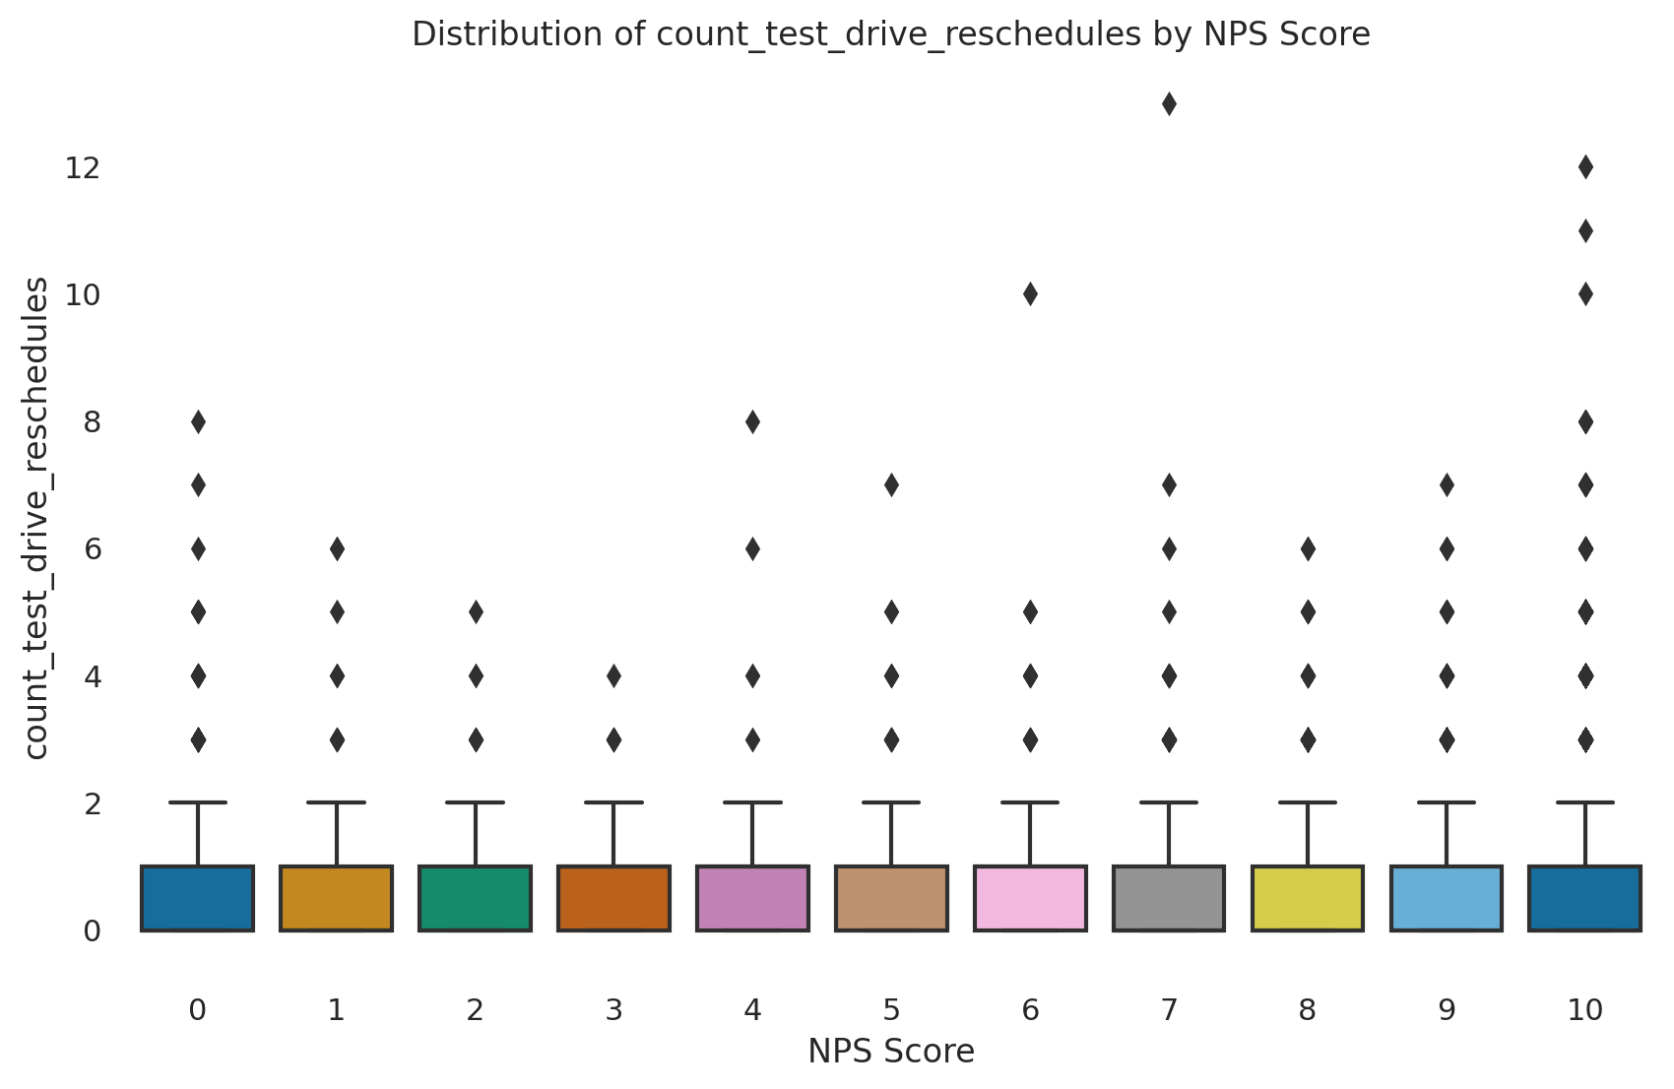
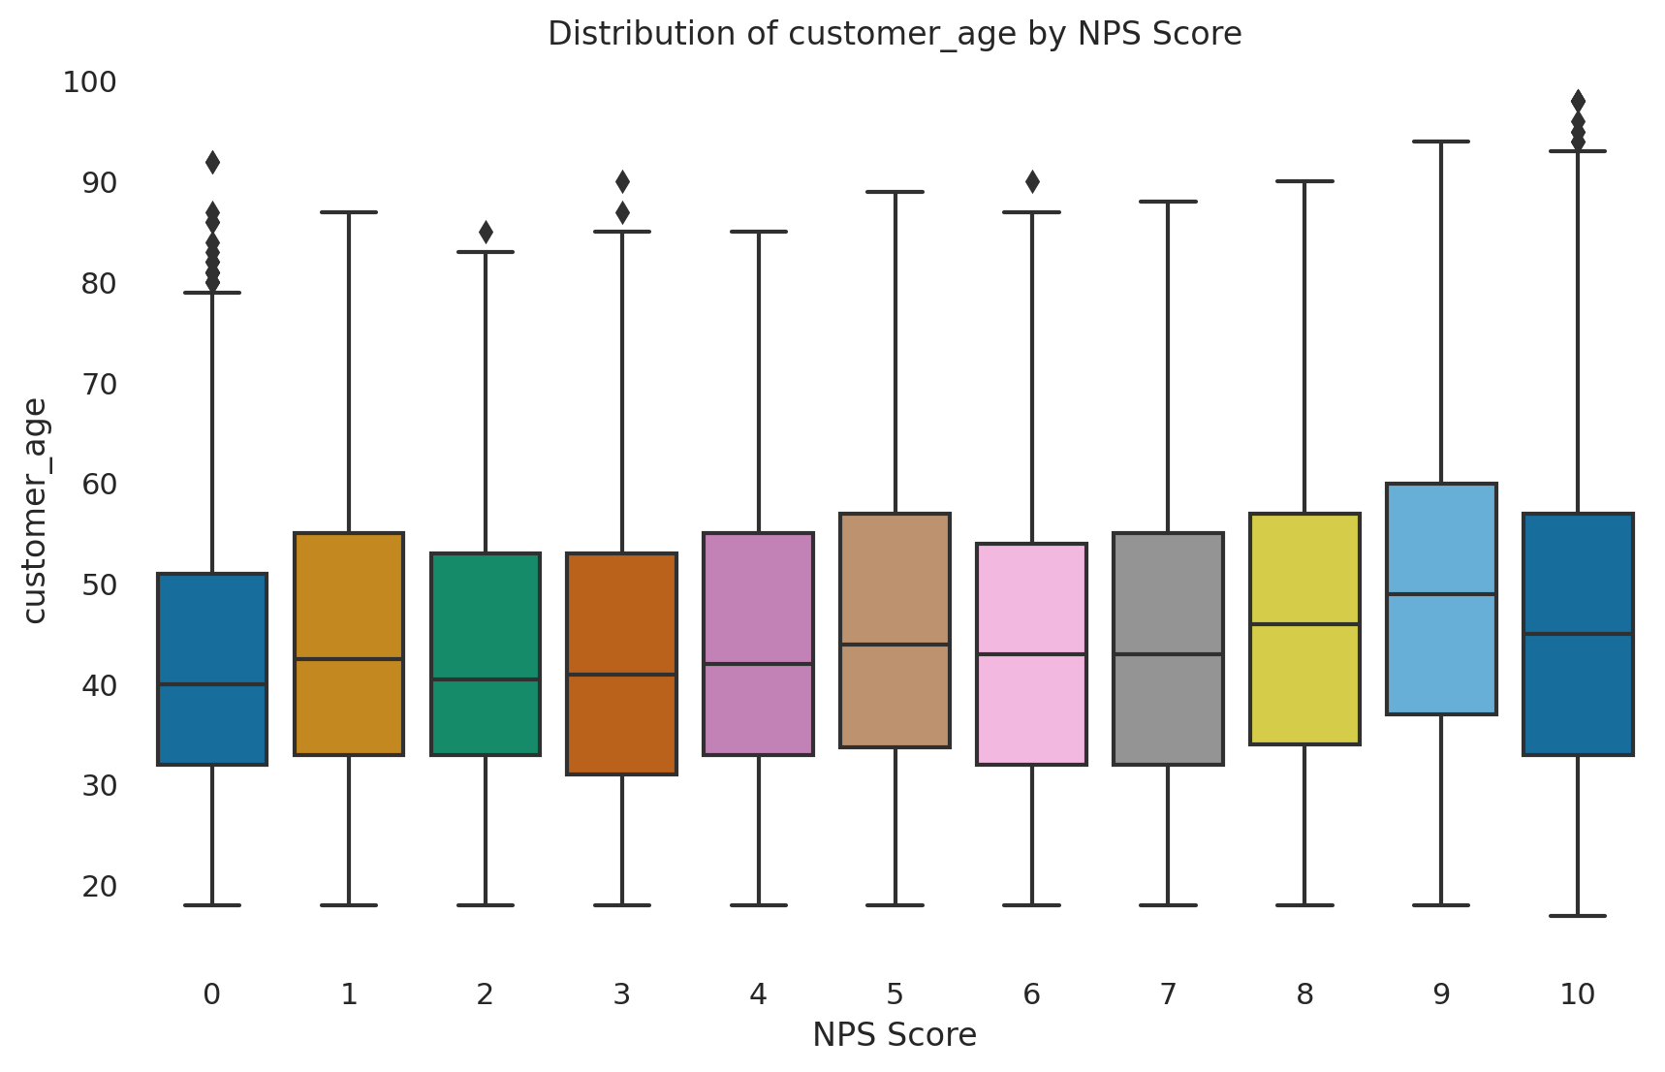
Importance of these levers
Better credit ratings align with higher NPS, suggesting financial stability contributes to customer satisfaction.
Minimizing test drive reschedules can enhance customer experience and improve satisfaction scores.

Slide 7
Financials
Sales/Revenue: Dip in the fiscal year 2023 due to decreased used vehicle sales.
Operating Income: Affected by increased SG&A expenses and lower sales volume.
Net Income: Decrease in the fiscal year 2023 due to lower gross profit.
Changes in Working Capital: Impacted by lower sales and profit margins.
Net Operating Cash Flow: Fluctuations in line with sales and operational efficiency.
The Gross Profit for CarMax for the fiscal year 2023 was significantly lower than the previous year due to a decline in used vehicle sales.

Slide 8
Conclusion
To elevate CarMax's Net Promoter Score, we must focus on five pivotal areas: refining service plans, engaging customers proactively, managing inventory effectively, streamlining test drive procedures, and tailoring our approach to customer preferences.
Implementing customer service enhancements could boost CarMax's NPS by 2%, translating to a $16 million profit increase.
Optimizing all five strategic levers, we're targeting an annual revenue surge of $650 million and a $52 million profit uplift.

Slide 9
Thank You !
The way car buying should be!

