Slide 1

CITY OF ASHEVILLE OPEN ENROLLMENT 2008/09

Slide 2
What’s New and Exciting in Our Medical Plan?
CoreSource (new administrator)
Adding a 3rd tier with new options
Crescent Physician Network
Enrollments will be made on-line or via telephone and must be completed by midnight, Sunday, August 10

Slide 3
Benefit Comparison - Medical

Slide 4

2008 Health Insurance Premiums

Slide 5
What’s So Great About the Hi In-Network Tier?
Significant premium savings in most cases
Large network of local providers
Significant savings in co-pays
No co-insurance (no 80/20 plan)
No generic drug co-pay
Flat $150 co-pay for ER visits

Slide 6
Hi In-Network Scenario

Slide 7
Hi In-Network Scenario

Slide 8
Hi In-Network Scenario

Slide 9
Standard Vs. Hi In-Network Plan

Slide 10
What’s New and Exciting in the Pharmacy Plan?
CareMark (new administrator)
Adding 3rd tier
Annual maximum removed
The City continues to offer 16 free medications regardless of your plan
Asheville Project – Prescriptions remain free of charge

Slide 11
Benefit Comparison - Pharmacy

Slide 12
2008 Dental Premiums

Slide 13
On-Line Enrollment – You Control Your Benefit Selections
You will enroll and select your benefit options either on-line or by telephone
You will receive a benefits enrollment worksheet in 5-10 days that will explain how to access the enrollment system.

Slide 14
It Only Takes A Minute
Every employee will receive a confirmation that details the elected benefits
You will have the opportunity to change/revise your initial benefit elections – must be completed by midnight, Sunday, August 17th

Slide 15
It’s Easy
A final confirmation letter will be mailed to you with vital information regarding your election
New insurance cards will be distributed in early September

Slide 16
How to Enroll
Go to www.eelect.com
Enter the Enrollment ID 17133 (on your form)
Enter your Social Security Number
Enter the 4 digit Pin that appears on your form
Call 1-866-203-3885

Slide 17
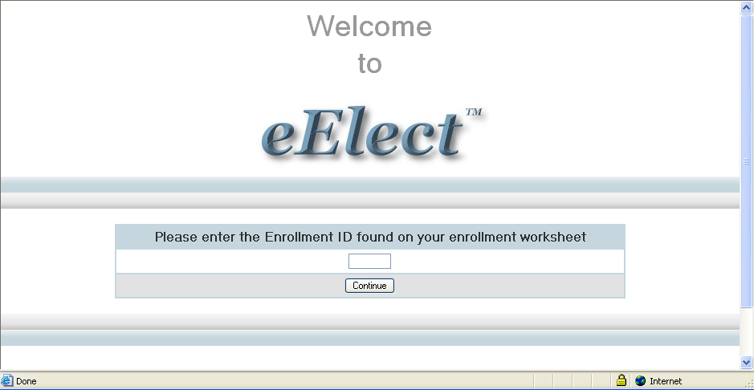

Slide 18
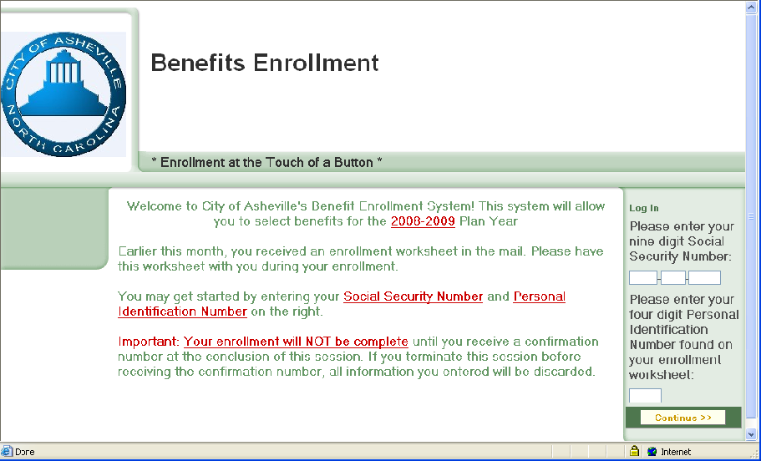

Slide 19
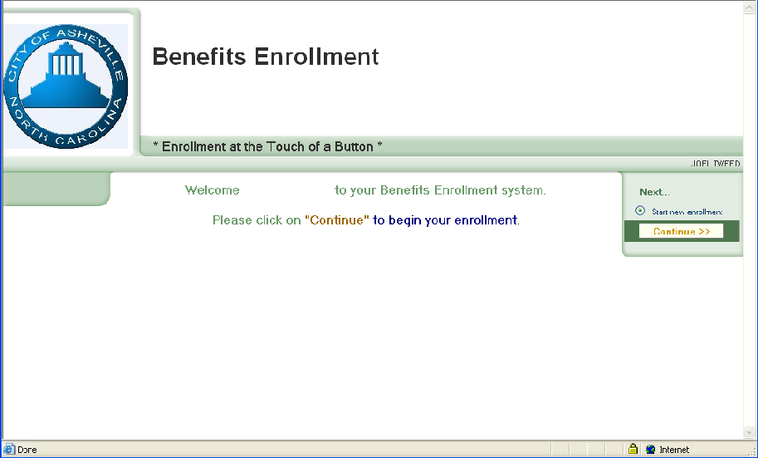

Slide 20
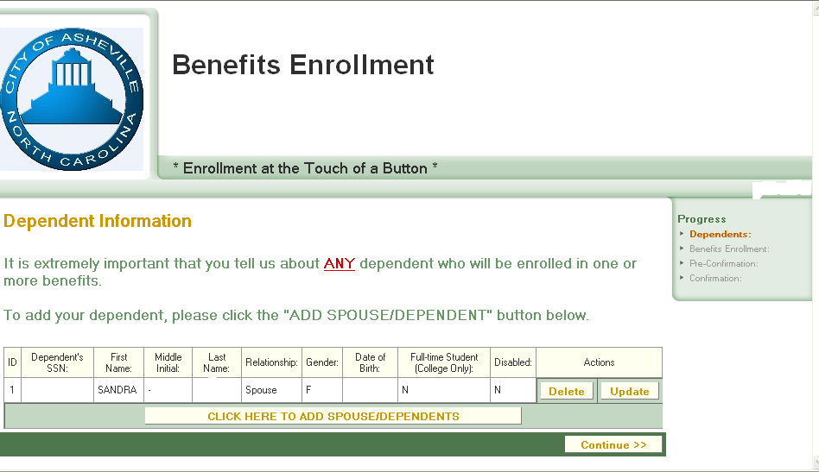

Slide 21
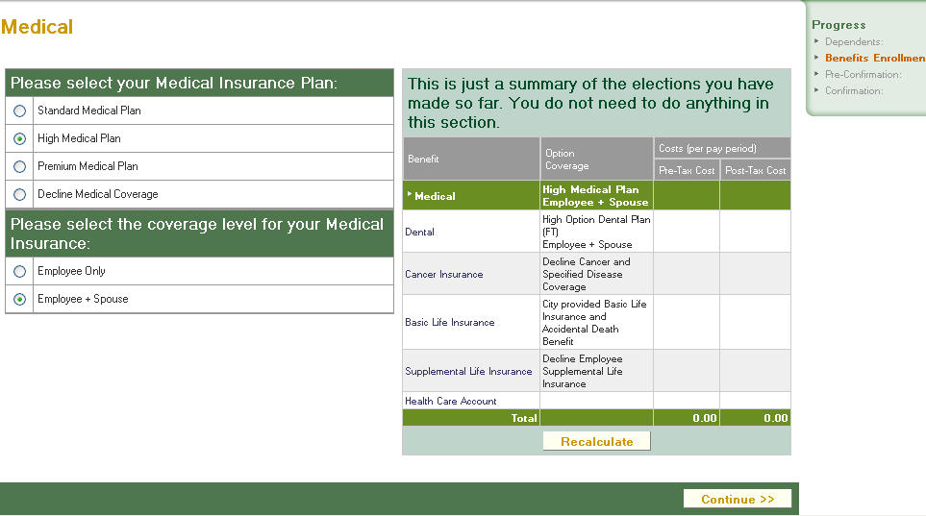

Slide 22
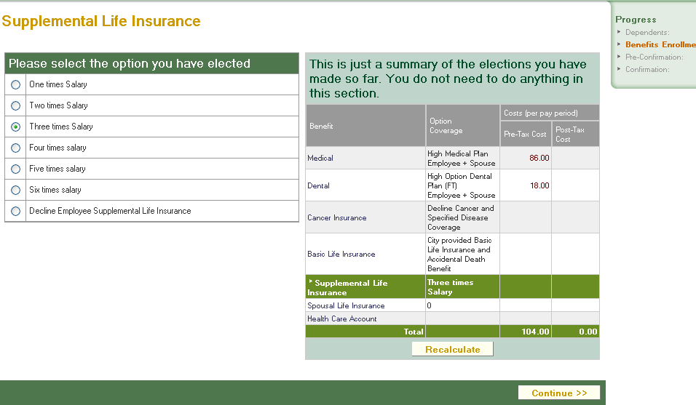

Slide 23
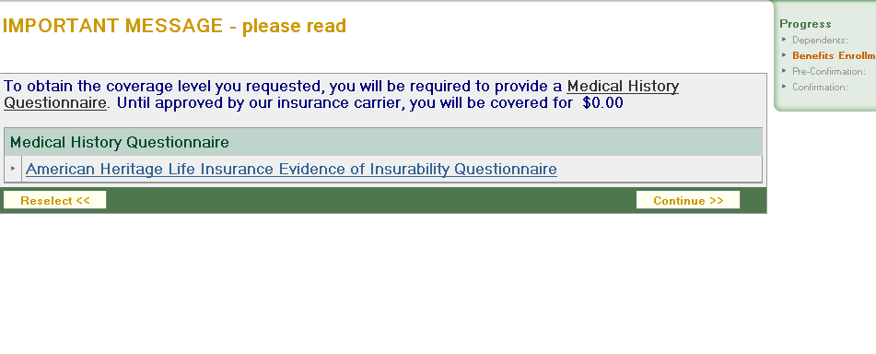

Slide 24
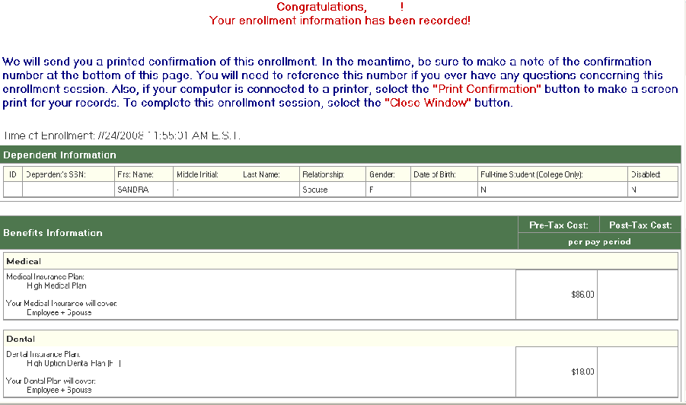

Slide 25
Cancer & Specified Disease
This benefit provides coverage to employees and their dependents diagnosed w/cancer or any of the other 29 other specified diseases.
Maximum 12 month pre-existing condition exclusion
$100 payment each year for each covered person getting annual physical that includes cancer screening
To add this coverage, you must complete the Evidence of Insurability & Enrollment Form

Slide 26
Life Insurance – The Standard
Rates remain the same
Rates are based on salary & age on 1/1
To increase your life insurance or your dependent life insurance requires additional paperwork and a physical

Slide 27


Slide 28
Flexible Spending Accounts
Because of the new plan, you may change the amount in your Flexible Spending Account.
This change affects 2008 only.

Slide 29
Flexible Spending Accounts
You should enter a “yearly” dollar amount when completing your on-line enrollment.
In December, all employees will have the opportunity to enroll for Calendar Year 2009.

Slide 30
Miscellaneous
Vision Benefit – Vision comes with the medical benefit and remains the same
Asheville Project
Forms are available on the Intranet/Internet, and in Human Resources and Health Services
Forms need to be returned to Human Resources/Destiny Mattsson
Beneficiary Changes
Forms are available on the Intranet/Internet. Return to HR for final processing.
401(k) – ICMA 457
To change your contributions you can go to the Intranet/Internet. Return to HR for final processing

