Slide 1
MiniBooNE Status
Eric Prebys
FNAL Beams Division

Slide 2
A Cautionary Tale About the Beamline
Look at the number of multiwires in your design.
Increase the number.
People will tell you this is not necessary.
These people are lying.
Power up the beamline with your design optics.
Do a power on access to verify all magnet polarities and control paths.
People will tell you this is not necessary.
These people are lying.
Now on to the Booster…

Slide 3
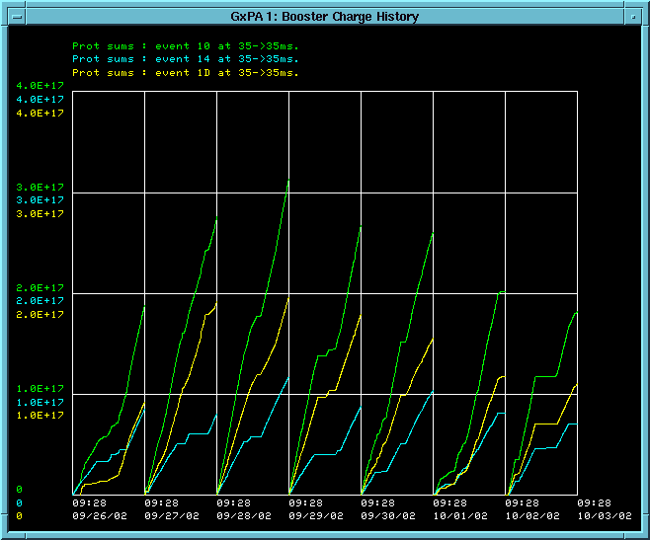
Protons to MiniBooNE this Week
Total
MiniBooNE
Stacking

Slide 4
In Short…
MiniBooNE is running.
We typically take 1.5-2.0 times as many protons as stacking.
This number needs to go up by about a factor of 8.

Slide 5
What it Limiting MiniBooNE
(Longitudinal?) instabilities in the Booster are limiting the per pulse intensity to ~4E12 ppp.
Normalized tunnel losses limit the total protons to about 2E16 pph when the Booster is running well.
Beam power loss limit (currently 400 W) is similar.
Heating in the extraction septum (MP02) currently limits MiniBooNE rate to ~.9 Hz during stacking.

Slide 6
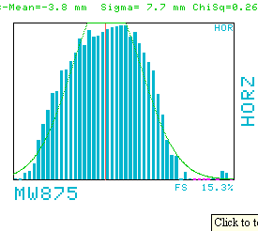
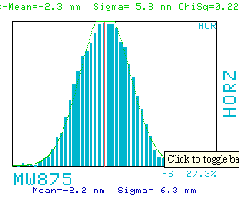
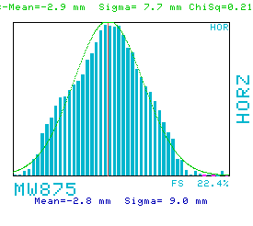
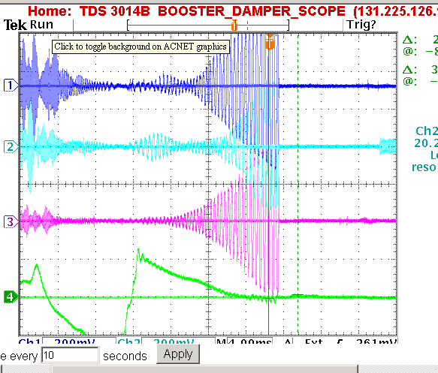
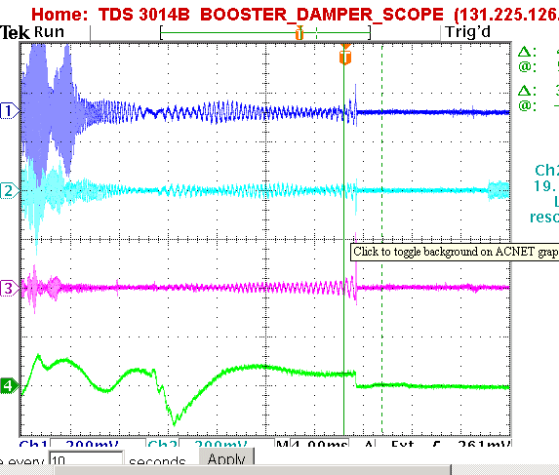
Effect of Longitudinal Damping
High Dispersion Region
Dampers Working
Occasional Bad Pulse at High Intensity (trips loss monitors)
No Dampers

Slide 7
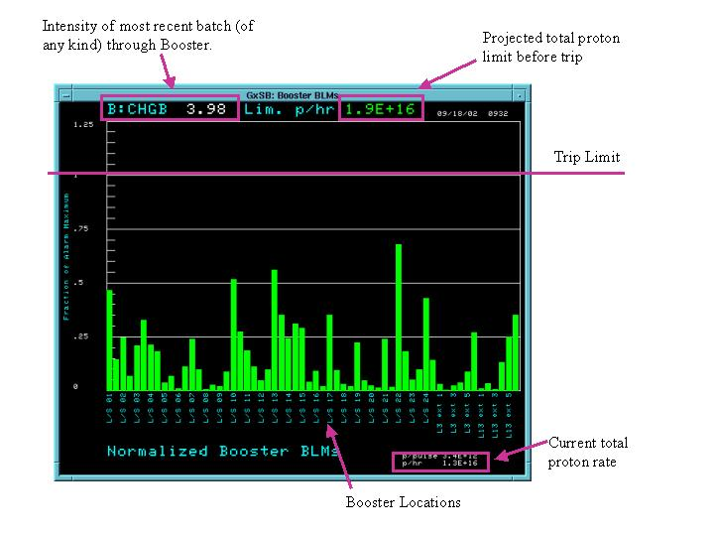
Tunnel Losses

Slide 8
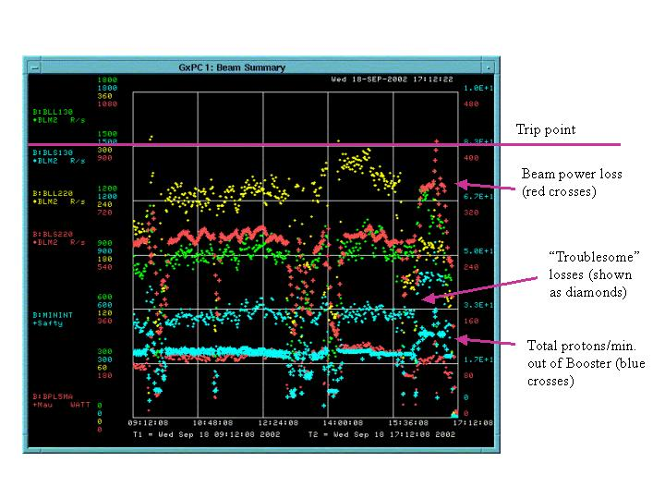
Limit Summary

Slide 9
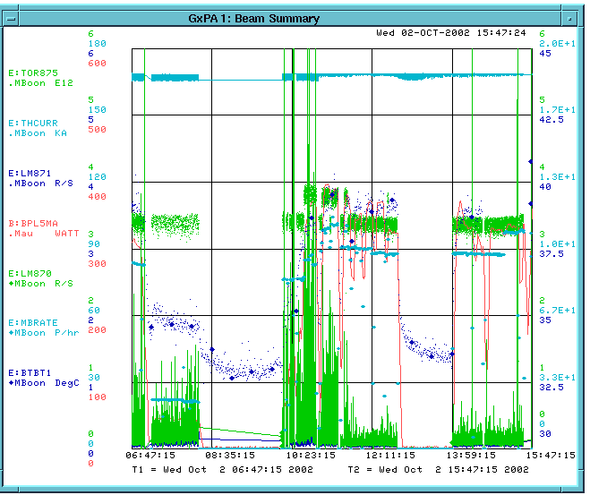
A Fairly Bad 9 Hour Period
Booster Power Loss
Per pulse intensity (E12)
MiniBooNE rate (p/hr)

Slide 10
Plan
New Power Supply is Ready for MP02. Negotiating time to connect.
At the same time, we will do a magnet move which should improve some of the worst losses (L13, L22, L24).
Review of collimator shielding design on Monday. Build and install shielding over next few months to bring collimators on line.
Progress in beam position correction. Soon implemented full time.
New extraction septum installed during January shutdown.

