Slide 1
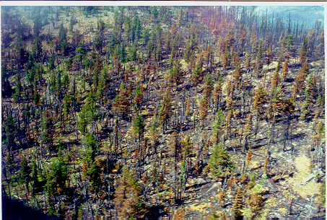
Strategic Environmental Compliance for Fire Safe Council & Community Wildfire Protection Plan Projects
Project Scope and Conservation Strategies:
Wildlife and Vegetation Community Considerations
Kevin Shaffer
Department of Fish and Game
(916) 651-7806
.kshaffer@dfg.ca.gov

Slide 2
Basic assumptions & questions
Components of fire regime are significant to wildlife
The interaction between wildlife and fire may be best understood when viewing regime attributes:
temporal,
spatial, and
magnitude
Fire & fuel management practices ⬄ altered regimes
 What means of reducing fuel are available that do not impact species or at least minimize the impacts?
 What is the role of fire or fire surrogates in:
restoring,
enhancing,
maintaining:
Wildlife habitat
Plant population viability
ecological integrity of a landscape
in a single project, and,
into the future?
How does controlling invasive species affect native species?

Slide 3
Basic assumptions from http://www.fws.gov/fire/living_with_fire [emphases added]
The U.S. Fish and Wildlife Service is the principal federal agency responsible for conserving, protecting and enhancing fish, wildlife and plants and their habitats.
The Service has long recognized fire as a unique process that shapes habitat structure and function, and a long history of managing and using fire extensively to maintain and enhance habitats throughout the country.
Protecting biological communities also protects human communities. Fire management helps restore and maintain desirable conditions for wildlife, which also protects local communities and critical habitat for many threatened and endangered species.
Healthy ecosystems are good for both wildlife and people.
Using fire is essential for managing habitats that sustain diverse wildlife populations.
Projects designed to reduce hazardous conditions in wildland-urban interface communities provide substantial benefits to wildlife habitat. Restoring and maintaining all lands in desirable ecological condition would maximize benefits to wildlife.

Slide 4
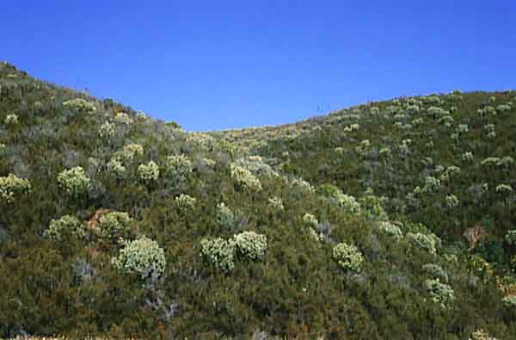
Defining your goals and Planning Capacity
Wildfire Protection
Reduced Fire intensity
Reduced rate of spread
Location & width of break or buffer
Crew/equipment access during incidents
Duration of reduced risk
other
Project capacity
Planning phase (included consultation with wildlife experts and permit compliance)
Intended implementation
Timing
Area/scope
Equipment
Staffing
Finances
Partners
Notes:
For fire treatments I typically think of the following: When was it last burnt (treated)?
What is the objective of the burn (e.g., single species -v- multi-species, desired complexity, etc.)?
Seasonal timing and conditions
Desired area (size) of impact
Coordination with others (neighbors and agencies)
What is an appropriate fire return interval to achieve long-term desired results?

Slide 5
Potential effects of a project
Altering fire regime attributes
Seasonality
Frequency (⬆⬇)
Exclusion of fire
Biological
Species displacement
Primary productivity
Animal fecundity
mortality
Ecological
Landscape heterogeneity
Loss of soil
Increase in sediment
Change in community composition or structure
Change in hydrology- storage, flow; timing; amount; recharge
Notes:
Other project outcomes could included increased habitat heterogeneity, productivity and fecundity. Most wildlife are able to survive fire events (many studies show this). Depending on the seasonal timing and intensity of fire, many plants can also survive fire treatments (e.g., burning when there is high fuel moisture versus low fuel moisture may contribute to increased survivorship for low intensity burns). Fire and treatments may alter the processes, functions and structures of ecosystems.

Slide 6
Communities at risk- synergy
Community Wildfire Protection Planning
Establishing Wildland Urban Interface (WUI) Boundaries
Considerations:
protecting values at risk
political
funding
accomplishing targets
WUI
An area in or adjacent to an at-risk community including isolated parcels of private property containing structures, infrastructure, or watershed with topographic features and fuel conditions (fuel type, fuel loading and arrangement) that have the potential to endanger that community.
Some Important criteria:
Fuel Hazard Threat Level
Risk of Occurrence
Values at Risk
Planning zones (100’, 1-mile)
Extending WUI for infrastructure assets (power, transportation, water)
Biological community conservation planning
Establishing maintaining habitat area and elements as well as ecological processes necessary for communities and specific species
Considerations
Vegetation structure, distribution, and health
Proximity and duration of exposure to activities
Relative value to other values at risk
Available funding
Setting targets- managing vegetation to improve habitat; scale; fire regime; specific species needs
Ecological zones
California’s bioregions are divided in ecological zones, which are defined by the interaction of biotic communities and soil, hydrology, climate, elevation, topography, and aspect. Within ecological zones can be found vegetation alliances, defined by existing dominant or co-dominant plant species.
Some Important criteria
Fuel/vegetation arrangement, distribution, and extent
Time (and effect) of last fire
Risk of continued exclusion or next wildfire (intensity)

Slide 7
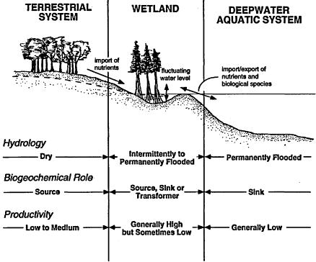
What do wildlife need?
Habitat heterogeneity
Ecological cycling (wood, water, nutrients)
Shelter/cover
Migration corridors
Foraging
Breeding and rearing

Slide 8
What do botanical wildlife need? Botanical characteristics associated with perturbation [from Manual of California Vegetation, J. Sawyer & T. Keeler-Wolf- in revision]
Plant Life Form | Includes duration, life form, modifiers, and leaf condition for plant species
Duration | The life span of the plant
Annual, perennial, etc. | A single year; variable; dies after fruiting; does not die after fruiting
Growth form | Size, above ground tissue types, stem arrangement, and external support
Herb, shrub, tree, vine | Lacks above ground woody tissue
Leaf condition
Evergreen, deciduous | Retaining leaves for the entire year, shedding during drought/dry season or winter/cold season
Modifiers | Underground organs, under-ground stems/above-ground roots; fleshiness; asexual reproduction
Bulbiferous, rhizomatous, stoloniferous, succulent, clonal | Having fleshy underground storage organs (herbs)
Seed storage
Canopy, soil, transient | Seeds stored above-ground (e.g., cones); below- ground (caches, distributed diffusely); not stored
Seed longevity | Length of time that seed remains viable under natural conditions
Short, medium, long | < = 1 yr or one growing season; 1-10 yrs; > 10 yrs
Mode of dispersal
Wind, animal, gravity
Stimulation agents
Chemical, heat, inundation, statification | Stratification- Suitable conditions of temperature and/or moisture in winter or summer
Sprouting mechanism
Buds, underground structures | Sprouting from buds on sm. Above-grnd branches/lg. above-grnd or trunks; lignotubers, rhizomes, roots
Notes:
I think the focus should be more terrestrial, which is more representative of species impacted by fuel treatment projects. I would say the aquatic species impacts are more of a concern for large landscape level impacts (“catastrophic” fires).

Slide 9
What do botanical wildlife need? Surviving fire perturbation due to biological and morphological characteristics [from Manual of California Vegetation, J. Sawyer & T. Keeler-Wolf- in revision]
Survivability of seedlings/mature plants
Fire-sensitive | Plant is likely to be killed by fire of average/moderate intensity
Fire-hardy | Plant is likely to survive fire of average/moderate intensity
Thin epidermis | Western redcedar (Thuja plicata), Brewer spruce (Picea breweriana)
Thick epidermis | Black oak (Quercus kelloggii), coast Douglas-fir, Ponderosa pine (Pinus ponderosa)
High flammability | Western redcedar, Brewer spruce, greenleaf manzanita (Arctostaphylos patula), whitethorn ceanothus (Ceanothus chordulatus)
Low flammability | Ponderosa pine
No/low sprouter
High sprouter | Blue oak (Q. douglassi), black oak, chamise (Adenostoma fasiculatum), greenleaf manzanita, whitethorn ceanothus
Canopy architecture susceptible (low, spreading) | Westerm redcedar, Brewer spruce, greenleaf manzanita, whitethorn ceanothus
Canopy architecture resistant (tall, narrow) | Coast Douglas-fir (Pseudotsuga menziesii var. menziesii), Ponderosa pine
Reproductive viability | Age from which a plant becomes sexually reproductive to time sexual reproduction ceases or becomes very low. May need to be qualified based on site conditions (For example, white fir will not produce cones until leaders reach full sunlight, regardless of the age of the tree)
Notes:
I think the focus should be more terrestrial, which is more representative of species impacted by fuel treatment projects. I would say the aquatic species impacts are more of a concern for large landscape level impacts (“catastrophic” fires). Pinus ponderosa var. scopulorum- interior ponderosa pine. NOTE the complexity of fire and Arctostaphylos and Ceanothus. This same adult/seed relationship exists with many species of pine.

Slide 10
What do terrestrial wildlife need?
Some terrestrial wildlife species are able to adapt to the rapid change in environment from fire & others cannot.
Arboreal (goshawk), ground-level (grouse), subterranean (burrowing owl)
Mobility (desert tortoise v. deer), escape mechanisms (flight, burrows, cavities)
Type, degree, and duration in change to environment- shelter, food….
Some habitat is (greatly) improved, others are (greatly) degraded, while others completely eliminated
There will be endless variation. Fire is not uniform, so cannot be uniformly "good" or "bad" for wildlife.
Fire effects on wildlife are immediate. But more importantly, effects to wildlife populations & wildlife habitat revolve around successional theory. Habitat structure and elements, and their utility to any given species, may follow trends in the plant populations & communities.
Fire/disturbance intervals, timing, extent, and uniformity play a significant role in these trends.
Terrestrial animal population changes tends to follow plant community succession but do not correlate 100%- predictable changes to bird and rodent communities, some insects….
Notes:
What are catastrophic fires?

Slide 11
What do terrestrial wildlife need?
What may influence terrestrial animal~fire (project) effects:
The current condition and arrangement of plant communities
The current condition and distribution of (key) habitat elements (tree cavities, talus rocks, downed trees or snags, dens, prey, foliage)
Likely or projected habitat element recruitment
The species that occur in the proposed, treated area (seasonally, perennially, conditionally)
Biological needs of animal population- breeding, rearing, migrating, over-wintering
Temporal nature
Spatial nature- where in the area and how much area
The species that would be anticipated to use, colonize, emigrate due to anticipated changes
Temporal nature of change/shift- how long might species stay or be displaced
Fire ecology and effects of animal species
Fire ecology/issues/concerns of sensitive species- USFWS listings and recovery
Habitat refugia during and immediate-post project
Notes:
What are catastrophic fires?

Slide 12
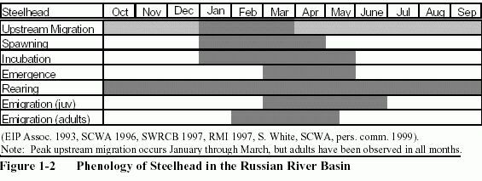
What do aquatic wildlife need?
Biological Requirements based on:
time of year
life-stage
population use of area
current, altered, and preferred habitat condition
Notes:
I think the focus should be more terrestrial, which is more representative of species impacted by fuel treatment projects. I would say the aquatic species impacts are more of a concern for large landscape level impacts (“catastrophic” fires).

Slide 13
Potential conflicts between mechanical fuel reduction and protection of at-risk species
Timing (seasonal)
Level of complexity and detail
Scope (spatial)
Re-entry for further treatment
Techniques:
Fuel buffer
Fuel break
Shaded fuel break
Feasibility to do project and attaining desired results versus impacting crucial aspect of species life cycle
Affordability, time required to conduct treatment, level of personnel needed versus planning for the special needs and variety of species involved
a. Attaining a lower risk versus or b. accomplishing what is feasible versus treating an area large enough to a. represent a threat or b. attaining enough reduction to allow fire to play a future role
the need for additional or continual treatment versus a. repeated stress on species or b. fire not being used in the future
The height needed for effect versus impacts to plants and animal habitat
Exposure of soil and elimination of plants and animal habitat; potential disturbance to animal home range or migration; stimulation of invasive plant species
Removal of habitat elements; fundamental alteration of vegetation community; disturbance of migration corridors, cover, or shelter
Notes:
You might check to see if Jennifer Potts (student of Scott Stephens) has published her research findings. In a nut shell, she found that mechanical treatments had lower species utilization (across taxa) in comparison to burn treatments.

Slide 14
Examples of fuel treatment and habitat and species conservation
Santa Rosa Plateau Ecological Reserve, southern Riverside County-
Mechanical treatment of vegetation & prescribed burning
native bunch grass grasslands, coastal sage scrub, Engelmann oak woodland, basalt-flow vernal pools, Santa Rosa Plateau fairy shrimp, winter wetlands (e.g., green-winged teal), California Orcutt grass, San Diego button-celery, mountain lion, burrowing owl and southwestern pond turtle.
Western Riverside County Multiple Species Habitat Conservation Plan
Mechanical treatment of vegetation
Quino checkerspot butterfly, Bell’s sage sparrow, cactus wren, CA gnatcatcher, [Arroyo toad, CA spotted owl, southern rubber boa, San Bernardino mountain snake, southern sagebush lizard], etc.
Channel Island National Park System
Mechanical treatment of vegetation, prescribed burning, control of invasive plant species
Island fox, Santa Rosa Island manzanita, Torrey pine, control: yellowspine thistle, silverleaf nightshade, Cape ivy, bull thistle, Australasian fireweed, and tocalote
U.C. Davis Jepson Prairie Reserve, Solano County
Mechanical treatment of vegetation, prescribed burning, control of invasive plant species
Vernal pools, native bunchgrasses, three listed fairly shrimp species, delta green ground beetle, Solano grass, dwarf downingia, Colusa grass, delta tule, and fragrant fritillary.
Pine Hills Preserve, El Dorado County
Mechanical treatment & some prescribed fire
Pine Hill ceanothus, Bisbee Peak rush-rose, Stebbin’s morning-glory, El Dorado mule-ears, El Dorado bedstraw, Pine Hill flannelbush, Red Hills soaproot, Layne’s butterweed
East Bay Regional Park District-Tilden Park/Mt. Diablo State Park {?}
Alameda whipsnake, pallid manzanita
Notes:
Tilden Park might also fit into this (EBRPD/Karen Swaim).
Cirsium ochrocentrum (yellowspine thistle) and Solanum elaeagnifolium (silverleaf nightshade), Delaria odorata (Cape Ivy), Cirsium vulgare (bull thistle) and Erechtites glomerata (Australasian fireweed) and Centaurea melitensis (tocalote)

Slide 15
Wildlife~habitat~project planning tools
Fire Effects Information System (FEIS), http://www.fs.fed.us/database/feis/index.html
FEIS provides up-to-date information about fire effects on 900 plant species, 7 lichen species, about 100 wildlife species plants and animals. It is maintained at USFS’s Rocky Mountain Research Station, Fire Sciences Laboratory in Missoula, Montana. Emphasis: how fire affects species. Information: taxonomy, distribution, basic biology, and ecology of each species, complete bibliography.
California Wildlife Habitat Relationships (CWHR), http://www.dfg.ca.gov/bdb/html/cwhr.html
State-of-the-art information system for California's wildlife. CWHR contains life history, geographic range, habitat relationships, and management information on 692 species of amphibians, reptiles, birds, and mammals known to occur in the state.
California Natural Diversity Database (CNDDB)
is a program that inventories the status and locations of rare plants and animals in California . CNDDB staff work with partners to maintain current lists of rare species as well as maintain an ever-growing database of GIS-mapped locations for these species.
RareFind 3 © The most complete computerized inventory of California's rarest species and natural communities available! http://www.dfg.ca.gov/bdb/html/rarefind.html
contains over 49,000 records on more than 2,600 rare native plants, animals, and natural communities in a convenient, searchable database. Offering all textual data associated with the Department of Fish and Game's California Natural Diversity Database, RareFind 3 can either be used as a stand-alone research tool or linked with GIS software such as Arcview or Arcmap for greater flexibility.
Fire in California's Ecosystems, http://www.ucpress.edu/books/pages/10085.html
Edited by Neil G. Sugihara, Jan W. van Wagtendonk, Kevin E. Shaffer, Jo Ann Fites-Kaufman and Andrea E. Thode. U.C. Press, 2006
Notes:
Planning tools? These are resources for fire effects and species distributions. Certainly the GIS components of CWHR and CNDDB are components of tools if added to other data sets (topography, urban infrastructure, etc.).

Slide 16
Partners!
The goal- enhancing the potential to conduct fuel/fire projects and conducting them successfully
Wildlife expertise evaluating the biological and management needs and interactions of species present, important habitat elements, and vegetation communities.
Fire ecology expertise evaluating current fire regime and potential changes in regime elements based on project(s) design and implementation.
Fire management expertise developing project options to altering vegetation for project goals
Regulatory agencies permits necessary, potential timelines, and coordination necessary for project design
A partnership is the best opportunity in avoiding & minimizing impacts, stream-lining project process, and potentially meeting mutual goals.
Recommendation: Design fuel reduction/management project goals to integrate as much as possible with habitat function, species needs, and fire regime in mind.
Recommendation: Design your project in collaboration with and input from fire ecologists, wildlife biologists, land stewards/managers as early as possible & practical.
Notes:
Local fire knowledge still available among certain indigenous communities, professional organizations and individuals, land agencies, regulatory agencies, local experts and academics

Slide 17
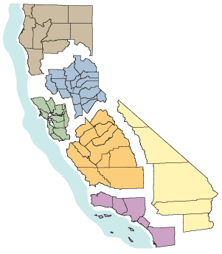
California Department of Fish and Game Regional Offices
 | 1 - Northern Region Serving Del Norte, Humboldt, Lassen, Mendocino, Modoc, Shasta, Siskiyou, Tehama and Trinity counties (530) 225-2300
 | 2 - North Central Region Serving Alpine, Amador, Butte, Calaveras, Colusa, El Dorado, Glenn, Lake, Nevada, Placer, Plumas, Sacramento, San Joaquin, Sierra, Sutter, Yolo and Yuba counties (916) 358-2900
 | 3 - Bay Delta Region Serving Alameda, Contra Costa, Marin, Napa, Sacramento, San Mateo, Santa Clara, Santa Cruz, San Francisco, San Joaquin, Solano, Sonoma, and Yolo counties (707) 944-5500
 | 4 - Central Region Serving Fresno, Kern, Kings, Madera, Mariposa, Merced, Monterey, San Benito, San Luis Obispo, Stanislaus, Tulare and Tuolumne counties (559) 243-4005
 | 5 - South Coast Region Serving Los Angeles, Orange, San Diego, Santa Barbara and Ventura counties (858) 467-4201
 | 6 - Inland Deserts Region Serving Imperial, Inyo, Mono, Riverside and San Bernardino counties (909) 484-0167

Slide 18
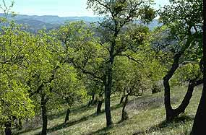
Questions?

