Slide 1
CTR Prediction of Advertisements
You got to know your customers

Slide 2
Importance of CTR
Reduce money spent on unnecessary ads
Amalgamate investment on interested population
Filter out the demanding medium for Ads display
Choose the locality and time where the ad is more likely to be clicked through

Slide 3
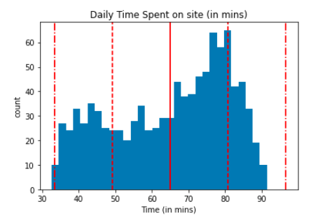
Your Time is limited .....
On an average , a person spends around an hour or 65 minutes on a particular site . So it is essential that the Ad is displayed at a prominent space on the site and at the same time grabs the attention of the user apart from what they are actually looking for on the site

Slide 4
Do people really find time for your Ad ?
Yes they do , but only at some point of time !!!
Best times are 9am and 7am -

Slide 5
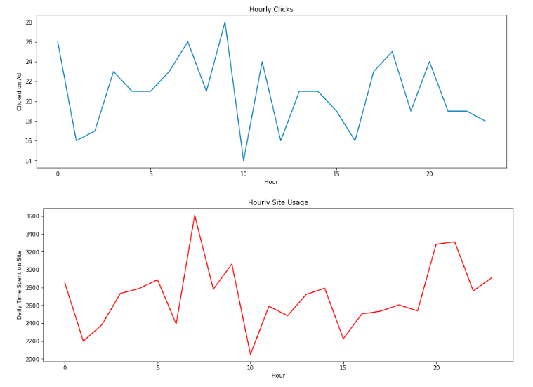

Slide 6
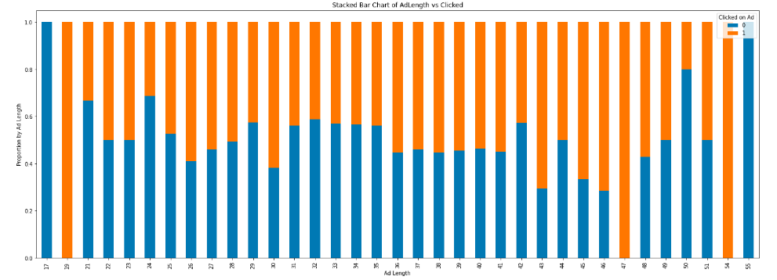
Does the length of the Ad matter ?
Not really , says the graph …..

Slide 7
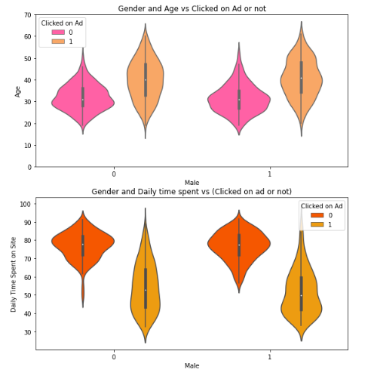
WHO LIKES YOUR AD ?
Male and Female of age group 32-48 years tend to click the ad more likely with the median age being 40 years .
Male and Female of who spend 70-95 mins do not click on the add
Females who spend 42-65 mins are more likely to click through , basically around an hour
Males who spend 42-60 mins are more likely to click through

Slide 8
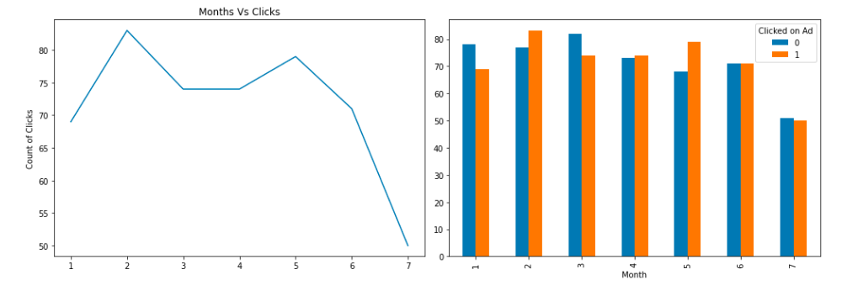
When to invest on Ads ?
February and May seem to be potential months

Slide 9
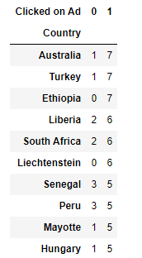
Which regions to focus ?
Out of the 10 top countries that are more frequently occurring in the dataset ,
Australia , Turkey , South Africa
Senegal , Peru
have clicked on the Ads several times !

Slide 10
GO GET YOUR CUSTOMERS NOW
THANK YOU !

