Slide 1
COMP2601
Lesson 8: GUI

Slide 2
Learning Outcomes
Create GUIs with components, behaviors, and lambda expressions
JFrame
JPanel
JList
JButton
JLabel
ActionListeners, ActionEvents, etc…

Slide 3
JFrame
https://docs.oracle.com/en/java/javase/17/docs/api/java.desktop/javax/swing/JFrame.html#%3Cinit%3E()
import javax.swing.JFrame;
The JFrame is our GUI’s “window” object
It can take parameters (e.g. the title) in the constructor, or not
Invoke its setVisible(true) method for it to be visible
We must also set its size or it appears minimized.

Slide 4
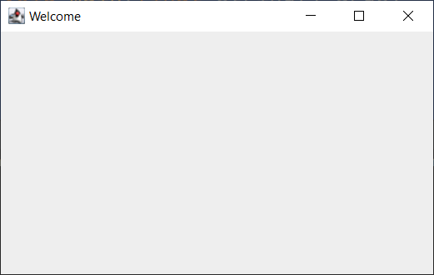
JFrame
import javax.swing.JFrame;
class Gui
{
Gui()
{
JFrame frame = new JFrame("Welcome");
frame.setVisible(true);
}
public static void main(final String[] args)
{
Gui gui = new Gui();
}
}

Slide 5
JPanel
The JFrame is essentially our window
We add a JPanel to our JFrame, to hold elements such as buttons, etc…
Both the JFrame and JPanel have many methods available
Typically when a JPanel is added to our JFrame, we
Set up a border (relative to the Frame)
Set the panel’s “layout”
Add elements to that layout
Example:
panel.setBorder(BorderFactory.createEmptyBorder(10, 20, 30, 40));
Creates a border of 10px from the top, 20 from the bottom, 30 from the left, and 40 from the right

Slide 6
Border
import javax.swing.JFrame;
import javax.swing.JPanel;
import javax.swing.BorderFactory;
class Gui
{
Gui()
{
JFrame frame = new JFrame("Welcome");
JPanel panel = new JPanel();
panel.setBorder(BorderFactory.createEmptyBorder(10, 20, 30, 40));
frame.setVisible(true);
}
public static void main(final String[] args)
{
Gui gui = new Gui();
}
}

Slide 7
Layout
We must set a “layout” for our panel now, to which we can add elements
Let’s add a grid with 2 rows and 3 columns
Then let’s add the panel to our frame (centered), and get it all working
The pack() method will automatically set the Frame’s size according to the components on it

Slide 8
Layout
class Gui{
Gui() {
JFrame frame = new JFrame("Welcome");
JPanel panel = new JPanel();
panel.setBorder(BorderFactory.createEmptyBorder(10, 20, 30, 40));
panel.setLayout(new GridLayout(2, 3));
frame.add(panel, BorderLayout.CENTER);
frame.setDefaultCloseOperation(JFrame.EXIT_ON_CLOSE);
frame.pack();
frame.setVisible(true);
}
public static void main(final String[] args) {
Gui gui = new Gui();
}
}

Slide 9
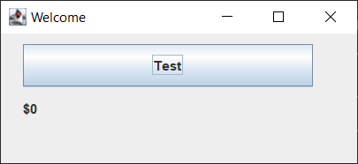
JLabel
Let’s create a label that adds one dollar to a money total every time a button is clicked
JLabel label = new JLabel("$0"); // see previous slide
panel.add(label);

Slide 10
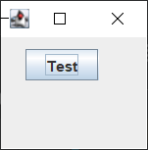
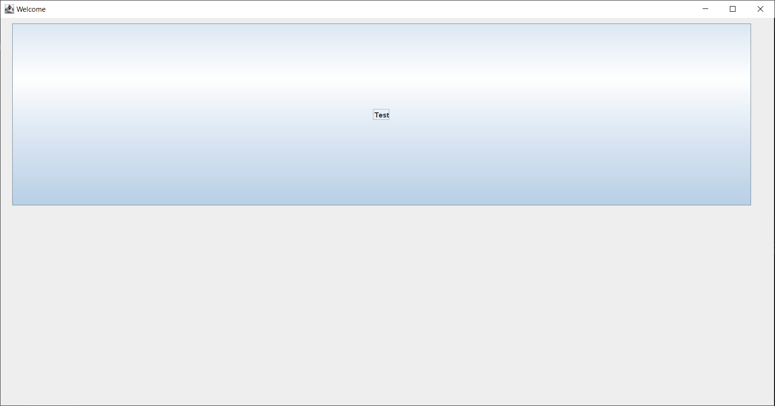
JButton
Let’s add a button to our panel, with the text “Test”
Then make the button clickable
JButton button = new JButton("Test");
panel.add(button);
button.setFont(new Font(“Arial”, Font.PLAIN, 32)); // enlarge the text

Slide 11
Clicking the JButton
JButtons have an addActionListener() method
If we pass “this” as its parameter, that means the current object’s class will provide the actionListener method
For this to work, the class must implement the ActionListener functional interface and implement its single method: actionPerformed():
https://docs.oracle.com/en/java/javase/17/docs/api/java.desktop/java/awt/event/ActionListener.html

Slide 12
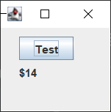
Clicking the JButton
The actionPerformed() method of the ActionListener interface takes one parameter: an ActionEvent object
When the button is clicked, this ActionEvent gets triggered (i.e. the actionPerformed() method is invoked)
Let’s add $1 to our total money when the button is clicked
Let’s also set the label’s text again (i.e. update it)

Slide 13
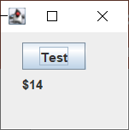
Our GUI
import javax.swing.*;
import java.awt.*;
import java.awt.event.ActionEvent;
import java.awt.event.ActionListener;
class Gui implements ActionListener{
private JFrame frame;
private JPanel panel;
private JButton button;
private JLabel label; // accessible outside the constructor now
private int moneyEarnedUsd = 0;
Gui() {
frame = new JFrame("Welcome");
panel = new JPanel();
label = new JLabel("$0");
button = new JButton("Test");
button.addActionListener(this);
panel.setBorder(BorderFactory.createEmptyBorder(10, 20, 30, 40));
panel.setLayout(new GridLayout(2, 3));
panel.add(button);
panel.add(label);
frame.add(panel, BorderLayout.CENTER);
frame.setDefaultCloseOperation(JFrame.EXIT_ON_CLOSE);
frame.pack();
frame.setVisible(true);
}
@Override
public void actionPerformed(final ActionEvent e)
{
moneyEarnedUsd++;
label.setText("$" + moneyEarnedUsd);
}
public static void main(final String[] args)
{
Gui gui = new Gui();
}
}

Slide 14
JList: Start with Standard JFrame Setup
class Celebrity {
private String firstName;
private String lastName;
private String famousFor;
private int yearBorn;
Celebrity(final String firstName, final String lastName, final String famousFor, final int yearBorn) {
this.firstName = firstName;
this.lastName = lastName;
this.famousFor = famousFor;
this.yearBorn = yearBorn;
}
@Override
public String toString() {
return "Celebrity{" +
"firstName='" + firstName + '\'' +
", lastName='" + lastName + '\'' +
", famousFor='" + famousFor + '\'' +
", yearBorn=" + yearBorn +
'}';
}
}
}
import javax.swing.*;
class CelebrityList{
JFrame frame;
CelebrityList() {
frame = new JFrame("Famous People");
frame.setDefaultCloseOperation(JFrame.DISPOSE_ON_CLOSE); // close this frame only
frame.pack();
frame.setLocationRelativeTo(null);
frame.setVisible(true);
}
public static void main(final String[] args) {
CelebrityList celebrityList;
celebrityList = new CelebrityList();
}

Slide 15
JList
The JList is a generic class, so we pass a type parameter:
JList<Celebrity> list = new Jlist<>();
JList is simplest when it uses a DefaultListModel as a data source:
DefaultListModel<Celebrity> model = new DefaultListModel<>();
list.setModel(model);
Let’s add a split pane. When we click on the left side of the pane, the relevant data appears on the right.
Note: JList needs to be added to JScrollPane before being added to any other container, because the JList is scrollable too

Slide 16
JList
list.setModel(model);
splitPane.setLeftComponent(new JScrollPane(list));

Slide 17
Our First GUI Application
import javax.swing.*;
class CelebrityList
{
private JFrame frame;
private JPanel panel;
private JList<Celebrity> list;
private DefaultListModel<Celebrity> model;
private JLabel label;
private JSplitPane splitPane; // looks nice
CelebrityList()
{
frame = new JFrame("Famous People");
frame.setDefaultCloseOperation(JFrame.DISPOSE_ON_CLOSE); // close this one only
panel = new JPanel();
list = new JList<>();
model = new DefaultListModel<>();
label = new JLabel();
splitPane = new JSplitPane();
panel.add(label);
list.setModel(model);
splitPane.setLeftComponent(new JScrollPane(list));
splitPane.setRightComponent(panel);
frame.add(splitPane);
frame.pack();
frame.setLocationRelativeTo(null);
frame.setVisible(true);
}
public static void main(final String[] args)
{
CelebrityList celebrityList;
celebrityList = new CelebrityList();
}
}

Slide 18
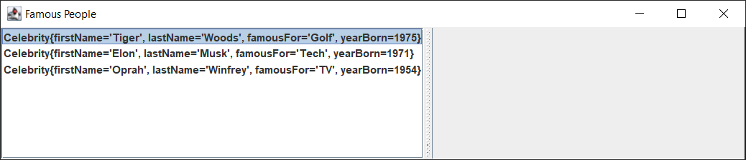
Our Model
Let’s add data to our model:
model.addElement(new Celebrity("Tiger", "Woods", "Golf", 1975));
model.addElement(new Celebrity("Elon", "Musk", "Tech", 1971));
model.addElement(new Celebrity("Oprah", "Winfrey", "TV", 1954));
Note that the toString() method is being invoked here.

Slide 19
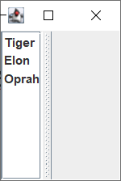
Our Model: override toString() differently
In the Celebrity class:
@Override
public String toString() {
return firstName;
}

Slide 20
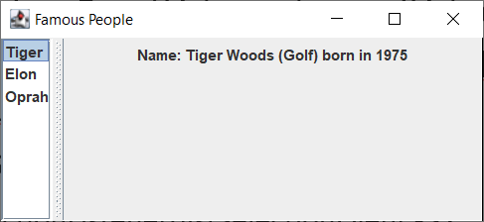
Interactive JSplitPane
Let’s select celebrities on the left and have it affect the right side
After adding elements, also add an EventListener to our JList: e.g. a ListSelectionListener
In order to do that, we call the list’s getSelectionModel():
list.getSelectionModel().addListSelectionListener()
We can use a lambda expression:
list.getSelectionModel().addListSelectionListener(listSelectionEvent -> {
Celebrity c = list.getSelectedValue();
label.setText("Name: " + c.firstName + " " + c.lastName + " (" + c.famousFor + ") born in " + c.yearBorn);
});
Note: the label is on the panel, which is on the right component of the split pane.
Try using the ARROW KEYS to navigate the list also.

Slide 21
Final code
import javax.swing.*;
class CelebrityList
{
private JFrame frame;
private JPanel panel;
private JList<Celebrity> list;
private DefaultListModel<Celebrity> model;
private JLabel label;
private JSplitPane splitPane; // looks nice
CelebrityList()
{
frame = new JFrame("Famous People");
// close this one only
frame.setDefaultCloseOperation(JFrame.DISPOSE_ON_CLOSE);
panel = new JPanel();
list = new JList<>();
model = new DefaultListModel<>();
label = new JLabel();
splitPane = new JSplitPane();
panel.add(label);
list.setModel(model);

Slide 22
Final code
model.addElement(new Celebrity("Tiger", "Woods", "Golf", 1975));
model.addElement(new Celebrity("Elon", "Musk", "Tech", 1971));
model.addElement(new Celebrity("Oprah", "Winfrey", "TV", 1954));
list.getSelectionModel().addListSelectionListener(listSelectionEvent -> {
Celebrity c = list.getSelectedValue();
label.setText("Name: " + c.firstName + " " + c.lastName + " (" + c.famousFor + ") born in " + c.yearBorn);
});
splitPane.setLeftComponent(new JScrollPane(list));
splitPane.setRightComponent(panel);
frame.add(splitPane);
frame.pack();
frame.setLocationRelativeTo(null);
frame.setVisible(true);
}
public static void main(final String[] args)
{
CelebrityList celebrityList;
celebrityList = new CelebrityList();
}
class Celebrity
{
private String firstName;
private String lastName;
private String famousFor;
private int yearBorn;
+ constructor, getters, and toString()

