Slide 1
COMP2601: Programming fundamentals part 3 (objects)
Lesson 6: Exception Handling & I/O Streams

Slide 2
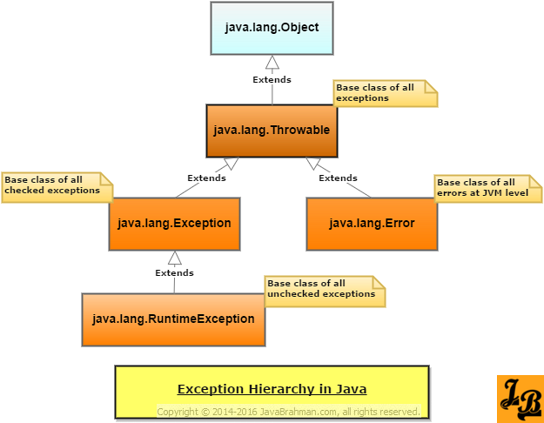
Exception Handling
https://www.javabrahman.com/corejava/understanding-exception-hierarchy-java-tutorial/

Slide 3
Class hierarchy
Throwable: anything with this parent, can be thrown
Error: the JVM that runs Java programs has a problem with hardware or software (e.g. out of memory)
Exception: program-specific problem out of the programmer’s (checked) control (e.g. a necessary file has been deleted; a network connection to a remote database is broken)
RuntimeException: a problem made by the programmer needs to be (unchecked) fixed (e.g. tried to call toUpperCase() on a null String reference): any resulting crash is good because it draws our attention and we will fix the coding error.

Slide 4
Exception handling
main() should not throw exceptions
The finally{ } block is always executed (even if try/catch blocks return)
The compiler forces us to handle checked exceptions (by try/catch or by declaring and rethrowing them)
The compiler does not force us to handle unchecked exceptions; don’t try/catch these; let them crash the program and thus draw our attention to make repairs
To handle an exception from a catch block, we can do a number of different things:
Handle it directly in that catch block
Call a handler method from the catch block
Print the stack trace in the catch block (ok for development, not for production)

Slide 5
Custom Exceptions
We can extend the Exception class to create custom Exception classes or even hierarchies (i.e. multiple Exception classes with our own custom parent class)
Often we provide two constructors: (String msg) and (String msg, Throwable cause)
See the example from our previous slides with CreationException and InvocationException
The msg string should be meaningful (e.g. “number out of range of 1 – 100”)

Slide 6
The filesystem
In Java, the backslash \ character has a special meaning for strings (escape character)
Therefore when working in a Windows environment, file paths such as C:\foo will need to be rewritten as C:\\foo or C:/foo

Slide 7
Working dir and commandline invocation
Consider running the public static void main() method in a java class called Main…running from the commandline with commandline arguments, as follows:
java Main foo/bar.txt
We need to consider where foo/bar.txt will be run from. Usually, the working directory that is being assumed is wherever the class file is located (here: Main).
Example: running “java Main foo/bar.txt” from “/users/tigerwoods/foo/bar.txt” will have a working directory of /users/tigerwoods.
Therefore, if we wanted to use the “foo/bar.txt” filepath, it would be relative to the /users/tigerwoods directory: /users/tigerwoods/foo/bar.txt. Keep this in mind.
Alternatively, an absolute path could be given instead:
java Main /foo/bar.txt
or C:/foo/bar.txt

Slide 8
Working with files
In Java, we have several classes that can work with files. We will use the FileReader and FileWriter classes to read() and write() to files. We can also use the Scanner class to assist.
Many things that are out of our hands could go wrong when working with files (e.g. no permission, no such file, file is corrupted, filesystem is full, network connection is lost, etc…).
The methods in these classes therefore can throw Exceptions…such as IOException.
Wrap input/output calls in try/catch blocks.

Slide 9
File handling example
Let’s read Strings from one file, uppercase them, and write the UPPERCASED version to another file.
Read the file with FileReader
Scan the file contents with Scanner; read each line into a String
Write the String to the new file with FileWriter

Slide 10
File handling example
import java.io.FileReader;
import java.io.FileWriter;
import java.io.IOException;
import java.util.Scanner;
public class Main
{
public static void main(String[] args)
{
FileReader reader;
FileWriter writer;
Scanner scanner;
try
{
reader = new FileReader("names.txt");
scanner = new Scanner(reader);
writer = new FileWriter("uppercase_names.txt");
System.out.println(System.getProperty("user.dir")); // prints “C:\myproject”
while(scanner.hasNextLine())
{
String line = scanner.nextLine();
writer.write(line.toUpperCase() + "\n");
}
writer.close();
}
catch(IOException e)
{
System.out.println(e.getMessage());
}
}
}
In this example, Main was run from the IDEA as follows:
C:\myproject: names.txt
C:\myproject\src: Main.java
See next slide

Slide 11
