Slide 1
COMP2601: Programming fundamentals part 3 (objects)
Lesson 7: Unit Testing

Slide 2
Learning outcomes
Unit Testing
Regression Testing
TDD
jUnit

Slide 3
Unit testing
Testing is a very important part of software development
There are many types of testing: https://www.softwaretestinghelp.com/types-of-software-testing
Unit tests are software programs that test “units”; for example, that test the methods of our classes
We write unit tests for several reasons:
To ensure the method does what it should
To ensure the method fails as it should (e.g. bad parameters → exceptions thrown)
To check that our code still works even after it is modified; tests that used to pass either: (a)still pass, or (b)now fail…but they show us what needs fixing! We are no longer “afraid” to make changes to our working code.

Slide 4
Unit testing
We will write tests for our constructors and methods
Each test will eventually pass or fail
jUnit is Java’s unit-testing framework
We will use assertions in our tests, which return true or false values
Example: if we set a Person object’s first name to “tiger” via a setFirstName() method, the getFirstName() method should return the string “tiger”
Our assert statements can compare an expected value (e.g. “tiger”) with the actual value (e.g. person.getFirstName())
If the actual value is different than the expected value, we would get a failed test
If the actual value is the same as the expected value, we would get a passed test

Slide 5
Junit assertions
jUnit 5 assertions:
https://junit.org/junit5/docs/current/api/org.junit.jupiter.api/org/junit/jupiter/api/Assertions.html

Slide 6
Java class and its unit test
Let’s create a little class hierarchy (see next slides)
Extend an abstract class
Implement an interface
Create some constructors and methods
Create a concrete Dog class
Test the Dog class
I put the cursor beside the word “Dog” in the dog class definition and then typed Alt-Enter then chose Create Test
I had to choose “Fix” because I had the error message “JUnit5 library not found in the module”

Slide 7
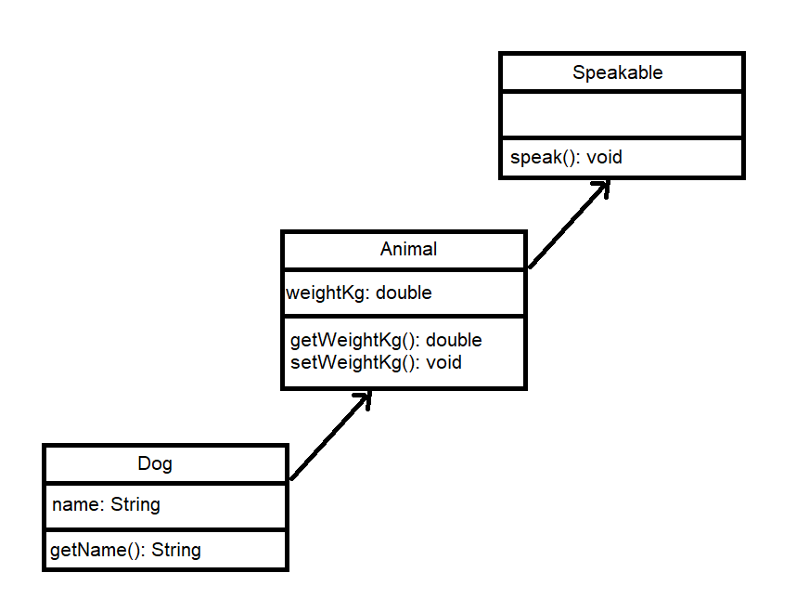
package ca.bcit.comp2601.animalkingdom;
public abstract class Animal implements Speakable
{
private double weightKg;
public Animal(final double weightKg)
{
this.weightKg = weightKg;
}
@Override
public void speak(final String vocalization, final int numTimes)
{
for(int i = 0; i < numTimes; i++)
{
System.out.println(vocalization);
}
}
private static void validateWeightKg(final double weightKg)
{
if(weightKg <= 0.0)
{
throw new IllegalArgumentException("invalid weight");
}
}
public void setWeightKg(final double weightKg)
{
this.weightKg = weightKg;
}
public double getWeightKg()
{
return weightKg;
}
}
package ca.bcit.comp2601.animalkingdom;
public class Dog extends Animal
{
private final String name;
public Dog(final String name, final double weightKg)
{
super(weightKg);
if(name == null || name.isBlank())
{
throw new IllegalArgumentException("invalid name");
}
this.name = name;
}
public String getName()
{
return name;
}
}
package ca.bcit.comp2601.animalkingdom;
public interface Speakable
{
void speak(final String vocalization, final int numTimes);
}
package ca.bcit.comp2601.animalkingdom;
public class Main
{
public static void main(final String[] args)
{
Dog d = new Dog("rocky", 40.0);
d.speak("woof", 4);
}
}

Slide 8
Finally: write some tests
Imagine setting and getting the Dog object’s name; if there were an error, it’s not immediately clear whether the error was in the setting (e.g. mutator or constructor) or in the getting. Therefore let’s unify these two methods into a single name() test inside the newly-created DogTest.java file:
@Test
void name()
{
Dog dog;
dog = new Dog("rocky", 40.0);
assertThat(dog.getName(), equalTo("rocky")); // passed test
assertThat(dog.getName(), equalTo(“Rocky")); // failed test
}

Slide 9
More tests
Imagine setting and getting the Dog object’s name; if there were an error, it’s not immediately clear whether the error was in the setting (e.g. mutator or constructor) or in the getting. Therefore let’s unify these two methods into a single name() test inside the newly-created DogTest.java file:
@Test
void name()
{
Dog dog;
dog = new Dog("rocky", 40.0);
assertThat(dog.getName(), equalTo("rocky")); // passed test
assertThat(dog.getName(), equalTo(“Rocky")); // failed test
dog.setName("banjo"); // note: I added this later to the Dog class
assertThat(dog.getName(), equalTo("banjo")); // passed test
}

Slide 10
Testing void print method
The unit test for speak() is not trivial to test (testing what is printed on the console is not trivial)
Rather than System.out.println’ing our parameter in the speak() method, let’s change it to return that string instead
Update (a)the Speakable interface speak() signature, (b)the Animal speak() implementation, and (c)the Main main() method call
Now we can test the speak() method in DogTest’s speak() test
Dog.java
@Override
public String speak(final String vocalization, final int numTimes)
{
StringBuilder sb;
sb = new StringBuilder();
for(int i = 0; i < numTimes; i++)
{
sb.append(vocalization);
sb.append("\n");
}
return sb.toString();
}
DogTest.java
@Test
void speak()
{
Dog dog;
dog = new Dog("rocky", 40.0);
assertThat(dog.speak("woof", 4), equalTo("woof\nwoof\nwoof\nwoof\n"));
assertThat(dog.speak("arf", 3), equalTo("arf\narf\narf\n"));
}

Slide 11
Code likes to have a name
bar() <-- test this
{
do this
do that
do something else
}
foo() <-- not this
{
for(int i = 0; i < 1000000; i++)
{
// do this
// do that
// do something else
bar()
}
}

Slide 12
Running tests
Rather than running single tests, we can run all the tests in DogTest at once
Now that all our tests are passing, we know that proper input to our methods and constructors, produces correct results
Next let’s rewrite our unit tests to show that improper input will produce the expected exceptions being
Our new, updated test will assert that the exception thrown: (a)is of the expected type (e.g. IllegalArgumentException) and (b)has the proper message inside it (e.g. “Invalid weight kg”). If either (a) or (b) fails, our test will fail.

Slide 13
Improved exception handling and tests
Since the chance is high that the user (i.e. not the developer) could enter a bad name for a Dog, let’s make our own checked Exception type and ensure it’s thrown whenever a Dog is trying to be given a name of null or blank.
Update your code to throw this new checked exception type.
try/catch where necessary now.
Here is the updated test:
@Test
void badConstructor()
{
final BadNameException e;
e = assertThrows(BadNameException.class, ()->new Dog("", 40.0));
assertThat(e.getMessage(), CoreMatchers.equalTo("invalid name"));
}

Slide 14
Refactored constructor tests
@Test
void badConstructorNullThrowsIllegalArgumentEx() // give EXTREMELY-specific test names
{
final IllegalArgumentException e;
e = assertThrows(IllegalArgumentException.class, ()->new Dog(null, 40.0));
assertThat(e.getMessage(), CoreMatchers.equalTo("name must not be null"));
}
@Test
void badConstructorEmptyNameThrowsIllegalArgumentEx()
{
final BadNameException e;
e = assertThrows(BadNameException.class, ()->new Dog("", 40.0));
assertThat(e.getMessage(), CoreMatchers.equalTo("name must not be blank"));
}

Slide 15
Refactored constructor tests
Even better, remove the @Test annotation from the bottom method (so it won’t run itself as a test) and call that method with a parameter, giving us a reusable test with minimal code:
@Test
void badConstructorNameThrowsIllegalArgumentEx ()
{
badConstructorName("");
badConstructorName("\n");
badConstructorName("\t");
badConstructorName("\t \n \t"); // etc….
}
void badConstructorName(final String attemptedName)
{
final BadNameException e;
e = assertThrows(BadNameException.class, ()->new Dog(attemptedName, 40.0));
assertThat(e.getMessage(), CoreMatchers.equalTo("name must not be blank"));
}

Slide 16
Refactored constructor tests
Next we need to ensure that Dog’s setName() method also throws the same Exceptions in the same cases, similarly to how we centralized the weight validation in the Animal class (see earlier slides).

Slide 17
Test-driven development
Many of you have already seen TDD in action
TDD involves writing the a test first, and then immediately writing the code to pass that test
The advantage of having the tests in place first is that errors can be found earlier in the software-development process

Slide 18
More unit-testing best practices
Keep the tests and code in separate folders
Keep the tests and code in the same package
Avoid assertTrue() and assertFalse()…they are too unclear

Slide 19
Final example
import org.hamcrest.CoreMatchers;
import org.junit.jupiter.api.*;
import static org.hamcrest.Matchers.closeTo;
import static org.hamcrest.MatcherAssert.assertThat;
import static org.junit.jupiter.api.Assertions.assertThrows;
class BankAccountTest
{
@Test
void testGoodTransactions() throws IllegalTransactionException
{
BankAccount b;
b = new BankAccount("abc123", 500.00);
assertThat(b.getBalanceCad(), closeTo(500.00, 0.01));
}
@Test
void testBadTransactions() throws IllegalTransactionException
{
IllegalTransactionException ex;
BankAccount b;
b = new BankAccount("abc123", 500.00);
ex = assertThrows(IllegalTransactionException.class, ()->b.setAccountNumber(""));
assertThat(ex.getMessage(), CoreMatchers.equalTo("no no"));
}
}

