Slide 1
COMP2601: Programming fundamentals part 3 (objects)
Lesson 3: Polymorphism & Interfaces

Slide 2
Learning outcomes
To implement good polymorphism techniques
To create and implement interfaces

Slide 3
Polymorphism
Polymorphism is a very important topic for OOP languages.
Java has three types that are involved in polymorphism:
Interfaces: if you implement this interface, you must implement its (abstract) methods
Abstract classes: no objects can be created of this class, which is still very useful as a parent class containing all common traits for child classes which extend this class
Concrete classes: the kind of classes we have used so far: to create objects

Slide 4
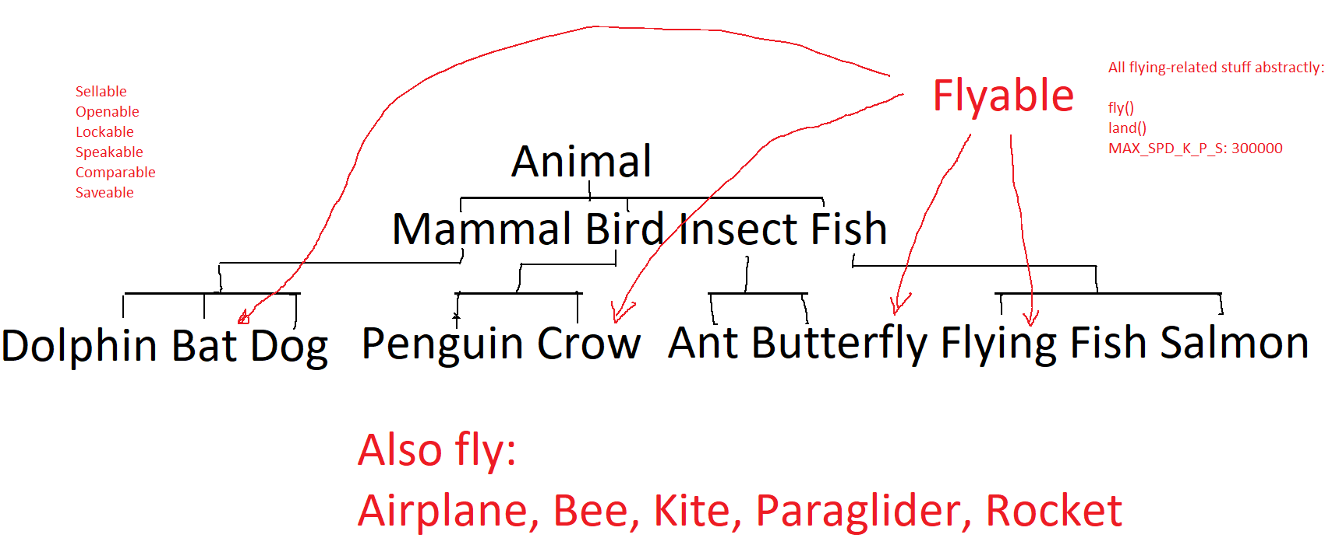
Outside of the class hierarchy

Slide 5
Inheritance: interfaces
An abstract class cannot have objects instantiated of it
An abstract class can be very useful; it is an idea; put common methods and data there
An abstract method has no body: it has only a method signature
An interface is (in general) a set of abstract methods and public static final data
An interface can also have default (concrete) methods
A class can implement zero, one, or more interfaces
That class must (a) implement all abstract methods and/or (b) be abstract itself

Slide 6
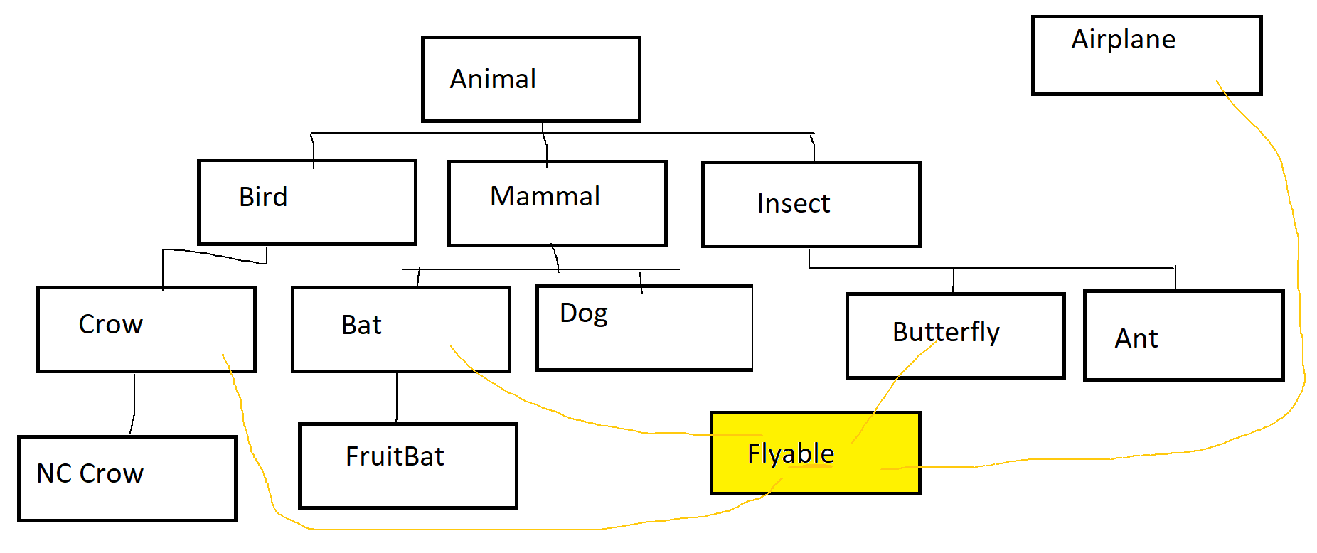

Slide 7
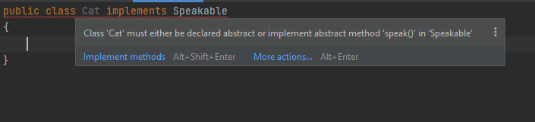
Inheritance: interfaces
public interface Speakable
{
public static final int MAX_DB = 194;
public abstract void speak();
void whisper(); // still public and abstract
default int getSilenceLevel()
{
return 0;
}
}
class Cat implements Speakable { }

Slide 8
Inheritance: interfaces
public interface Speakable
{
public static final int MAX_DB = 194;
public abstract void speak();
void whisper(); // still public and abstract
default int getSilenceLevel()
{
return 0;
}
}
public class Cat implements Speakable
{
@Override
public void speak()
{
System.out.println("MEOW");
}
@Override
public void whisper()
{
System.out.println("mew");
}
// optionally can Override getSilenceLevel() also
}

Slide 9
Inheritance: parent classes
Any non-final class (“parent class aka. super class”) can be extended by another class (“child class aka sub class”).
The parent’s non-private data and methods are inherited by the child
The child’s constructor(s) must call one of its parent’s constructors with the proper parameters, by calling super() as its first instruction (see next slide)

Slide 10
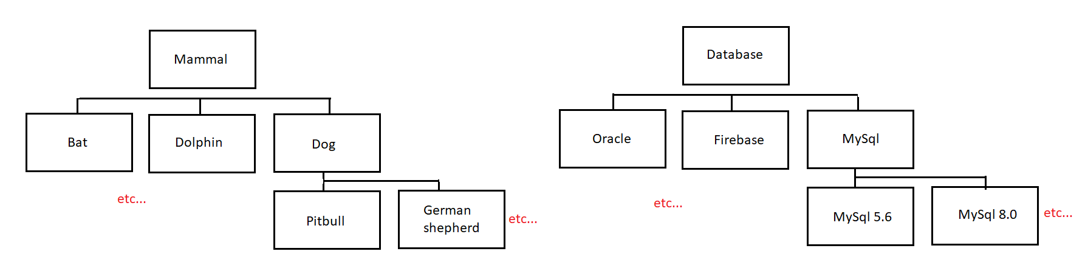
Inheritance: parent classes
Many of these classes would be abstract
Parent classes would have the common methods: speak(), move(), query(), etc….

Slide 11
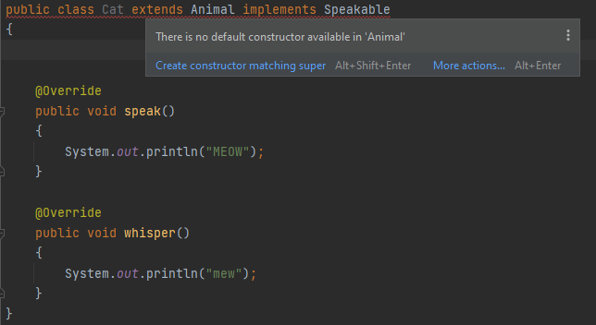
Inheritance: parent classes
abstract class Animal // abstract: Animal is only an *idea*
{
private final int yearBorn;
Animal(final int yearBorn)
{
this.yearBorn = yearBorn;
}
public int getYearBorn()
{
return yearBorn;
}
}
class Cat extends Animal implements Speakable { }

Slide 12
Inheritance: parent classes
abstract class Animal // abstract: Animal is only an *idea*
{
private final int yearBorn;
Animal(final int yearBorn)
{
this.yearBorn = yearBorn;
}
public int getYearBorn()
{
return yearBorn;
}
}
public class Cat extends Animal implements Speakable
{
private final boolean spayedNeutered;
public Cat(final int yearBorn, final boolean spayedNeutered)
{
super(yearBorn);
this.spayedNeutered = spayedNeutered;
}
@Override
public void speak()
{
System.out.println("MEOW");
}
@Override
public void whisper()
{
System.out.println("mew");
}
public boolean isSpayedNeutered()
{
return spayedNeutered;
}
}

Slide 13
substitution
Speakable: interface
Animal: abstract class, implements Speakable
Cat: extends Animal
Cat therefore also implement Speakable methods (or be abstract itself)
import java.util.ArrayList;
import java.util.List;
class Veterinarian
{
List<Animal> animals; // want to declare as the Interface type
Veterinarian()
{
animals = new ArrayList<>(); // ArrayList is a List
animals.add(new Cat(2020, true)); // Cat is an Animal
animals.get(0).speak(); // all Animals speak() and whisper()
in this example, the Animal will MEOW
}
}

Slide 14
Guaranteed Methods
public static void main(final String[] args)
{
List<Movable> movables;
movables = new ArrayList<>();
movables.add(new Car());
movables.add(new Dolphin());
for(Movable m: movables)
{
m.move();
m.stop();
}
}

Slide 15
Comparable
Override compareTo
Return a positive int if “this” is “bigger than” the parameter
Return a negative int if “this” is “small than” the parameter
Return 0 if “this” is “equal to” the parameter
Collections.sort() can use this information

Slide 16
Using compareto again
public class Max
{
public static void main(final String[] args)
{
Integer[] ints = {5, 44, 321, -6, 0, 31, 34, 300};
Character[] chars = {'a', 'g', 'z', 'w', 't'};
Double[] doubles = {5.5, 44.44, 321.321, -6.6, 0.0, 31.31, 34.34, 300.3};
Dog[] dogs = {new Dog(20, 2000), new Dog(14, 2014), new Dog(17, 2017)};
String[] strings = {"hello world", "the end", "how are you", "whatever", "bye"};
System.out.println(getMax(ints));
System.out.println(getMax(chars));
System.out.println(getMax(doubles));
System.out.println(getMax(dogs));
System.out.println(getMax(strings));
}
static <T extends Comparable<T>> T getMax(final T[] a) {
T max = a[0];
for(T i: a) {
if(i.compareTo(max) > 0) {
max = i;
}
}
return max;
}
/*
static int getMax(final int[] a) {
int max = a[0];
for(int i: a) {
if(i > max) {
max = i;
}
}
return max;
}*/
}

