Slide 1
Feature Engineering Using Snowflake and Feature Stores

Slide 2
agenda
1. Introduction to Feature Engineering
2. Using Snowflake for Data Storage & Processing
3. Feature Store Concepts
4. Implementing Feature Engineering with Snowflake & Feature Store
5. Practical Task

Slide 3
Introduction to Feature Engineering
What is Feature Engineering?
Feature engineering is the process of taking raw data and turning it into meaningful information that a machine learning model can use.
Think of it like making ingredients ready before cooking. Raw data is like raw vegetables; feature engineering is chopping, cleaning, and preparing them to make a tasty dish.
Why is it important?
Better features → better machine learning predictions.
Without good features, even smart algorithms may fail.
Types of Feature Engineering:
Normalization/Scaling:
Makes numbers smaller or bigger so they’re all in the same range.
Example: Test scores from 0-100 → 0-1 scale.
Encoding Categorical Data:
Convert words into numbers.
Example: "Red", "Green", "Blue" → 0, 1, 2.
Aggregations:
Summarize data over time or groups.
Example: Average attendance over a semester.
Time-based Features:
Extract useful information from dates or times.
Example: Day of week, month, season.

Slide 4
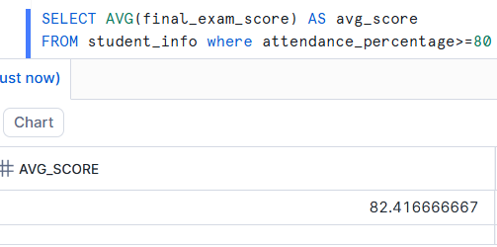
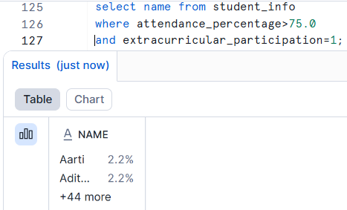
Using Snowflake for Data Storage & Processing
What is structured data?
Data organized in rows and columns, like a spreadsheet. Each column has a defined data type.
How Snowflake stores structured data:
Snowflake creates tables to hold this data.
You define the columns and their types when creating a table.
Snowflake automatically handles storage, indexing, and scaling.
SQL queries can be used to insert, update, delete, or read data efficiently.
What is semi-structured data?
Data that does not fit neatly into rows and columns. Often has nested structure, may vary from record to record.
How Snowflake stores semi-structured data:
Snowflake uses a special data type called VARIANT to store semi-structured data.
It can store JSON, XML, Avro, Parquet, or ORC in a single column.
Snowflake allows you to query and manipulate nested data using SQL without flattening it manually.
How Snowflake Integrates with Machine Learning Pipelines
Feature Extraction: Use SQL to select, filter, and aggregate raw data.
Feature Storage: Save engineered features in a table or feature store.
Model Training : ML models can read features directly using: Snowflake Python Connector Snowpark DataFrames
Prediction & Deployment: Once trained features computed, and predictions made without moving data to another platform.

Slide 5
Feature Store Concepts
What is a Feature Store?
A Feature Store is a place to save all your ready-to-use features so that multiple ML models can use them without recalculating.
Think of it like a pantry where you keep pre-chopped ingredients for many recipes.
Why do we need it?
Avoids repeating work.
Ensures consistent features for training and real-time predictions.
Popular Feature Stores:
Feature Store | Description
AWS SageMaker FS | Managed by Amazon, integrates with SageMaker ML.
Snowflake FS | Integrates directly with Snowflake, easy SQL access.
Databricks FS | Works well with big data pipelines in Databricks.

Slide 6
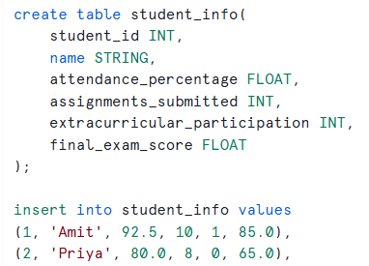
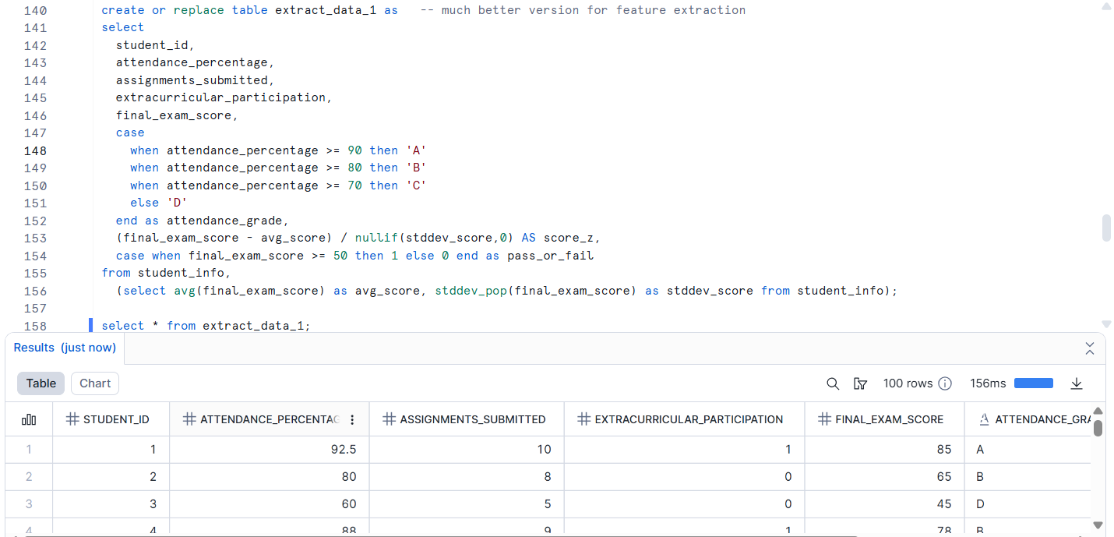
Implementing Feature Engineering with Snowflake & Feature Store
Top-Left: Table is created and values are inserted.
Top-middle: Average of final exam score is obtained with SQL query
Top-Right: Students who have attendance % >75 along with extracurriculars are retrieved
Bottom-right: It shows the Feature engg. Where name is excluded, new features like attendance_grade, z_score, pass or fail binary indicators are added as new labels. For z_score we are aggregating the scores.

Slide 7
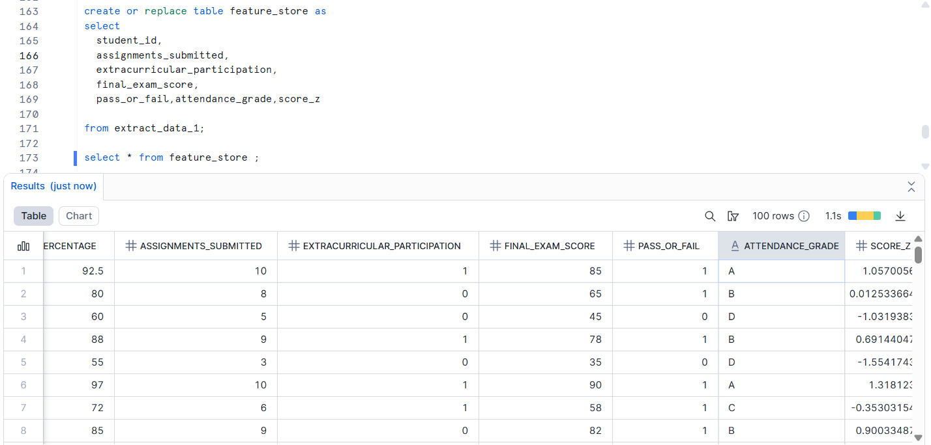
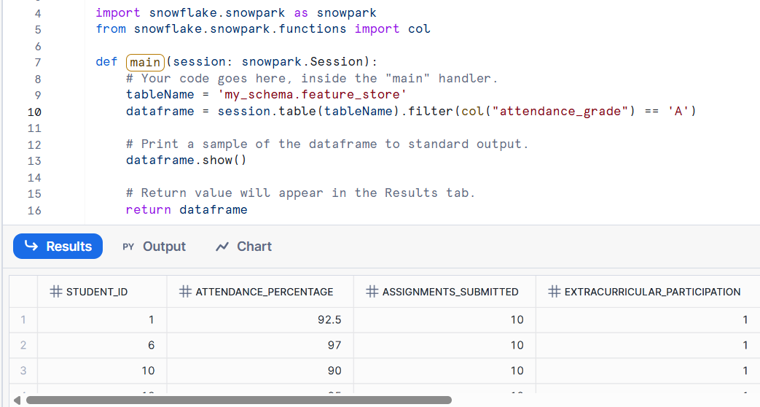
Top-Left: Selected features from original table along with the new labels are added to
table named feature_store. Adding our features to snowflask feature store is only possible if we take enterprise at the time of account creation. As I took standard, I had to create separate table for that.
Bottom-Left: This is the already existing code present in the python worksheet. We have to connect our ware house and required schema to this and install additional packages required to execute the code.
I just changed the table name and filter.
ML models read features directly from the Feature Store instead of recalculating them.
Ensures consistency, speed, and reusability.
Feature Store → Load Features → Train Model → Make Predictions

Slide 8
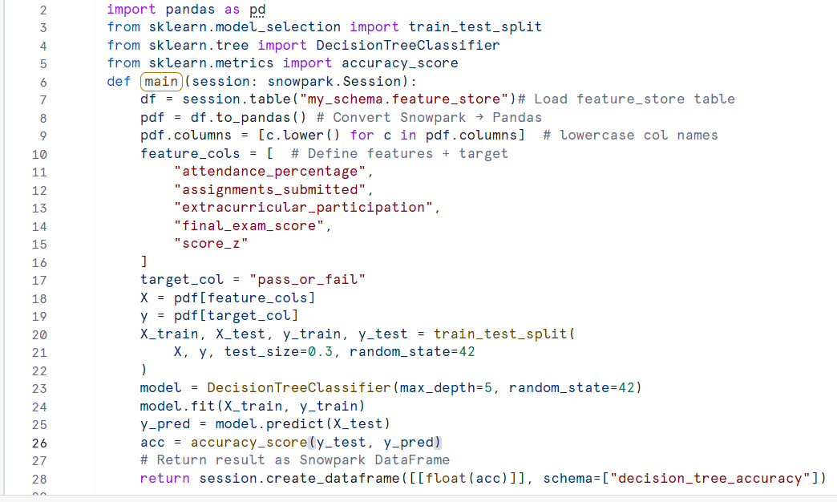
Practical Task
I used decision tree model to make use of the features.
First, we import all the necessary libraries and load our feature store.
Snow flask stores data in cloud(meant for mostly SQL) and decision tree uses data from local memory as numpy and pandas so we have to convert data frames here.
Choose a target feature and proceed with normal decision tree code and execution.
We get accuracy as output.

Slide 9
Thank you
Mounika Garnedi
22BCE9818
VIT
mounika.22bce9818@vitapstudent.ac.in
mounikagarnedi714@gmail.com

