Slide 1

BANKBOT_CHATBOT

Slide 2



PROJECT OVERVIEW
Intelligent Banking Assistance
BankBot is an advanced AI-powered chatbot designed to streamline banking interactions, offering a seamless and intuitive user experience for a variety of financial services.
Leverages sophisticated AI for natural language understanding.
Performs intent recognition and entity classification for precise responses.
Integrates securely with an SQLite database for data management.

Slide 3

MILESTONE 1
Objective: Understanding User Needs
1
2
Identify User Intent
Extract Key Entities
Accurately determine the user's goal from their banking queries.
Precisely pull out relevant information like amounts or account types.
3
Train & Validate
Develop and rigorously test the AI model for optimal performance.

Slide 4

MILESTONE 1
Intent Design & Training
Our AI model is meticulously trained on specific banking intents, ensuring the chatbot comprehends the user's request accurately.
Check Balance
Transfer Money
Find ATM
Card Block
Each intent includes multiple examples to enhance model robustness and accuracy.

Slide 5

MILESTONE 1
Precise Entity Classification
BankBot identifies and extracts critical entities from user queries, enabling personalized and accurate responses for banking transactions.
Account Type
Savings, Checking, Credit Card
Account Number
Unique identifier for accounts
Amount
Monetary value for transactions
Card Number
For blocking or inquiries
Action keywords further refine entity detection, and new entities can be easily integrated.

Slide 6
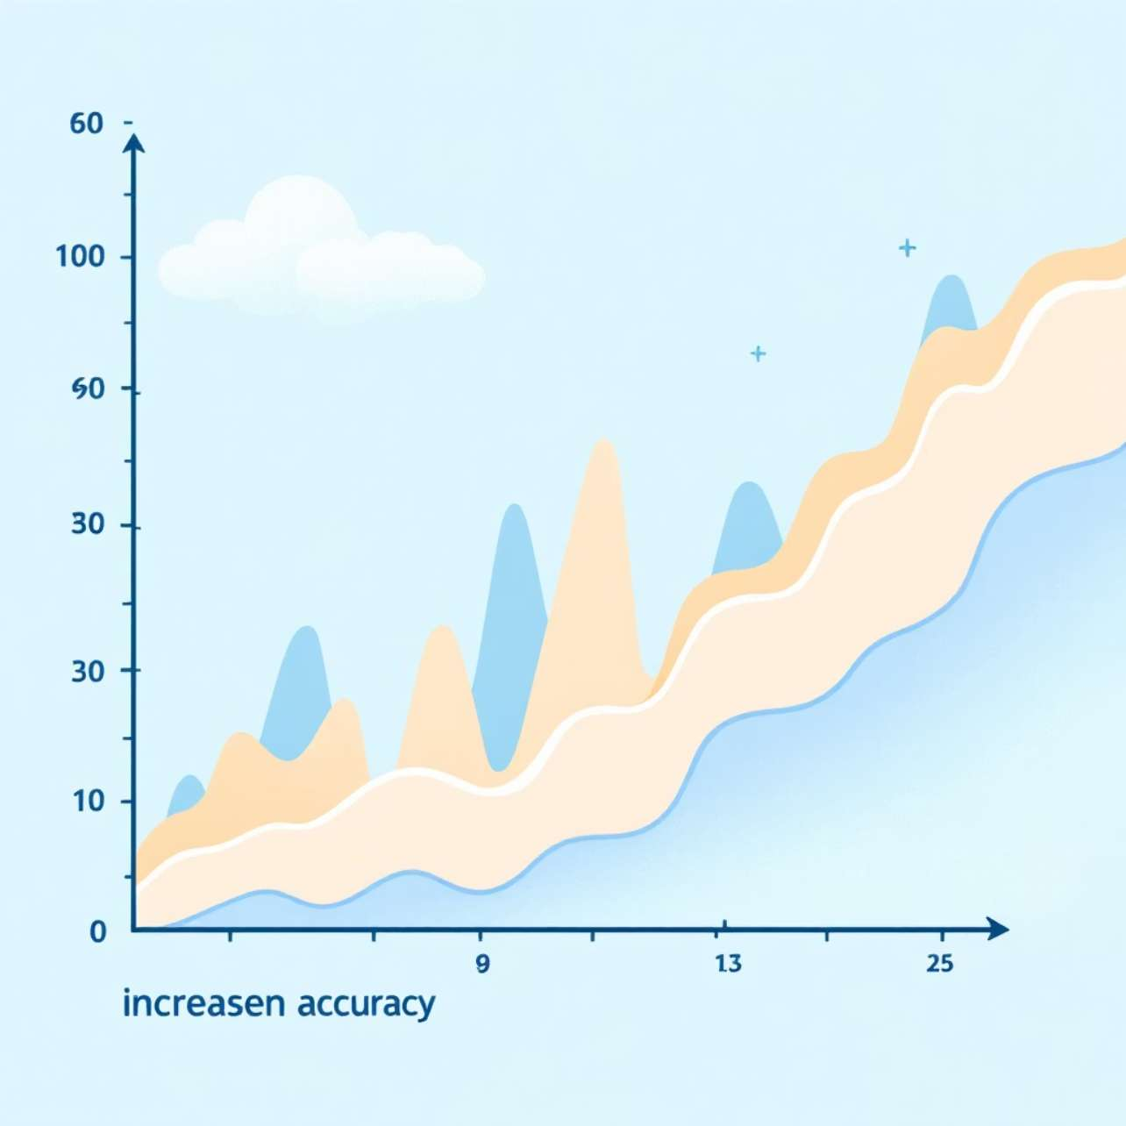
MILESTONE 1
Validation & Confidence
Dynamic adaptation: New intents and examples can be added.
Continuous improvement: Supports model retraining for enhanced performance.
Rigorous testing: Intent and entity predictions are thoroughly validated.
Accuracy metric: Confidence scores ensure reliability and precision.

Slide 7




MILESTONE 2
Objective: Conversational Flow & Data Integration
Build Conversation Flow
Design intuitive dialogue for each banking intent.
Create Intent Pipeline
Develop dedicated processing pipelines for seamless execution.
Integrate SQLite Database
Establish robust connection for secure data access and management.

Slide 8

MILESTONE 2
Pipeline Architecture
User Query
Intent
Entity Extraction
Pipeline Execution
This architecture ensures efficient processing of user requests, from initial query to final database interaction, supporting personalized multi-account management.

Slide 9
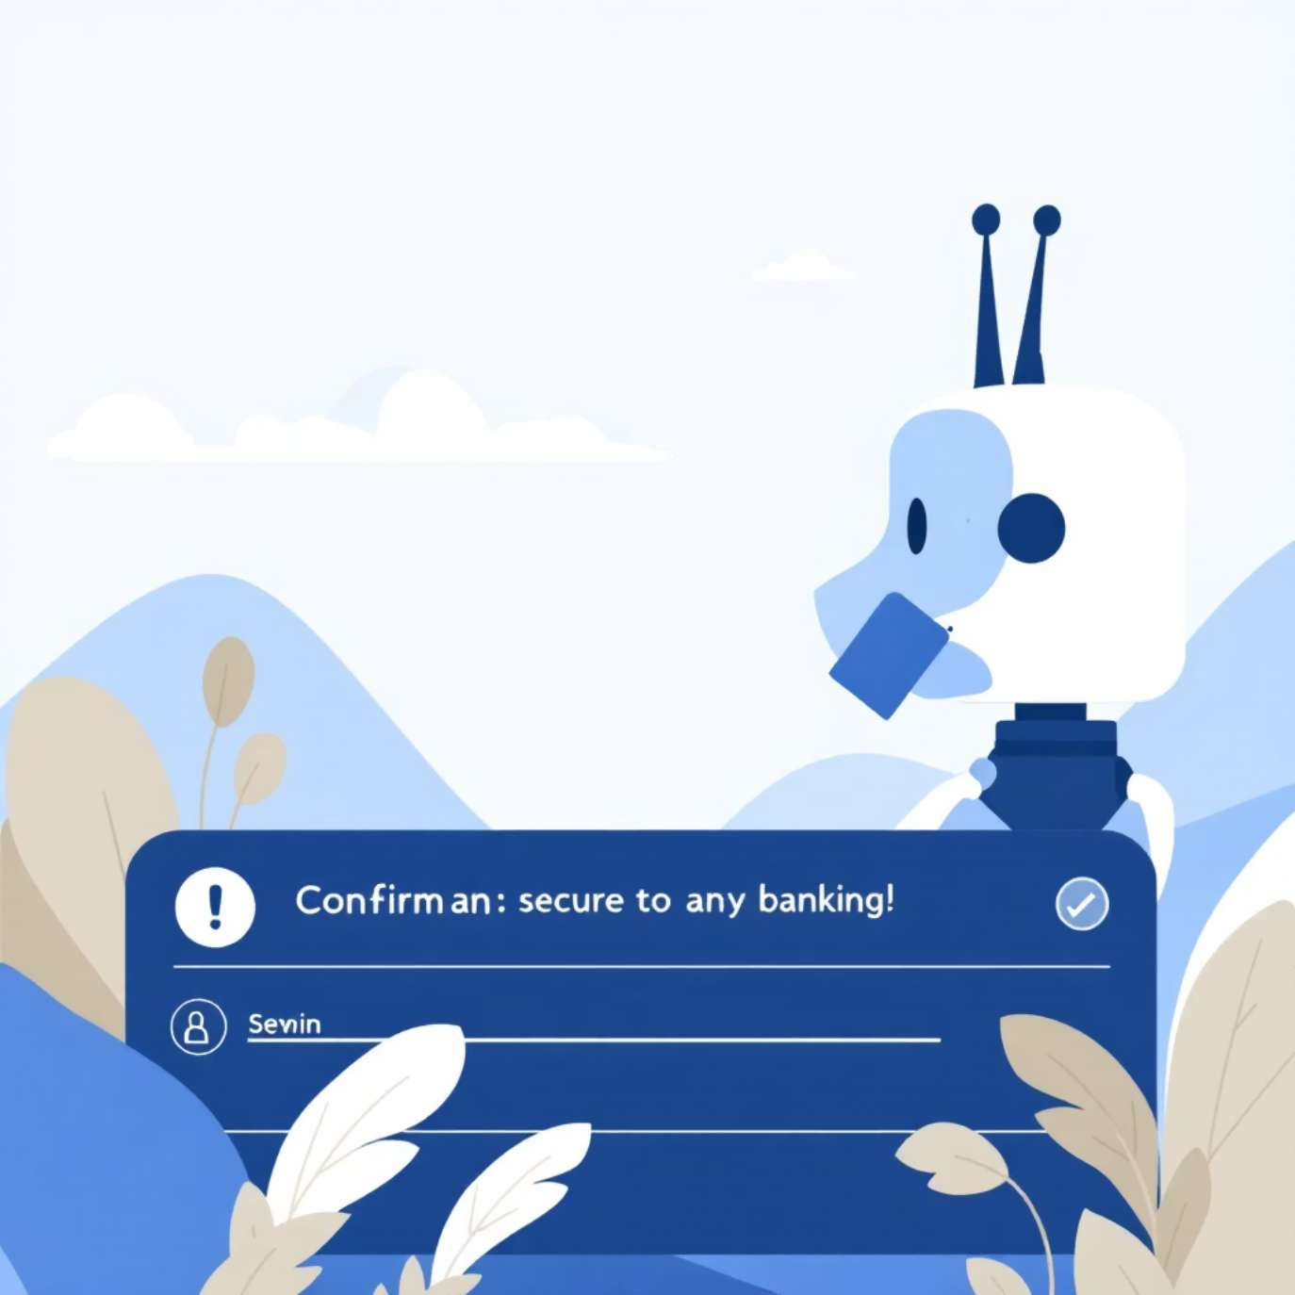



MILESTONE 2
Enhanced Chatbot Features
Double Confirmation
Ensures security for sensitive transactions.
Account Dropdown
Seamless selection of available user accounts.
Card Removal
Securely removes blocked cards from the database.

Slide 10
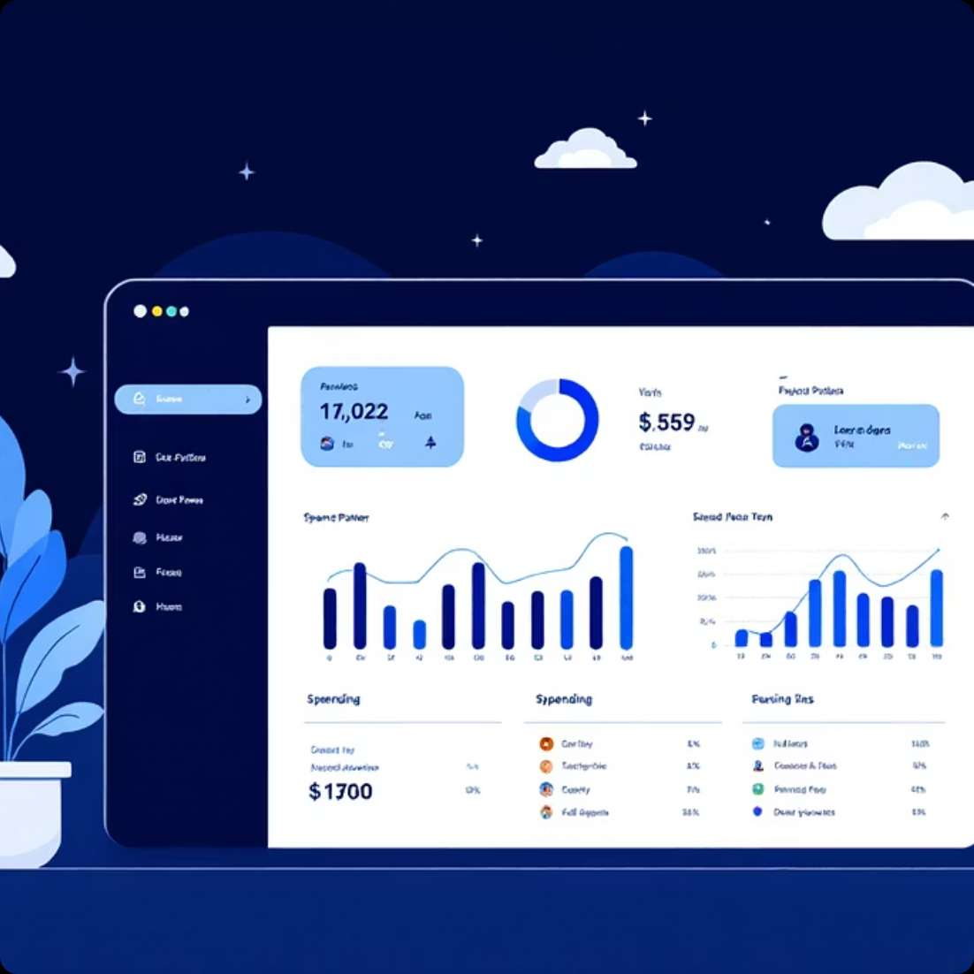


MILESTONE 2
Analytics & Robust Outcomes
Spending Analytics
Real-time Updates
Stable & Secure
Insights derived from transaction data for financial oversight.
Database reflects changes instantly for up-to-date information.
Ensures a reliable and protected conversational environment.

Slide 11

MILESTONE 3
LLM Integration: Objective
Broadened Scope
1
Handle non-banking specific user queries.
Seamless Integration
2
Integrate LLM into existing chatbot architecture.
Core Preservation
3
Preserve and protect existing banking intent pipelines.

Slide 12
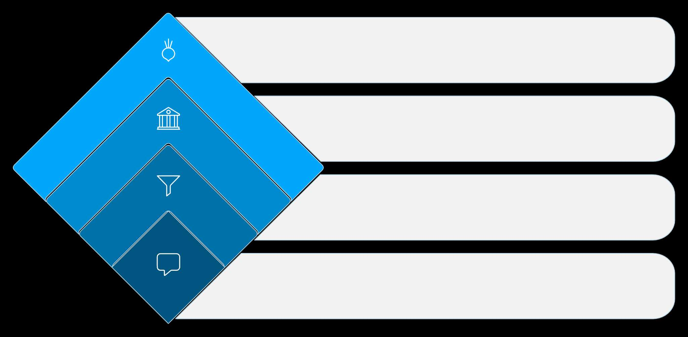





MILESTONE 3
Decision Logic Flow
Non-Banking Query
Forward to LLM model
Banking Query
Go to banking pipeline
Intent Classifier
Route by intent
User Query
Incoming user request
Intent Classification
Banking Path
LLM Path
User query first routed through an intelligent intent classifier.
Banking-related queries are directed to the specialized banking pipeline.
Non-banking queries are forwarded to the LLM model for processing.

Slide 13
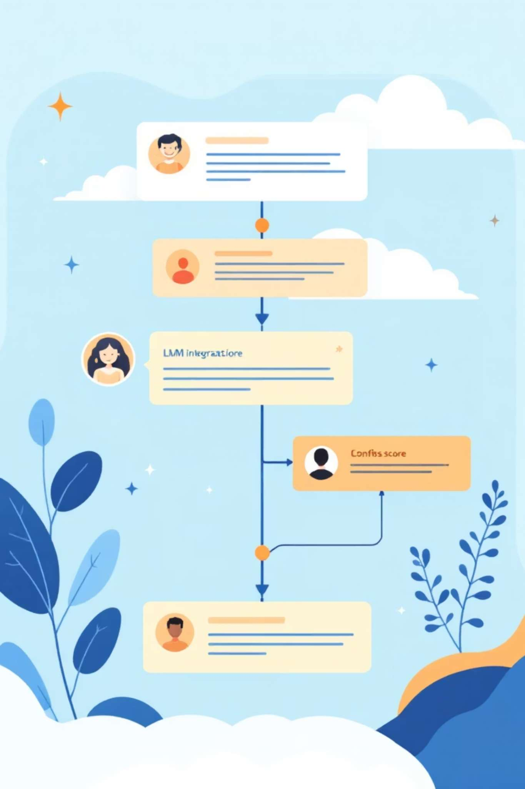
MILESTONE 3
Dynamic Integration Flow
01
02
Confidence Check
LLM Hand-off
Intent confidence score evaluated after initial classification.
Low confidence or non-banking queries are seamlessly directed to the LLM.
03
Unified Response
A coherent, single response is generated and returned to the user.

Slide 14




MILESTONE 3
Hybrid Architecture Outcome
Hybrid Architecture
Enhanced Flexibility
Seamless blend of rule-based and LLM-powered responses.
Improved conversational capabilities for diverse user inputs.
Robust System
Banking Integrity
A more adaptable and resilient chatbot solution.
No adverse impact on critical banking operations or security.

Slide 15
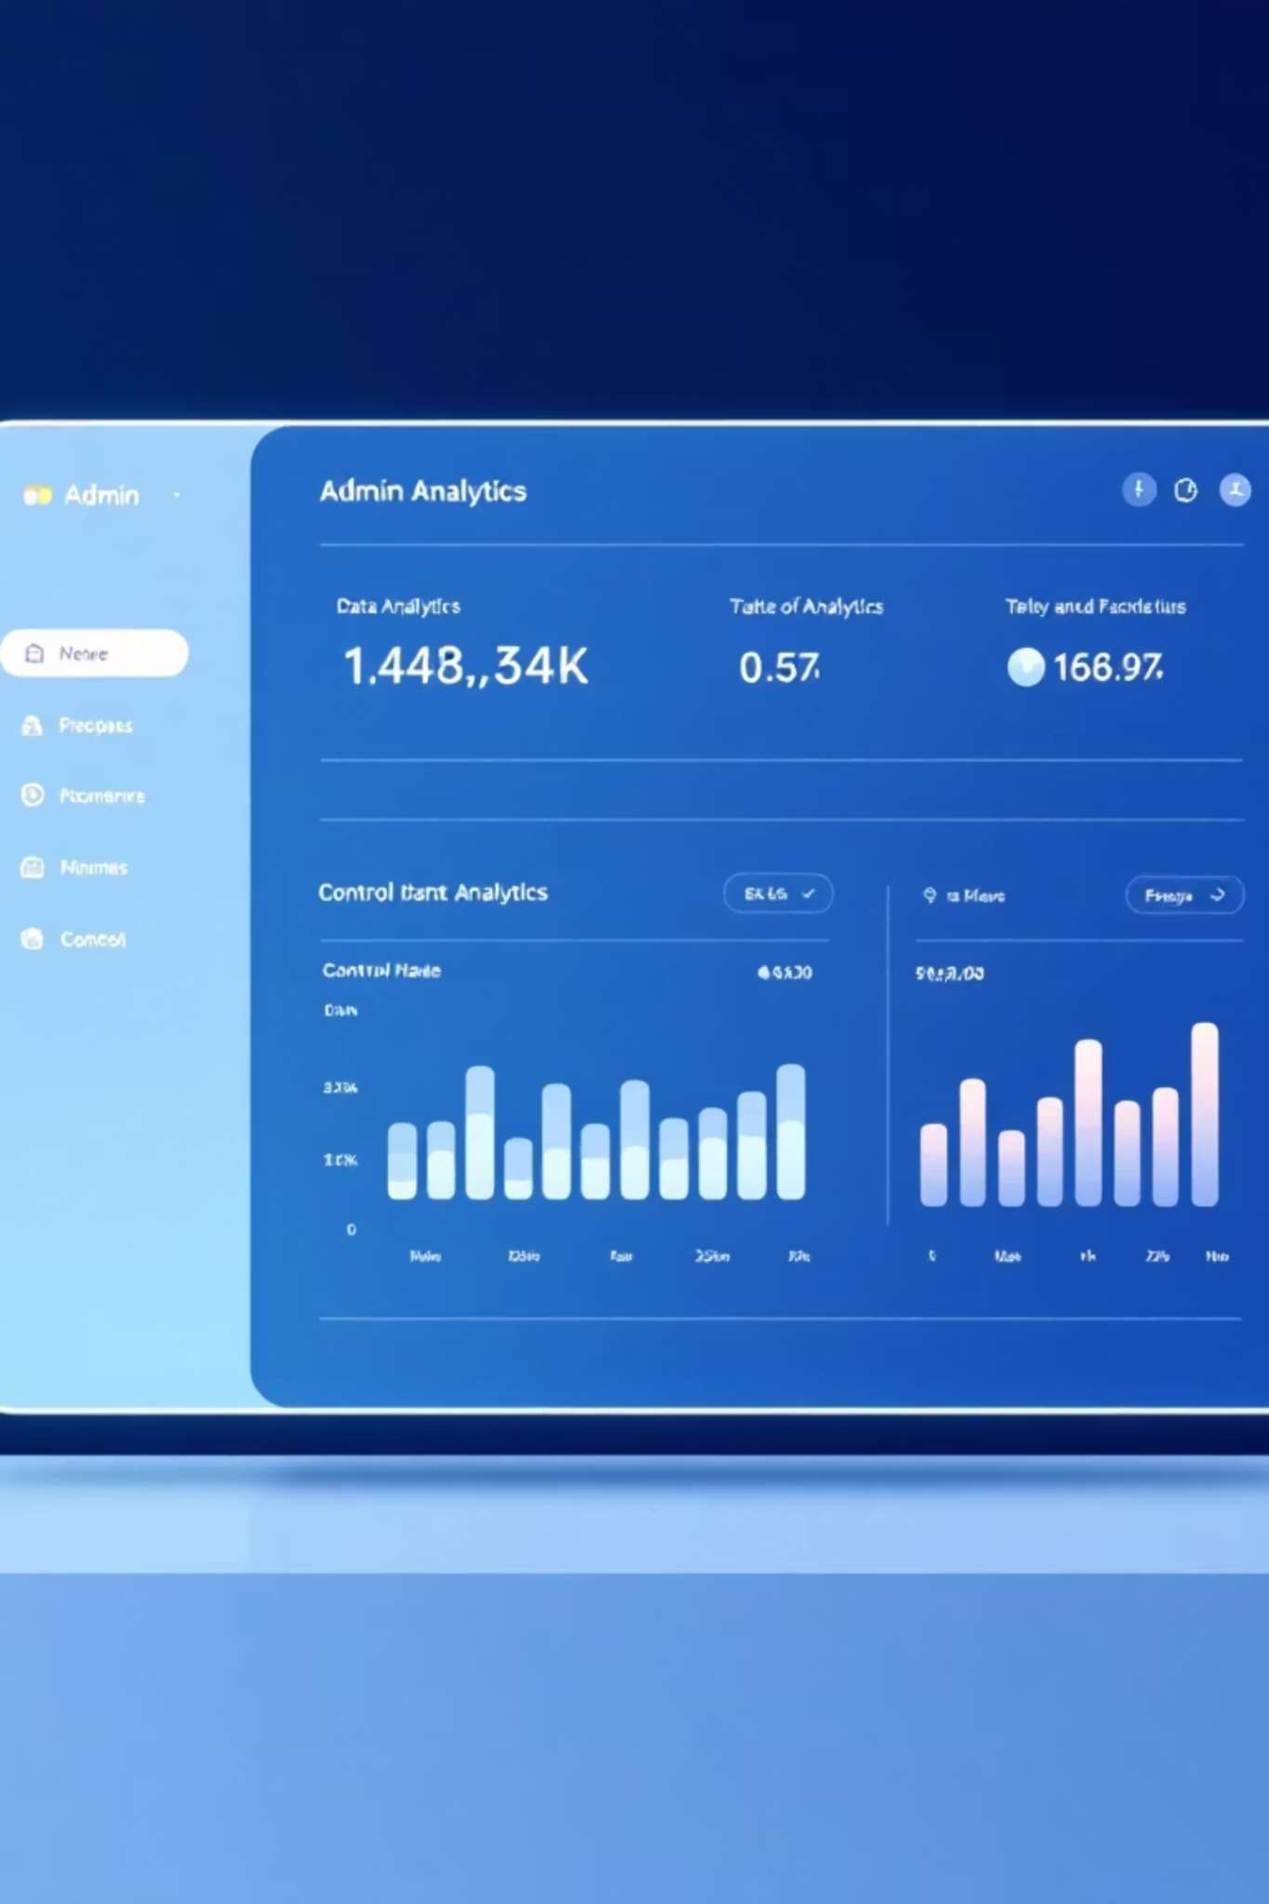
MILESTONE 4
Admin Panel & Analytics: Objective
Dashboard Creation
1
Develop a comprehensive admin dashboard.
Activity Monitoring
2
Enable real-time tracking of chatbot interactions.
Data Management
3
Facilitate training data and intent management.

Slide 16

MILESTONE 4
Chat History & Confidence Tracking
1
Timestamped History
Detailed chat logs with precise timing for each interaction.
2
Confidence Scores
Visibility into the AI's confidence levels for intent predictions.
3
Intent-wise Tracking
Comprehensive history organized by predicted intent.
4
Interaction Insights
Identify patterns and areas for improvement in user interactions.

Slide 17
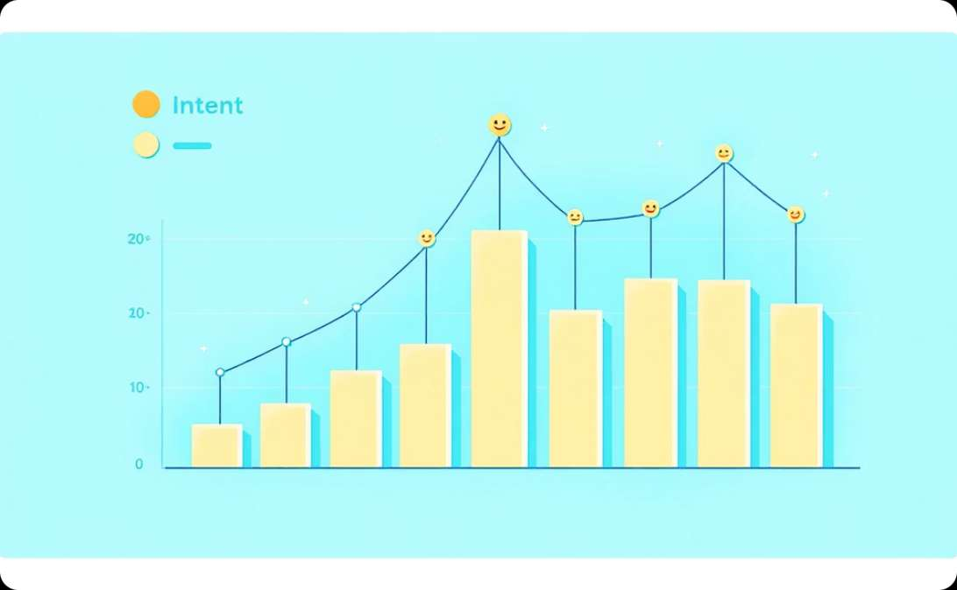
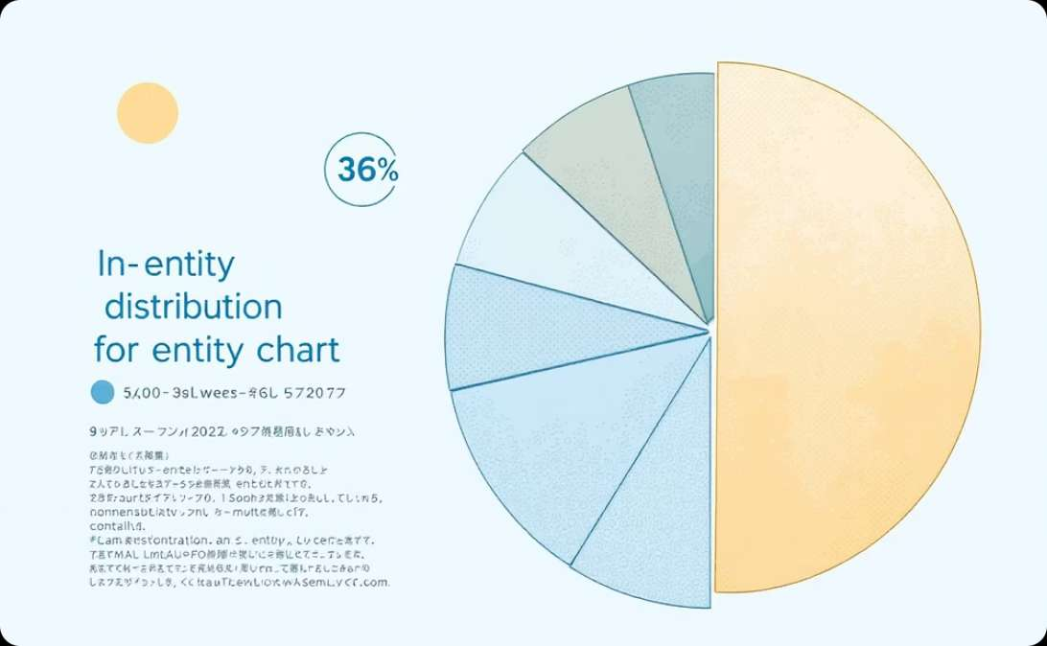
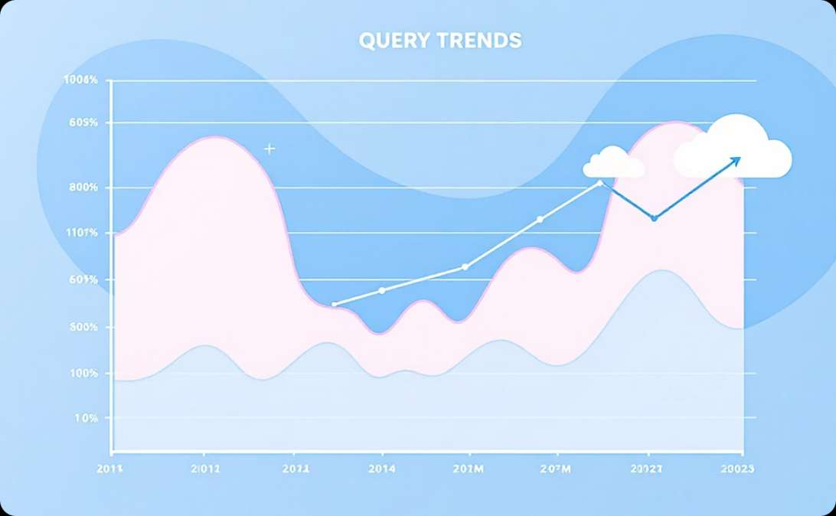
MILESTONE 4
Analytics Dashboard Visualizations
Intent-wise Analytics
Entity-wise Analytics
Time-wise Analytics
Breakdown of interactions by recognized user intents.
Analysis of extracted entities across user queries.
Visualize user query trends and system performance over time.
Visual dashboards provide actionable insights into chatbot performance.

Slide 18

MILESTONE 4
Training & Control Features
1
Intent Management
2
Training Data Editor
Ability to add and define new intents for expanded functionality.
Add and refine training examples to improve model accuracy.
3
Model Retraining
4
Training History
Initiate model retraining cycles with updated data for continuous improvement.
View detailed history of training sessions and model versions.

Slide 19
THANKYOU

