Slide 1

VELALAR COLLEGE OF ENGINEERING AND TECHNOLOGY
(AUTONOMOUS)
(Accredited By NAAC with ‘A+’ Grade)
Intelligent Human Expression Recognition System and Characterization using Facial Features
Presented By MONIKKA R (732919CSR061) MADHUNISHA PK (732919CSR055) MALAVIKAJ (732919CSR056)
Project Guide
Mrs R VIDHYA
Assistant Professor/CSE

Slide 2
Abstract
Human Beings express Emotions in Day to Day Interactions. Understanding Emotions and Knowing how to React to People’s Expressions greatly enriches the interaction.
Facial Expressions are the facial changes in response to persons.
Internal Motion State, Intentions, Social Communication
Facial Detection is Based on Image Processing and Computer Vision Techniques.
Expression Recognized using SVM, Face API (open source).
The Algorithm consists of three main Stages:
Image Preprocessing
Facial Feature Extraction
Emotion Detection.

Slide 3
System Specification
Processor Type : Intel i3
Speed : 3.40GHZ
RAM : 4GB DD2 RAM
Hard disk : 500 GB
Keyboard : 101/102 Standard Keys
Mouse : Optical Mouse
Webcam : Standard Web Cam
Operating System : Windows 10/ Windows 11
Environment : Visual Studio
Software : Node JS, Face API

Slide 4
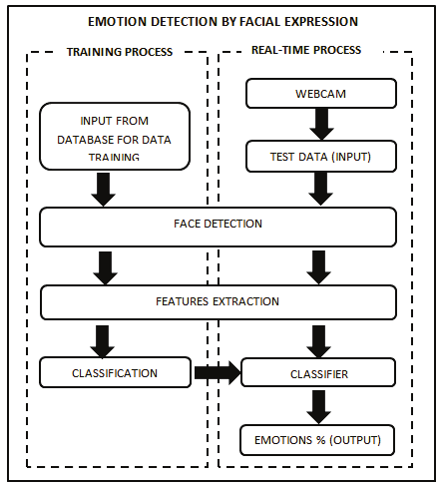
System Architecture

Slide 5
Module Description
Home Module
Interaction Module
Data Collection
Data Cleaning
Data Pre-processing
Result Module

Slide 6

Home Module
Home module contains a small tab where we can preview the web camera and ask permissions for camera.

Slide 7
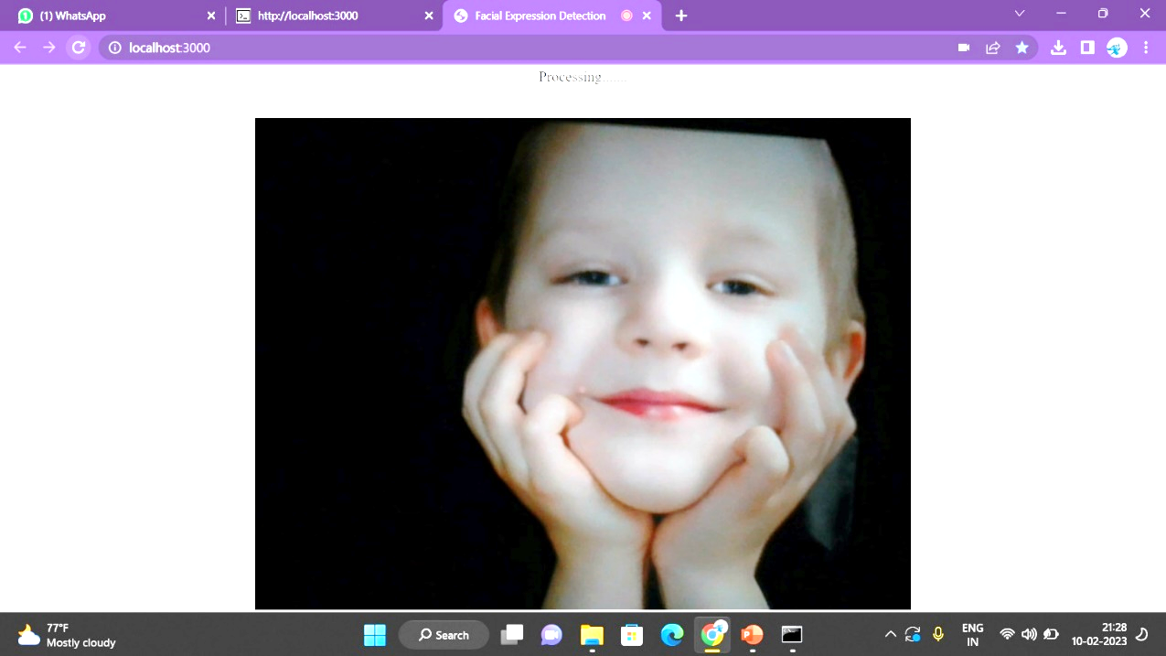
Interaction Module
In Interaction module we can record the live video and perform Data collection, Data Cleaning, Data Pre-process the live video in background.

Slide 8
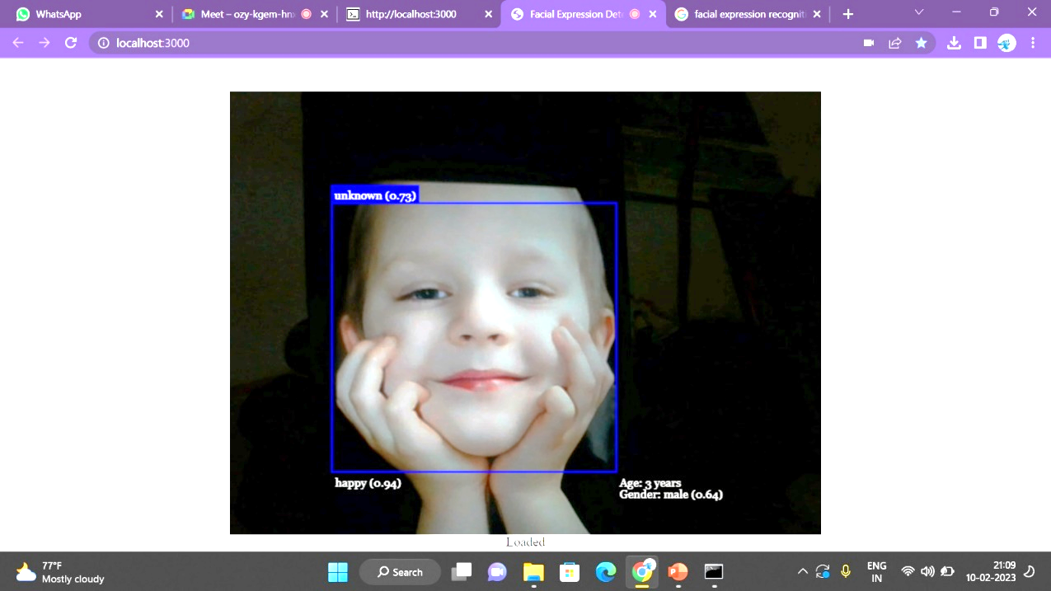
Result Module
Result module is the page where the output is displayed with the help of Face API where the Trained dataset is compared with Live video and display the Result.

Slide 9
Sample Coding
var express = require('express');
var path = require('path');
var favicon = require('serve-favicon'); var cookieParser = require('cookie-parser');
var bodyParser = require('body-parser');
var hbs=require('express-handlebars');
var index = require('./routes/index');
var app = express();
app.engine('hbs', hbs({extname:'hbs', defaultLayout:'layout', layoutDir:__dirname+'/views/layouts/'}));
app.set('views', path.join(__dirname, 'views'));
app.use(bodyParser.json());
app.use(bodyParser.urlencoded({ extended: false }));
app.use(cookieParser());
app.use(express.static(path.join(__dirname, 'public')));
app.use(express.static('public/images'));
app.use('/facedetection',express.static('public'));
app.use('/ageandgender',express.static('public'));
app.use('/', index);
app.use(function(req, res, next) {
var err = new Error('Not Found');
err.status = 404;
next(err);
});
app.use(function(err, req, res, next) {
res.locals.message = err.message;
res.locals.error = req.app.get('env') === 'development' ? err : {};
res.status(err.status || 500);
res.render('error');
});
module.exports = app;

Slide 10
References
Bettadapura, V. (2021). Face expression recognition and analysis: the state of the art. arXiv preprint arXiv:1203.6722.
Shan, C., Gong, S., & McOwan, P. W. (2016, September). Robust facial expression recognition using local binary patterns. In Image Processing, 2005. ICIP 2005. IEEE International Conference on (Vol. 2, pp. II-370). IEEE.
Bhatt, M., Drashti, H., Rathod, M., Kirit, R., Agravat, M., & Shardul, J. (2020). A Studyof Local Binary Pattern Method for Facial Expression Detection. arXiv preprint arXiv:1405.6130.
Chen, J., Chen, Z., Chi, Z., & Fu, H. (2019, August). Facial expression recognition based on facial components detection and hog features. In International Workshops on Electrical and Computer Engineering Subfields (pp. 884-888).
Ahmed, F., Bari, H., & Hossain, E. (2018). Person-independent facial expression recognition based on compound local binary pattern (CLBP). Int. Arab J. Inf. Technol., 11(2), 195-203.
Happy, S. L., George, A., & Routray, A. (2021, December). A real time facial expression classification system using Local Binary Patterns. In Intelligent Human Computer Interaction (IHCI), 2012 4th International Conference on (pp. 1-5). IEEE.

Slide 11


Slide 12
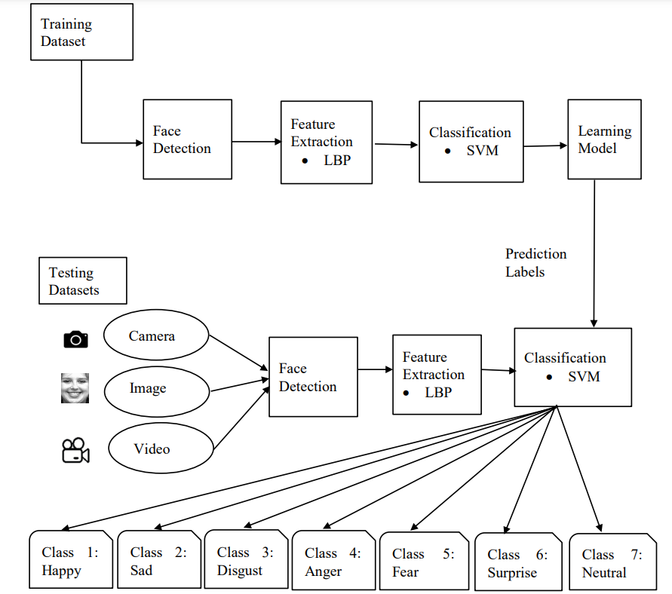
System
Architecture

Slide 13
Module Description
There are Three Modules for the project
Dataset preprocessing
There are 4 methods for pre-processing step:
Face detection & cropping, resize, adding noise, and normalizations.
It aims to remove background and non-face areas, then crop the face area.
Face detection
Face detection stage processes the facial images, without human intervention to find the face region from the input images or sequences

Slide 14
Module Description
Feature extraction
After face is positioned, the next step is to extract discriminative information caused by facial expressions.
Classification based on the features
Facial expression recognition is the last stage of the systems. The classifications of features involve the training of various emotional models to perform the classification appropriately and it shows the results.

Slide 15
Project Domain- Artificial Intelligence
The ability of A digital computer or computer-controlled robot to perform tasks commonly associated with intelligent beings.
Machine Learning is a growing technology which enables computers to learn automatically from the past data sets.
Facial recognition is a category of biometric software that maps an individual’s facial features and stores the data as a face print.

Slide 16
Objectives
The main objective of this project is to find an emotion detection from the live video.
From the Live video we can also detect Age as well as Gender.
We can implement this project in chatbot inside the car or public malls or Airports to detect the emotion of the people and create a better chatting experience.
Also, we can implement this in systems which can adapt their responses and behavioral patterns according to the emotions of the humans and make the interaction more natural.

Slide 17
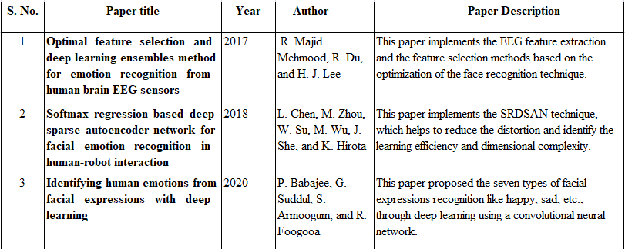
Literature Review

Slide 18
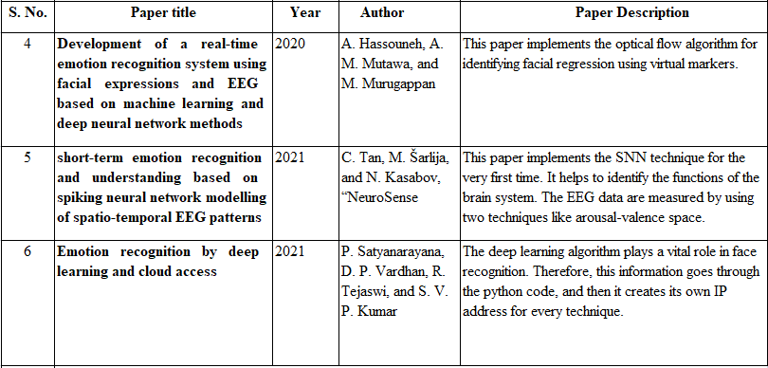
Literature Review

Slide 19
Existing System
Facial Emotion Recognition is a system to determine human facial expressions.
Movements of individual facial muscles are slightly different from instant changes in facial appearance.
DISADVANTAGES:
The accuracy of emotion recognition is low.
It focus on recognizing the peak high-intensity expression and ignore lower-intensity expressions. This leads to inaccurate recognition of emotion.
Surroundings and body posture can provide the same amount of information on emotions as a face.

Slide 20
Proposed System and Advantages
This system will work on detecting emotions from live video footage.
We will work on how to make the system more efficient so that it works on bright background or for people with darker skin.
ADVANTAGES:
The work is to increase the efficiency of emotion recognition systems in terms of Accuracy.
Adding more emotions to detect is one of my future plans as it will only detected four emotions in the existing system.

