Slide 1
Deepfake image detection
Custom CNN versus EfficientNet-B0
NNDL project | Final results and demonstration

Slide 2
Task and dataset
Binary classification of face images: FAKE or REAL
Training: 8,000 images (4,000 per class)
Validation: 1,000 images (500 per class)
Held-out test: 1,000 images (500 per class)
The integrity report found no corrupt images or exact duplicates crossing splits.

Slide 3
Two models, one test set
Custom CNN
EfficientNet-B0
Trained from scratch
224 × 224 input
AdamW and early stopping
11 logged epochs
ImageNet transfer learning
Classifier head, then feature fine-tuning
Best validation-loss checkpoint
25 logged epochs

Slide 4
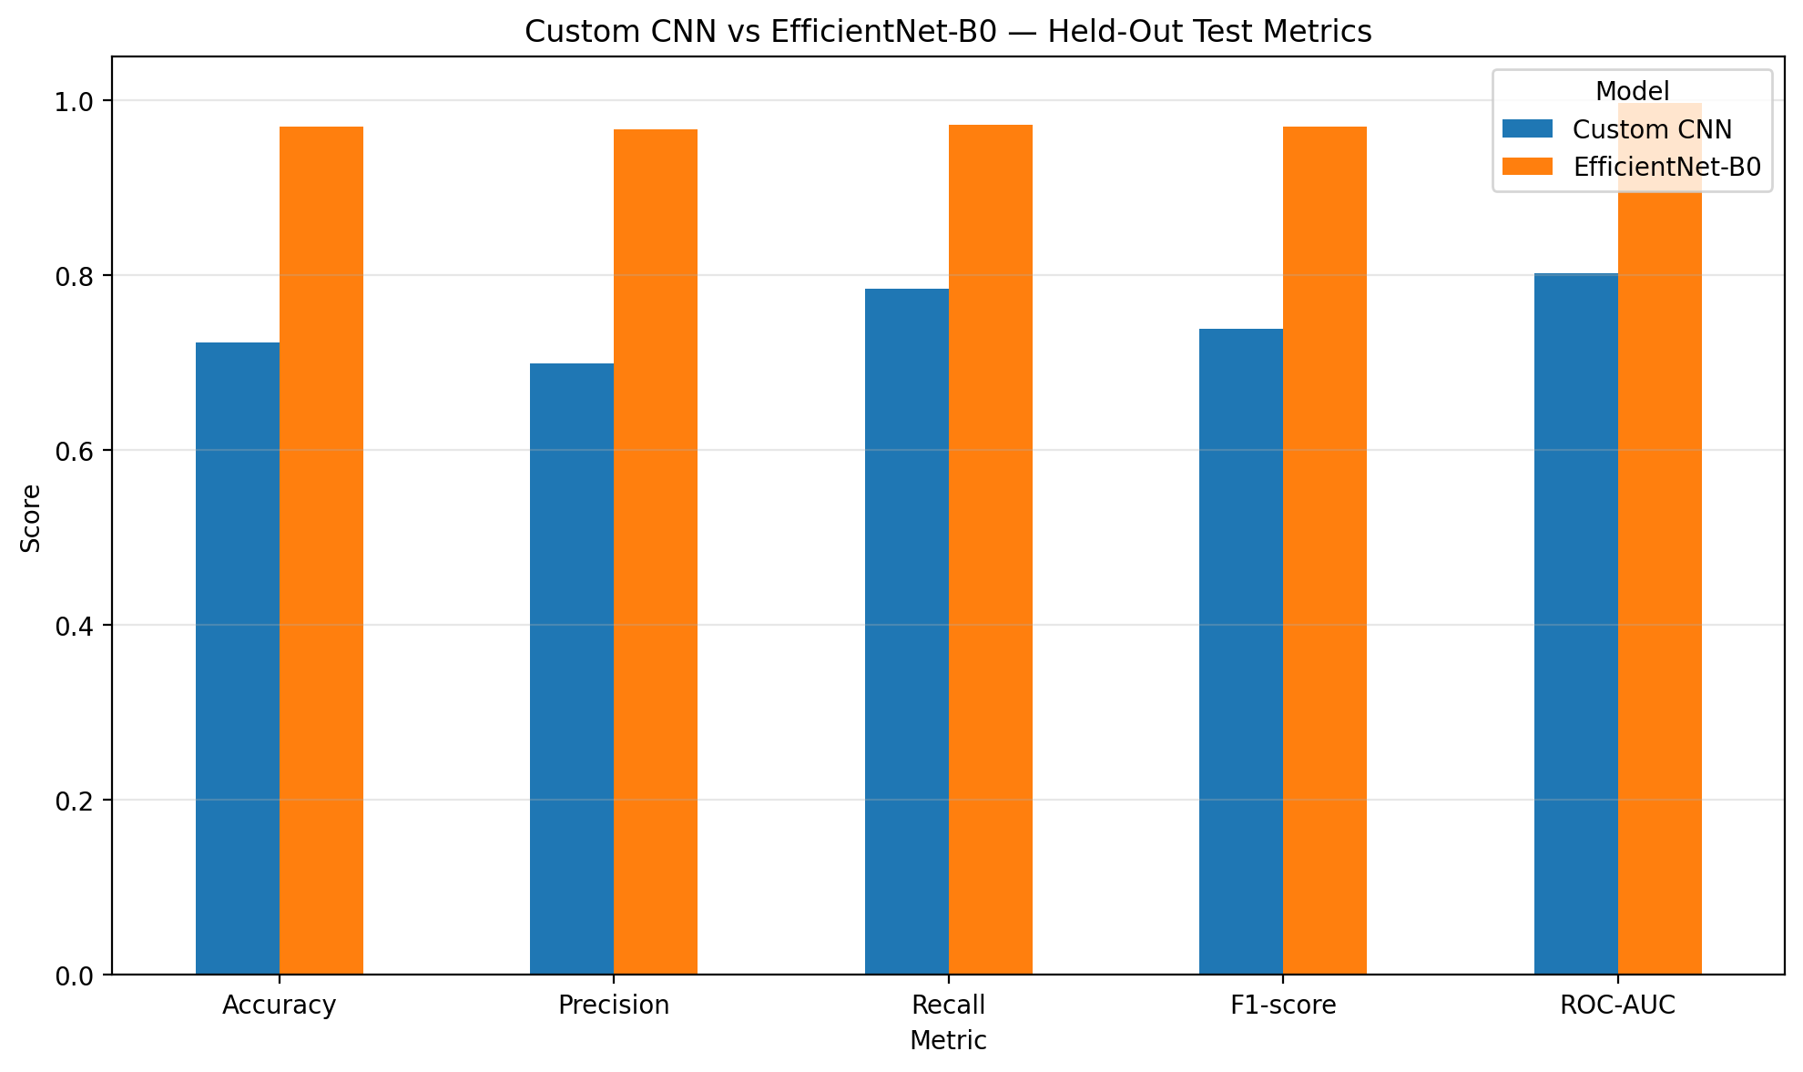
EfficientNet leads on every metric
Held-out test set; FAKE is the positive class

Slide 5
96.9% accuracy on the held-out test set
EfficientNet-B0
Custom CNN
Accuracy 96.9%
Precision 96.6%
Recall 97.2%
F1 96.9%
ROC-AUC 0.9963
Accuracy 72.3%
Precision 69.9%
Recall 78.4%
F1 73.9%
ROC-AUC 0.8018

Slide 6
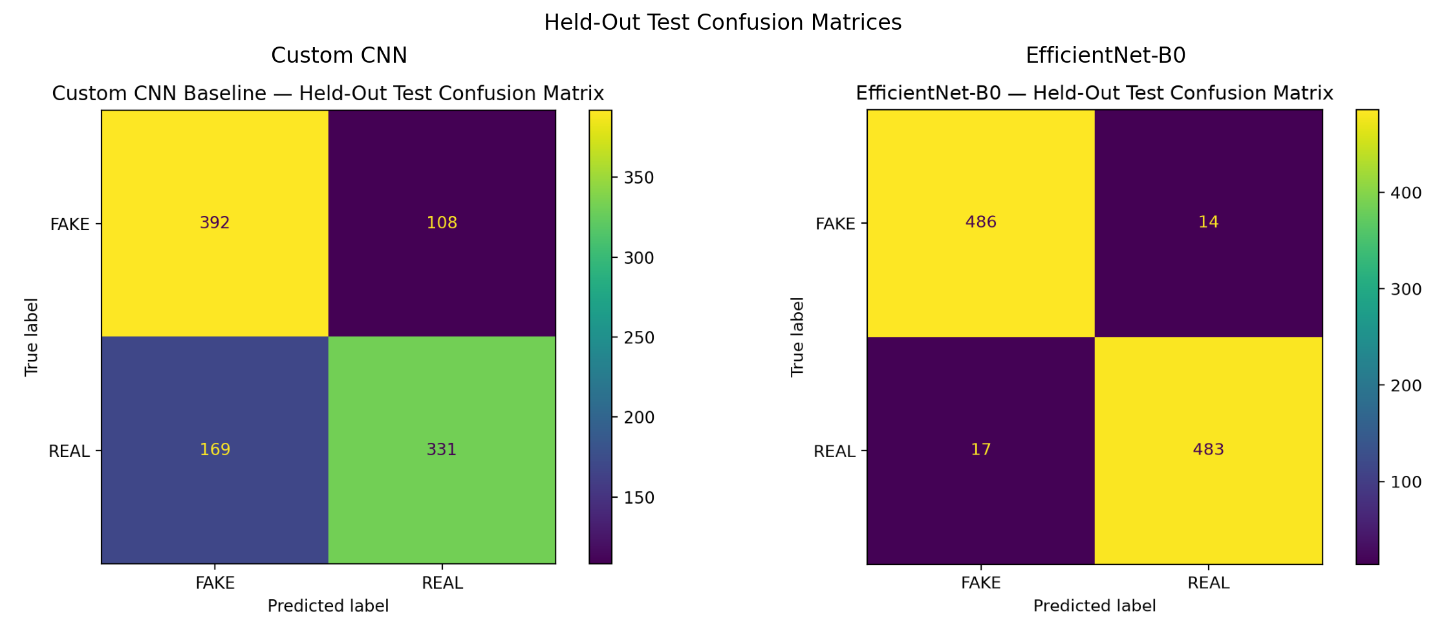
Error analysis
Rows are true classes; columns are predicted classes
CNN: 277 errors
EfficientNet: 31 errors
REAL false alarms:
169 → 17
Missed FAKE images:
108 → 14

Slide 7
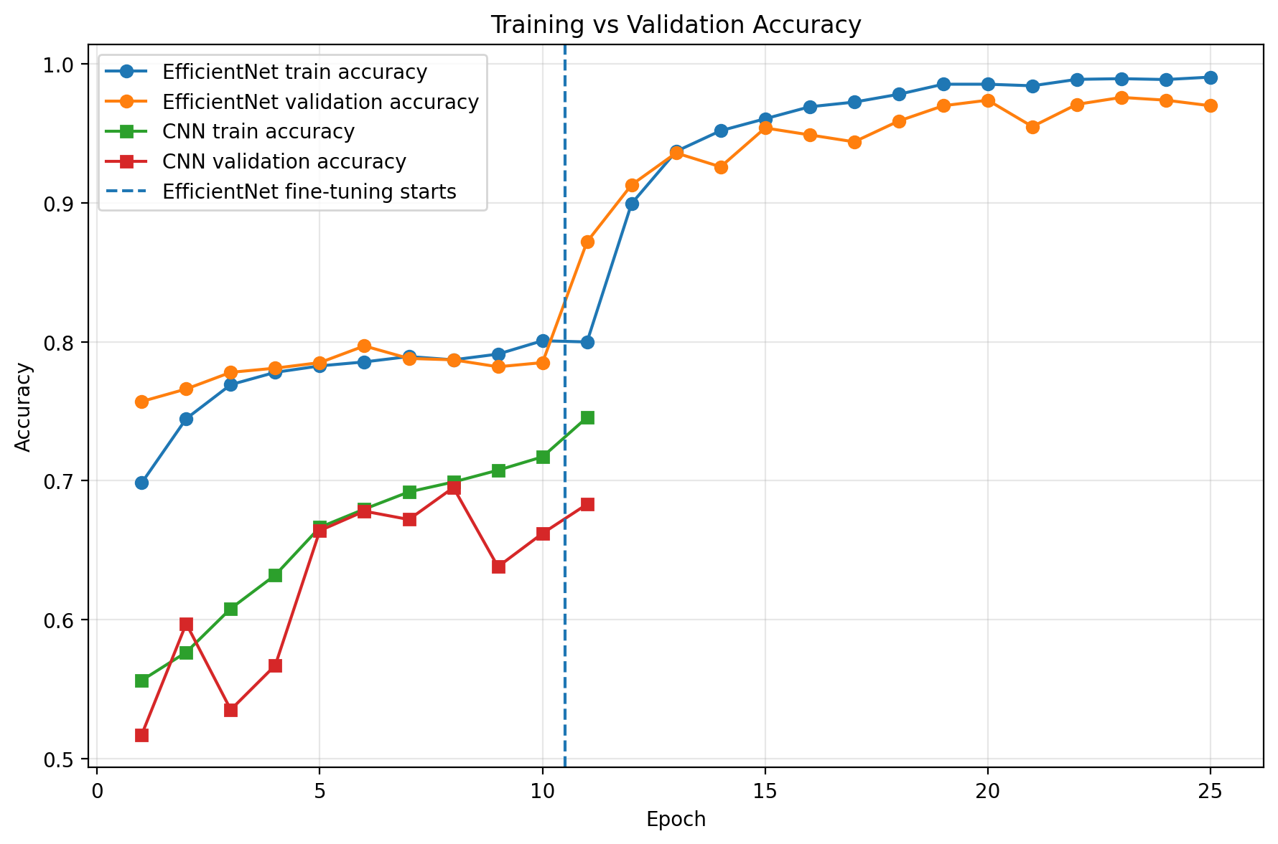
Training behavior
CNN final train / validation gap: 6.25 points.
EfficientNet gap at the selected epoch: 1.35 points.
Both show some late-stage overfitting; evaluation uses the best validation-loss checkpoint.

Slide 8
Local image-upload demo
Upload a face image
EfficientNet-B0 applies the same test preprocessing and computes P(FAKE).
Output: FAKE or REAL • predicted-class confidence • P(FAKE) • P(REAL)
Run: python -m streamlit run app/demo.py

Slide 9
Conclusion and limits
EfficientNet-B0 meets the project targets and improves accuracy by 24.6 percentage points over the CNN.
The result is measured on one held-out dataset. Performance across other generators or cameras is unknown.
The demo displays raw model probabilities, which are not calibrated authenticity guarantees.

