Slide 1
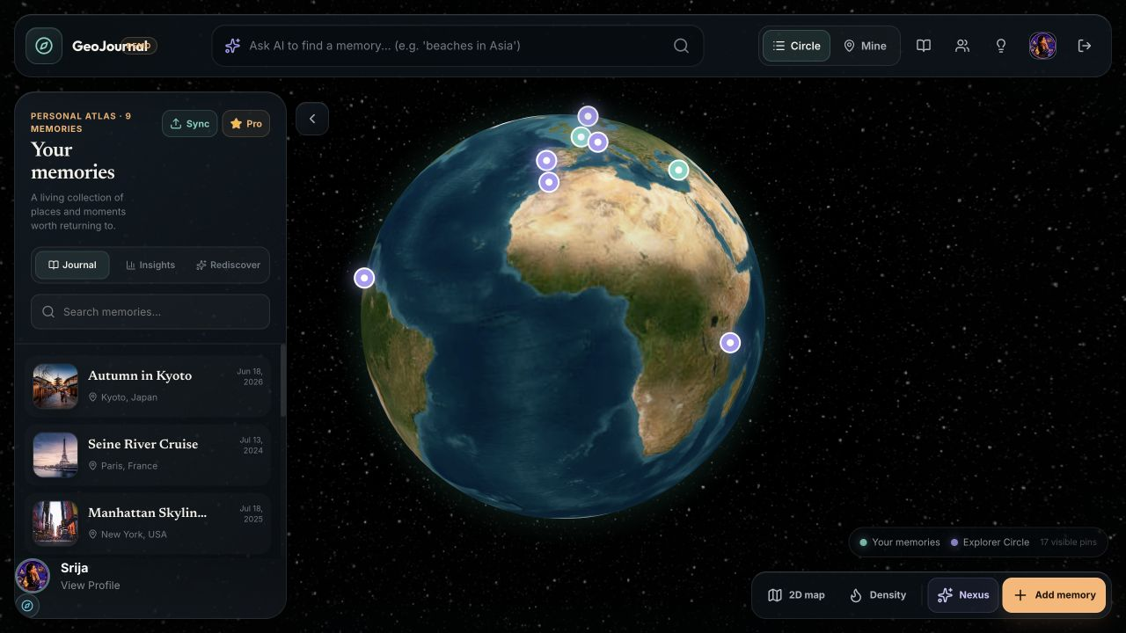
GEOJOURNAL
Every journey
deserves its
own world.
A living 3D Memory Atlas that turns scattered travel history into something you can search, relive, plan from and share.
Srija Moningi
IIT Bombay CSE ’25 · Platform Software Engineer, Oracle

Slide 2
THE PROBLEM
Travel memories survive. Their meaning gets fragmented.
Photos keep the image. Maps keep the location. Journals keep the feeling. Planning tools ask us to start again.
PHOTOS
MAPS
JOURNALS
What it looked like
Where it happened
Why it mattered
Thousands of moments, but weak memory of context.
Pins and routes, but almost none of the story.
Rich reflection, but disconnected from place and discovery.
The memory is not missing. The connection is.
GEOJOURNAL · MEMORY ATLAS
02

Slide 3
THE DELTA-4 EXPERIENCE
One Atlas reconnects place, story and people.
Five jobs become one loop: import · remember · retrieve · plan · share
01
Spatial memory
A high-quality WebGL globe with a familiar 2D map fallback.
02
Mine or Circle
Teal keeps my memories distinct; violet brings trusted explorers into view.
03
Context on every pin
Place, date, photos, journal text and author stay connected.
9 personal memories
17 Circle pins
GEOJOURNAL · MEMORY ATLAS
03

Slide 4
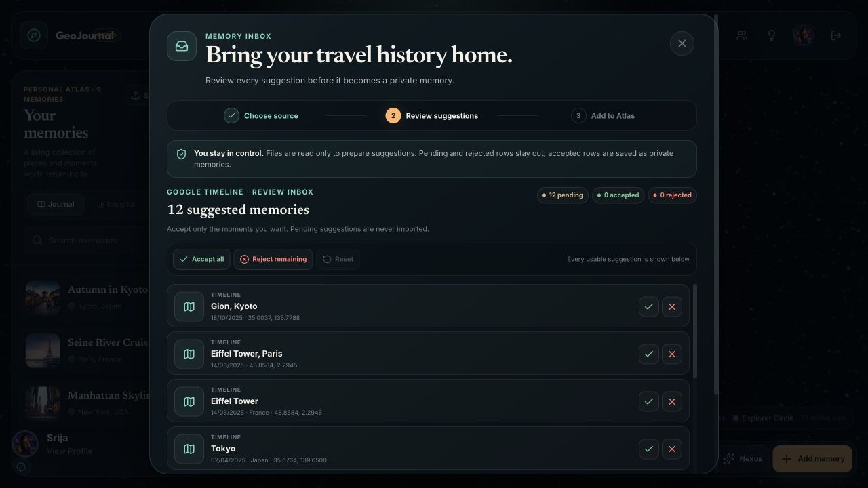
COLD-START SOLVED
Start with history, not an empty globe.
Google Timeline and geotagged Instagram exports become suggestions first. Nothing is silently published.
01
Choose an export
Current or legacy Timeline JSON; Instagram archive rows only when coordinates exist.
02
Accept or reject
Every suggested place stays in a human review inbox.
03
Private by default
Only accepted memories become pins, and users decide if they are ever shared.
GEOJOURNAL · MEMORY ATLAS
04

Slide 5
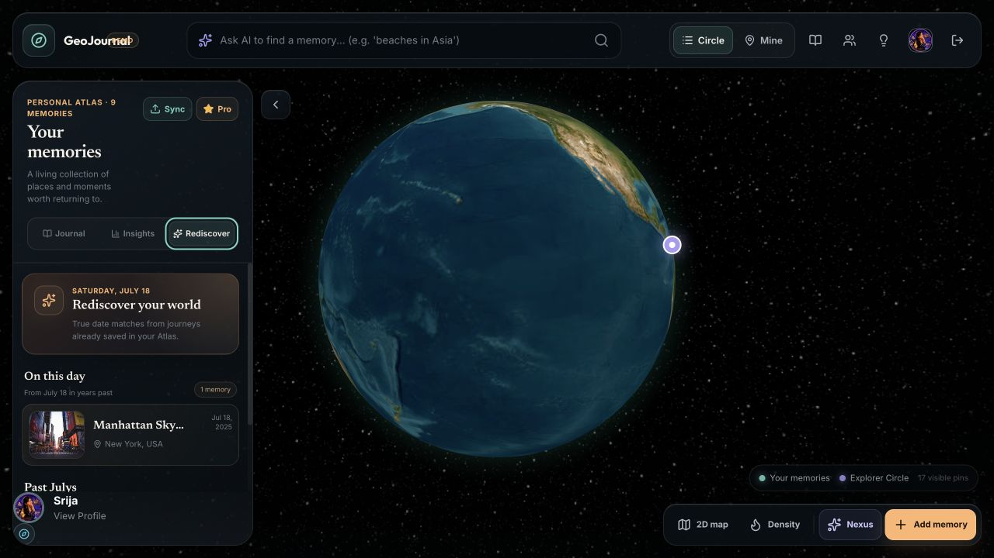
MEMORY UTILITY
The Atlas gives old memories a second life.
Search by meaning
“Crimson streets” can focus Kyoto—even when the place name is never typed.
Rediscover on purpose
On this day and past-month moments make nostalgia a product habit instead of an accident.
Semantic search keeps a local fallback for a stage-safe demo.
GEOJOURNAL · MEMORY ATLAS
05

Slide 6
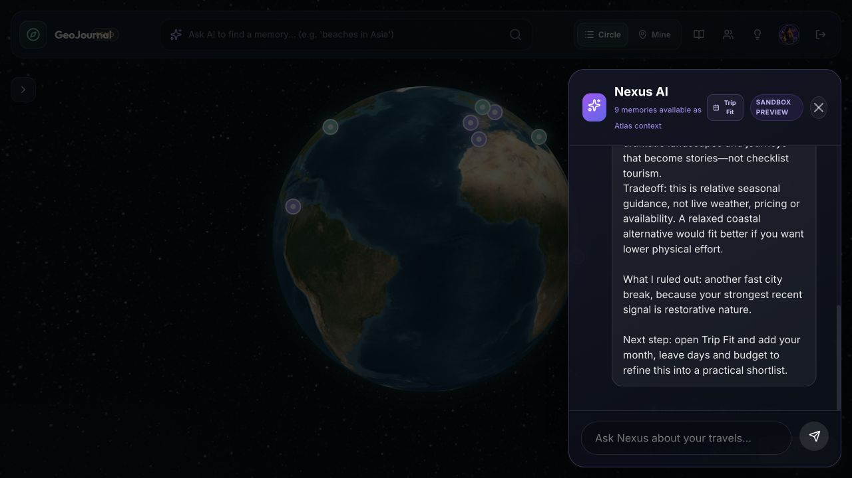
NEXUS AI
Plan forward from the life already lived.
Nexus grounds the next trip in Atlas memories, then adds practical Trip Fit constraints.
01
Atlas context
Past places, stories and recurring preferences shape the answer.
02
Trip Fit
Month, leave days, home city, budget, holidays and local ICS events.
03
Honest infrastructure
OpenAI is configurable. Maximem Synap is active; the consented server bridge is next.
GEOJOURNAL · MEMORY ATLAS
06

Slide 7
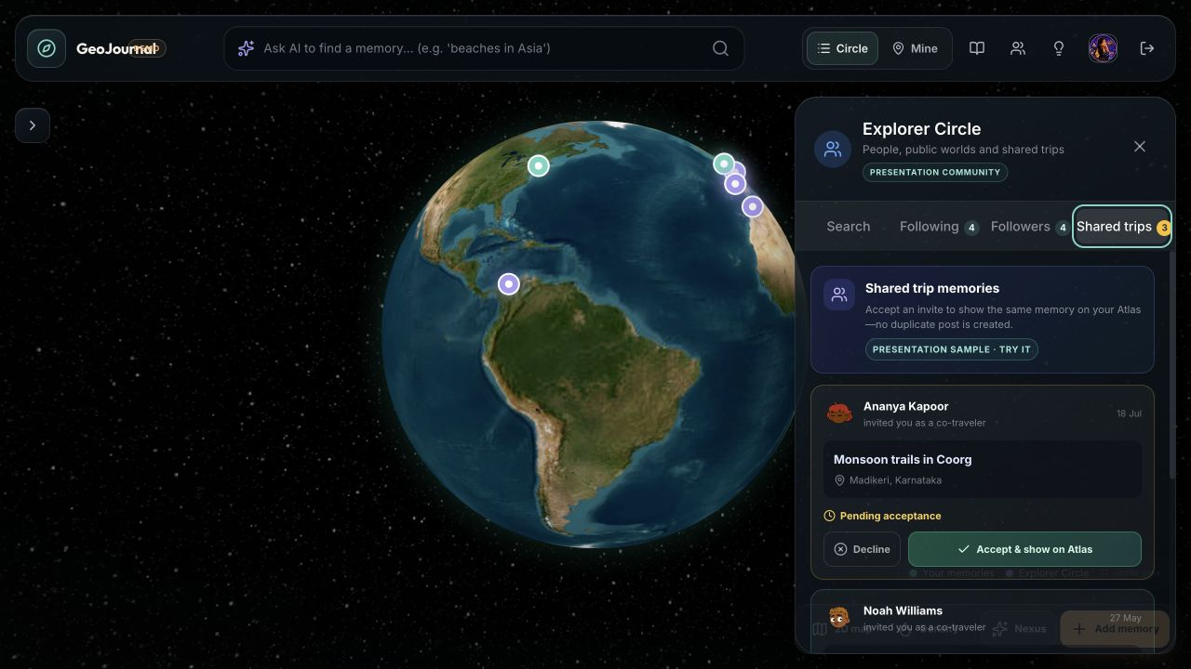
INTENTIONAL SOCIAL
Travel together without giving up privacy.
Community is useful only when visibility and authorship remain explicit.
01
Co-traveler consent
A shared memory appears on a friend’s Atlas only after acceptance.
02
Friend globes
Open a public profile and explore that person’s world spatially.
03
Layered visibility
Private, close friends and public are choices made per memory.
Seeded presentation community · interaction design is live
GEOJOURNAL · MEMORY ATLAS
07

Slide 8
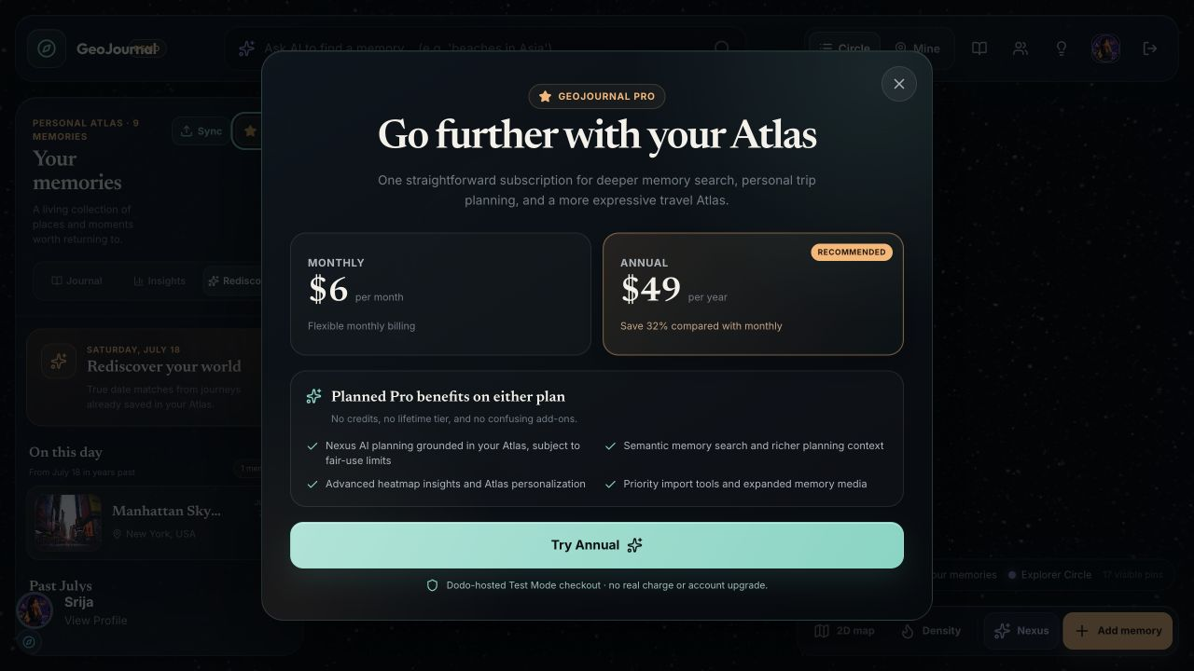
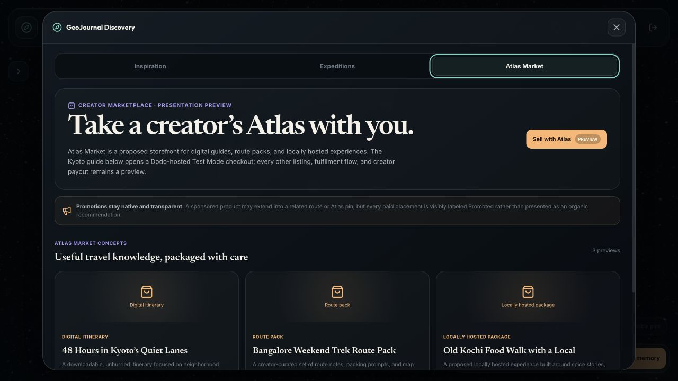
BUSINESS MODEL
A simple subscription, then a creator economy.
Users pay for a trusted travel companion—not metered AI tokens.
$6
$49
Creator guides · trip groups · labelled promotions
monthly
annual · 32% lower
Dodo-hosted Test Mode checkout validated · no production charge or fulfilment claimed
GEOJOURNAL · MEMORY ATLAS
08

Slide 9

LAUNCH AND VISION
Start with people who already curate their journeys.
Frequent independent travelers and creators are the first customer: they already keep photos, notes or map history—but cannot use them together.
01
Global product, focused beachhead
Launch globally; build the first dense community through US travel clubs and creator networks.
02
A built-in acquisition loop
THE QUESTION
A shareable Atlas brings the next traveler in through a memory, not an ad.
What would make you trust GeoJournal with your full travel history?
Srija Moningi · geojournal-atlas-srija-a6b0b.web.app
GEOJOURNAL · MEMORY ATLAS
09

