Slide 1

FARMQUEST
The story starts in class. It unlocks at the farm.
A choose-your-own-adventure learning game for grades 6–12 that turns real farm visits
into food-systems literacy — starting with food insecurity.
Teacher-approved stories
Zero student data
Works offline at the farm
Pilot pitch · 2026–27 school year · Monique Mavour

Slide 2
The Idea
One story arc across the classroom, the farm, and back.
THE PROBLEM
In class — the setup
1
Students meet the mystery on Chromebooks; farm chapters quietly cache to their phones.
14.1M
children live in food-insecure households — about 6 in every class of 30. (USDA 2024, the final federal survey.)
Yet food insecurity is taught as a statistic and toured as a walk-through — abstract to students who don't live it, quietly stigmatizing to those who do. Teachers can't fix it without custom materials they have no time to build.
At the farm — the expedition
2
QR scans at real farm stations unlock chapters — the clues live in the physical world.
Back in class — the finale
3
Every group's ending reflects its choices; a reflection chapter ties it to the curriculum.
THE SOLUTION
A branching story game — AI-drafted per farm and class, teacher-approved before any student plays. Chapters unlock via QR codes at real farm stations, and Grow-to-Give continues the story into a class garden that feeds food-insecure neighbors.
Grow-to-Give — the harvest (extension)
4
Chapters unlock at planting, first sprouts & harvest — ending in a real food-bank donation.
< $2 per story pack
< $50 / month pilot
Groups of 2–4 · one phone
Museums & nature centers next

Slide 3




Customer Personas
Four sides of the same trip — the teacher adopts, the city may pay.
Maya · Student, gr. 7
Mr. Alvarez · Teacher
Denise · Farm owner
Commissioner · City
End user
Buyer / adopter
Channel partner
Sponsor / funder
Has her own phone; groans at anything babyish; loves games with choices and secrets.
Time-poor agriscience teacher; needs vetted, standards-relevant material in under 45 minutes of prep.
Hosts 6–10 school groups a season; wants zero per-visit effort and schools that rebook.
Food insecurity is rising on his agenda; wants a fundable program with metrics and his name on it.
“My group's ending was different from yours.”
“I read every branch before my students see a word.”
“Set up once. The signs are already up.”
“How can we bring this here?” (real quote)
Full personas & journeys in PRD.md · student profiles are pseudonymous by design (no PII, ever).

Slide 4
Competitive Landscape & Moat
Five categories each own a piece — nobody owns the seam.
WHO SOLVES IT TODAY — PARTIALLY
WHY NOBODY DOES THE WHOLE THING
Goosechase · Actionbound
1 · Economics just flipped
2 · AI-for-minors minefield
3 · A three-industry seam
QR scavenger hunts: location mechanics, no narrative — the teacher still authors everything.
A farm-specific branching story used to cost hundreds in writer time. LLMs made it < $2 — this product was impossible before ~2023.
The viable design ships LESS AI than possible: pre-generated, moderated, teacher-gated. Most AI-edtech teams won't make that trade.
Edtech x agritourism x municipal funding. Stitching them is BD work, not code — so it attracts no software competitors.
Kahoot! · Nearpod · Gimkit
Game engines schools already buy — but screen-only; nothing leaves the classroom.
Ag in the Classroom · FFA
Curriculum credibility, but generic across all farms and paper-based.
HARD TO COPY ONCE IT WORKS — the app is weeks of work; these aren't
Farm network
Trust artifacts
Food-bank kits · hunger sims
QR signs bolted to real barns; every onboarded farm is a supply node a copycat rebuilds call-by-call.
District approvals, zero-PII posture, a clean safety record — clonable never, only earned slowly.
Emotional one-off events; simulation formats risk poverty tourism.
Pack library compounds
Municipal incumbency
Every teacher review is labeled signal; proven packs drive content cost toward zero.
A city budget line + a politician's track record — the stickiest position in any market.
The real incumbent: the guided tour + worksheet — at $0
Real threat: Goosechase or Nearpod ships an “AI story mode.” Defense: depth they won't build — farm onboarding, food-insecurity credibility, city funding.

Slide 5

Voice of Customer — Preliminary Results
1 real interview synthesized (no-fabrication protocol) · 4 guides ready · backdrop: 14.1M U.S. children food-insecure (USDA 2024).
EVIDENCE BY SEGMENT
“Our homeless population is growing, food insecurity is growing. How can we bring it here?”
Farmers — partially validated
Tours already monetized (~$20/head); school buses come to farms today.
City of Winter Haven commissioner — unprompted (@21:33)
City officials — strong pull
Unprompted demand + a public-land & CDBG funding playbook exists.
Teachers — 0 interviews
“I love to tell y'all to start tours, because it just makes money.”
The buyer. Biggest gap; 4–6 interviews scheduled next (Guide 2).
Students — pending
Week-1 story-quality test doubles as first student evidence.
Kesha Cobb, farm nonprofit operator (@30:34)
“The school buses — they brought the school bus to my house.”
NO-FABRICATION PROTOCOL
Every claim timestamped to the transcript · blank answers stay blank · [not asked] is a valid answer · PRD updates require 2+ independent citations per segment.
Kesha Cobb, on school demand for farm visits (@50:07)

Slide 6




AI Hypothesis & Validation — Preliminary
Every AI dependency sits behind the state of the art — by design.
THE CONTENT PIPELINE
VALIDATED SO FAR
AI drafts the branching pack
Working MVP generates stories + TTS narration with live OpenAI calls
Structured Outputs make schema-valid branching a solved problem
Nothing real-time, nothing student-facing — model risk is contained
gpt-4o-mini · structured outputs · < $2
↓
Schema & branch validation
every path terminates, no orphan chapters
↓
Moderation API screen
free · auto-quarantine + regenerate
RISKIEST UNPROVEN ASSUMPTION
↓
Teacher approves every branch
“A $2, mini-model story can be good enough that 12-to-18-year-olds voluntarily finish it.”
the hard invariant — enforced in the data model
↓
Students play — offline
The failure mode is “mid,” and no validator catches cringe. Test: 3 real packs → 1 real class, week 1, ~$6 of API calls — before any platform is built.
no student → AI path exists, ever

Slide 7
Roadmap — 8 Weeks to a Real Trip
Sequenced around evidence, not features. Riskiest test runs first.
W1
W2–3
W4–5
Story quality test
Generation + teacher flow
Student play
3 real packs → 1 real class. Kill-or-continue signal for $6.
Prompt scaffold, moderation pipeline, review & approve UI.
Group codes, QR resolver, choices, offline caching.
W6
W7
W8
Trip-day kit
THE REAL TRIP
Evidence memo
Printable QR signs, trip sheet, check-in list, CSV export.
One class, one farm. Completion funnel measured live.
Fix what broke; debrief interviews; write up results.
Cut for speed: TTS, dashboards, auth, farm portal, load tests. Never cut: moderation + the teacher-approval gate.
Full 6-milestone engineering plan (M0–M6) in ARCHITECTURE.md — this 8-week cut ships the pilot's first evidence.

Slide 8
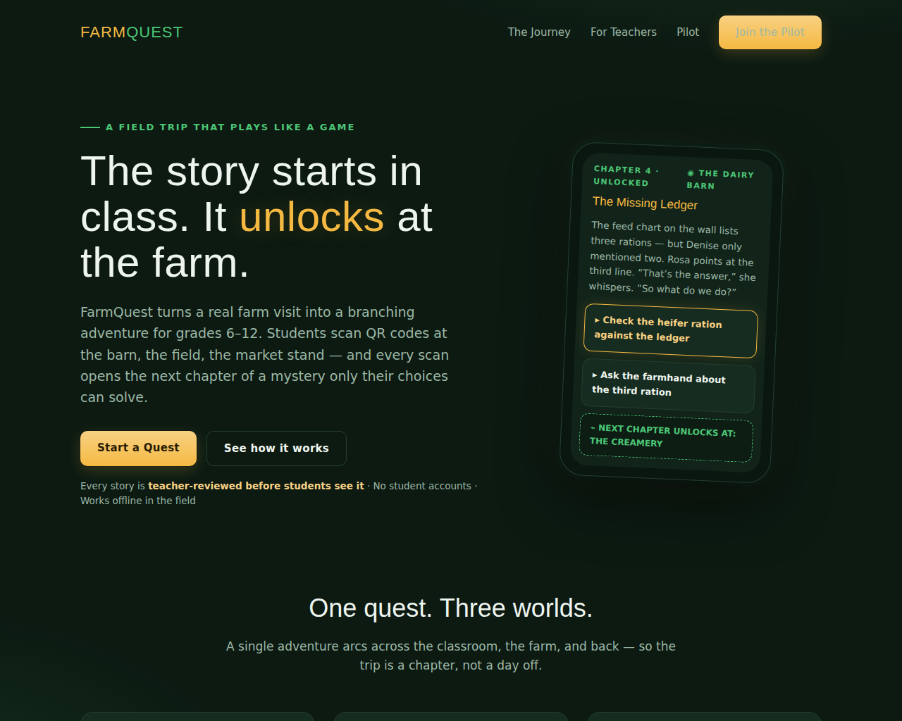
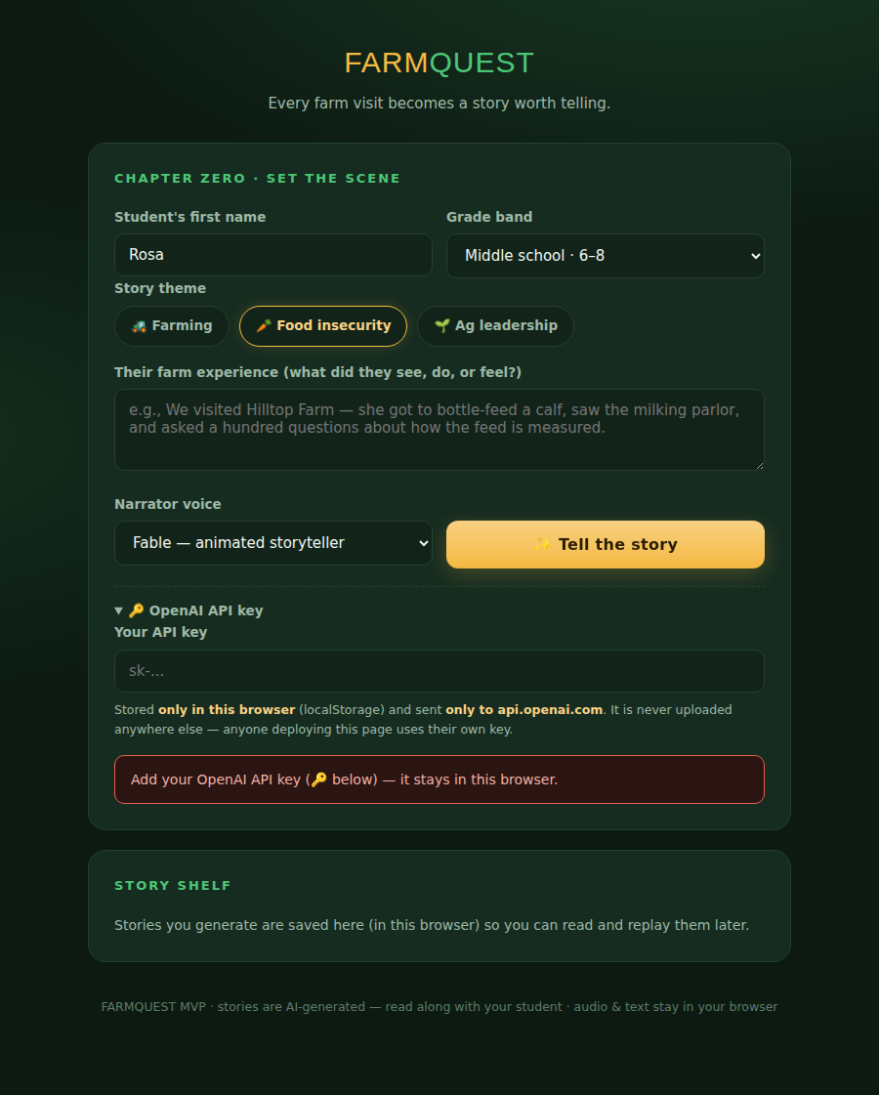
Preliminary Mockups — Built, Not Imagined
Both are real HTML in the repo today; the story teller calls OpenAI live.
“Night Trail” landing page — chosen from 3 differentiated design explorations
Working MVP — name + farm experience + theme → live story + TTS narration

Slide 9

Progress to Date
Everything below is committed and pushed to the GitHub repo.
PRD v1.0
3 design explorations
personas, metrics, MVP scope, 18 corner cases
clearly differentiated; Night Trail selected
SELF-ASSESSED WEAKEST AREAS
1. Core value & willingness to pay
zero payment evidence; story-quality bet unproven
2. Problem & segmentation
the buyer (teacher) has 0 interviews on file
One fix for both: week-1 class test + 4–6 teacher interviews (~2 weeks, ~$10).
Architecture + plan
Working HTML MVP
local-first monolith, safety gates, 6 milestones
live OpenAI text + TTS, replay, story shelf
Pitch kit × 2
VOC system
2-min scripts, PM summaries, Discord posts
4 interview guides + 1 real interview synthesized
BUSINESS MODEL SNAPSHOT (hypotheses, anchored to comparables)
$199 / class / yr
$5–25k / city / yr
$300–500 / farm / yr
~97% gross margin
school subscription
(Goosechase / Nearpod anchor)
sponsored programs
(CDBG & food-bank grants)
listing — only after
rebooking value is proven
packs cost < $2 and
serve a whole class

Slide 10



Tech Resources & Skills We're Looking For
The spec is written — PRD.md + ARCHITECTURE.md are the onboarding docs.
Full-stack TypeScript
EXPECTATIONS FOR THE TECH TEAM
Next.js App Router, SQLite/Drizzle, SSE streaming — one local-first monolith.
Ship a runnable increment every week — the milestone plan (M0–M6) already defines each exit test
The safety invariant is non-negotiable: no unreviewed AI text ever reaches a student — it's enforced in the data model, not by policy
Build for a laptop, design for a county — local-first now, clean seams to Postgres/cloud later
Evidence over features: completion rate and generation latency are the two numbers that matter
Budget discipline: < $50/month total run cost during the pilot
Offline-first PWA
Service-worker caching, QR flows, sync — the farm has no Wi-Fi where the cows are.
AI engineering
Prompt scaffolds, structured outputs, moderation pipeline, story-quality evals.
Design & data
Game-feel mobile UI readable in sunlight; completion-funnel instrumentation.
Join the build — pilot cohort forming for 2026–27
github.com/MoniqueMogul/Test · PRD · architecture · MVP · VOC — all in the repo

